Slide 1
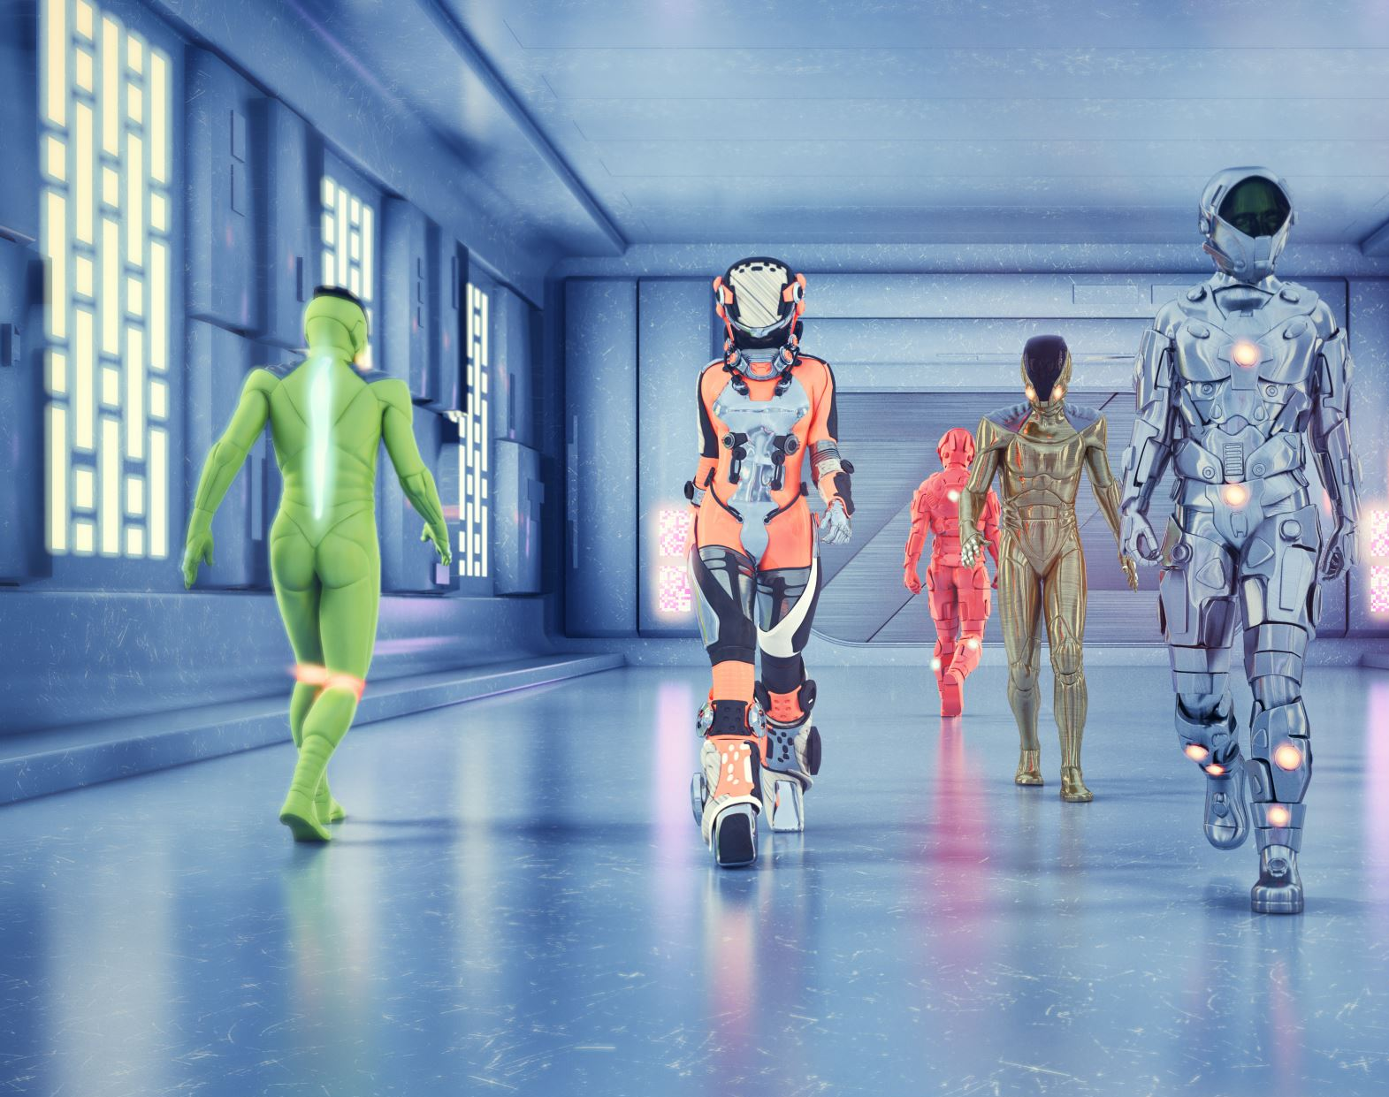
Algorithms 2 Exam: Zombie AI
Damian Zioło

Slide 2
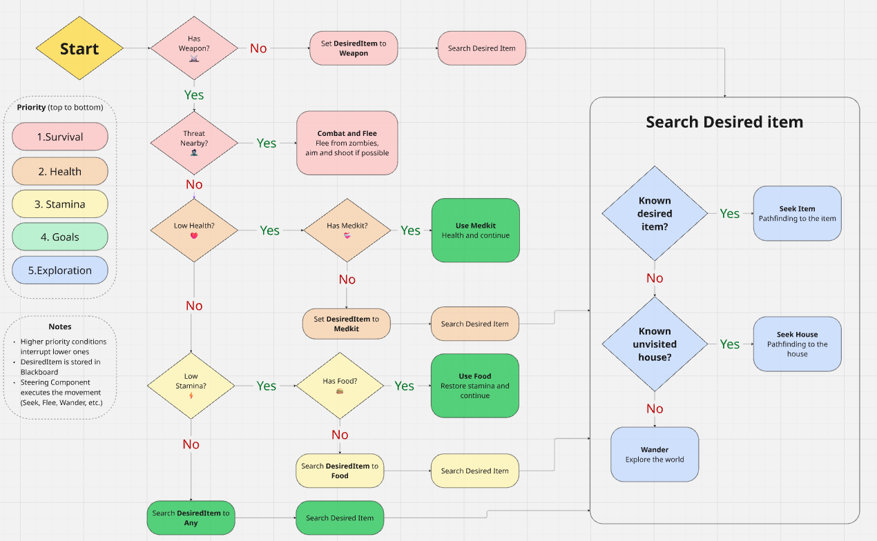
Decision Making
Visualization of your decision making structure (readable!)
Tip: use miro.com!

Slide 3
Enemy handling
The agent remembers nearby zombies and calculates a flee direction away from them. If it has a weapon, it rotates toward the closest zombie while still moving away, allowing it to “kite” enemies. It only shoots when it is facing the zombie correctly and the weapon has ammo. If the agent is damaged from behind, it can create a temporary “ghost zombie” memory behind itself to react to unseen threats

Slide 4
Inventory
How does your agent manage the inventory (inventory organization, item usage, picking up and remembering items,…)?

Slide 5
Movement - Steering
How many steering behaviors does it use? Does it use blended steering?

Slide 6
Movement - Exploration
How does your agent explore the world ( how does it traverse the world, when and why does it visit houses, does it have a memory?)?
USE IMAGES/GIFS

Slide 7
High Score
Screen shot or list of highest scores

