Slide 1
GPP Exam: Zombie AI
Made by Runiskovs Dan

Slide 2
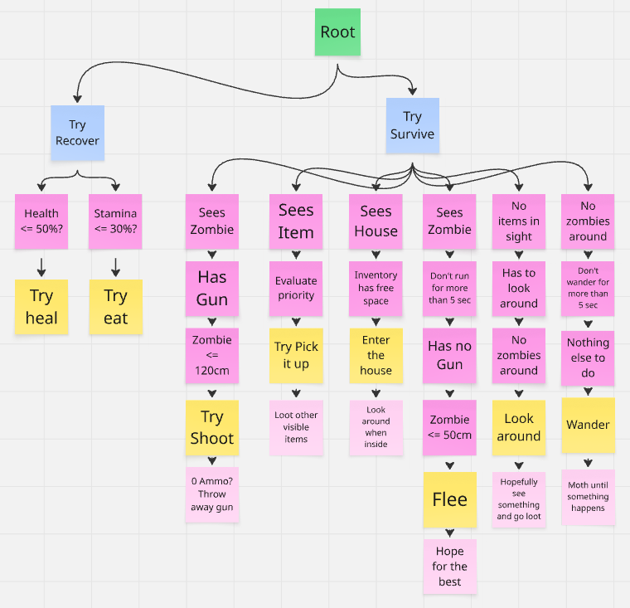
Decision Making
Surviving based on 2 main principles:
Try Survive
Try Recover (taking priority)
Record of survival +/- 5min
– happened in the background trust me :D

Slide 3
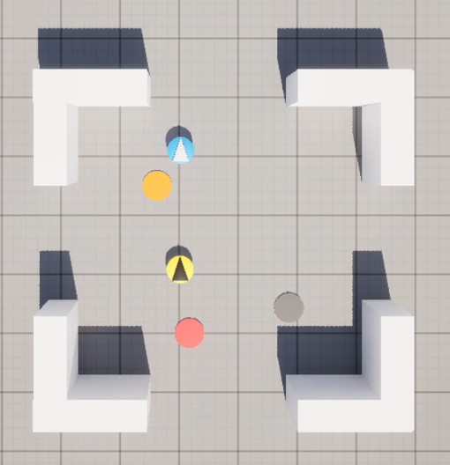
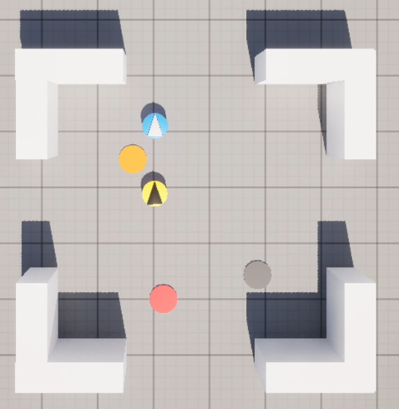
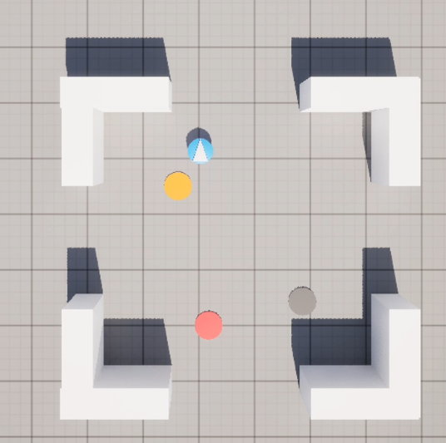
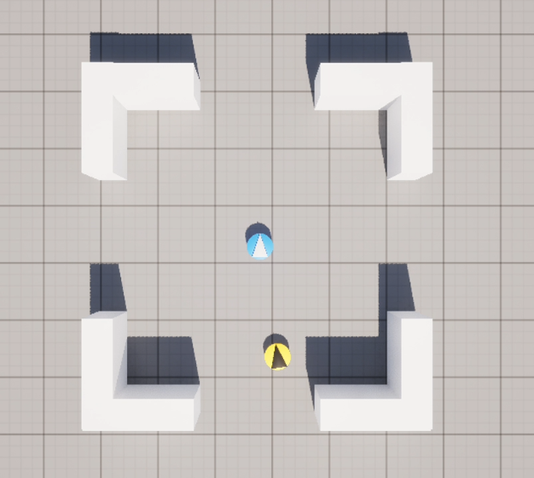
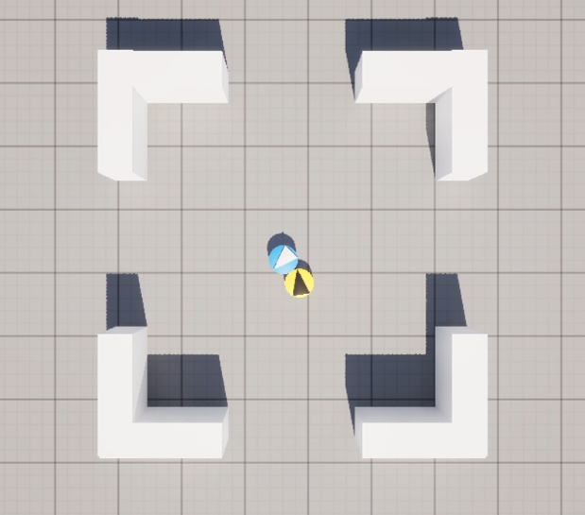
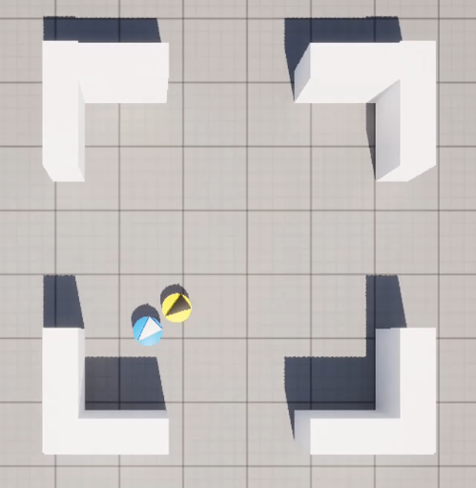
Enemy handling
Has Guns? See -> Turn -> Shoot:
Split second turn + shoot
(Physics allow)
Looking around
Notices Zombie
Zombie’s dead
No Guns? Run away:
Fleeing has a time limit (5sec) to avoid running away for ever
Looking around
Looking around
Try Flee

Slide 4
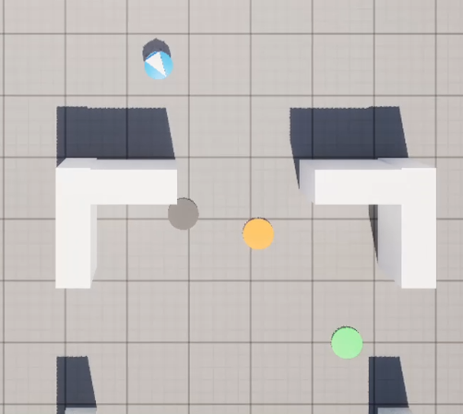
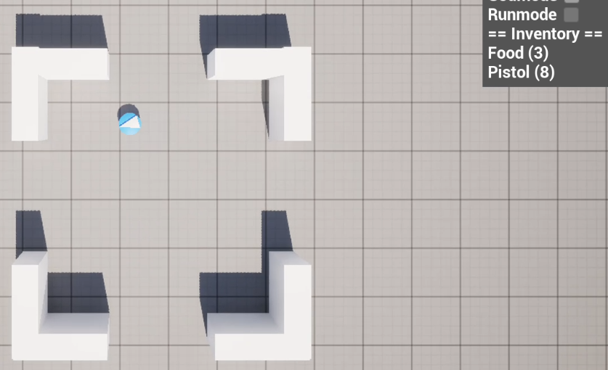
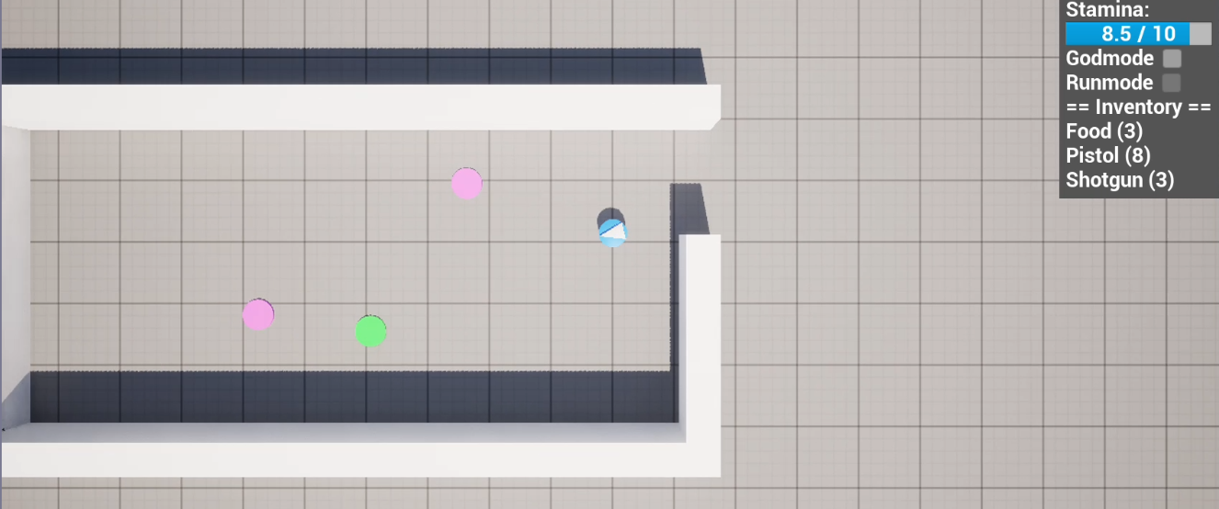
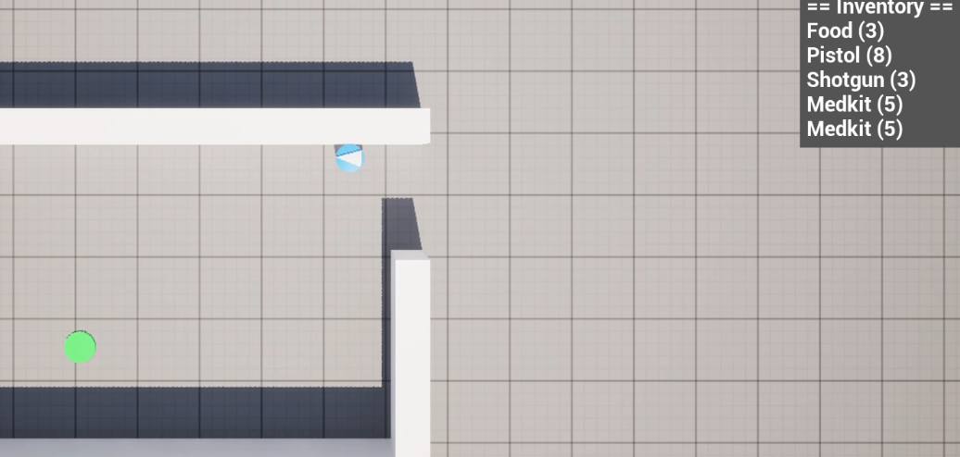
Inventory
See house
Loot the place, throw out garbage
Loot the next house
After item usage (guns/food/med kits)
-> throw away if fully used (Value==0)
Ignore other items if inventory full

Slide 5
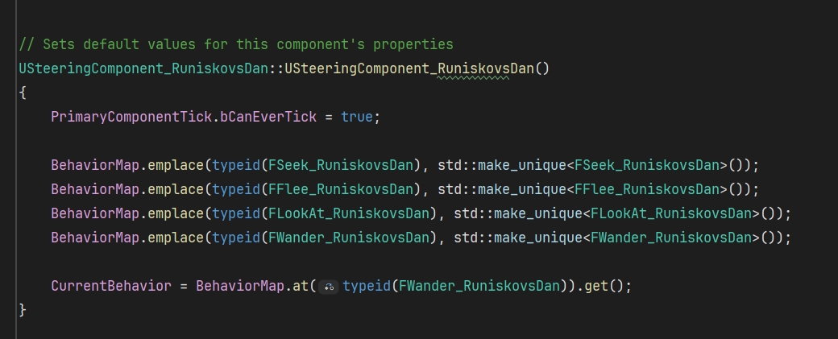
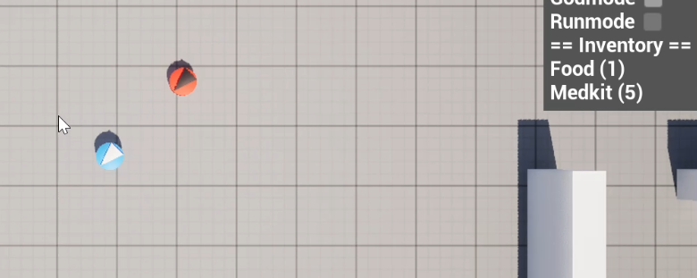
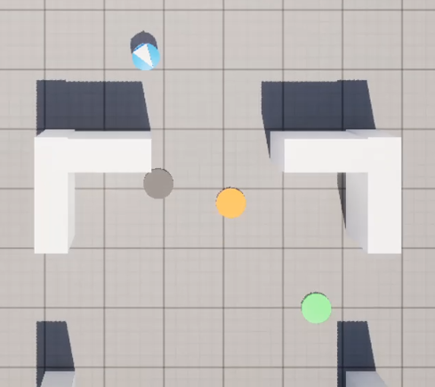
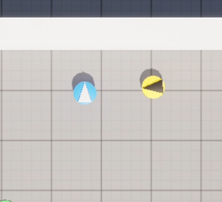
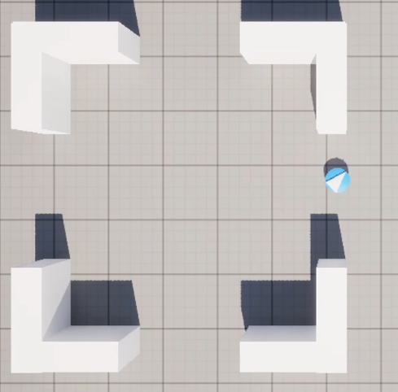

Movement - Steering
Example of “Seek”
Example of “Flee”
Example of “Look at”
Example of “Wander”

Slide 6
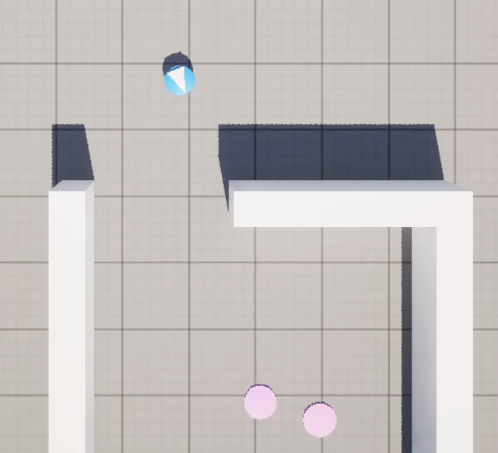
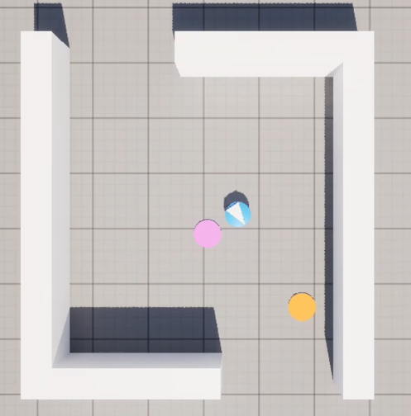
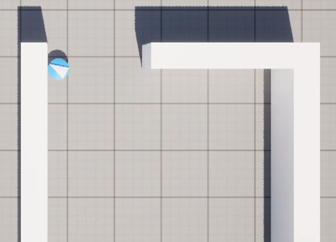
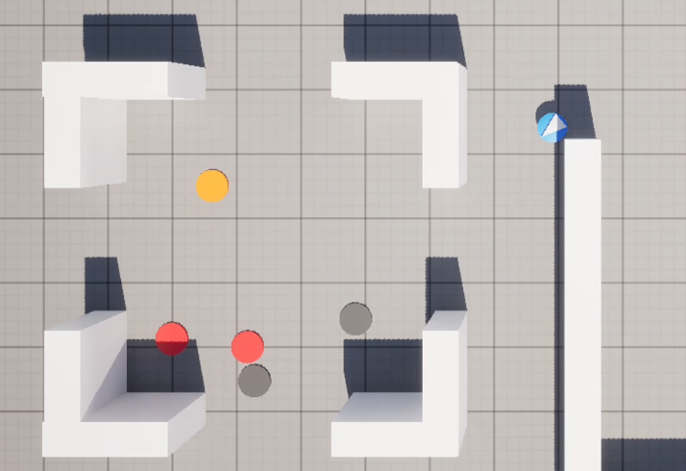
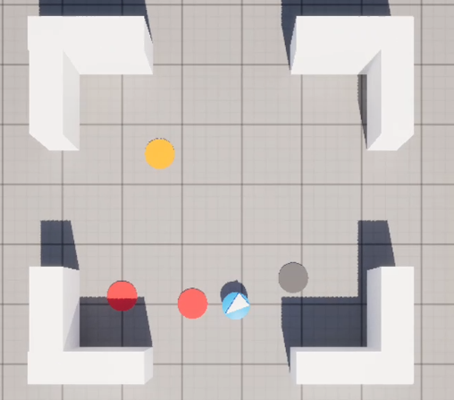
Movement - Exploration
Postmortem: If I had a tiny bit more time, I would make it consciously exit houses
Sees a house
Loot it (if possible)
Wander out
I must admit: one of late bug fixing sessions introduced a bug that SOMETIMES the Survivalist re-enters a house right after exiting, or does not remember visiting a house (results in re-visiting it later)
Sees next house
(ignore up to 3 recently visited ones)
Loot it (if possible)

