Slide 1
GPP Exam: Zombie AI

Slide 2
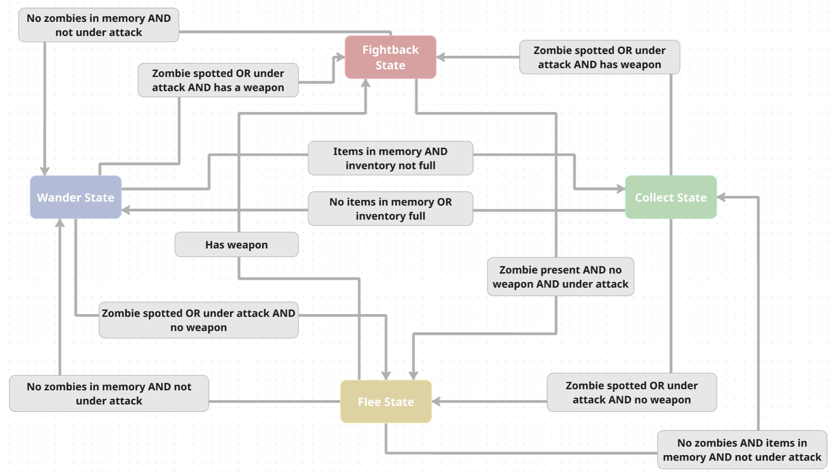
Decision Making

Slide 3
Enemy handling
Item Usage
Uses medkit when health drops below 5
Eats food when stamina drops below 5
Aiming and Shooting
When zombie is spotted via perception or attacking from behind, survivor checks if he has a weapon and enters FightBack state
Spins, faces zombie and shoots
Fleeing
If zombie is attacking and the survivor has no weapon, survivor enters Flee state

Slide 4
Inventory
Items are registered from AgentMemory via perception when seen, and forgotten after ItemForgetTime seconds
When entering CollectState, the survivor prioritizes weapons if unarmed, medkit if health is below 50%, or just the closest item
HandleItemUsage() checks every frame when items should be used: medkit when health is below 5, food when stamina is below 5
When inventory is full, the survivor exits CollectState, remembering unvisited houses, so it can return to them later when the inventory frees up

Slide 5
Movement - Steering
Uses Seek steering behavior in CollectState to move toward a target item
All other states use path following via the Navigation System

Slide 6
Movement - Exploration
Survivor explores outward from spawn in a spiral pattern, advancing angle with 45 degrees and increasing radius each step
When a house is spotted, the survivor navigates toward it, enters, marks it visited and collects the items. If inventory is full, it exits without marking the house as visited to return later
AgentMemory keeps track of seen houses, visited houses, zombies, items and purge zones, each with its own forget rules

