Slide 1
GPP Exam: Zombie AI
DRIES FIERENS

Slide 2
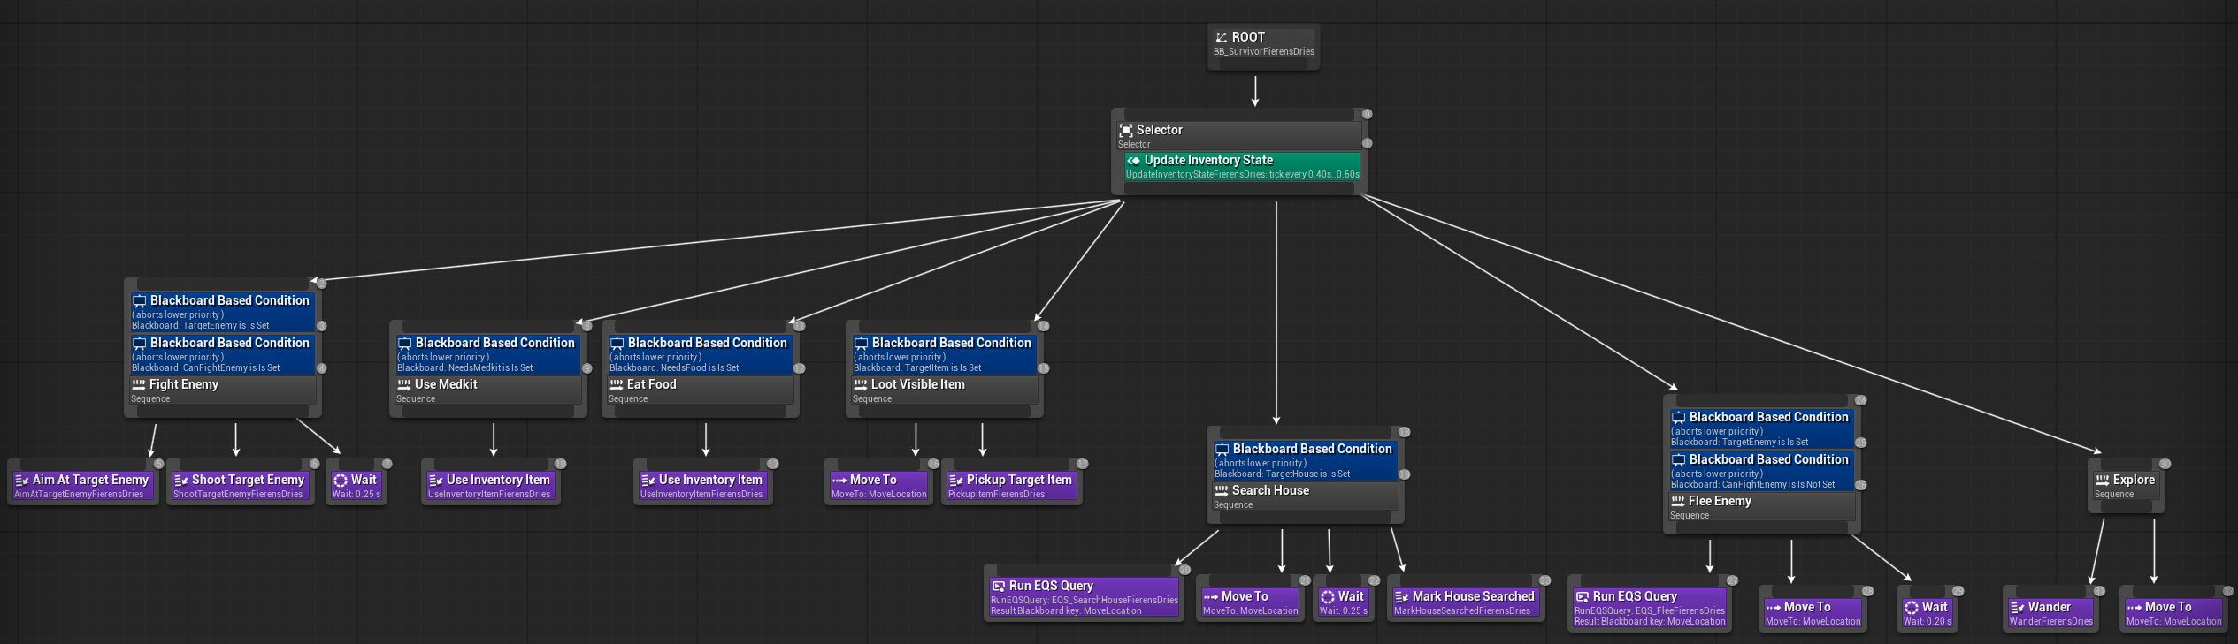
Decision Making

Slide 3
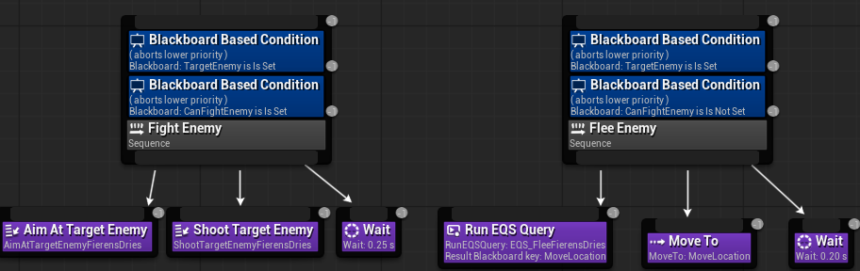
Enemy handling

Slide 4
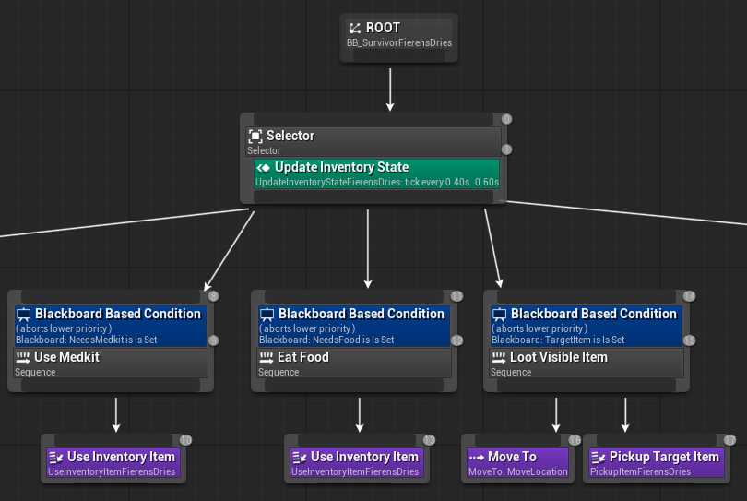
Inventory
Notes:
How does your agent manage the inventory (inventory organization, item usage, picking up and remembering items,…)?

Slide 5
Movement - Steering
Seek, Wander, Face and Flee
Notes:
How many steering behaviors does it use? Does it use blended steering? => Wander, Seek, Face, Flee. EQS for pathfinding, Also easier to leave houses. No blended steering

Slide 6
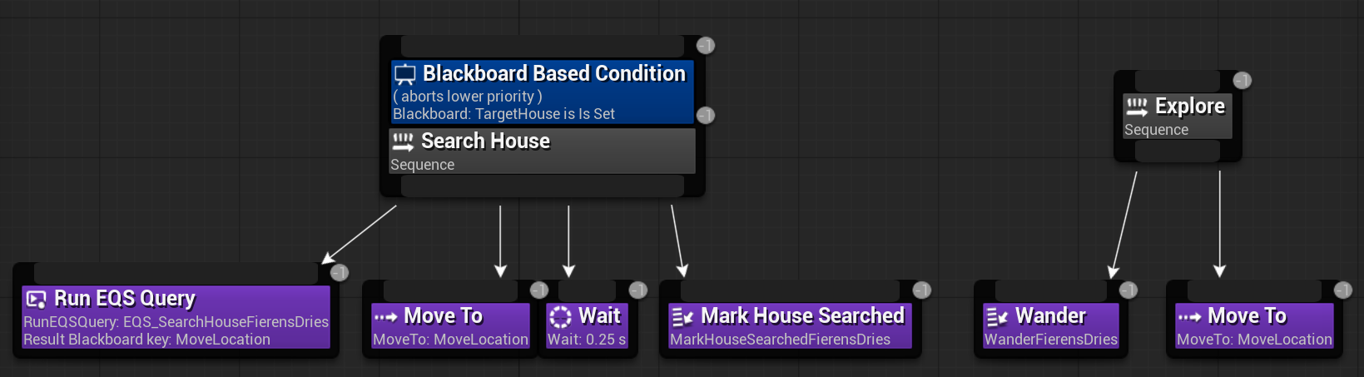
Movement - Exploration
Notes:
How does your agent explore the world ( how does it traverse the world, when and why does it visit houses, does it have a memory?)?

