Slide 1
GPP Exam: Zombie AI
Indeherberge Ferentz
Notes:
Click to add Notes

Slide 2
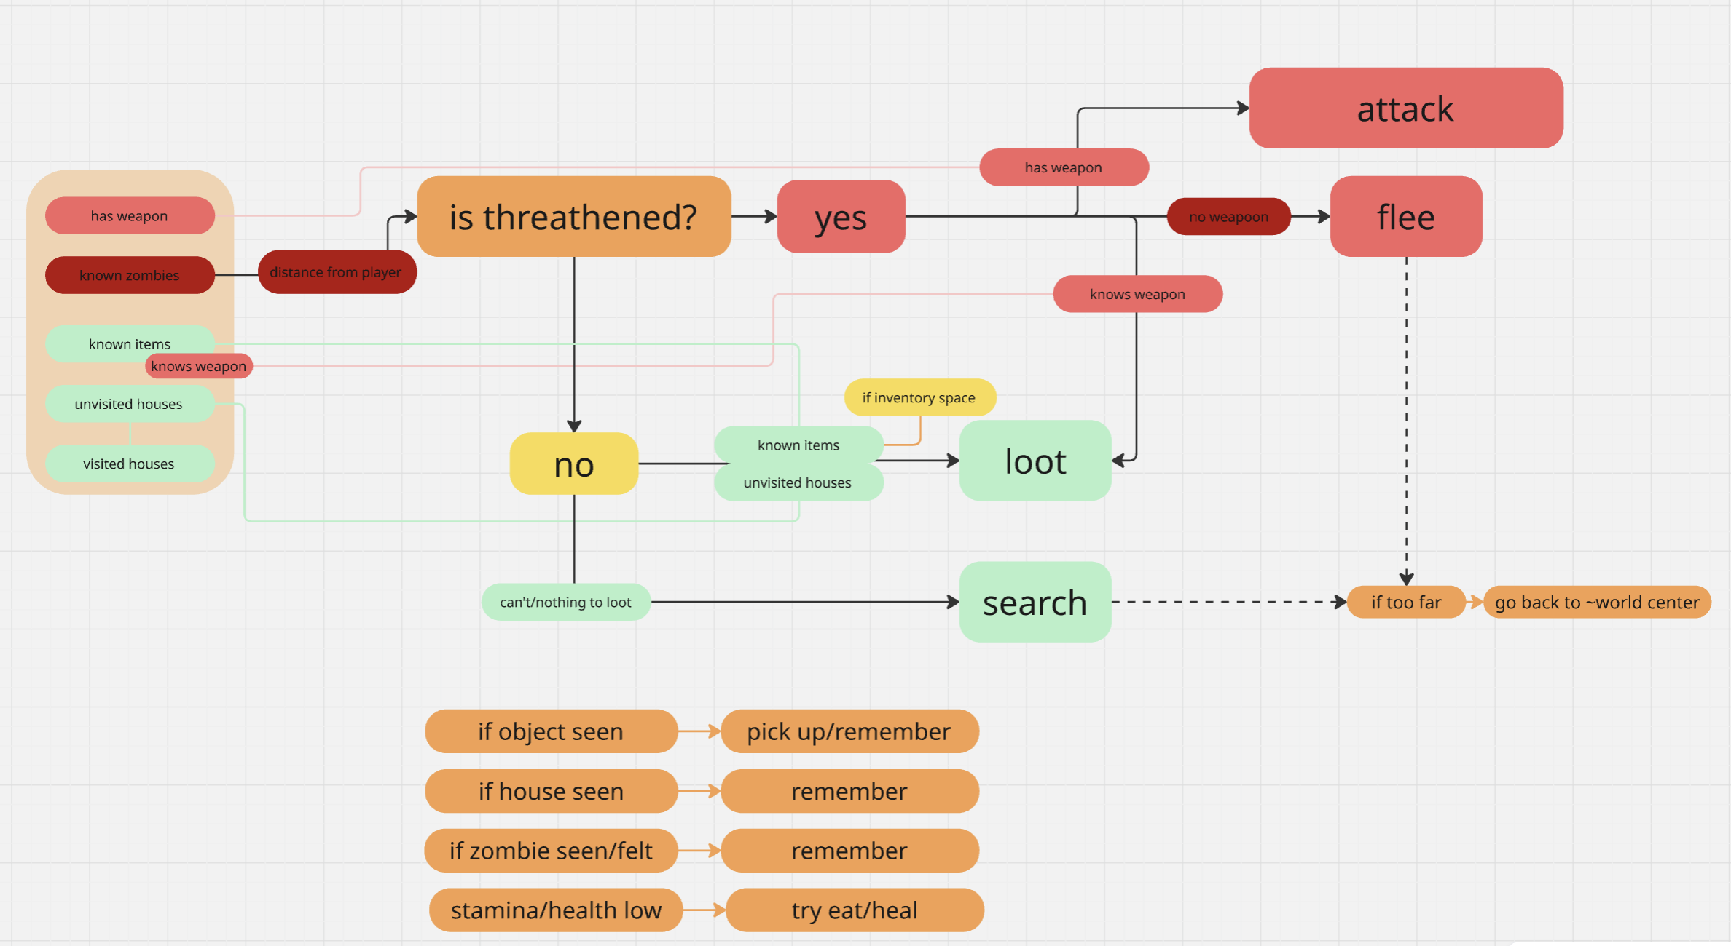
Decision Making
(in BT action “go in direction” as field size is unknown to brain)
Notes:
Click to add Notes

Slide 3
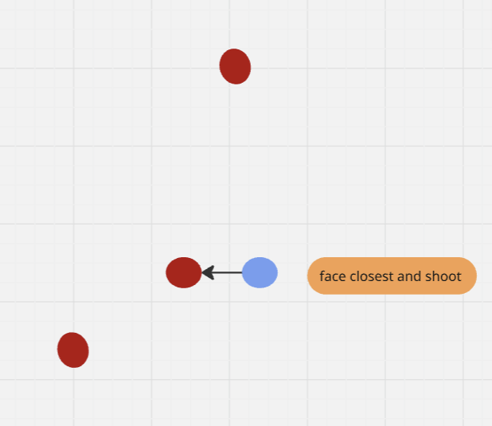
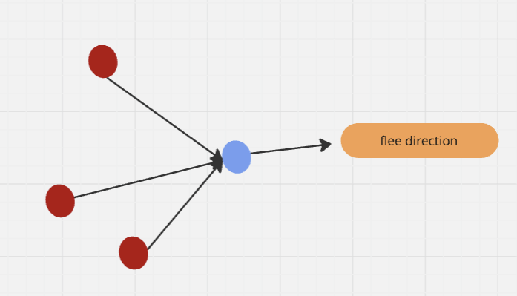
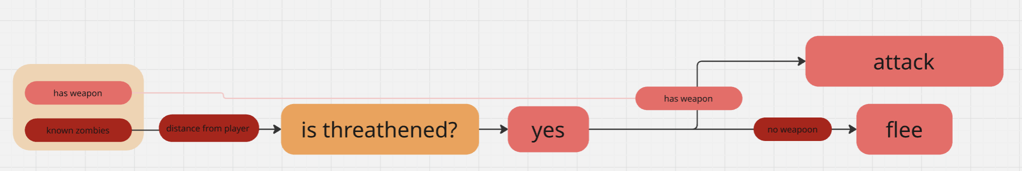
Enemy handling
Attack :
focus (ai function) on closest zombie
use weapon
Flee :
get average vec of all zombies in threat range
Sprint (double speed)
Notes:
Click to add Notes

Slide 4
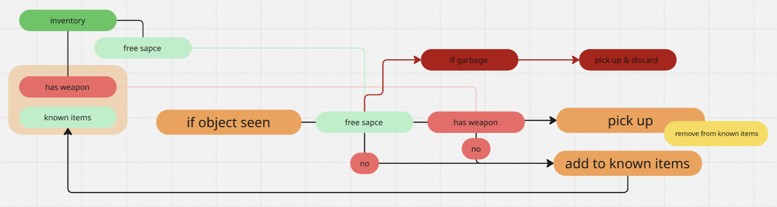
Inventory
The priority is weapons.
If the survivor has a weapon, all items are accepted.
If an item is not picked up, it’s remembered
Except for garbage, which is picked up and discarded to remove from world
Notes:
Click to add Notes

Slide 5
Movement - Steering
For targeted movement (ex looting) it uses ai move to to take he shortest path.
For directed movement (ex fleeing, searching) it uses a vector decided by the brain.
No particular steering is used, but when searching he will take a random direction away from the known zombies.
Notes:
Click to add Notes

Slide 6
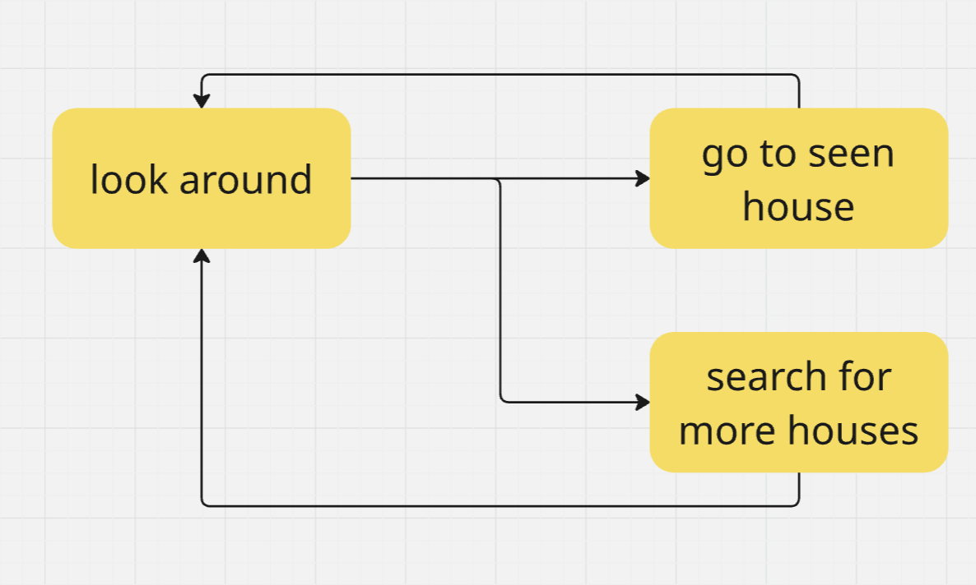
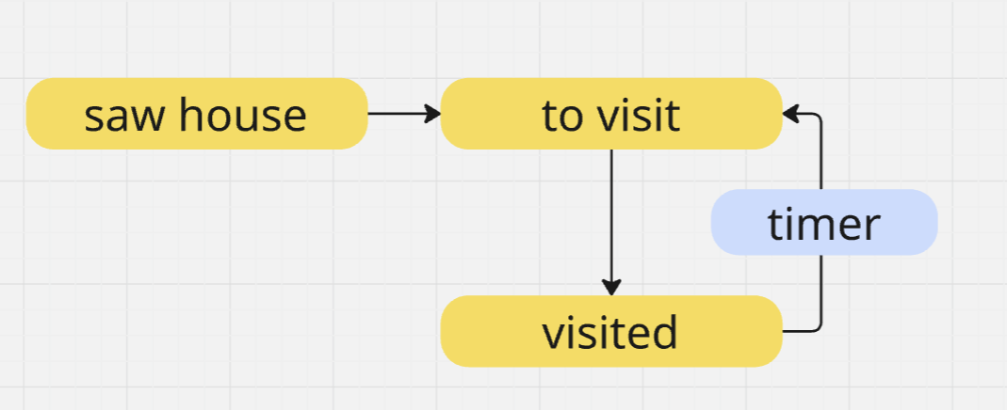
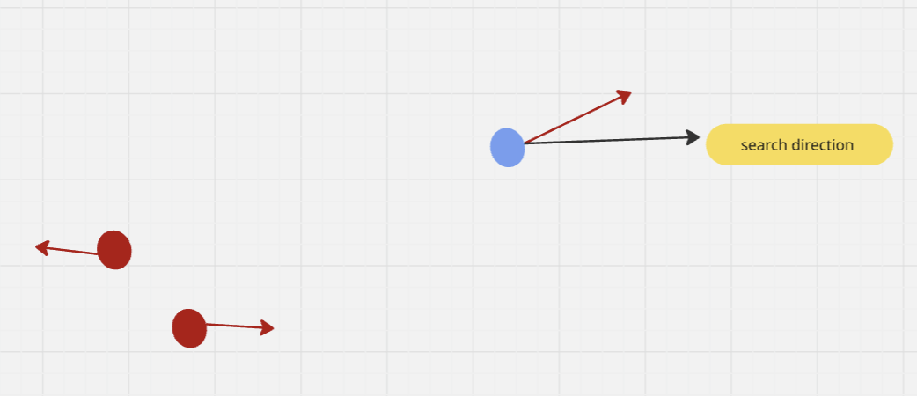
Movement - Exploration
- The agent first looks around in all 4 directions to spot any nearby houses.
- If a house is spoted, he will go to it’s center and look around, picking up items as he sees them (see item handeling)
- On an interval, he will reset all visited houses back to “to visit houses” to help him stay around the vilages and in case items would respawn/he missed some items
- After he will start searching in a direction (away from known zombies), looking around intermediatly for any houses.
Once he has reached too far away from the world center he will go to a random position near the center and continue his search. This doesnt happen in the brain, as he brain can’t tell when he’s hitting the world edge, so i opted to have it in the behaviour action “go to direction” instead. Re-searching old houses will prevent him from needing this, but when fleeing he might stray too far.
Notes:
Click to add Notes

