Slide 1
GPP Exam: Zombie AI

Slide 2
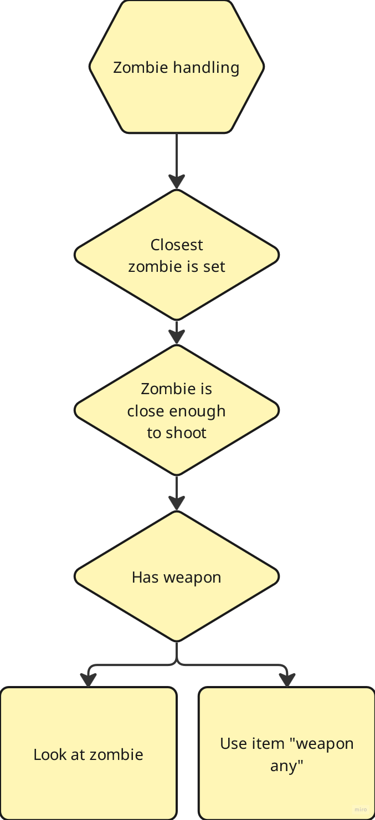
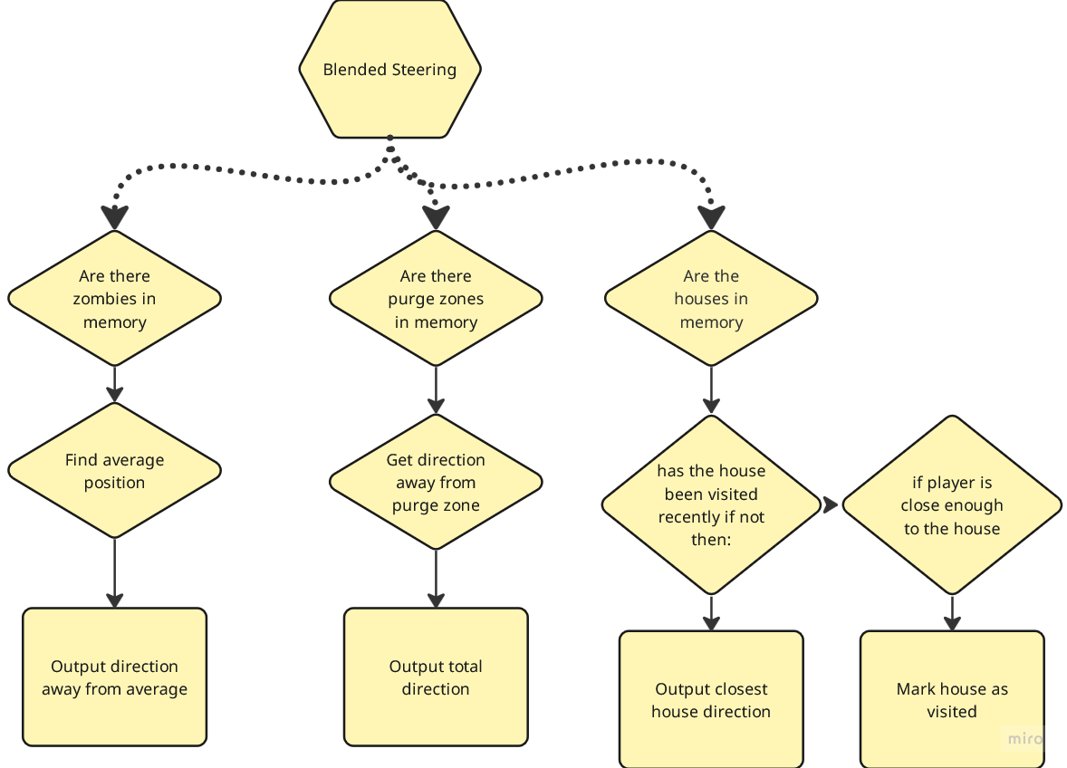
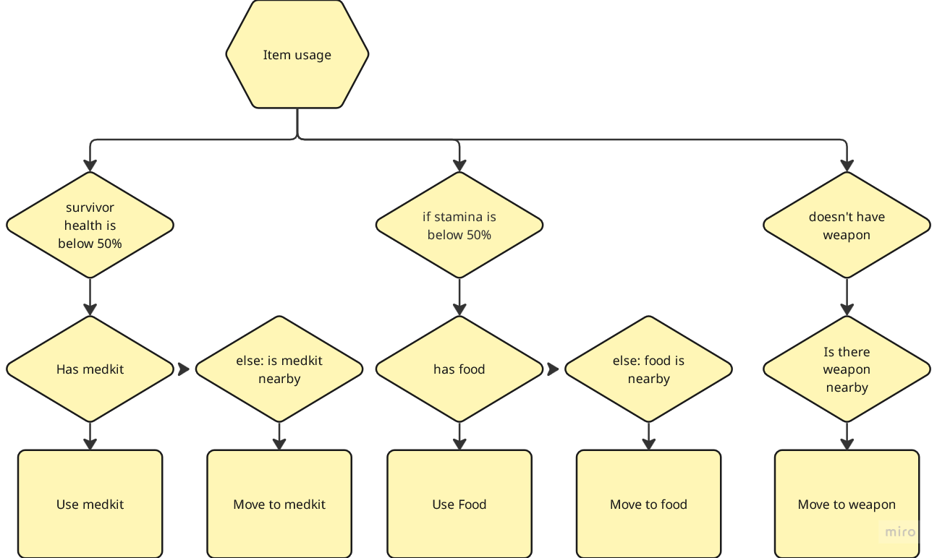
Decision Making

Slide 3
Enemy handling
Staying in buildings -> Avoid being spotted
Avoid purge zones -> Lets survivor remain hidden
If zombie is too close (runner) and has weapon -> shoot
Else keep running away

Slide 4
Inventory
Survivor remembers items seen in houses
Picks up weapon as first thing
Searches for food and medkits, doesn’t overstock

Slide 5
Movement - Steering
Blended Steering
Flee from zombies
Avoid purge zones
Find houses

Slide 6
Movement - Exploration
Survivor stores houses in memory
Visits houses periodically
Attempts to remain hidden

