Slide 1
GPP Exam: Zombie AI

Slide 2

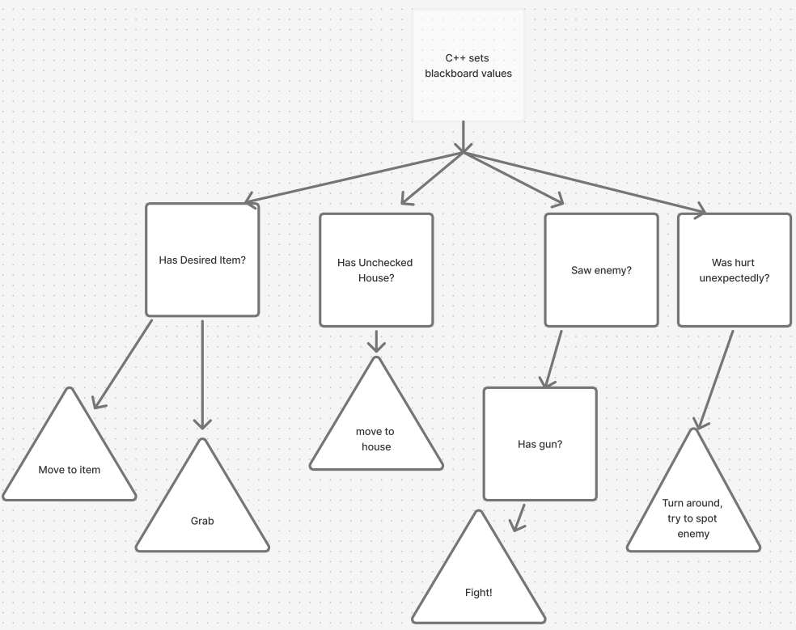
Decision Making (Behavior Tree)

Slide 3

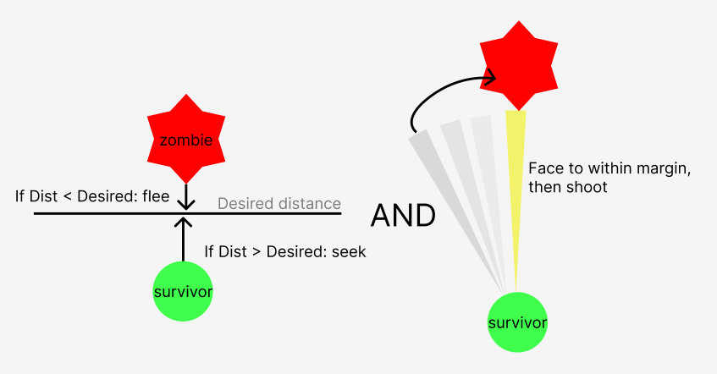
Enemy handling

Slide 4
Inventory
Item percieved → register in list
Score listed known items desirability against inventory items
Empty slot → score 0
Higher value → higher score
No food, low stamina? Food gets increasingly higher score
Same for health

Slide 5
Movement - Steering
Seek, flee, face. Invoked through Behavior Tree tasks. Blending implemented though not used.
Path following uses MoveTo nodes

Slide 6
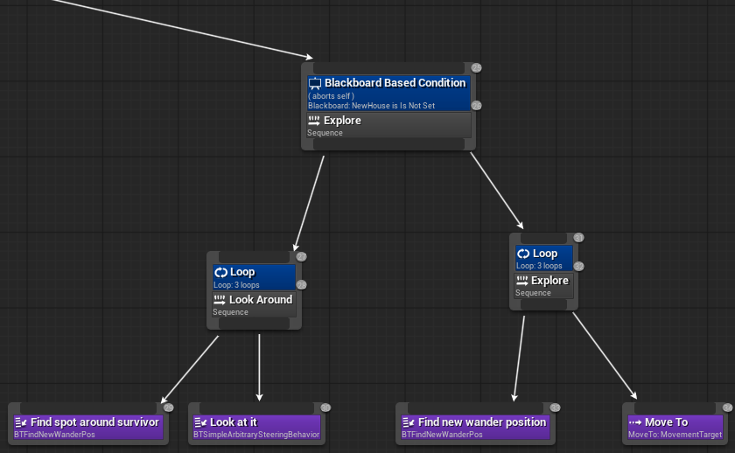
Movement - Exploration
Perceptor registers list of unchecked & checked houses. If no unchecked, wander (img). Otherwise, go inside house. Items found inform pick ups.

