Slide 1
GPP Exam: Zombie AI
Karan Kalra • Game Feature Plugin AI
Goal: survive as long as possible
The agent uses a Behavior Tree, AIPerception memory, item prioritization, emergency combat, smart fleeing, house exploration, and garbage cleanup

Slide 2
Decision Making
MIRO DECISION BOARD
Inputs
Priority checks
Chosen action
Memory update
Update World State
Health, stamina, inventory, threats, stuck state
Emergency?
Heal, eat food, damaged scan
Use survival item
Medkit or food consumed instantly when needed.
Remember result
Visited houses get cooldown; bad targets are ignored.
Escape / shelter
Medkit → weapon → safe house → flee point.
Zombie threat?
If armed: attack / kite. If blocked: move aside.
AIPerception Memory
Items, zombies, houses, garbage, last-known positions
Attack zombie
Rotate toward target and use pistol/shotgun.
Useful item?
Prioritize weapon, medkit, food. Ignore full inventory.
Blackboard loop
Targets update every 0.25s through the service.
Loot / clean garbage
Pick useful item; garbage is removed to free spawns.
Low information?
Scan more often, then seek unvisited houses.
Explore houses
Visit remembered houses; far random point if none known.
Priority order: survive first → react to enemies → handle inventory → clean blockers → explore new houses.

Slide 3
Enemy handling
The agent reacts differently depending on weapons, danger and recent damage.
Combat and survival response
Gameplay GIF: Shooting
If armed and a zombie is known, Emergency Attack rotates toward it and shoots immediately.
If damaged from behind with no target, Damage Scan spins the pawn to let AIPerception reacquire the attacker.
If blocked while fleeing, Move Aside chooses a reachable sideways escape point instead of pushing into enemies.
If unarmed or low health, Flee prioritizes medkits, weapons or safe shelter before pure escape points.
Enemy decision rules
Has weapon + target → Attack
Recently damaged + no target → Scan
Danger + no weapon/low health → Flee
Blocked while fleeing → Move aside

Slide 4
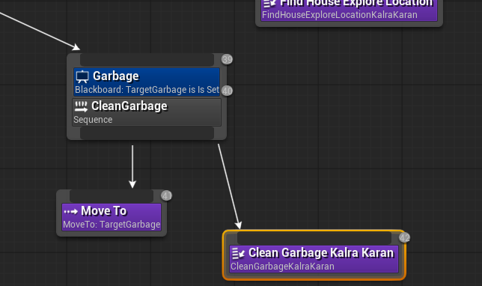
Inventory
Inventory policy
Medkits are used automatically when health is low.
Food is consumed when stamina is low
Weapons are prioritized when unarmed and ignored once empty.
Normal looting ignores garbage, but a separate Clean Garbage branch removes it to free future item spawns.
If inventory is full, TargetItem is cleared so the AI does not loop on unreachable pickups.
Item priority
1. Medkit low health
2. Weapon unarmed
3. Food low stamina
4. Garbage cleanup only

Slide 5
Movement - Steering
Movement is task-driven through navmesh MoveTo goals and careful target selection.
Movement strategy
World State
BT Task
The agent does not use blended steering. Unreal navigation handles actual path movement.
Behavior Tree tasks choose the next movement goal: loot, shelter, flee, purge escape, unstuck or exploration.
Move goals are projected onto the navmesh to avoid unreachable item/house origins.
Fleeing tests multiple directions and rejects paths that initially move toward zombies.
Move Aside handles body-blocking by selecting side-step directions instead of continuing into enemies.
Navmesh Goal
MoveTo
Re-evaluate
Tuning
Acceptable radii are intentionally generous for emergency movement.
Exact movement is avoided when fleeing or navigating inside houses.

Slide 6
Movement - Exploration
Exploration is memory-guided and focused on houses.
Exploration loop
Gameplay GIF: house exploration
AIPerception stores seen houses, items and zombies with last-known locations.
Exploration prefers unvisited houses, then far random navmesh points to discover new villages.
Visited houses receive a cooldown so the agent does not camp the same empty building.
Scan When Low Info rotates the agent more often while exploring or fleeing with little useful knowledge.
Garbage cleanup helps empty houses/villages refresh item spawns.
Scan
Remember
Visit house
Loot/clean
Mark visited
Explore far

Slide 7
High Score
Best recorded run
High score screenshot

