Slide 1
GPP Exam: Zombie AI
Delete all comments after reading
You are not allowed to add more slides to this presentation

Slide 2
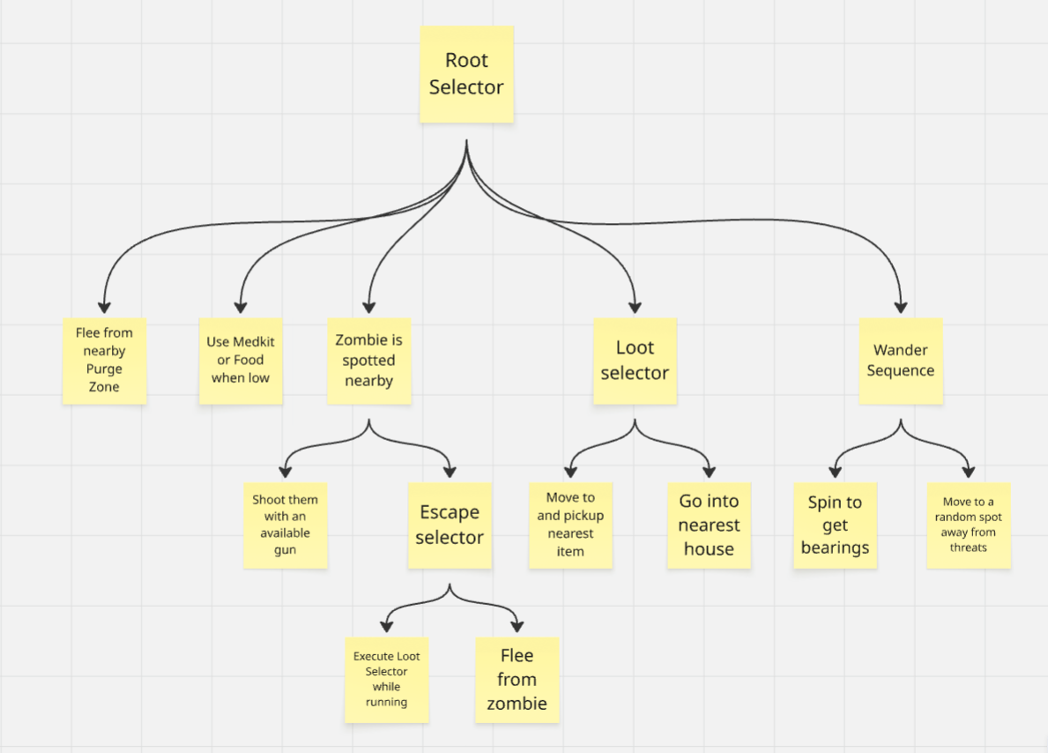
Decision Making
Visualization of your decision making structure (readable!)
Tip: use miro.com!

Slide 3
Enemy handling
Fight - Shoot Task:
Shoots nearby zombies with the lowest ammo weapon
If the weapon runs out then it is removed
If there is no second weapon then HasWeapon is set to false
Escape – Loot or Flee:
Looting interrupts fleeing behavior if there’s a valid Item or House to go to in hopes of finding a weapon
Fleeing picks a point away from the zombie to move to
If navmesh projection fails, uses a wider angle to pick a point

Slide 4
Inventory
Weapons:
Only picks up weapons in the first 2 inventory slots, removing the weapon with the lowest ammo when picking up a new one
Consumables:
Stored in inventory and tries to find and use the appropriate item when Health or Stamina are lower than half
Used early to make space for new items

Slide 5
Movement - Steering
How many steering behaviors does it use? Does it use blended steering?
Flee behavior picks a point in mostly the opposite direction of the target and moves to that point
Wander behavior picks a random point slightly away from the nearest known purge zone and heavily away from the nearest known zombie

Slide 6
Movement - Exploration
How does your agent explore the world ( how does it traverse the world, when and why does it visit houses, does it have a memory?)?
USE IMAGES/GIFS

Slide 7
High Score
Screen shot or list of highest scores

