Slide 1
GPP Exam: Zombie AI

Slide 2
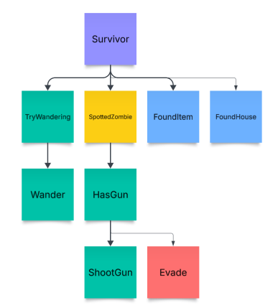
Decision Making

Slide 3
Enemy handling
I runs away from the Zombie’s location, once the OnSpottedZombie event is called.

Slide 4
Inventory
It does not handle inventory.

Slide 5
Movement - Steering
I use the MoveAI System Unreal Engine provides, not blendedsteering behavior is implemented.

Slide 6
Movement - Exploration
I use the blackboard to store information, the exploration is just wandering until a house is found.

