Slide 1
GPP Exam: Zombie AI
Delete all comments after reading
You are not allowed to add more slides to this presentation

Slide 2
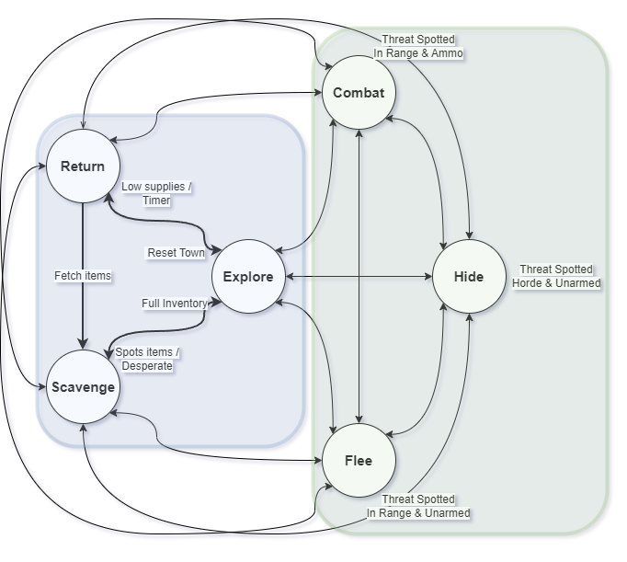
Decision Making
States
Scavenge
Return
Explore
Flee
Combat
Hide
Resume Previous State
If you get interrupted by a zombie / purge zone while running to a house you:
Fight it
Flee from it
Hide from it
But the AI remember to finish walking to the house

Slide 3
Enemy handling
Keeping Distance:
The agent avoids zombies that are far away (to save stamina)
Keeping more distance around heavy zombies
Kiting:
When fighting, it backs away while shooting to keep zombies at a safe distance
Weapon Switching:
Based on range, the agent will use a shotgun for up close and pistol for far away
Last-Minute Escape:
If unarmed and in danger, it runs to the nearest house to look for a weapon
Hiding:
Only hides when it has enough of a lead
If a zombie follows inside, it immediately runs and finds another route
How does your agent deal with enemies (aiming, shooting, item usage, avoidance, hiding, usage of sprint, …)?
USE IMAGES/GIFS

Slide 4
Inventory
Garbage Disposal:
The agent instantly picks up and destroys garbage. (for item respawn)
Smart Consumption:
Uses Medkits when health drops below 40%
Uses Food when stamina drops below 50%
Item Swapping:
The agent dynamically drops nonessential items (like food when at full stamina) to grab essential weapons
Remember Items:
Caches the exact location of items it couldn't carry
When inventory space frees up in the ReturnState, it paths directly to those left behind items first
How does your agent manage the inventory (inventory organization, item usage, picking up and remembering items,…)?

Slide 5
Movement - Steering
Blended Steering:
I use a weighted blend of
Seek (pulling toward the NavMesh waypoint)
Separation (pushing away from known zombies).
Tangential Avoidance:
I use the Cross Product to calculate a tangent vector, this allows the agent to smoothly walk past a zombie's shoulder without losing forward momentum.
Anti Stuck Fixes:
Tracks physical velocity, if the agent gets stuck on a doorframe or behind a wall, it skips waypoints or recalculates the path to get free
How many steering behaviors does it use? Does it use blended steering?

Slide 6
Movement - Exploration
Memory Map:
Uses arrays to separate KnownHouses from VisitedHouses, this prevents the AI from getting in an endless loops visiting the same building
Town Sweeping vs. Wandering:
Systematically sweeps all houses in a localized cluster. Once a town is dry, it randomly wanders a direction and discover new locations (hopefully)
Paranoia Checks:
Smoothly interpolates 160°-200° shoulder checks every 8-15 seconds to ensure behind
Restocking (The Return):
Because items respawn in houses, the FSM tracks how long it has been in the exploring, it goes back
When supplies get low
When the AI has explored 30 seconds without success
It paths back to previously visited towns hoping items respawned
How does your agent explore the world ( how does it traverse the world, when and why does it visit houses, does it have a memory?)?
USE IMAGES/GIFS

Slide 7
High Score
Screen shot or list of highest scores

