Slide 1
GPP Exam: Zombie AI
Delete all comments after reading
You are not allowed to add more slides to this presentation

Slide 2
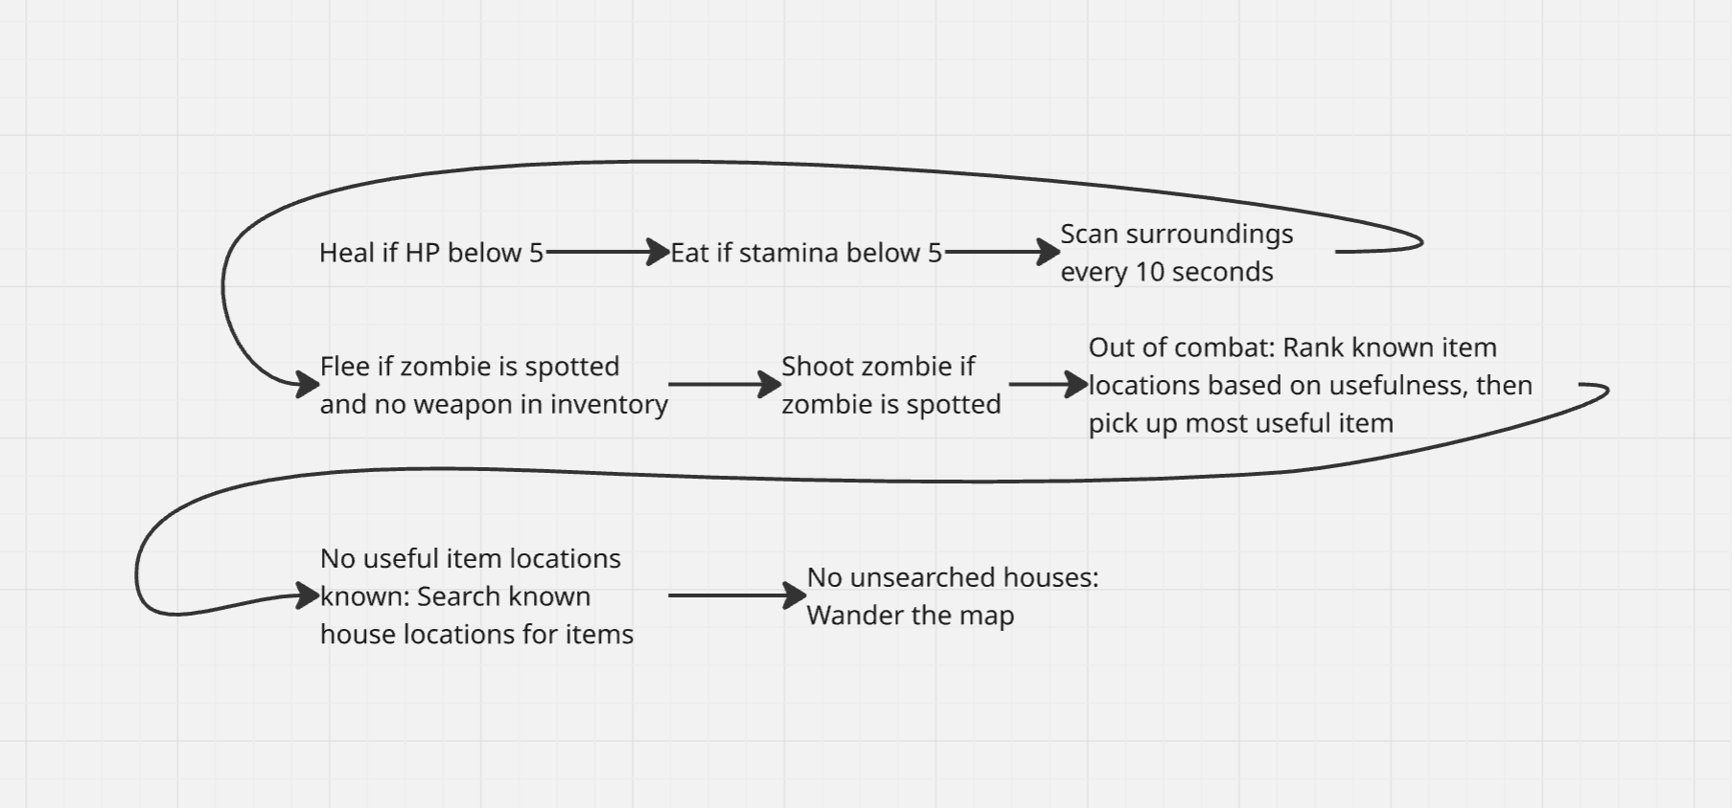
Decision Making

Slide 3
Enemy handling
If no gun in inventory => run away
Else: Look at zombie => use gun

Slide 4
Inventory
StudentPerceptor keeps a list of all known items on the ground
That list gets evaluated and the highest priority item will be picked up
Weapons are used when zombies are spotted
Consumables are used when their respective stats fall below half

Slide 5
Movement - Steering
It only uses the BTTask MoveTo provided by unreal
The way the Behavior Tree is set up makes it similar to priority steering

Slide 6
Movement - Exploration
StudentPerceptor keeps track of all seen houses and keeps track of which are visited
When no known items have a valid pickup priority, we search unvisited houses
When all known houses are visited, we wander the map
Notes:
How does your agent explore the world ( how does it traverse the world, when and why does it visit houses, does it have a memory?)?
USE IMAGES/GIFS

