Slide 1
GPP Exam: Zombie AI
By Yannick

Slide 2
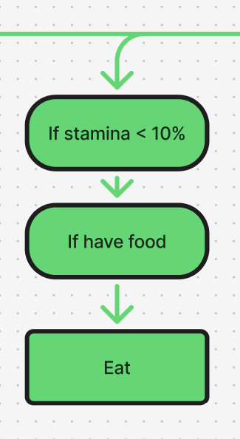
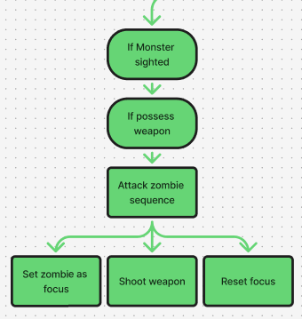
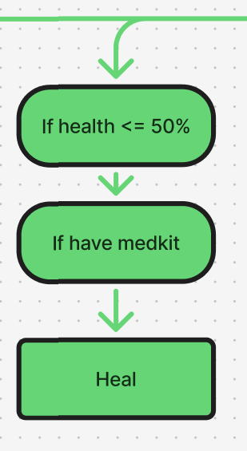
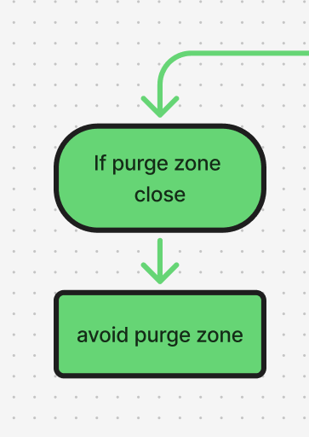
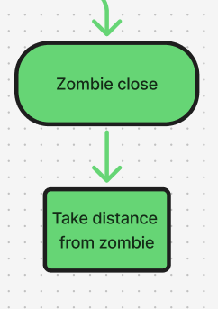
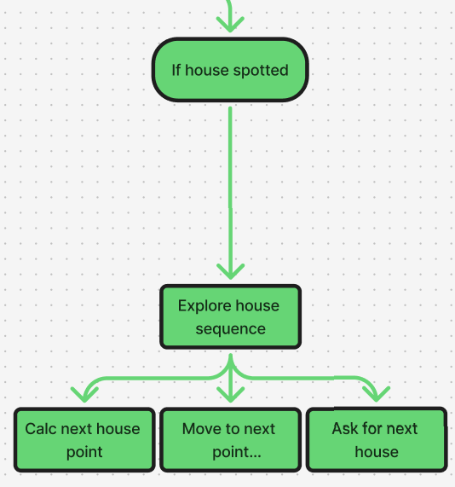
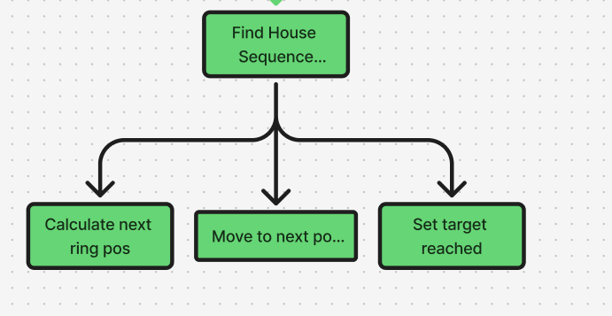
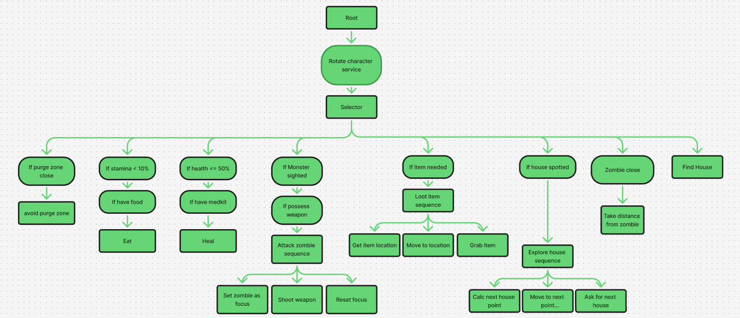
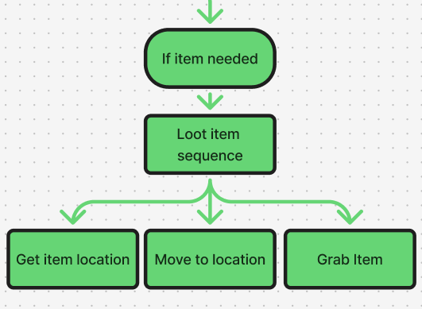
Decision Making
Visualization of your decision making structure (readable!)
Tip: use miro.com!

Slide 3
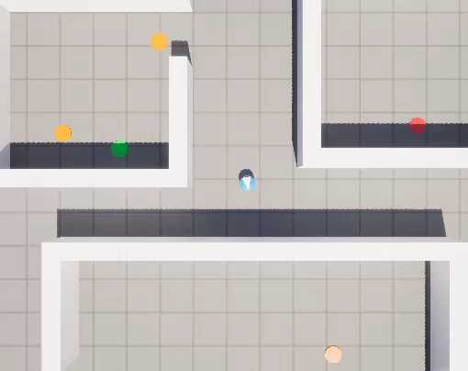

Movement - Exploration
Finding houses
-Get random location on map
-Go to location
-Base direction & Location
-Rotate left
-Add side length
-increase side length
Exploring Houses
-Go to center
Storing houses
-List of houses
-house index
-house threshold
Finding houses
Exploring houses
Storing houses
End house exploration
Ask for next
Increment index
Checks if index in range
Return next house
Return nullptr
Return first
Constant rotation
If new house spotted
-add to list

Slide 4
Enemy handling
Stored Data
-Zombies in sight -> Shooting zombies
-Zombies close -> Fleeing
Fighting zombies
-Zombie in sight
-Have weapon
->Aim at closest zombie
->Shoot gun
Flee from zombies
-Zombie close
-Get average zombie location
-Flee from that location
-Curved

Slide 5
Inventory
Triggers when
->new item sighted
->Inventory changes
Stored Data
-List of items
-Optimal layout
Item needed check
Inventory full
always pick up
Item frequency check
Get type
Check redundant items
Compare ammo
For all spotted items
First needed item

Slide 6
Movement - Steering
Aiming -> Face
Rotating -> Face
Spiraling -> Pathfollow
Exploring house -> Seek
Running from zombie -> Custom flee

Slide 7
Improvements
Blended steering for purge zones (again)
Item need values (distance, itemValue)
Explore around house (again)

