Slide 1

GPP Exam: Zombie AI
Yanto Caluwe – 2DAE10

Slide 2
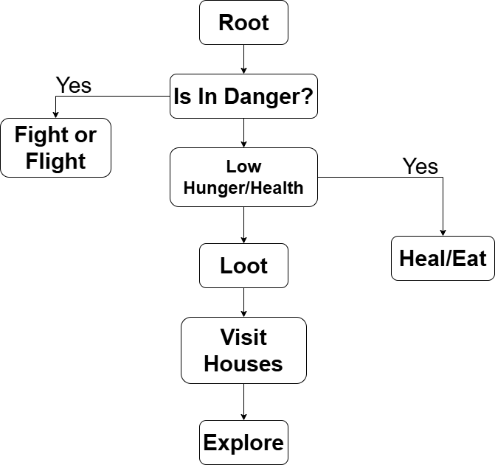
Decision Making
Decision-Making: We use Blackboard Booleans to choose the best course of action
Safety First: ‘IsInDanger’ flag gets called when our character is in danger and overrides the current Branch
Fallback: The ‘Explore’ branch is kept as last until our current area hass been fully scouted.

Slide 3



Enemy handling
Scan
Flee
Fight

Slide 4
Inventory
Garbage Disposal:
The character skips any garbage it comes across along the way.
Item Evaluation:
Each item type get assigned a weight to choose pickup priority.
Consumption Routine:
When the character stamina/health falls below 50% this triggers an automatic consumption
Notes:
Gives each type a value to prioritise between
Skips garbage completely
Consumption: - Medkit and Food when below 50% of their respective max
Prioritize Items when it spots an item it ignores house seeking and loots

Slide 5
Movement - Steering
K.I.S.S.
MoveTo(): I kept It simple and used the exposed Method
The Method Simply gets handed a TargetLocation that gets manipulated by the Behavior Tree.

Slide 6
Movement - Exploration
Our character keeps two Arrays, A Spotted Houses and Visitsed Houses. This ensures it stays focused on the new houses.
We don’t revisit any houses we came across.
When our character enters a house, it heads for the middle and scans the room. To see for loot or danger nearby

