Slide 1
GPP Exam: Zombie AI

Slide 2
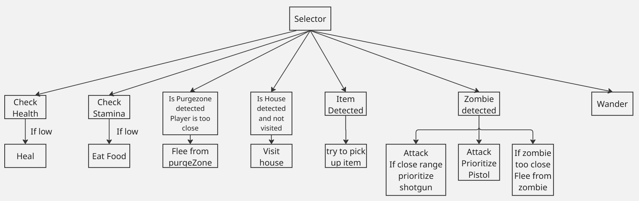
Decision Making

Slide 3
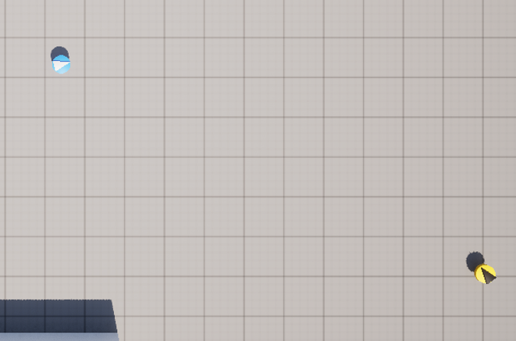
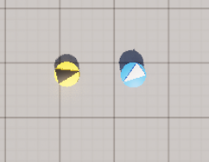
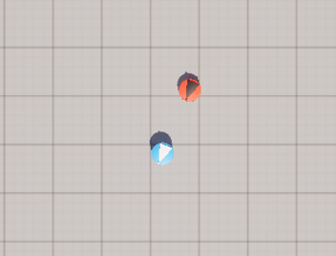
Enemy handling
If zombie is far away, prioritize to use pistol
If zombie is close, prioritize to use shotgun
If no weapon is available, flee from the zombie

Slide 4
Inventory
Each type of item gets its own slot.
0 > Pistol
1 > Shotgun
2 > Medkit
3 > Food
4 > Garbage
After an item has been used and it can’t be used anymore, it gets removed.

Slide 5
Movement - Steering
3 steering behaviors used
Seek: used for visiting houses
Flee: used to run away from zombie’s and purge zone’s
Wander: To explore the world.

Slide 6
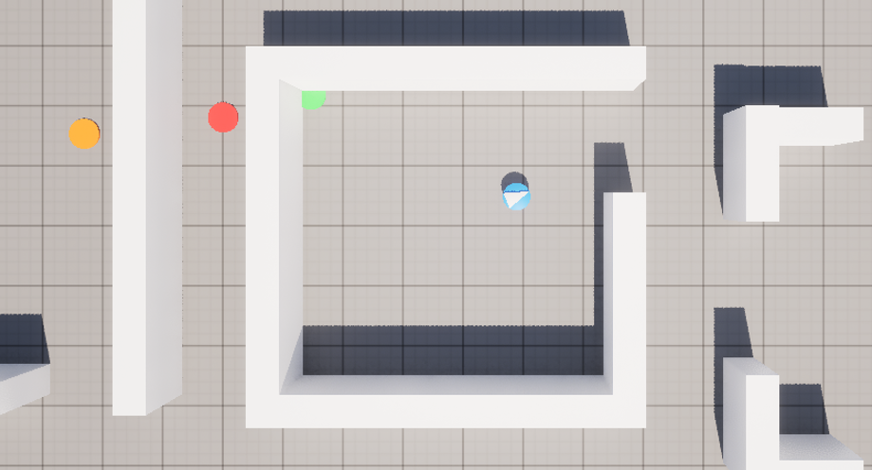
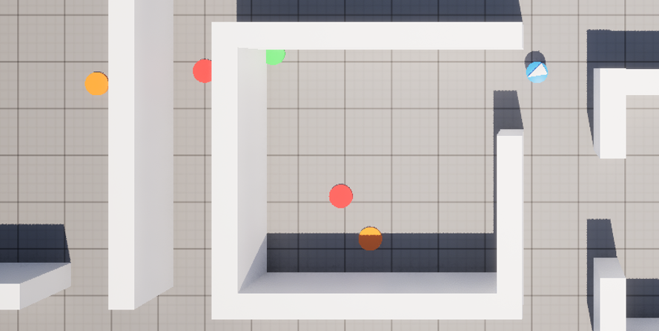
Movement - Exploration
The survivor wanders around the world.
When visiting the house, it picks up the items that it is missing.
When it sees a house, it goes visit it.
After that it remembers the house it has visited and won't visit it again.

