Slide 1
GPP Exam: Zombie AI
Delete all comments after reading
You are not allowed to add more slides to this presentation

Slide 2
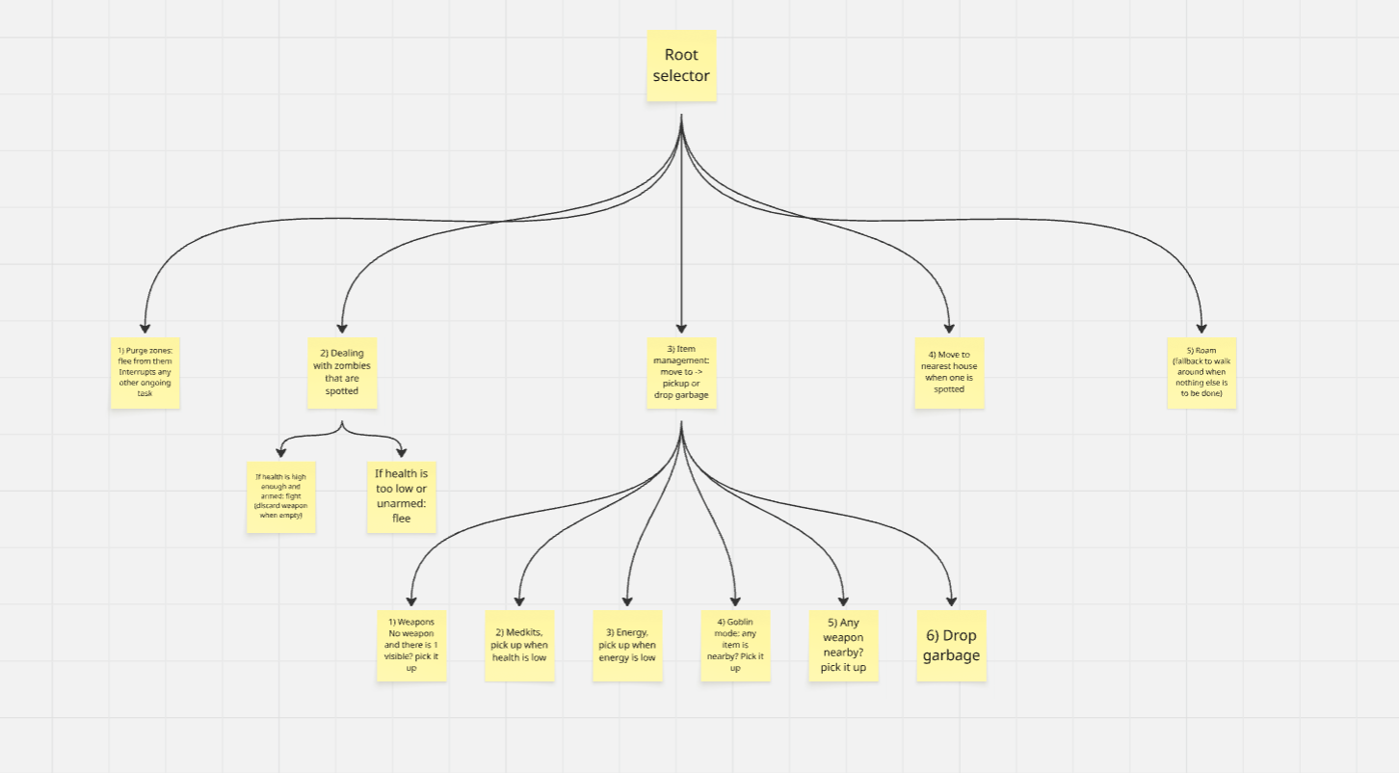
Decision Making

Slide 3
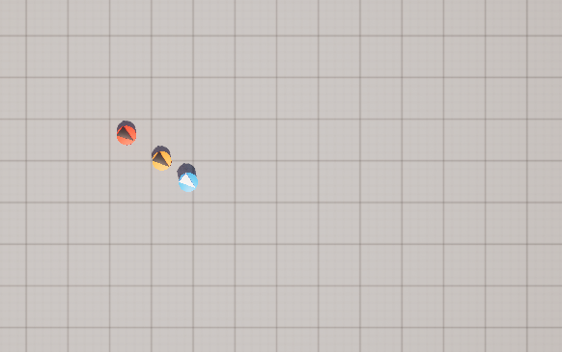
Enemy handling
Detection
Sight: UAISenseConfig_Sight, 1500u radius, detects all affiliations
Damage: UAISenseConfig_Damage, intends to catch hits from outside the sight cone
Fight: ShootZombie task
SetFocus on zombie, fire via inventory UseItem, ClearFocus after shot
Checks ammo via GetSlotValue, removes the weapon if empty, sets bHasWeapon false afterwards
Flee: FleeFromZombie task
Calculates direction away from zombie, projects onto navmesh, MoveToLocation 1500u away

Slide 4
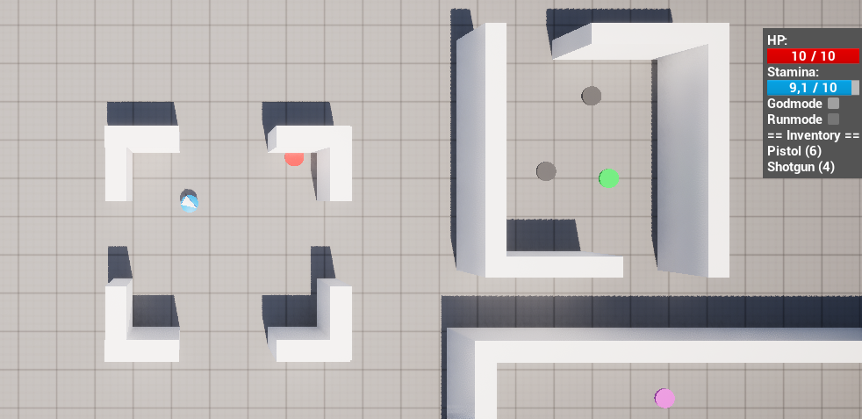
Inventory
Weapons (Pistol / Shotgun)
Kept in inventory slot, bHasWeapon blackboard key set to true
Ammo tracked via GetSlotValue, empty weapons are removed, bHasWeapon resets to false after this
Consumables (Food / Medkit)
Grabbed into a free slot, UseItem called immediately, slot cleared
Garbage
Grabbed and immediately removed, clears blocked item spawn slots so useful items can appear
Priority rule
If it has no weapon, prefer weapon pickup over consumables (BT task order)

Slide 5
Movement - Steering
No blended steering, but the movement that is done is fundamentally the same as known steering behaviours from class with some changes
1) Flee -> FleeFromZombie & FleePurgeZone
Fundamentally the same as the flee from the weekly assignments, direction away from threat scaled by the distance, but projected onto the navmesh
2) Seek -> MoveToTarget
UE5's pathfinding does the seek calculation internally, following a path to the target rather than a straight line
3) Wander -> Roam
Same concept as the original wander, but the random point on the navmesh replaces the circle offset and respects world geometry.

Slide 6
Movement - Exploration
Roam: random world traversal
GetRandomReachablePointInRadius with 1500u radius: fallback when nothing else to do
House memory: persistent knowledge map
Houses detected via AIPerception are stored in KnownHouses, they persist after leaving sight range
Agent targets nearest known house to search for items inside
House removed from list when within 800u, visited heuristic prevents revisiting

