Slide 1
GPP Exam: Zombie AI
Aina Nees Colomina | 2DAE09

Slide 2
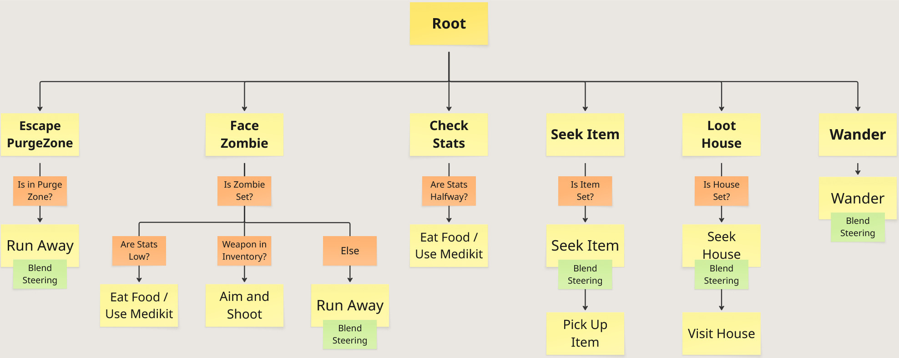
Decision Making

Slide 3
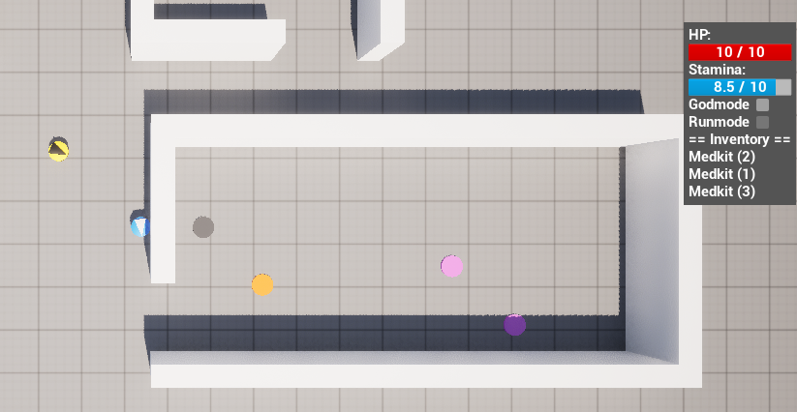

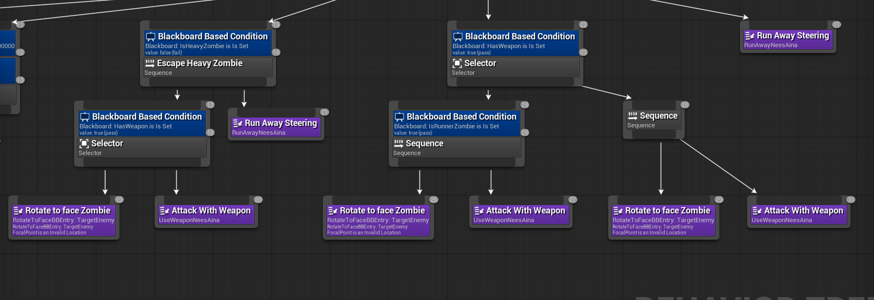
Enemy Handling
Detection: Uses the UE AI Perception system to track zombies via sight/hearing and manage memory via timestamped saves.
Shooting and Sprint: Armed agents halt to shoot targets; sprint automatically triggers against purge zones or special zombies.
Item usage: Automatically consumes food/medkits when stats are critically low.
Avoidance: Uses blended steering to escape while seeking shelter in a house if TargetHouse is set.

Slide 4
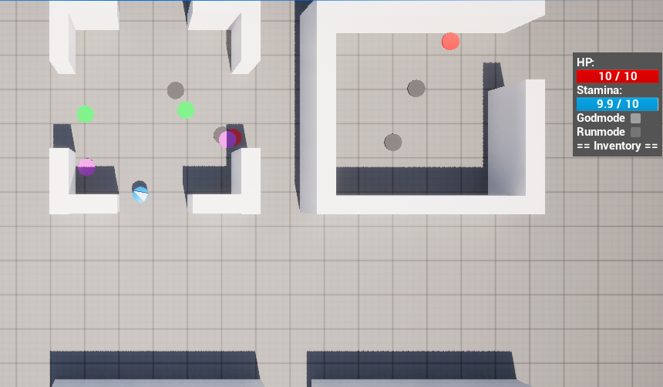
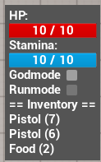
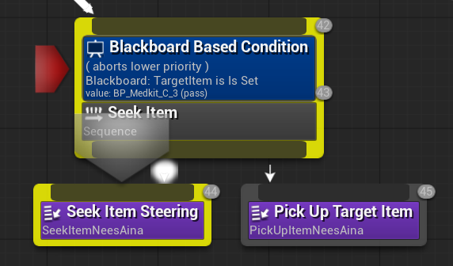
Inventory
Blackboard Inventory: A service loops through the item slots and checks for Food, Medkits, or Weapons, setting boolean flags.
Item Usage: The agent consumes food or medikits when the stats drop, instantly removing the item from inventory.
Picking Up Items: Checks the closest item and, if there is space in the slots, picks up the item or automatically destroys the garbage.
Item Memory: Saves all seen items to later assess which of the known ones is closest.

Slide 5
Movement - Steering
Steering Behaviors: Implements 4 steering behaviors: Seek, Flee, Evade, and Wander.
Blended Steering: It uses BlendedSteering logic to mix multiple behavior weights into a single velocity vector. Uses child behavior tree tasks to adjust individual movement weights depending on the task easily.
Example: Flee ⟶ 70% Flee, 20% Seek, 10% Wander
Anti-Stuck Logic: Registers if the agent is blocked for 1.0 second, instantly overriding paths with a 90-degree escape detour, adding 45 degrees for a more extreme turn if stuck for triple that time.

Slide 6
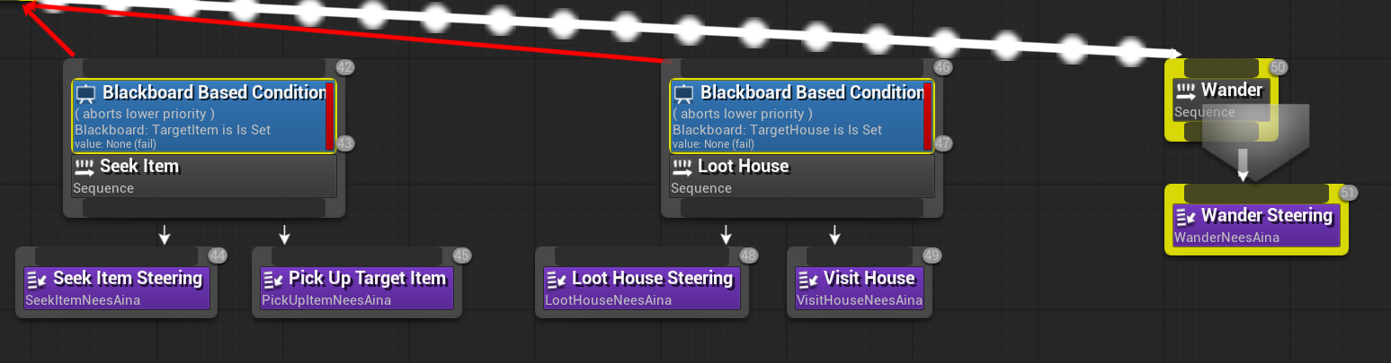
Movement - Exploration
Traversing the World: Uses a Seek steering force to navigate directly toward items or house entrances or switches to traverse the environment using a Wander task.
Memory: Saves all seen items to a tracking list and maps discovered buildings into a collection, flagging cleared houses as looted to filter for the closest target.
House Perimeter Navigation: Uses the map memory to register valid entryway points (DiscoveredEntrances), automatically choosing the closest known door vector to enter.

