Slide 1
GPP Exam: Zombie AI

Slide 2
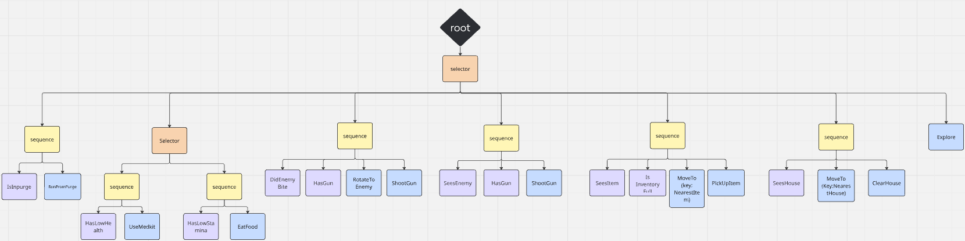
Decision Making

Slide 3
Enemy handling
When the agent gets bitten it will check if there is a gun in the inventory, turn to the enemy and will shoot the enemy.
If there is an enemy and the agent doesn’t have a gun it just continues exploring.

Slide 4
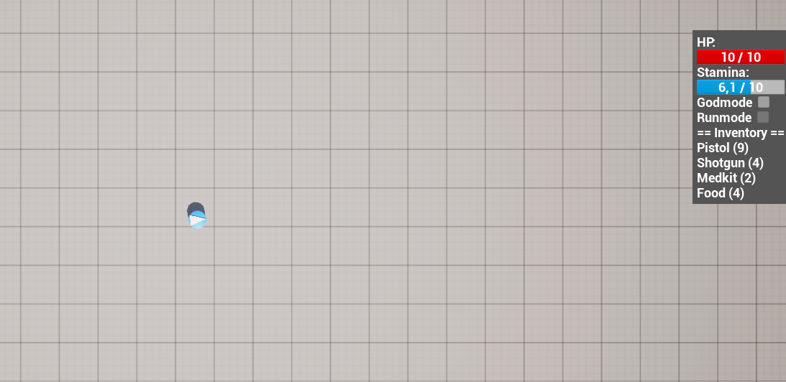
Inventory
Picks up trash and discards it so new items can spawn.
The inventory management is simple, pick up one of every item and one free slot for the garbage.
Medkit and food are used when their respective bars are half empty(since the max uses are 5 points).
Items that are used get checked if they have any more uses, else drop them.

Slide 5
Movement - Steering
When an object is found will run towards it and pick it up. Unless the inventory is full then it will remember it to pick up later.
When a house is seen it will move towards it enterance and just stands there to check for objects and then goes back to it’s last position.
When the agent percepts the nearest purgezone, it flees away from it.

Slide 6
Movement - Exploration
Implemented a grid that the agent goes trough in a circular exploration.
Agent goes to the center of a cell and if houses/items are passed. It goes to them after.
After those are explored it continues.
Remembers all the passed items and goes to fetch a new it already cam across.

