Slide 1
GPP Exam: Zombie AI

Slide 2
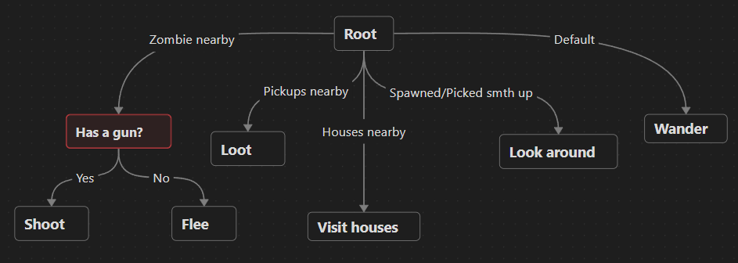
Decision Making

Slide 3
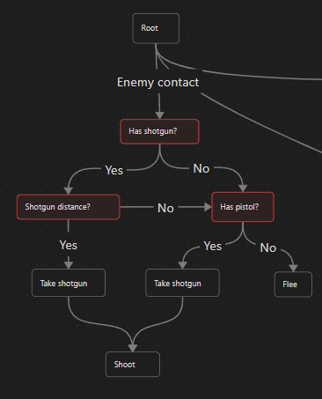
Enemy handling
Weapon selection
Enemy too close -> flee
Looting while fleeing

Slide 4
Inventory
Priorities: guns, meds, food
Using item whenever needed
Throwing away if value is 0
Thro

Slide 5
Movement - Steering
Steering behavior types:
Idle
Seek
Flee
Wander
Blended steering Flee = Seek + Wander

Slide 6
Movement - Exploration
Entering houses
Remembering visited houses
Remembering houses to visit
Remembering items to loot

Slide 7
GPP Exam: Zombie AI
Alex Stukalovs 2GD11

Slide 8
Decision Making
Visualization of your decision making structure (readable!)
Tip: use miro.com!

Slide 9
Enemy handling
How does your agent deal with enemies (aiming, shooting, item usage, avoidance, hiding, usage of sprint, …)?
USE IMAGES/GIFS
Enemy too close -> flee
Still looting items
Weapon selection

Slide 10
Inventory
How does your agent manage the inventory (inventory organization, item usage, picking up and remembering items,…)?
Prioritizing guns, then med kits, then food
Picking up, trying to use first and then store. Garbage gets destroyed
Any moment make full use of an item, use it
Remembering visited houses

Slide 11
Movement - Steering
How many steering behaviors does it use? Does it use blended steering?
Yes, steering
Buh, blended steering, okaay

Slide 12
Movement - Exploration
How does your agent explore the world ( how does it traverse the world, when and why does it visit houses, does it have a memory?)?
USE IMAGES/GIFS
d

