Slide 1
GPP Exam: Zombie AI
Vladimir Prisacaru - 2DAE10

Slide 2
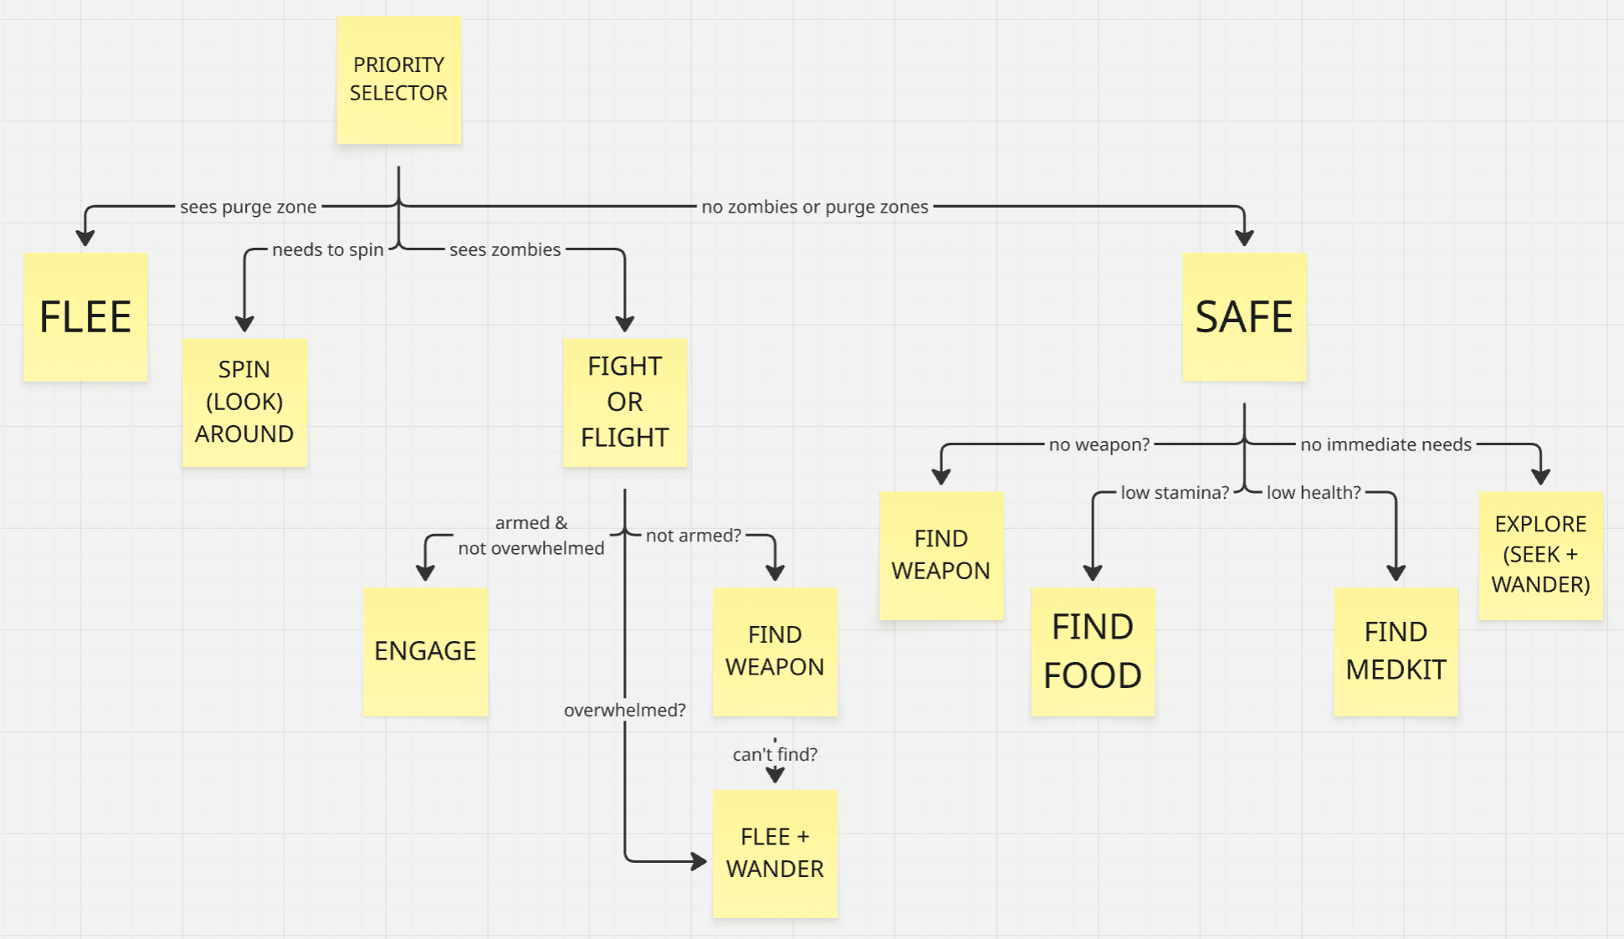
Decision Making

Slide 3
Enemy handling
Zombies spotted via AIPerception -> sets bSeesZombies
Estimates the speed of each zombie to determine if it’s fast or normal/slow
If has weapons + slow zombie count <= threshold -> moves toward nearest zombie
In attack range -> faces zombie, fires weapon; empty weapons removed immediately
Overwhelmed (too many slow zombies) -> flee + wander (wander angle biased away from nearest zombie)
Unarmed -> seeks a weapon on the ground or searches a house; if none available -> flee + wander
Sprint always active in fight and flee branches
Purge zone nearby -> flee branch takes priority, flees from closest threat (zombie or purge zone)
When taking damage -> spins around to reveal unseen attackers via AIPerception

Slide 4
Inventory
Only picks up items that satisfy a current need (low HP, low stamina, no weapon)
Priority on use: medkit first, then food, then weapon collection
Items consumed and slot cleared in the same tick they are identified as needed
Weapons removed from inventory when ammo hits zero
Items discovered via AIPerception sight and cached; picked-up or hidden items removed each tick
Always targets the nearest qualifying seen item; no pre-planned routes
Free slot checked before any pickup attempt

Slide 5
Movement - Steering
2 blended steering behaviours:
Wander + Seek: while safe, wander angle additionally pulled toward least-explored destination each tick
Wander + Flee: in fight, wander angle pushed away from nearest zombie each tick
All wander targets reject positions inside known purge zone danger radius

Slide 6
Movement - Exploration
Explored positions recorded in a list on each wander interval transition
Wander destination picked from N random candidates, scored by visit density → least-visited wins
Houses discovered via sight and cached; visited on demand when HP, stamina, or weapon is needed
On arrival at a house -> 360° spin to sweep AIPerception across the interior, revealing items
Visited houses stored in SearchedHouses and skipped until a periodic reset timer fires
Known purge zones remembered indefinitely (until they disappear); act as soft spatial obstacles for all wander steering

