Slide 1
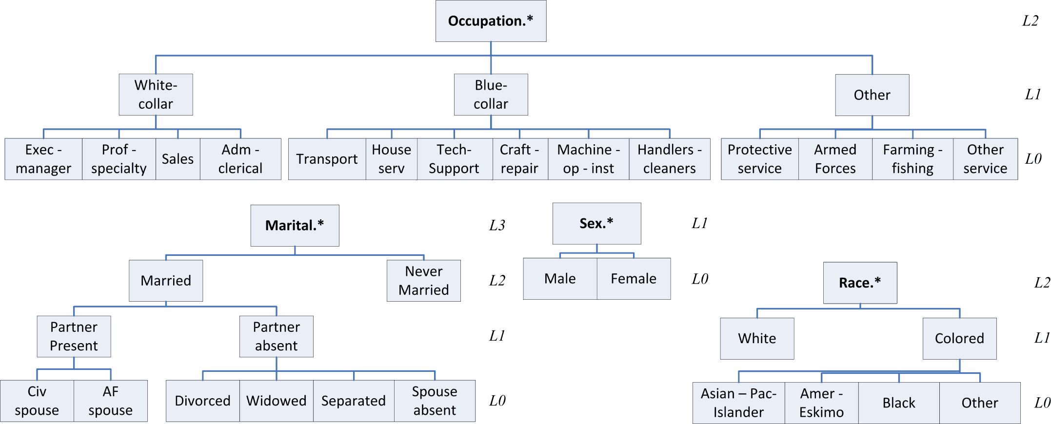
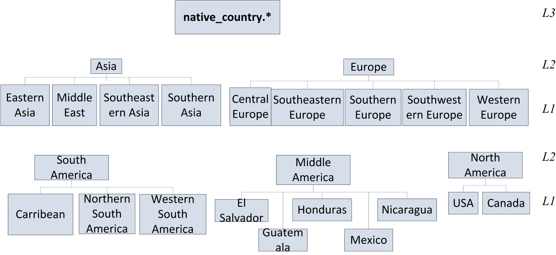

Slide 2
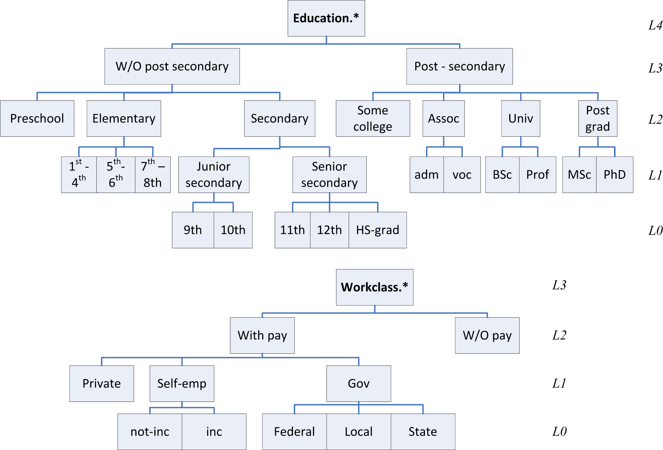

Slide 3
CREATE DIMENSION age_dim
RELATED SQL_TABLE age
LIST OF LEVEL { age.level0 AS lvl0 ,
age.level1 AS lvl1 ,
age.level2 AS lvl2 ,
age.level3 AS lvl3 ,
age.level4 AS lvl4
} HIERARCHY lvl0>lvl1>lvl2>lvl3>lvl4;
CREATE DIMENSION marital_dim
RELATED SQL_TABLE marital_status
LIST OF LEVEL { marital_status.level0 AS lvl0 ,
marital_status.level1 AS lvl1 ,
marital_status.level2 AS lvl2 ,
marital_status.level3 AS lvl3
}HIERARCHY lvl0>lvl1>lvl2>lvl3;
CREATE DIMENSION native~country_dim
RELATED SQL_TABLE native_country
LIST OF LEVEL { native_country.level0 AS lvl0 ,
native_country.level1 AS lvl1 ,
native_country.level2 AS lvl2 ,
native_country.level3 AS lvl3
}HIERARCHY lvl0>lvl1>lvl2>lvl3;
CREATE DIMENSION gender_dim
RELATED SQL_TABLE gender
LIST OF LEVEL { gender.level0 AS lvl0 ,
gender.level1 AS lvl1
}HIERARCHY lvl0>lvl1;
CREATE DIMENSION race_dim
RELATED SQL_TABLE race
LIST OF LEVEL { race.level0 AS lvl0 ,
race.level1 AS lvl1,
race.level2 AS lvl2
}HIERARCHY lvl0>lvl1>lvl2;
CREATE DIMENSION occupation_dim
RELATED SQL_TABLE occupation
LIST OF LEVEL { occupation.level0 AS lvl0 ,
occupation.level1 AS lvl1,
occupation.level2 AS lvl2
}HIERARCHY lvl0>lvl1>lvl2;
CREATE DIMENSION work_dim
RELATED SQL_TABLE work_class
LIST OF LEVEL { work_class.level0 AS lvl0 ,
work_class.level1 AS lvl1,
work_class.level2 AS lvl2,
work_class.level3 AS lvl3
}HIERARCHY lvl0>lvl1>lvl2>lvl3;
CREATE DIMENSION education_dim
RELATED SQL_TABLE education
LIST OF LEVEL { education.level0 AS lvl0 ,
education.level1 AS lvl1,
education.level2 AS lvl2,
education.level3 AS lvl3,
education.level4 AS lvl4
}HIERARCHY lvl0>lvl1>lvl2>lvl3>lvl4;
CREATE CUBE adult_cube
RELATED SQL_TABLE adult
MEASURES hrs AT adult.hours_per_week
REFERENCES DIMENSION
age_dim AT adult.age,
work_dim AT adult.work_class,
marital_dim AT adult.marital_status,
occupation_dim AT adult.occupation,
race_dim AT adult.race,
gender_dim AT adult.gender,
native~country_dim AT adult.native_country,
education_dim AT adult.education

