Slide 1
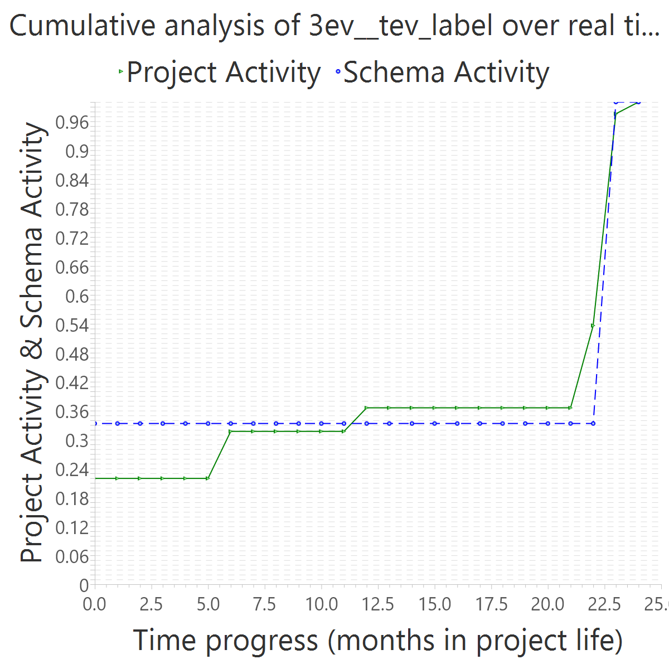
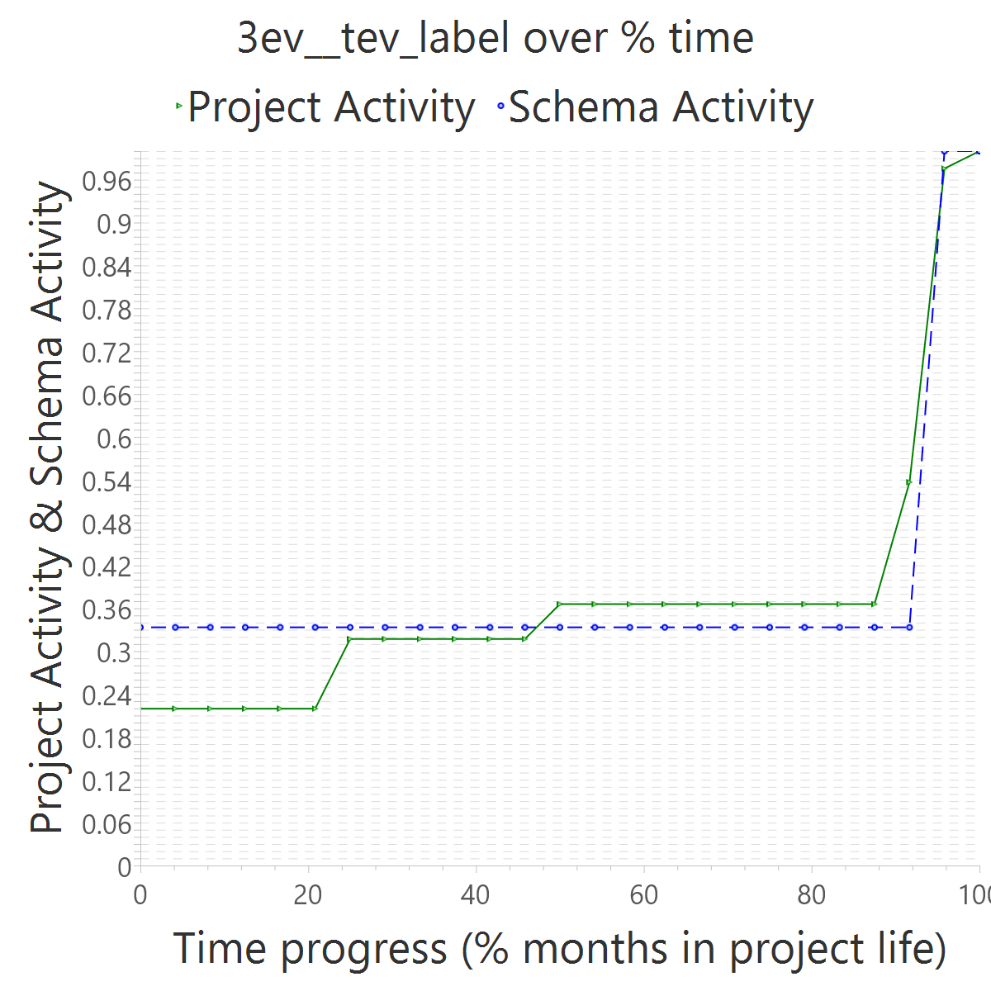
Project OVERALL CLASS #ActiveCommits #AreedspostV0 Activity Class SUP(Months) #Commits TotalActivity Project #Commits Project FileUpds Project Start Date UTC Project End Date UTC PUP+V0(Months) 10%-sync (%) 50%-attain.(%) 75%-attain.(%) 80%-attain.(%) 100%-attain.(%) AvgTimeLag AvgSrcLag TimeLagsSchemaAlways? SrcLagsSchemaAlways?
3ev__tev_label 1_FocusedShot_n_FROZEN 2 1 2_SMALL 23 4 20 36 86 2013-09-20 10:08:08 +0000 2015-09-16 13:18:29 +0000 25 0.72 0.96 0.96 0.96 0.96 -0.12 0.01 FALSE FALSE

Slide 2
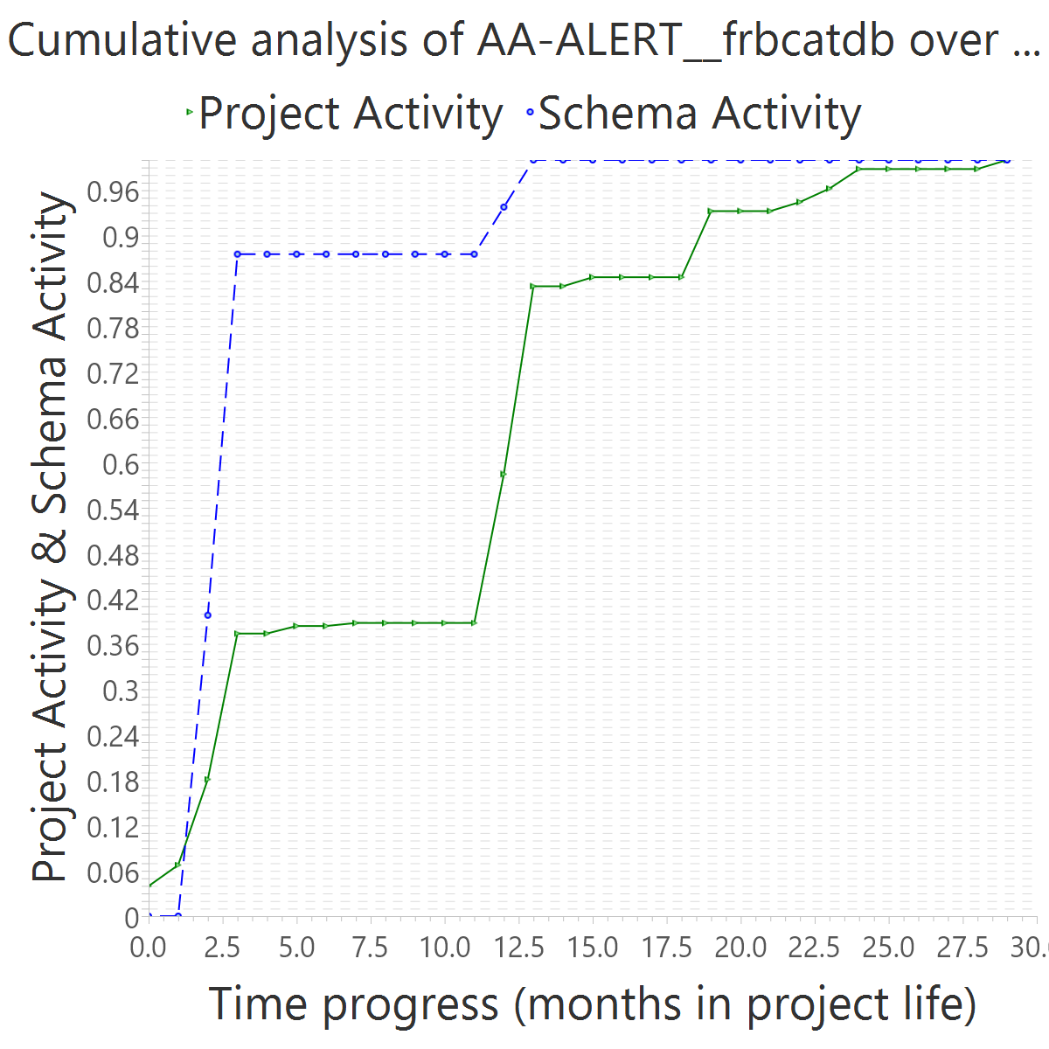
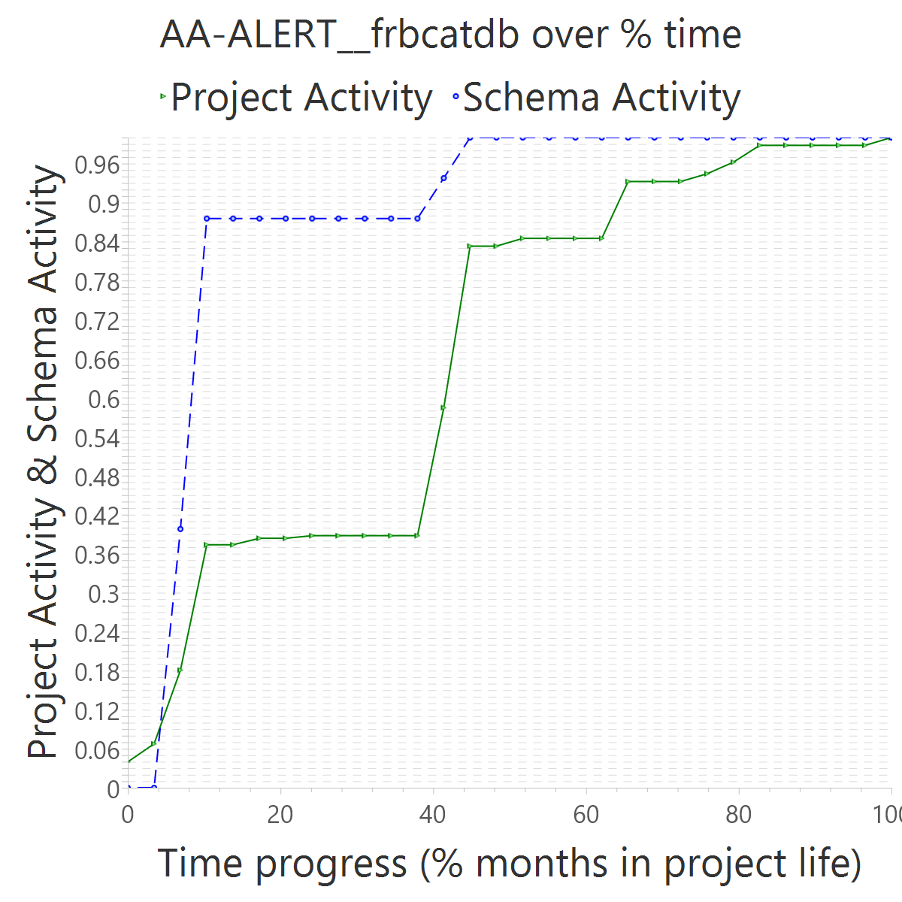
Project OVERALL CLASS #ActiveCommits #AreedspostV0 Activity Class SUP(Months) #Commits TotalActivity Project #Commits Project FileUpds Project Start Date UTC Project End Date UTC PUP+V0(Months) 10%-sync (%) 50%-attain.(%) 75%-attain.(%) 80%-attain.(%) 100%-attain.(%) AvgTimeLag AvgSrcLag TimeLagsSchemaAlways? SrcLagsSchemaAlways?
AA-ALERT__frbcatdb 4_ACTIVE 12 3 4_HIGH 11 16 174 231 571 2016-08-17 10:08:46 +0000 2019-01-29 20:38:14 +0000 30 0.43 0.10 0.10 0.10 0.45 0.39 0.21 FALSE FALSE

