Slide 1
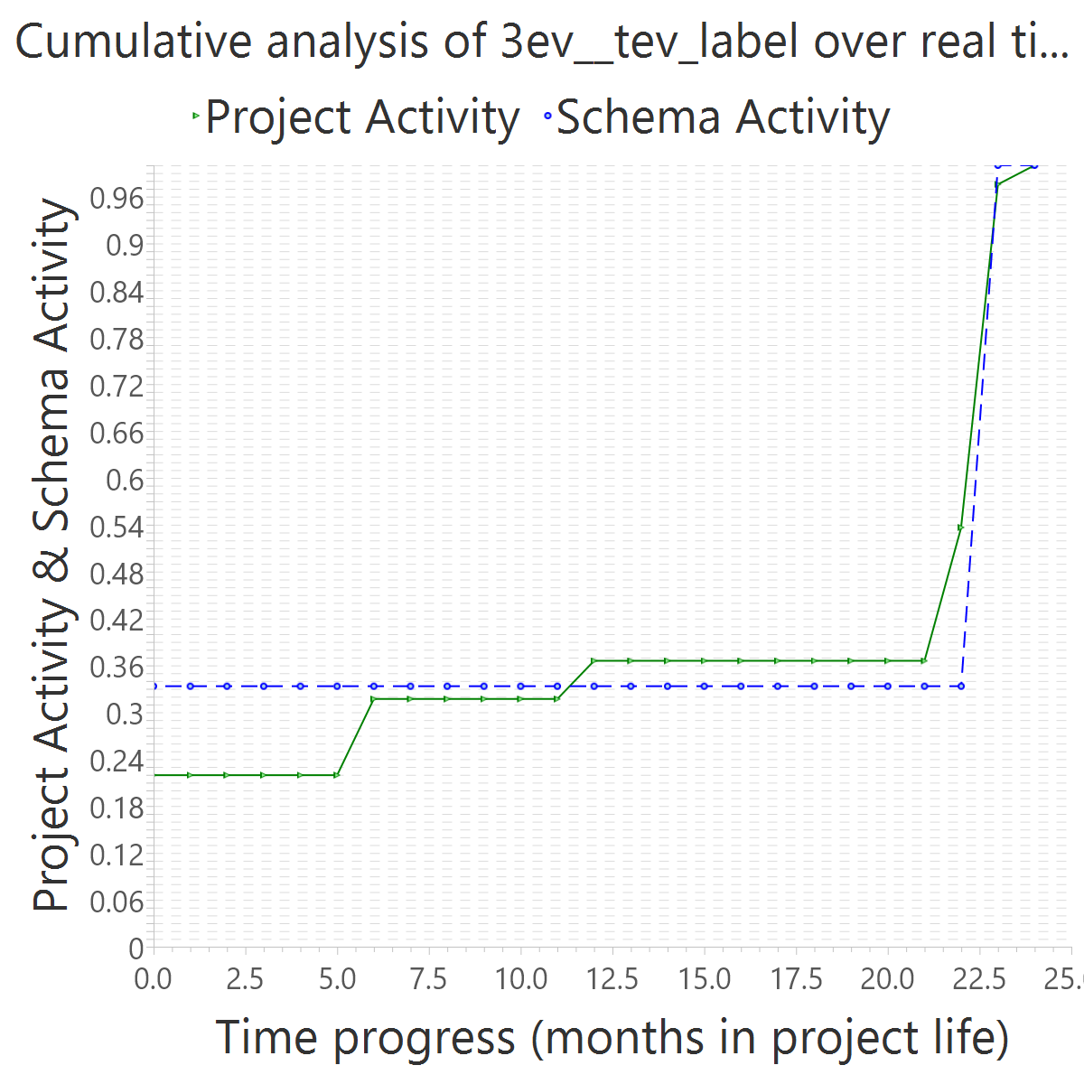
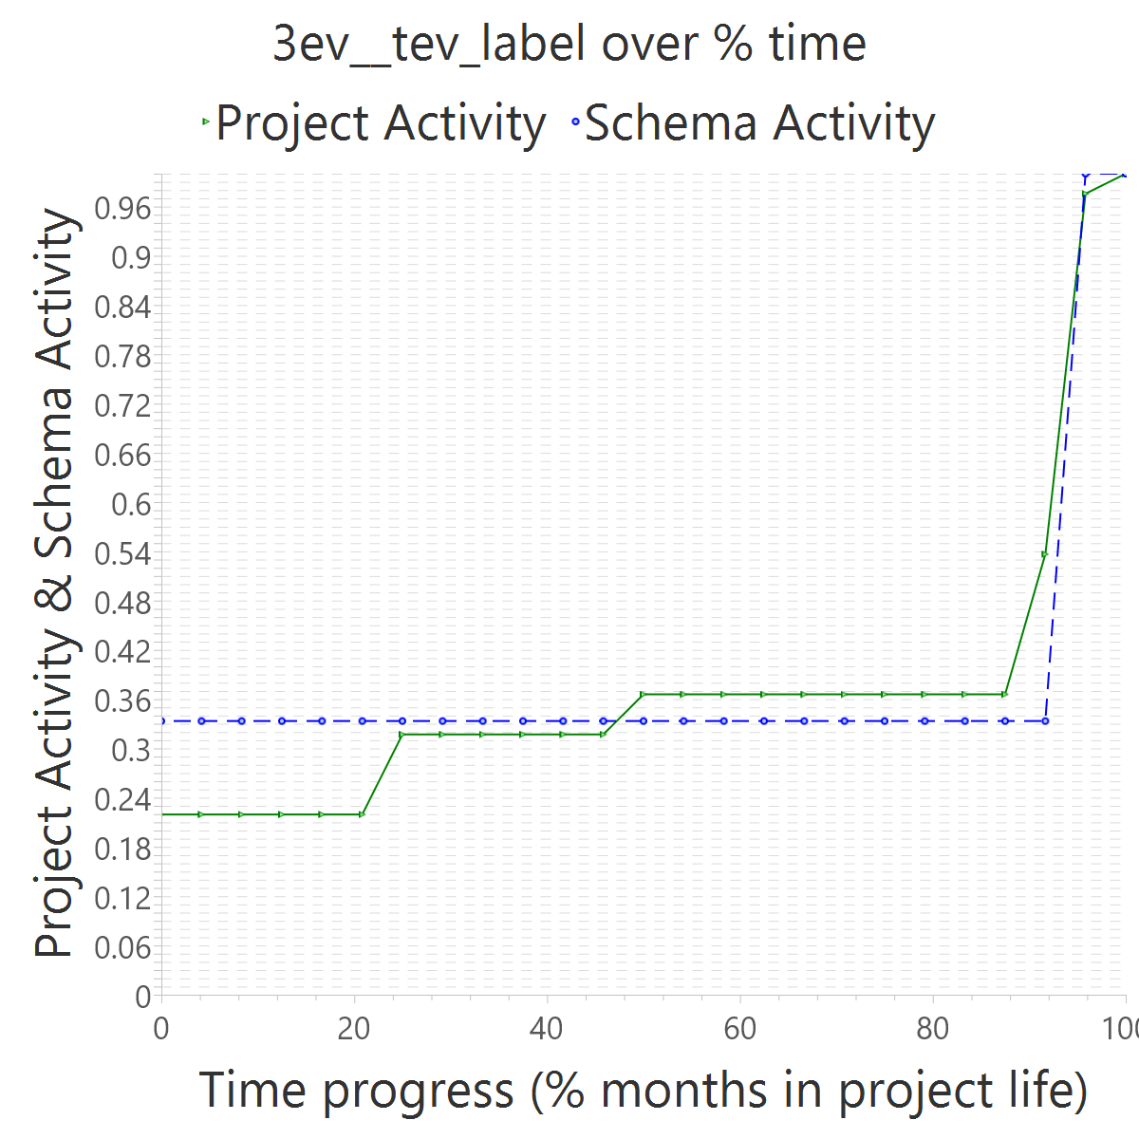
Project OVERALL CLASS #ActiveCommits #AreedspostV0 Activity Class DurationInMonths #Commits TotalActivity Project #Commits Project FileUpds Project Start Date UTC Project End Date UTC PUP+V0 10%-syncrhonicity (%) 50%-attain. time point (% PUP) 75%-attain. time point (% PUP) 80%-attain. time point (% PUP) 100%-attain. time point (% PUP) AvgTimeLag AvgSrcLag TimeLagsSchemaAlways? SrcLagsSchemaAlways?
Month SchActivity PrjActivity cumulPtime cumulSchActivity cumulPrjActivity 0 10 18 0.0 0.3333333333333333 0.21951219512195122

