Slide 1

Wiz Light Bulb: An introspective into the dangers that insecure IoT devices bring to the house
Daniel Alejandro Leon Ortiz
Dominykas Baronas
Jose Fredy Navarro Motta
Group 5, School of Computer Science, University of Oklahoma

Slide 2
Background
The usage of IoT devices is rapidly growing.
Research shows most IoT manufacturers are aware of security risks, but do little to protect their devices.
Growing concern over the possible scale of security exploits, one compromised device can lead to a whole network being exploited.
A lot of research has been done into their security and risk assessment strategies, how to exploit them, but not a lot to inform common users or potential buyers about specific popular devices.

Slide 3
Challenges
Analyze and attempt multiple types of attacks to check if the device selected has any vulnerability.
This challenge aims to address device resource limitations, the lack of security in device design, privacy concerns, the usability-security trade-off, interoperability issues, and user awareness gaps in the IoT landscape.

Slide 4
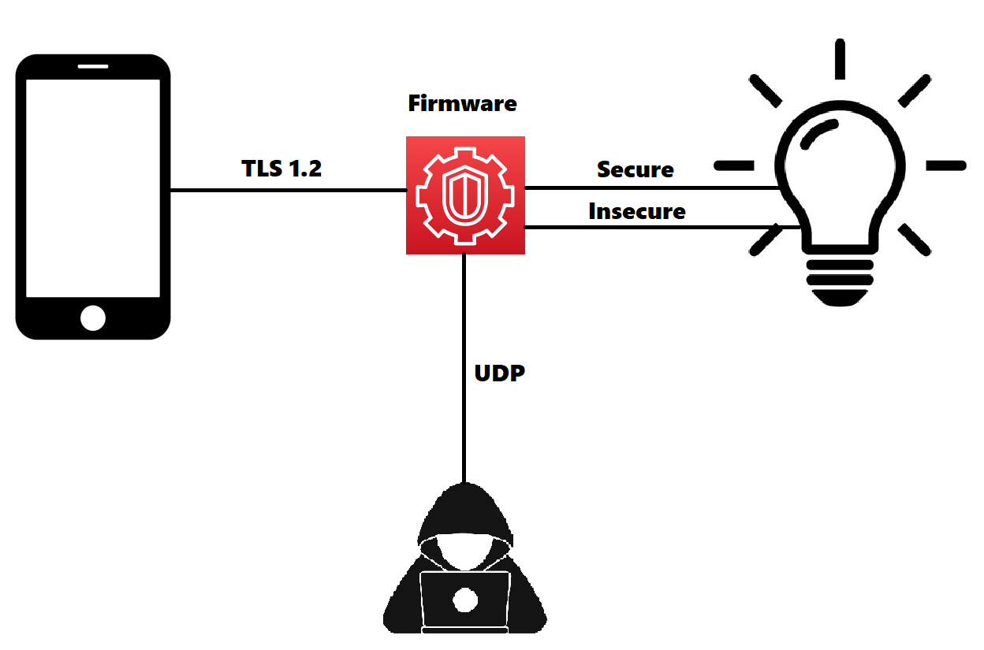
Firmware exploitation attack
The communication between the user's smartphone and the light bulb is predetermined over the TLS 1.2 protocol.
Due to a lack of security measures in the firmware, UDP packets are also accepted.
An attacker sends UDP packets and retrieves sensitive information, such as the current color set for the light.

Slide 5
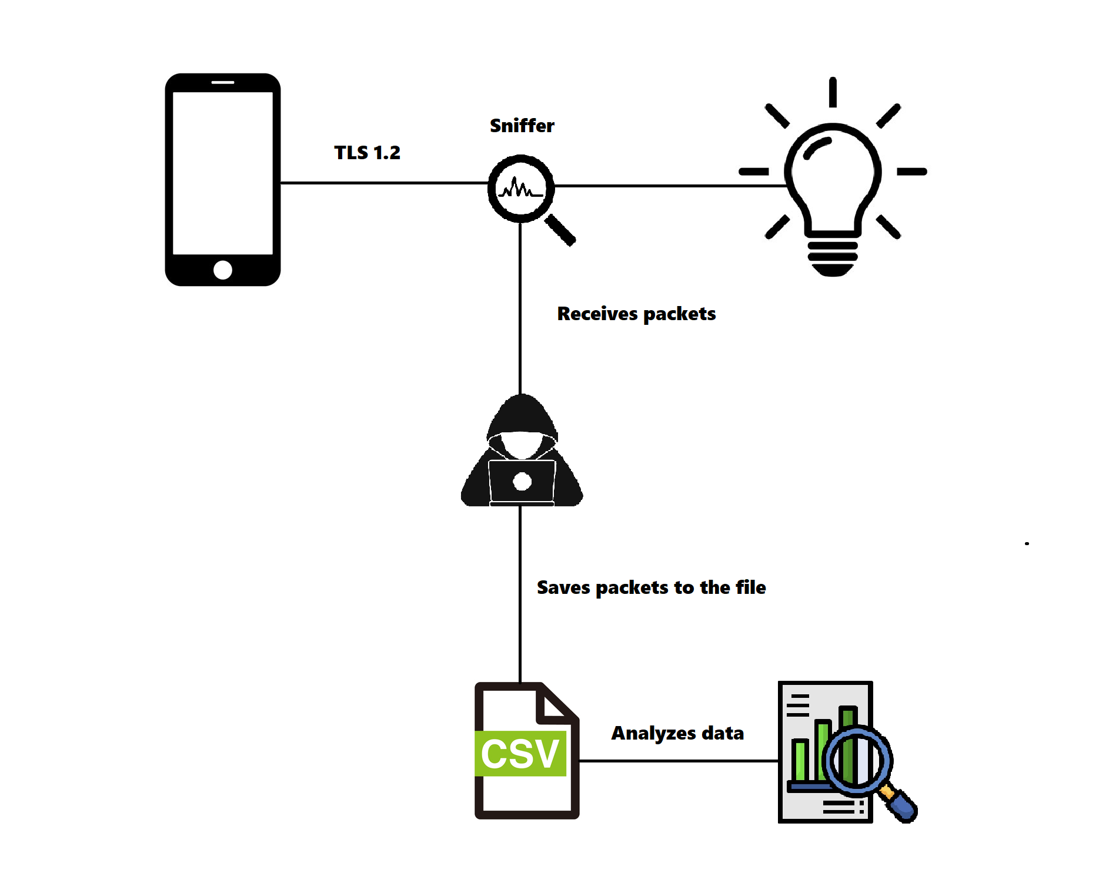
Privacy attack
The communication between the user's smartphone and the light bulb is predetermined over the TLS 1.2 protocol.
A sniffing program, executed by an attacker, observes TLS packets and saves them inside a CSV file for further data analysis.

Slide 6
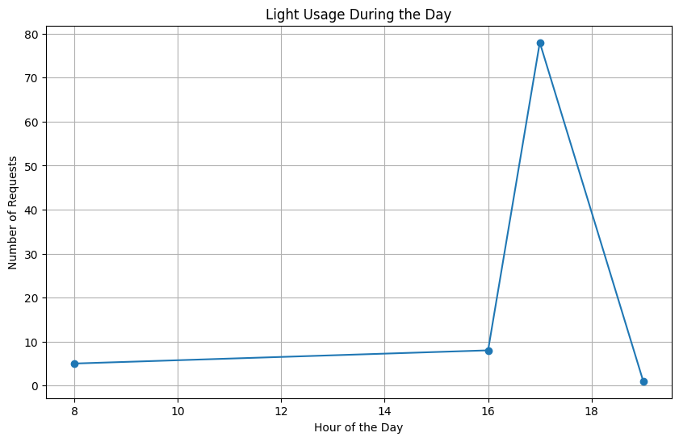
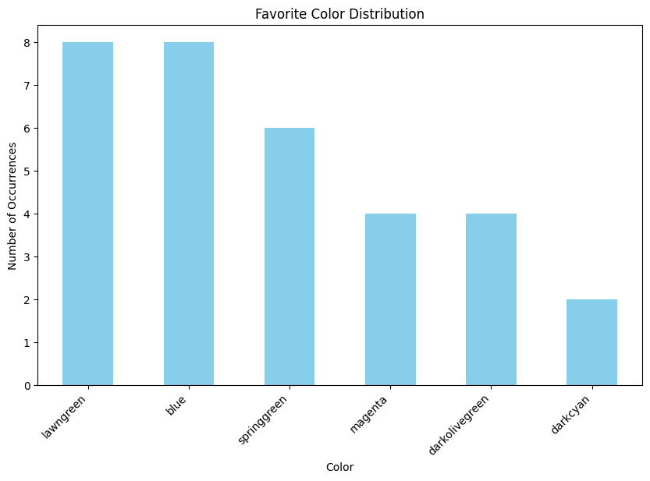
Data analysis

Slide 7
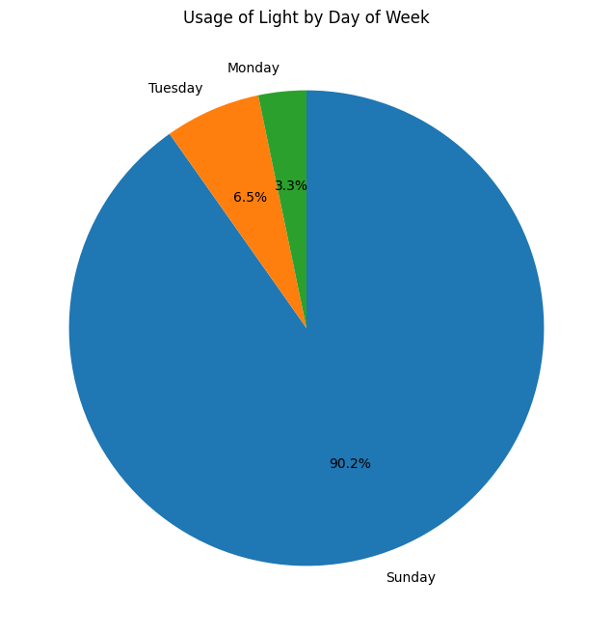
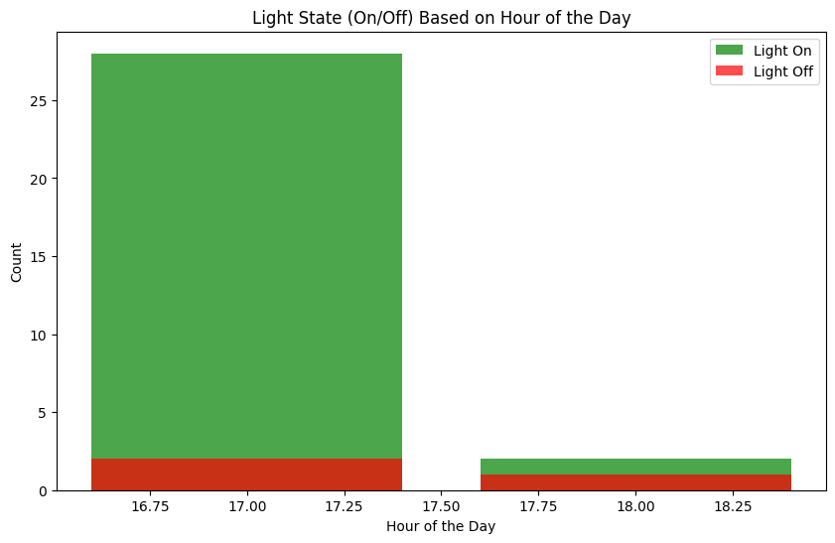
Data analysis

Slide 8
Conclusion
Conducted data analysis reveals confidential user information:
Light usage during the day and throughout the week indicates when the user is at home.
The patterns of turning the light on and off may suggest when the user potentially leaves the house or goes to sleep.
Knowing the user's favorite color discloses a personal preference.

Slide 9
Thanks for hearing us out :)

