Slide 1
Development of a Friction Tester for research of tribological properties
<p> I am a specialist presenter..., so I must be all-powerful. </p>

Slide 2
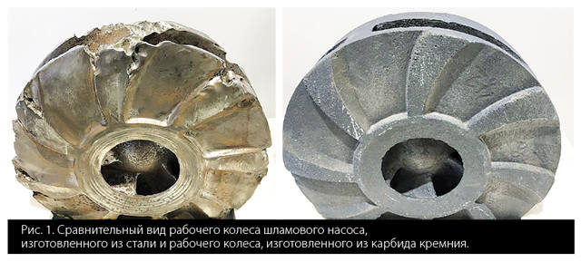
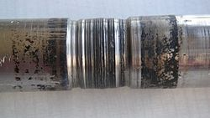
Why it's Important?
<p> Friction and wear are the main enemies of machinery </p>

Slide 3
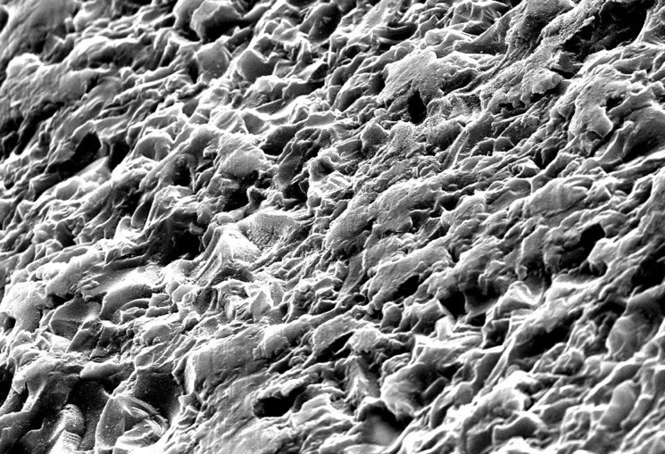
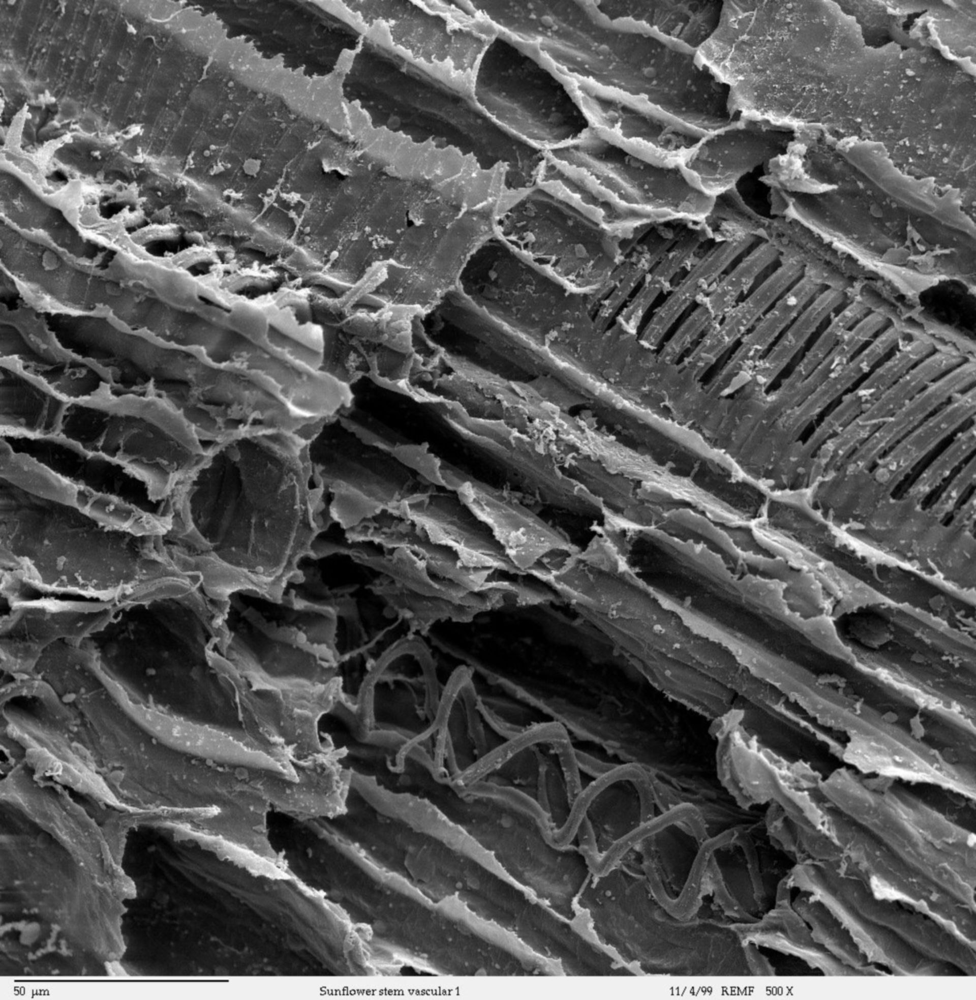
Purpose of Work?
<p> Create a device that allows you to study how materials wear through friction, in real time </p>

Slide 4
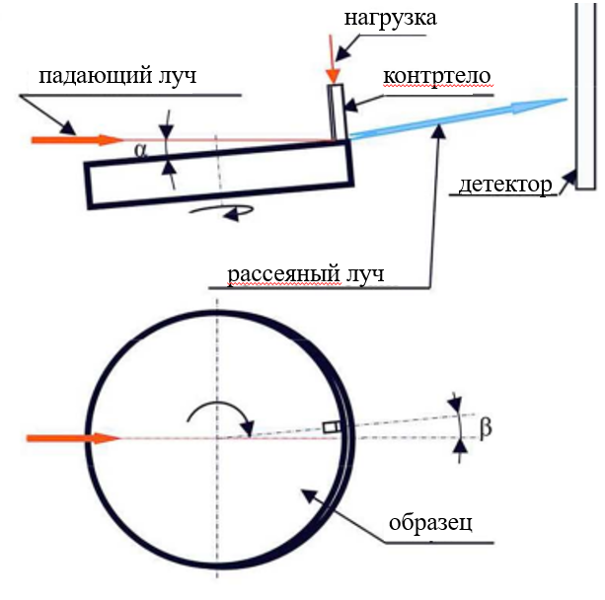
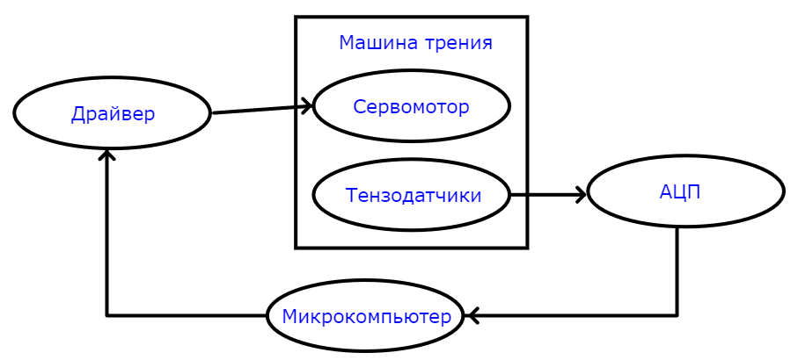
How does it Work?

Slide 5
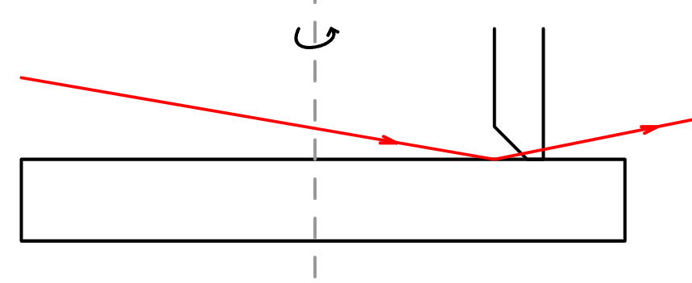
What's New?
<p> Added the ability to observe changes in material structure directly during friction</p>
<p> Synchrotron radiation utilisation</p>

Slide 6
RESULTS

Slide 7
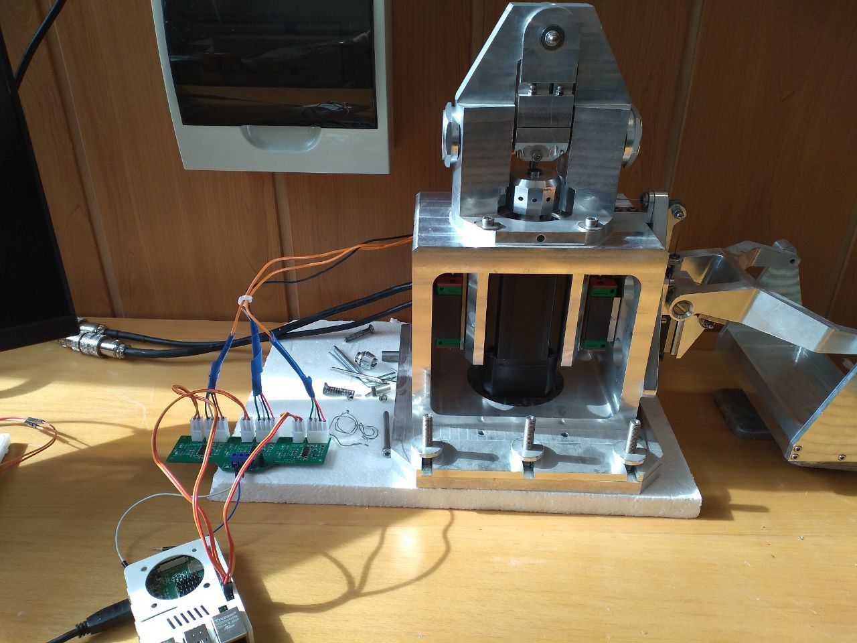
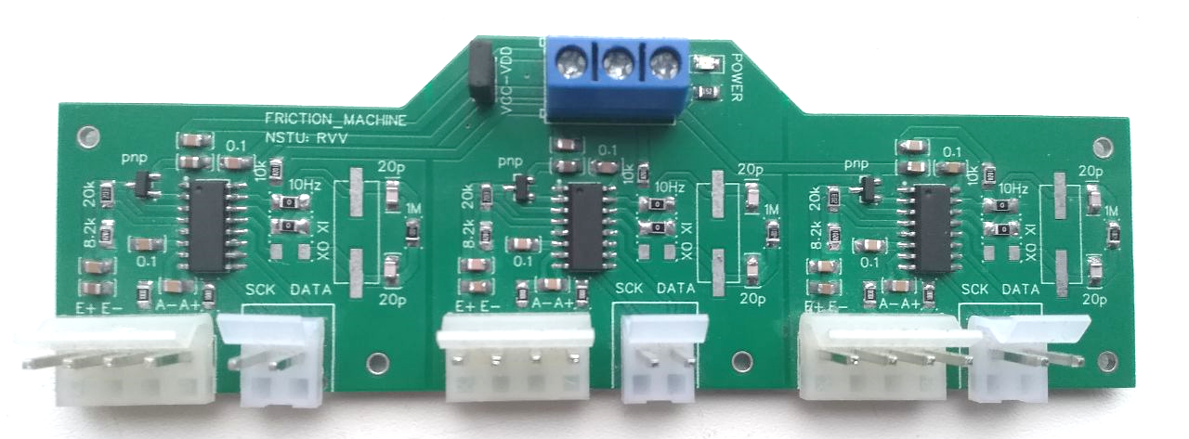
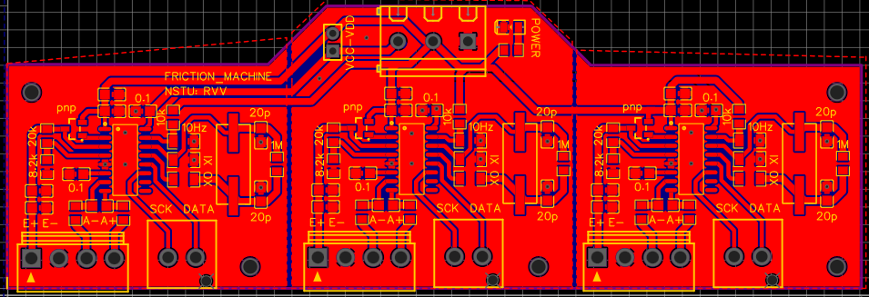
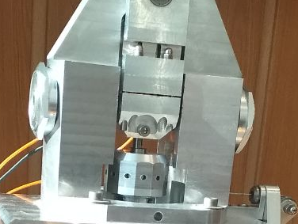
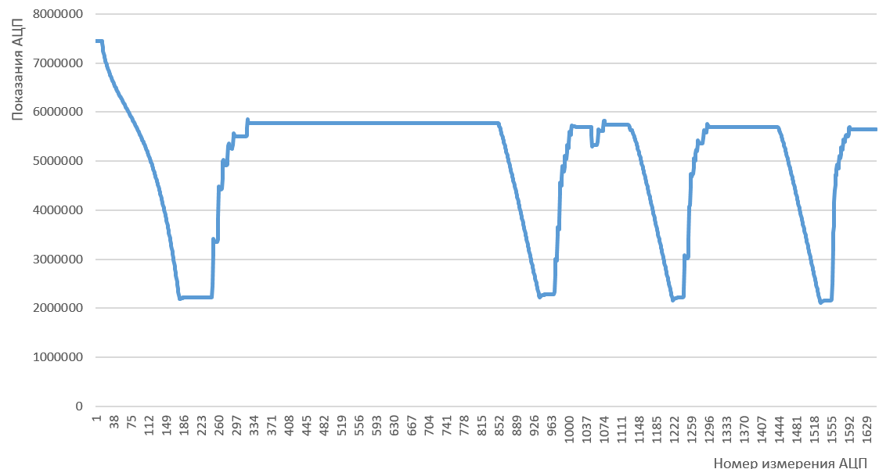
What did you Get?
___
(0_о)
<|>
/ \
Established:
Sensor data acquisition board
Control board for servo drive
Analysis software
Friction Tester

Slide 8
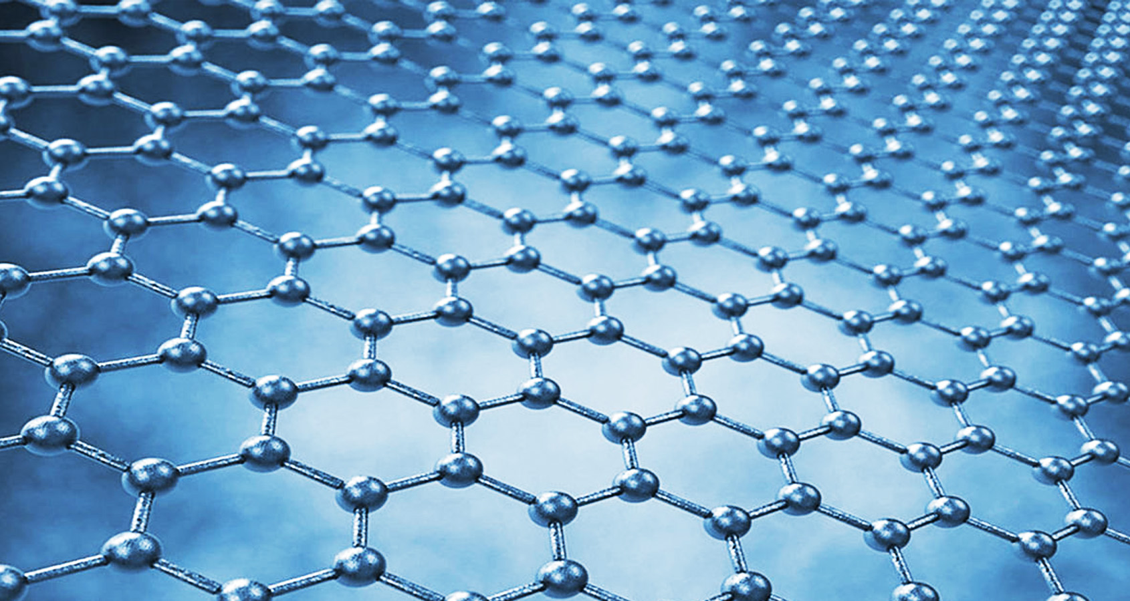
How does that HELP?
Application
Optimisation of materials for industry
Development of wear-resistant coatings

Slide 9
THANK YOU!
vlad.razuvaev.2805@mail.com
Do you have any questions?

