Slide 1

A general exposome factor explains individual differences in functional brain network topography and cognition in youth
Keller et al., 2024

Slide 2
Research Question
How does the exposome impact children’s neurodevelopment and cognition as they move through the critical transition from childhood to adolescence?
The authors leverage the diverse environmental and cognitive metrics available in the ABCD (Adolescent Brain Cognitive Development) dataset to understand the impact of the exposome on the brain and cognitive performance across a critical two-year development window.

Slide 3
Introduction
Childhood environments are critical in the shaping of cognitive neurodevelopment
The Exposome refers to hundreds of interconnected and co-occurring features of a child’s environment
Individual differences in cognition may increase as children develop and and environmental exposures, combined with individual experiences, continually mold the brain’s functional organization
These changes in cognition are also associated with with future SES, physical health, and mental health outcomes

Slide 4
Methods
The exposome score was calculated from a combination of school, family, neighborhood, community, and physical environment risk and protective factors
Neurocognition data was drawn from the ABCD cognitive task battery as well as broader MRI data to construct an evaluation of cognitive performance as well as personalized functional brain networks within individuals
Exposome scores and cognitive performance scores were evaluated longitudinally, across a two-year period to understand how changes in the exposome impacted cognitive performance from baseline to follow-up

Slide 5
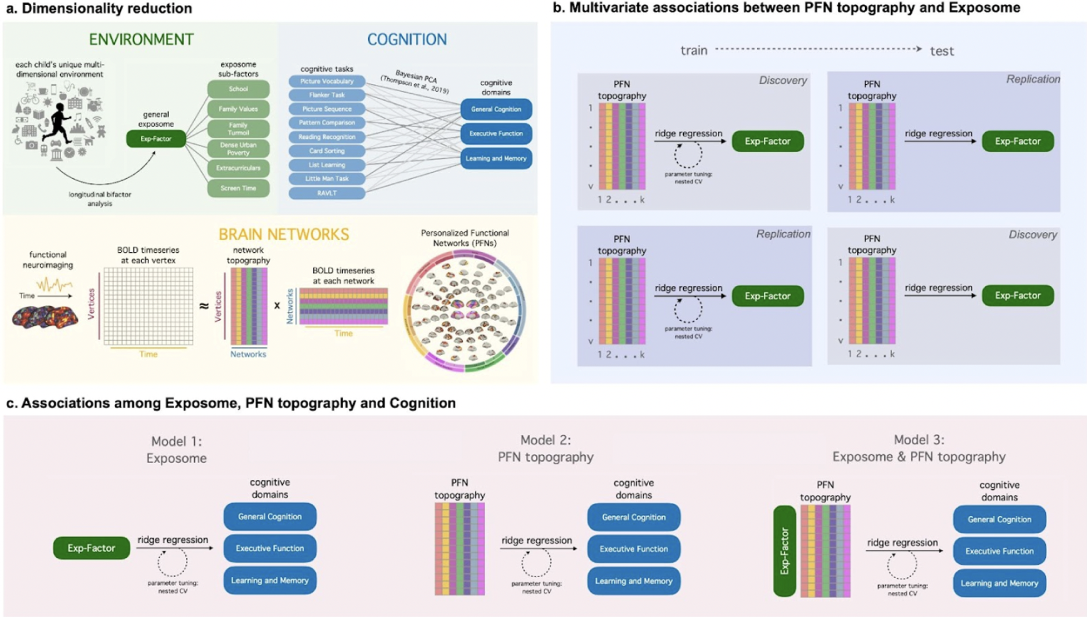

Slide 6
Results
Many of the most impactful exposome variables were those capturing dimensions of SES
The General Exposome Factor could explain additional variance in cognitive abilities over and above the effects of two commonly used measures of SES: parental education and household income
The aggregate exposome measure captures more nuance than individual measures

Slide 7
Discussion
Neurodevelopment does not occur in a vacuum, but amid a variety of environmental exposures and experiences
Models trained on a single exposome variable predicted children’s cognition better than models trained on a wealth of personalized neuroimaging variables
Studies on the exposome have uncovered associations with various mental and physical health outcomes in adults and children—explaining up to ~40% of variance in overall psychopathology in early adolescence
It is also associated with with changes in cognition over a two-year period
Exposome findings may point to early markers for targeted prevention efforts

