Slide 1
Digital Biomarker Study with Smartphone: Gait and Balance Disorder Can the combination of raw inertial data (3-axis Accelerometer/Gyroscope) and software-fused kinematics (Linear Acceleration and Game Rotation Vector) provided by standard mobile architectures accurately classify pathological gait phenotypes and quantify postural sway asymmetry?

Slide 2
Which sensors in a smartphone are useful to derive data?
1. Linear Acceleration Sensor (Virtual/Fused)
This sensor automatically subtracts the constant pull of Earth's gravity from the raw accelerometer data.
Clinical Value: Gives back the isolated force on the patient
2. Goldfish 3-axis Gyroscope (Hardware)
It measures angular velocity (how fast the phone is rotating around its axes).
Clinical Value: Essential for capturing trunk sway during balance tests and turning velocity during mobility tests (like the Timed Up and Go).
3. Game Rotation Vector Sensor (Virtual/Fused)
This sensor fuses the accelerometer and gyroscope to track the phone’s precise 3D angle in space. Crucially, it ignores the magnetometer (compass).
Clinical Value: Standard "Rotation Vector" sensors use the magnetometer, which gets heavily distorted indoors by hospital beds, steel floor beams, and radiology equipment. The Game version is completely immune to indoor magnetic interference, making it the gold standard for tracking clean, drift-free pelvis or trunk rotation.
4. Gravity Sensor (Virtual/Fused)
It isolates only the gravity component from the accelerometer.
Clinical Value: Perfect for static balance analysis (like the Romberg test). By tracking how the gravity vector shifts relative to the phone, you can calculate the exact angle of a patient's postural lean (e.g., whether a patient with a progressive supranuclear palsy phenotype is leaning dangerously backward).

Slide 3
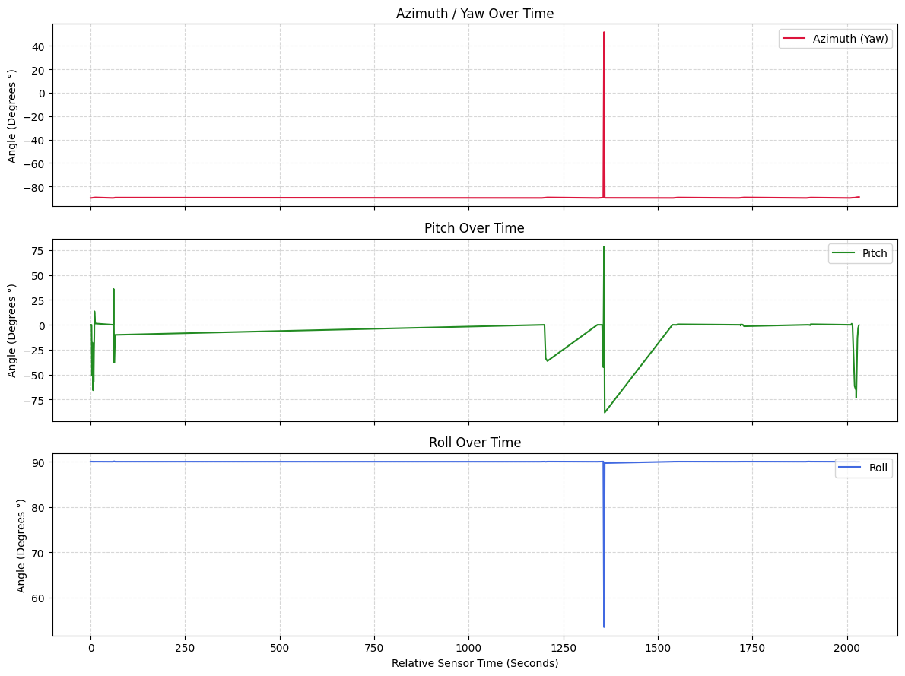
Visualization
data.json

