Slide 1

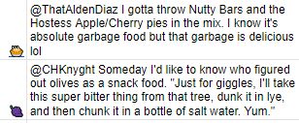
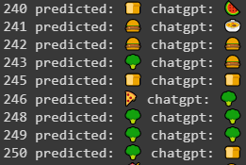
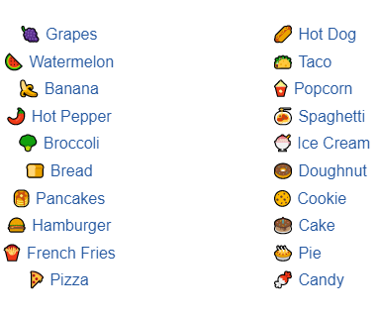
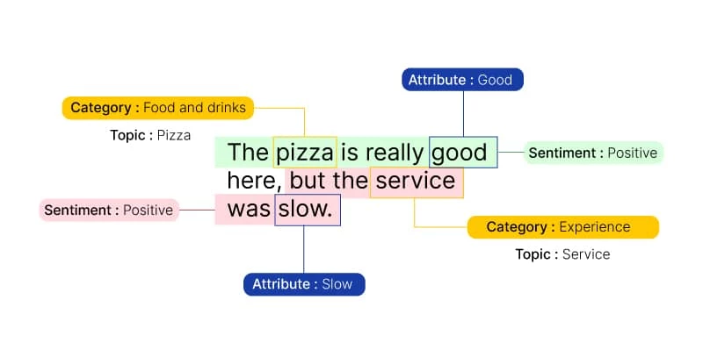
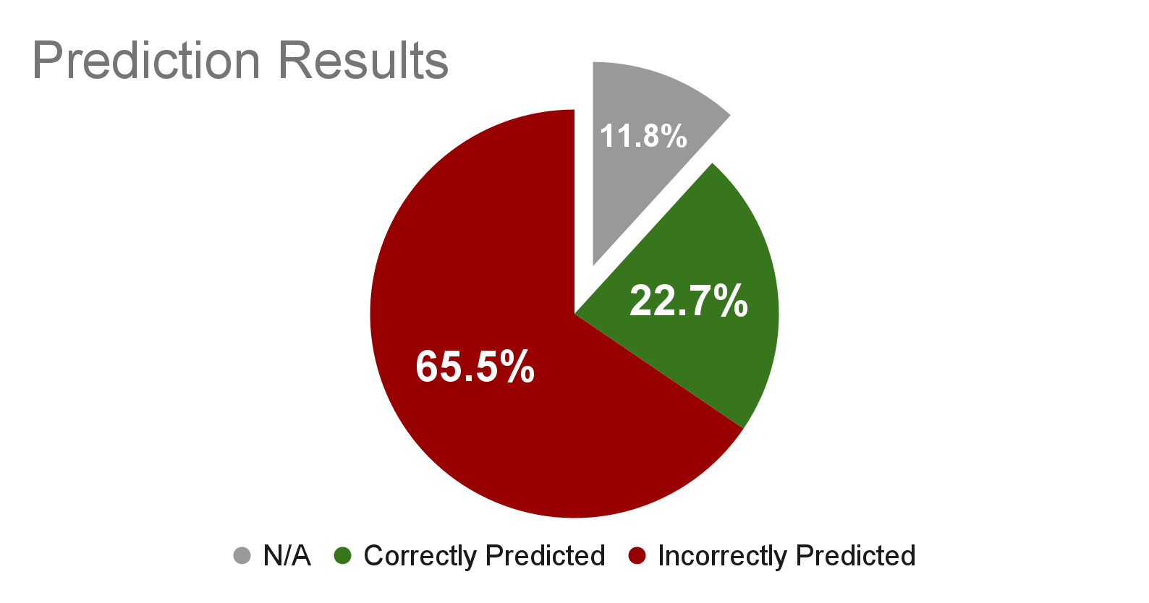


Analysis in Food Emoji Prediction
CSCI 5541
Word Wizards: Danial Syed, Alex Iliarski, Jiayi Huang, Sai Tarun Inaganti
BACKGROUND
RESULTS
CONCLUSIONS
Does ChatGPT understand emojis?
Emojis have become an increasingly prevalent part of digital communication. It is important that we understand the capabilities of modern NLP models to understand and accurately utilize emojis, and also their abilities on sentiment analysis and expression. As such, we strive to analyze ChatGPT’s performance for a narrow and fairly unambiguous situation: using the appropriate food emoji to describe a tweet with the keyword "FOOD," regardless of ChatGPT's approach, either from a objective or subjective perspective.
Too Few Emojis
It is clear that our emoji set of 20 food-related emojis is much too small. There was extreme difficulty in assigning an emoji if none of the emojis fit the tweet particularly well, which was the vast majority of the tweets analyzed. This would cause a lot of human variance for predictions, and ChatGPT would surely struggle to match a particular human’s opinion of which emoji fits best. Conversely, many tweets had multiple emojis that would have fit well, but only one can be chosen.
ChatGPT Struggles to Follow Directions
ChatGPT would often suggest an emoji not listed in our bank of 20 emojis or would list multiple emojis, against our explicit instructions. This demonstrates ChatGPT’s inconsistency and unreliability for this particular strictly-defined task.
Difficult to label: (Above) Could choose 🍬 or 🥧. (Below) No applicable emoji, up to interpretation to choose the best fit in the emoji-bank.
A sample of human vs ChatGPT predictions
The experiment’s results:
Approximately 12% of tweets scraped were not applicable to this experiment, and thus disregarded.
ChatGPT is incorrect 3 times more often than it is correct.
REFERENCES
METHODS
Picture:
https://www.voxco.com/blog/sentiment-analysis-helps-improve-customer-experience/
GPT-3:
https://platform.openai.com/
Snscrape:
https://github.com/JustAnotherArchivist/snscrape
Twitter:
https://twitter.com/
Data Collection
Use snscrape to retrieve 300 food-related tweets
Manually label tweets with a standard set of 20 food emojis
Analysis
Use openAI API to test whether ChatGPT predicts the same emoji as human labellers
ACKNOWLEDGMENTS
This work is the final project of CSCI 5541 of Spring 2023 in University of Minnesota, Twin Cities with the mentorship of Risako Owen, Dongyeop Kang, and Shirley Anugrah Hayati.

