Slide 1
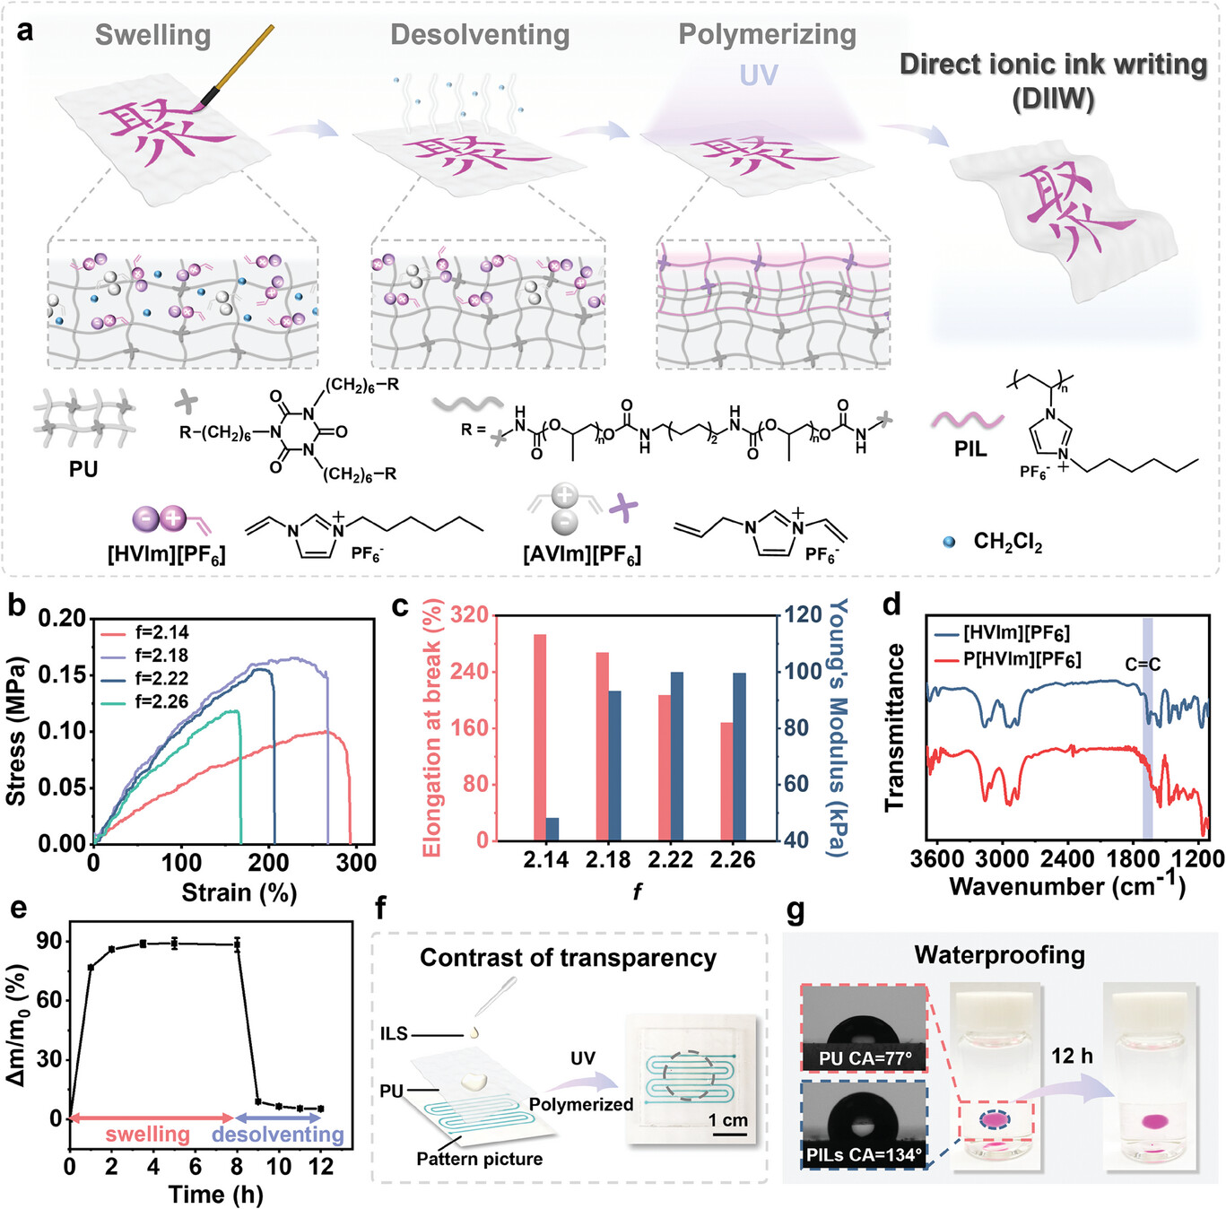
Direct Ionic Ink Writing on and Penetrating into Elastomer for Patternable, Waterproof, and Wear‐Resistant Ionic Circuits
Adv Funct Materials, First published: 27 September 2024, DOI: (10.1002/adfm.202413434)
Notes:
a) Schematic illustration of the direct ionic ink writing (DIIW) and the formation of the interpenetrating networks based on polyurethane (PU) and ionic liquid. b) Stress‐strain curves of PU with different functionality. c) Comparison of Young's modulus and elongation at break of PU with different functionality. d) FT‐IR spectra of the poly(ionic liquids) (PILs) before and after polymerization. e) Swelling and desolventing curves of PU in ILS. f) Comparison of the transparency of PU and PILs‐interpenetrated PU. The serpentine circuit is on the paper under the PU, and the area within the circle of the dashed line is PILs‐interpenetrated PU. g) Photographs of PILs‐interpenetrated PU before and after immersing in water for 12 h. The insets are photographs of the contact angles of water droplets on the surfaces of PU and PILs‐interpenetrated PU.
IF THIS IMAGE HAS BEEN PROVIDED BY OR IS OWNED BY A THIRD PARTY, AS INDICATED IN THE CAPTION LINE, THEN FURTHER PERMISSION MAY BE NEEDED BEFORE ANY FURTHER USE. PLEASE CONTACT WILEY'S PERMISSIONS DEPARTMENT ON PERMISSIONS@WILEY.COM OR USE THE RIGHTSLINK SERVICE BY CLICKING ON THE 'REQUEST PERMISSIONS' LINK ACCOMPANYING THIS ARTICLE. WILEY OR AUTHOR OWNED IMAGES MAY BE USED FOR NON-COMMERCIAL PURPOSES, SUBJECT TO PROPER CITATION OF THE ARTICLE, AUTHOR, AND PUBLISHER.

