Slide 1
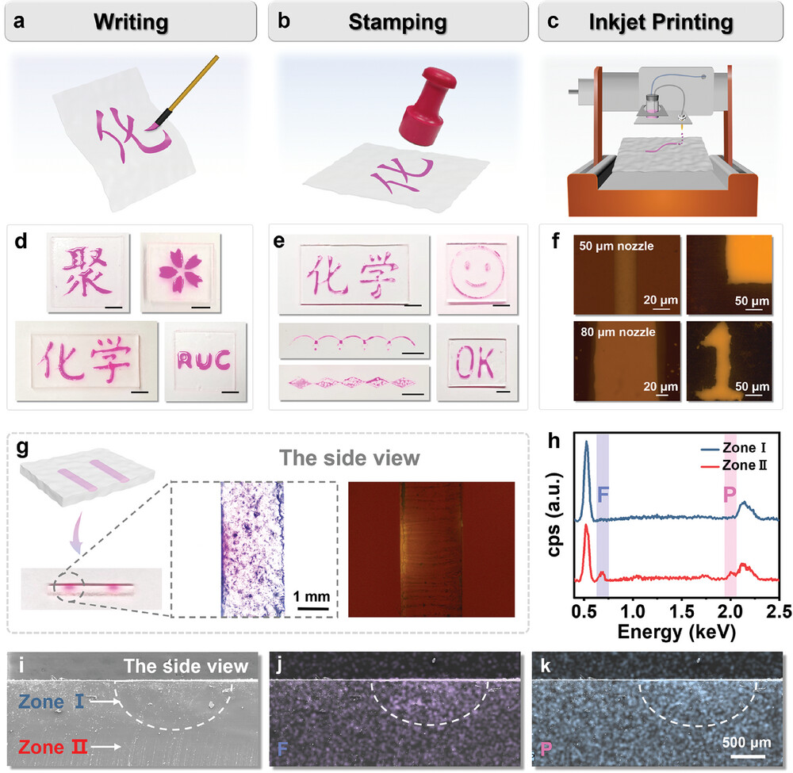
Direct Ionic Ink Writing on and Penetrating into Elastomer for Patternable, Waterproof, and Wear‐Resistant Ionic Circuits
Adv Funct Materials, First published: 27 September 2024, DOI: (10.1002/adfm.202413434)
Notes:
a–f) Illustrations and optical photographs of patterns prepared by writing (a,d, and the left column of f), stamping (b,e), and inkjet printing (c and the right column of f). Black scale bar: 5 mm. g) The cross‐section of the ionic circuit and its optical images of ordinary microscope and fluorescence microscope. h) EDS intensities of fluorine and phosphorus in Zone I and Zone II. i–k) SEM and EDS images of the cross‐section.
IF THIS IMAGE HAS BEEN PROVIDED BY OR IS OWNED BY A THIRD PARTY, AS INDICATED IN THE CAPTION LINE, THEN FURTHER PERMISSION MAY BE NEEDED BEFORE ANY FURTHER USE. PLEASE CONTACT WILEY'S PERMISSIONS DEPARTMENT ON PERMISSIONS@WILEY.COM OR USE THE RIGHTSLINK SERVICE BY CLICKING ON THE 'REQUEST PERMISSIONS' LINK ACCOMPANYING THIS ARTICLE. WILEY OR AUTHOR OWNED IMAGES MAY BE USED FOR NON-COMMERCIAL PURPOSES, SUBJECT TO PROPER CITATION OF THE ARTICLE, AUTHOR, AND PUBLISHER.

