Slide 1
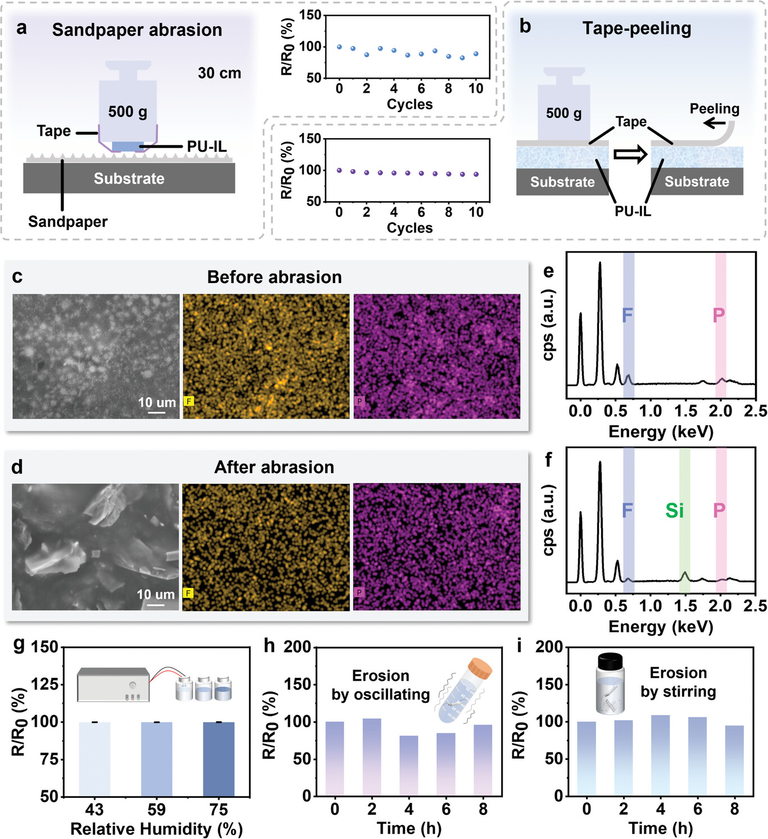
Direct Ionic Ink Writing on and Penetrating into Elastomer for Patternable, Waterproof, and Wear‐Resistant Ionic Circuits
Adv Funct Materials, First published: 27 September 2024, DOI: (10.1002/adfm.202413434)
Notes:
a,b) Diagram and resistance changes of sandpaper abrasion and tape‐peeling. c,d) The SEM and EDS images of the ionic circuit before and after abrasion. e,f) The intensities of elements fluorine and phosphorus before (e) and after (f) sandpaper abrasion. g) Electrical stability of the ionic circuits under conditions of different humidities. h,i) Resistance changes of the ionic circuit under the erosion of water by oscillating and stirring.
IF THIS IMAGE HAS BEEN PROVIDED BY OR IS OWNED BY A THIRD PARTY, AS INDICATED IN THE CAPTION LINE, THEN FURTHER PERMISSION MAY BE NEEDED BEFORE ANY FURTHER USE. PLEASE CONTACT WILEY'S PERMISSIONS DEPARTMENT ON PERMISSIONS@WILEY.COM OR USE THE RIGHTSLINK SERVICE BY CLICKING ON THE 'REQUEST PERMISSIONS' LINK ACCOMPANYING THIS ARTICLE. WILEY OR AUTHOR OWNED IMAGES MAY BE USED FOR NON-COMMERCIAL PURPOSES, SUBJECT TO PROPER CITATION OF THE ARTICLE, AUTHOR, AND PUBLISHER.

