Slide 1
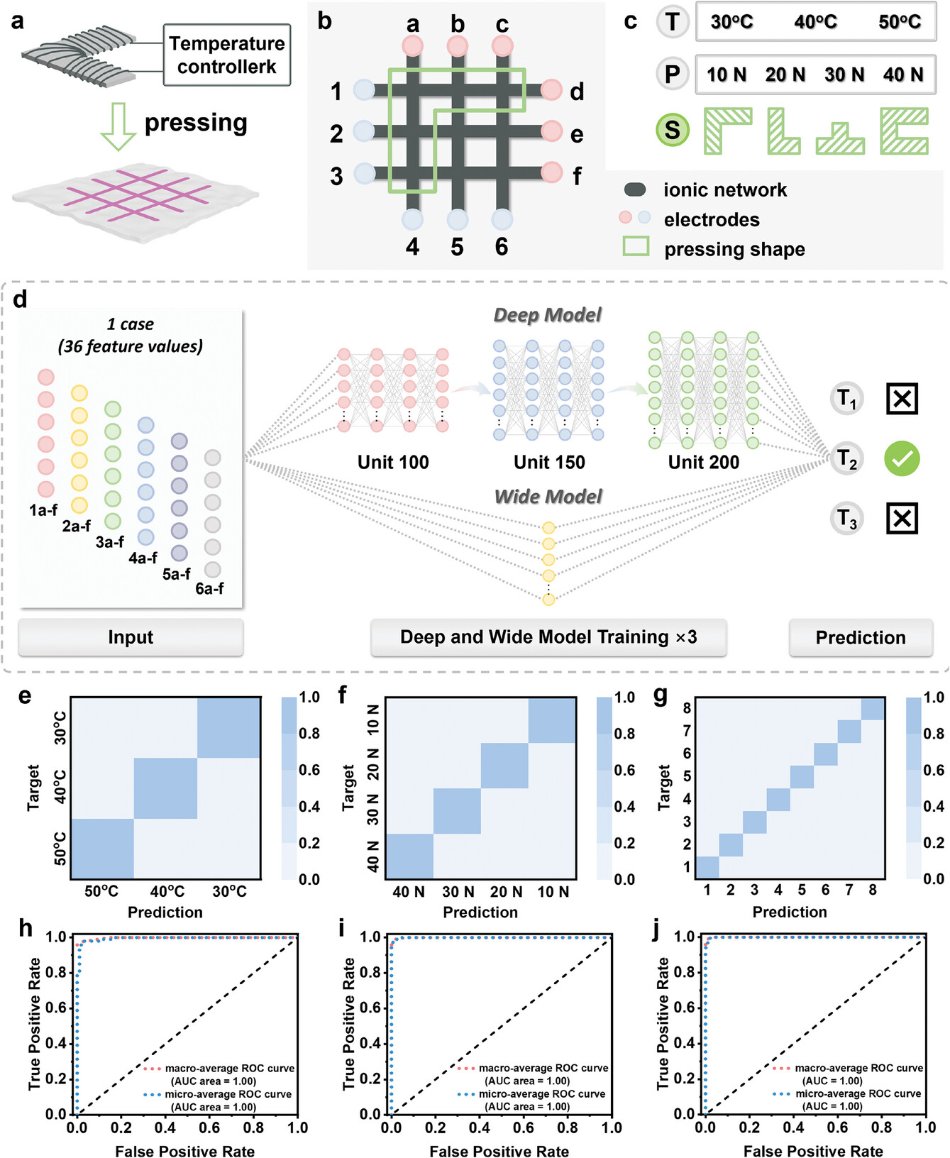
Direct Ionic Ink Writing on and Penetrating into Elastomer for Patternable, Waterproof, and Wear‐Resistant Ionic Circuits
Adv Funct Materials, First published: 27 September 2024, DOI: (10.1002/adfm.202413434)
Notes:
a,b) Schematic diagrams of the test method (a) and the ionic network with electrodes (b). c) Temperatures, pressures, and pressing shapes on the ionic network. d) Schematic diagram illustrating the procedure of electrical signal recognition at different temperatures, pressures, and pressing shapes, including signal input, model training, and prediction. e–g) Confusion matrix of classification results at different temperatures, pressures, and pressing shapes. h–j) The ROC curves and AUC areas of predictions of temperatures, pressures, and pressing shapes, respectively.
IF THIS IMAGE HAS BEEN PROVIDED BY OR IS OWNED BY A THIRD PARTY, AS INDICATED IN THE CAPTION LINE, THEN FURTHER PERMISSION MAY BE NEEDED BEFORE ANY FURTHER USE. PLEASE CONTACT WILEY'S PERMISSIONS DEPARTMENT ON PERMISSIONS@WILEY.COM OR USE THE RIGHTSLINK SERVICE BY CLICKING ON THE 'REQUEST PERMISSIONS' LINK ACCOMPANYING THIS ARTICLE. WILEY OR AUTHOR OWNED IMAGES MAY BE USED FOR NON-COMMERCIAL PURPOSES, SUBJECT TO PROPER CITATION OF THE ARTICLE, AUTHOR, AND PUBLISHER.

