Slide 1

ECE 9013A – Programming for Engineers Final Project
Students: Instructor:
WEICHIH
Seyedmostafa Mirmohammadi Dr. Dimitrios M. Manias
Zhecheng Xie
Heyu Zhong

Slide 2
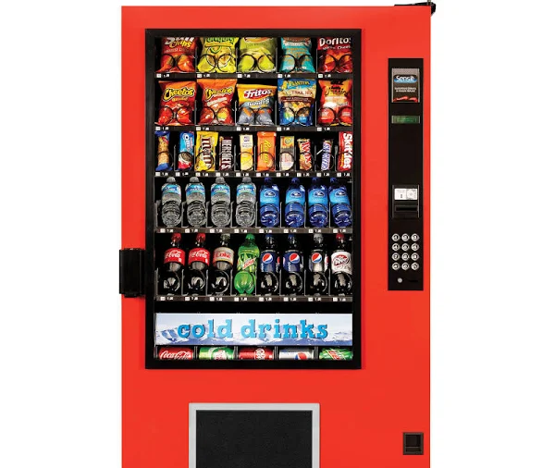
Project Title: vending Machine

Slide 3
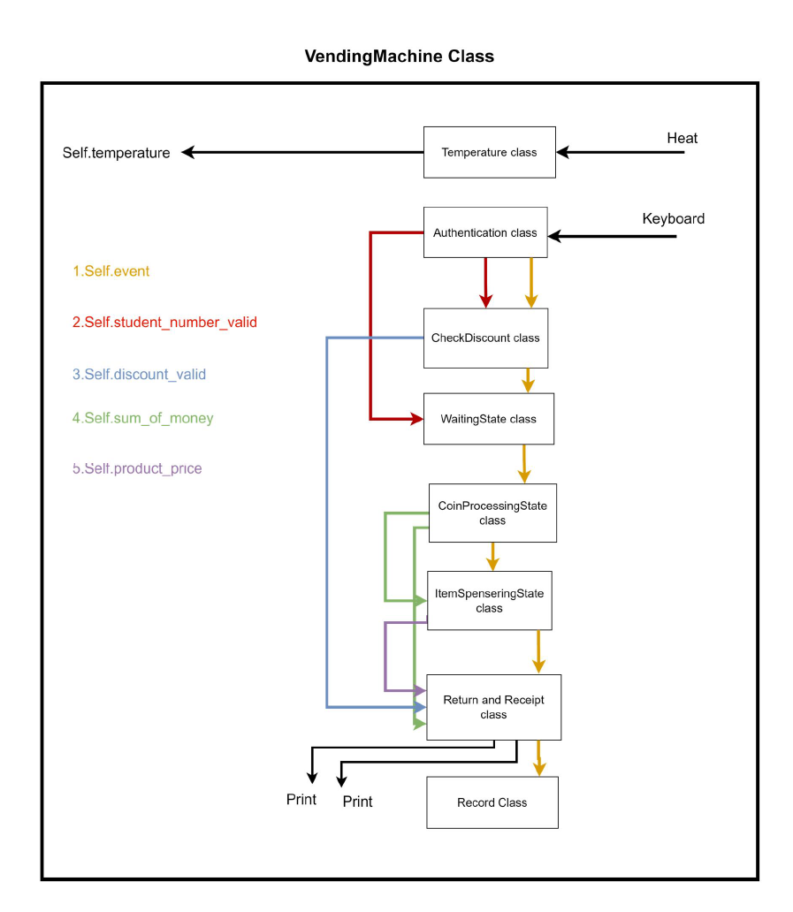
Python-based software-driven vending machine simulation
This Project involves creating a Python-driven vending machine simulation at a university campus, prioritizing student authentication for exclusive access. We replicate real-world vending machine functions, including coin insertion, product selection, and purchase tracking. The solution utilizes a state-based approach, employing separate classes for each state to ensure precision and modular design. Key features include a User-Friendly Interface, Efficient Product Handling, and Temperature Monitoring, aiming to provide a seamless and comprehensive vending experience.

Slide 4
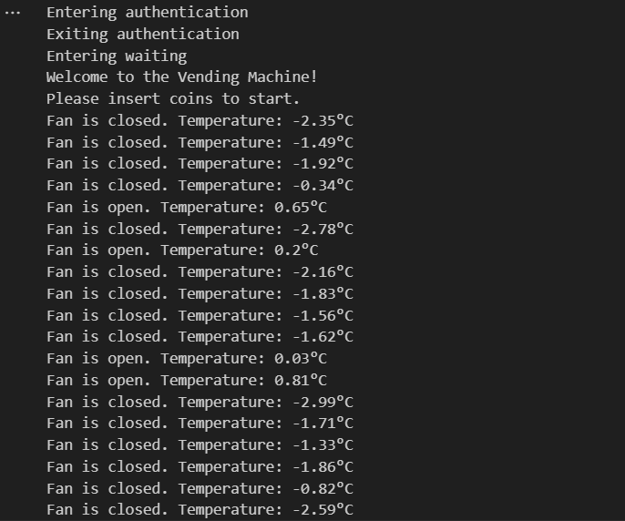
Class TemperatureSensor
class TemperatureSensor:
def __init__(self):
pass
def read_temperature(self):
self.degree=random.uniform(-3, 1)

Slide 5

Class VendingMachine
Initialize various state variables
A foundation for building a versatile and interactive vending machine simulation.
Methods for updating GUI elements, allowing for a user-friendly interface.
Check_temperature method simulates the monitoring of temperature using a sensor.

Slide 6

Class State
The State class serves as a blueprint for different states.

Slide 7
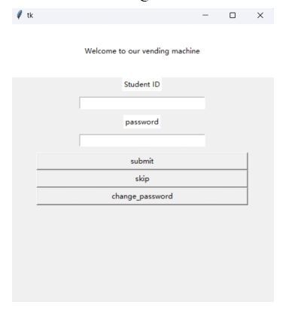
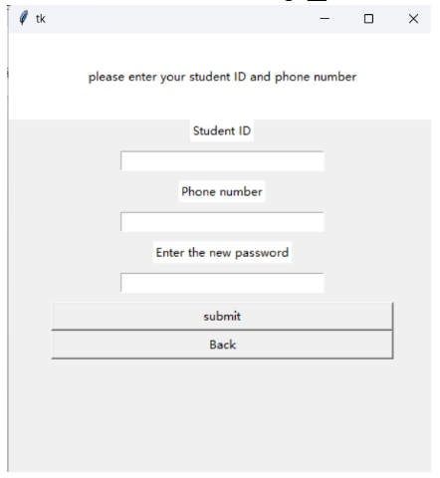
AuthenticationState: User verification and password changes
User verification: This section of our Python simulation authenticates users by verifying the student ID and password entered via the keyboard on the GUI. Users can interact with different buttons to perform specific functions and receive corresponding feedback
Password changes: This section allows users to change their password using their personal information for verification. After the ‘submit’ button is pressed and the information is verfied as correct, the new password will be updated in the database

Slide 8

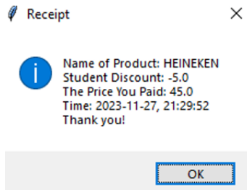

DiscountState: Discount eligibility checks
Following successful login the system automatically evaluates if user qualifies for a discount
Discounts are granted based on the user’s purchase history; an odd-numbered purchase history entitles the user to a discount on the next even-numbered purchase (e.g., if the purchase history is 3, the user would receive a discount on the next purchase).
Once there is a discount eligibility for user, there will be a message on the terminal to inform and the final receipt will detail the discount applied to the purchase

Slide 9
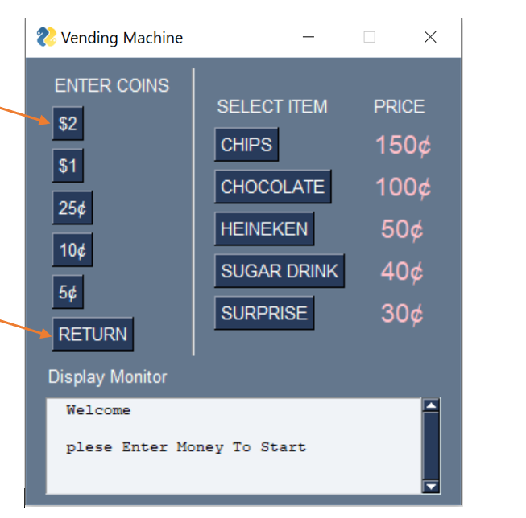
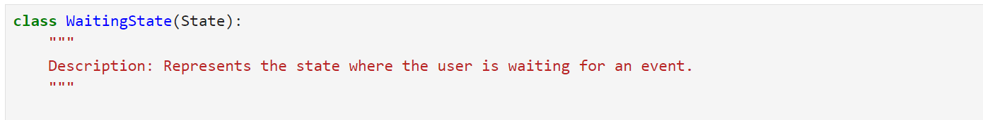

WaitingState: Welcome, Coin Selection, and Easy Cancel
WaitingState in our Python vending simulation guides users with welcoming instructions and enables coin selection on the GUI. Users simulate coin insertion by choosing the corresponding key. They can also press Return to easily cancel and return to the initial state, enhancing user interaction for a seamless experience.

Slide 10
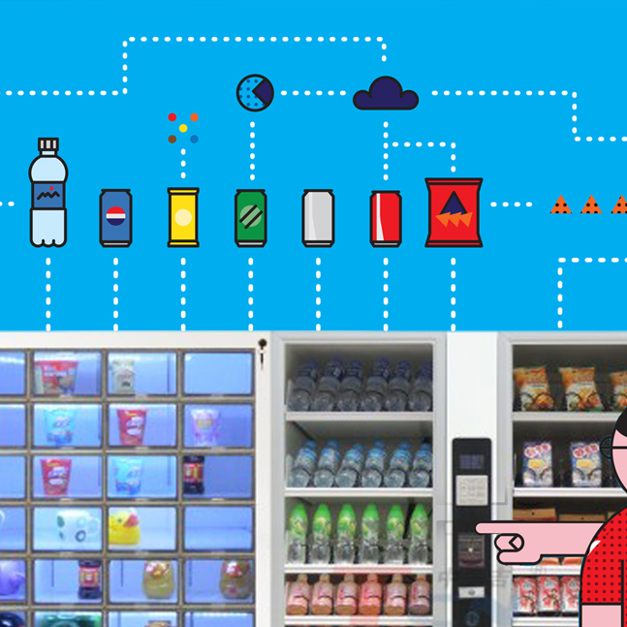
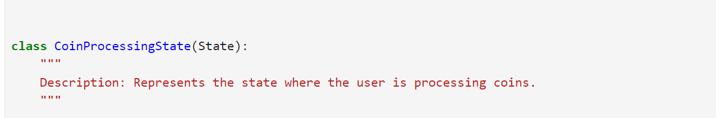
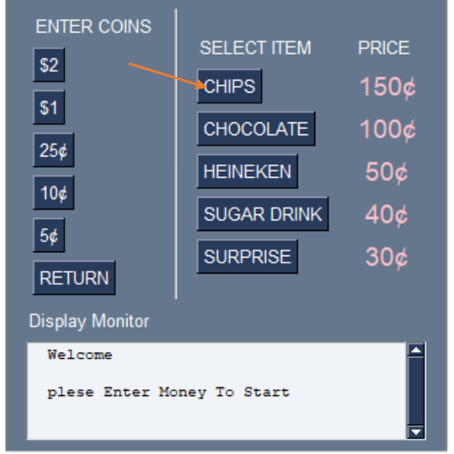
CoinProcessingState: Coin Insertion, Item Selection, and Notifications
CoinProcessingState manages the pivotal phase in our Python vending simulation. It oversees coin insertion and updates the total sum of money in the machine. The state transitions based on user input, progressing to return_and_receipt or delivering. After coin insertion, users can select items on the GUI. Notifications include Money Insufficiency prompts, allowing users to insert more coins, and Sold-out Item indications, highlighting unavailable items in red. In case of selecting a sold-out item, users receive a notification and can make an alternate selection or choose to return. This state ensures a smooth and responsive vending experience.

Slide 11

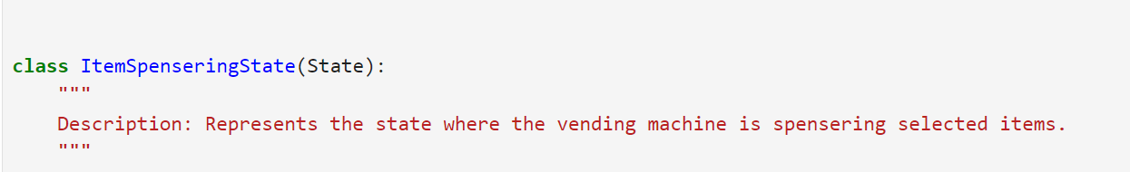
ItemDispensingState: Product Dispensing and Transaction Handling
ItemDispensingState ensures seamless product dispensing. As the machine enters delivering,on_entry initiates item processing via process_selection. The update method manages user input, transitioning to return_and_receipt or continued selection. Users can press "Return" for a refund or proceed. process_selection validates and processes the selected item, ensuring a smooth transition. process_item handles intricate details, guaranteeing a reliable vending experience by dispensing products as intended.

Slide 12
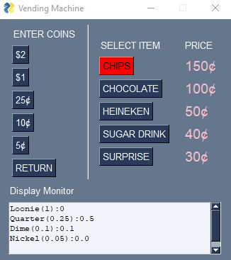
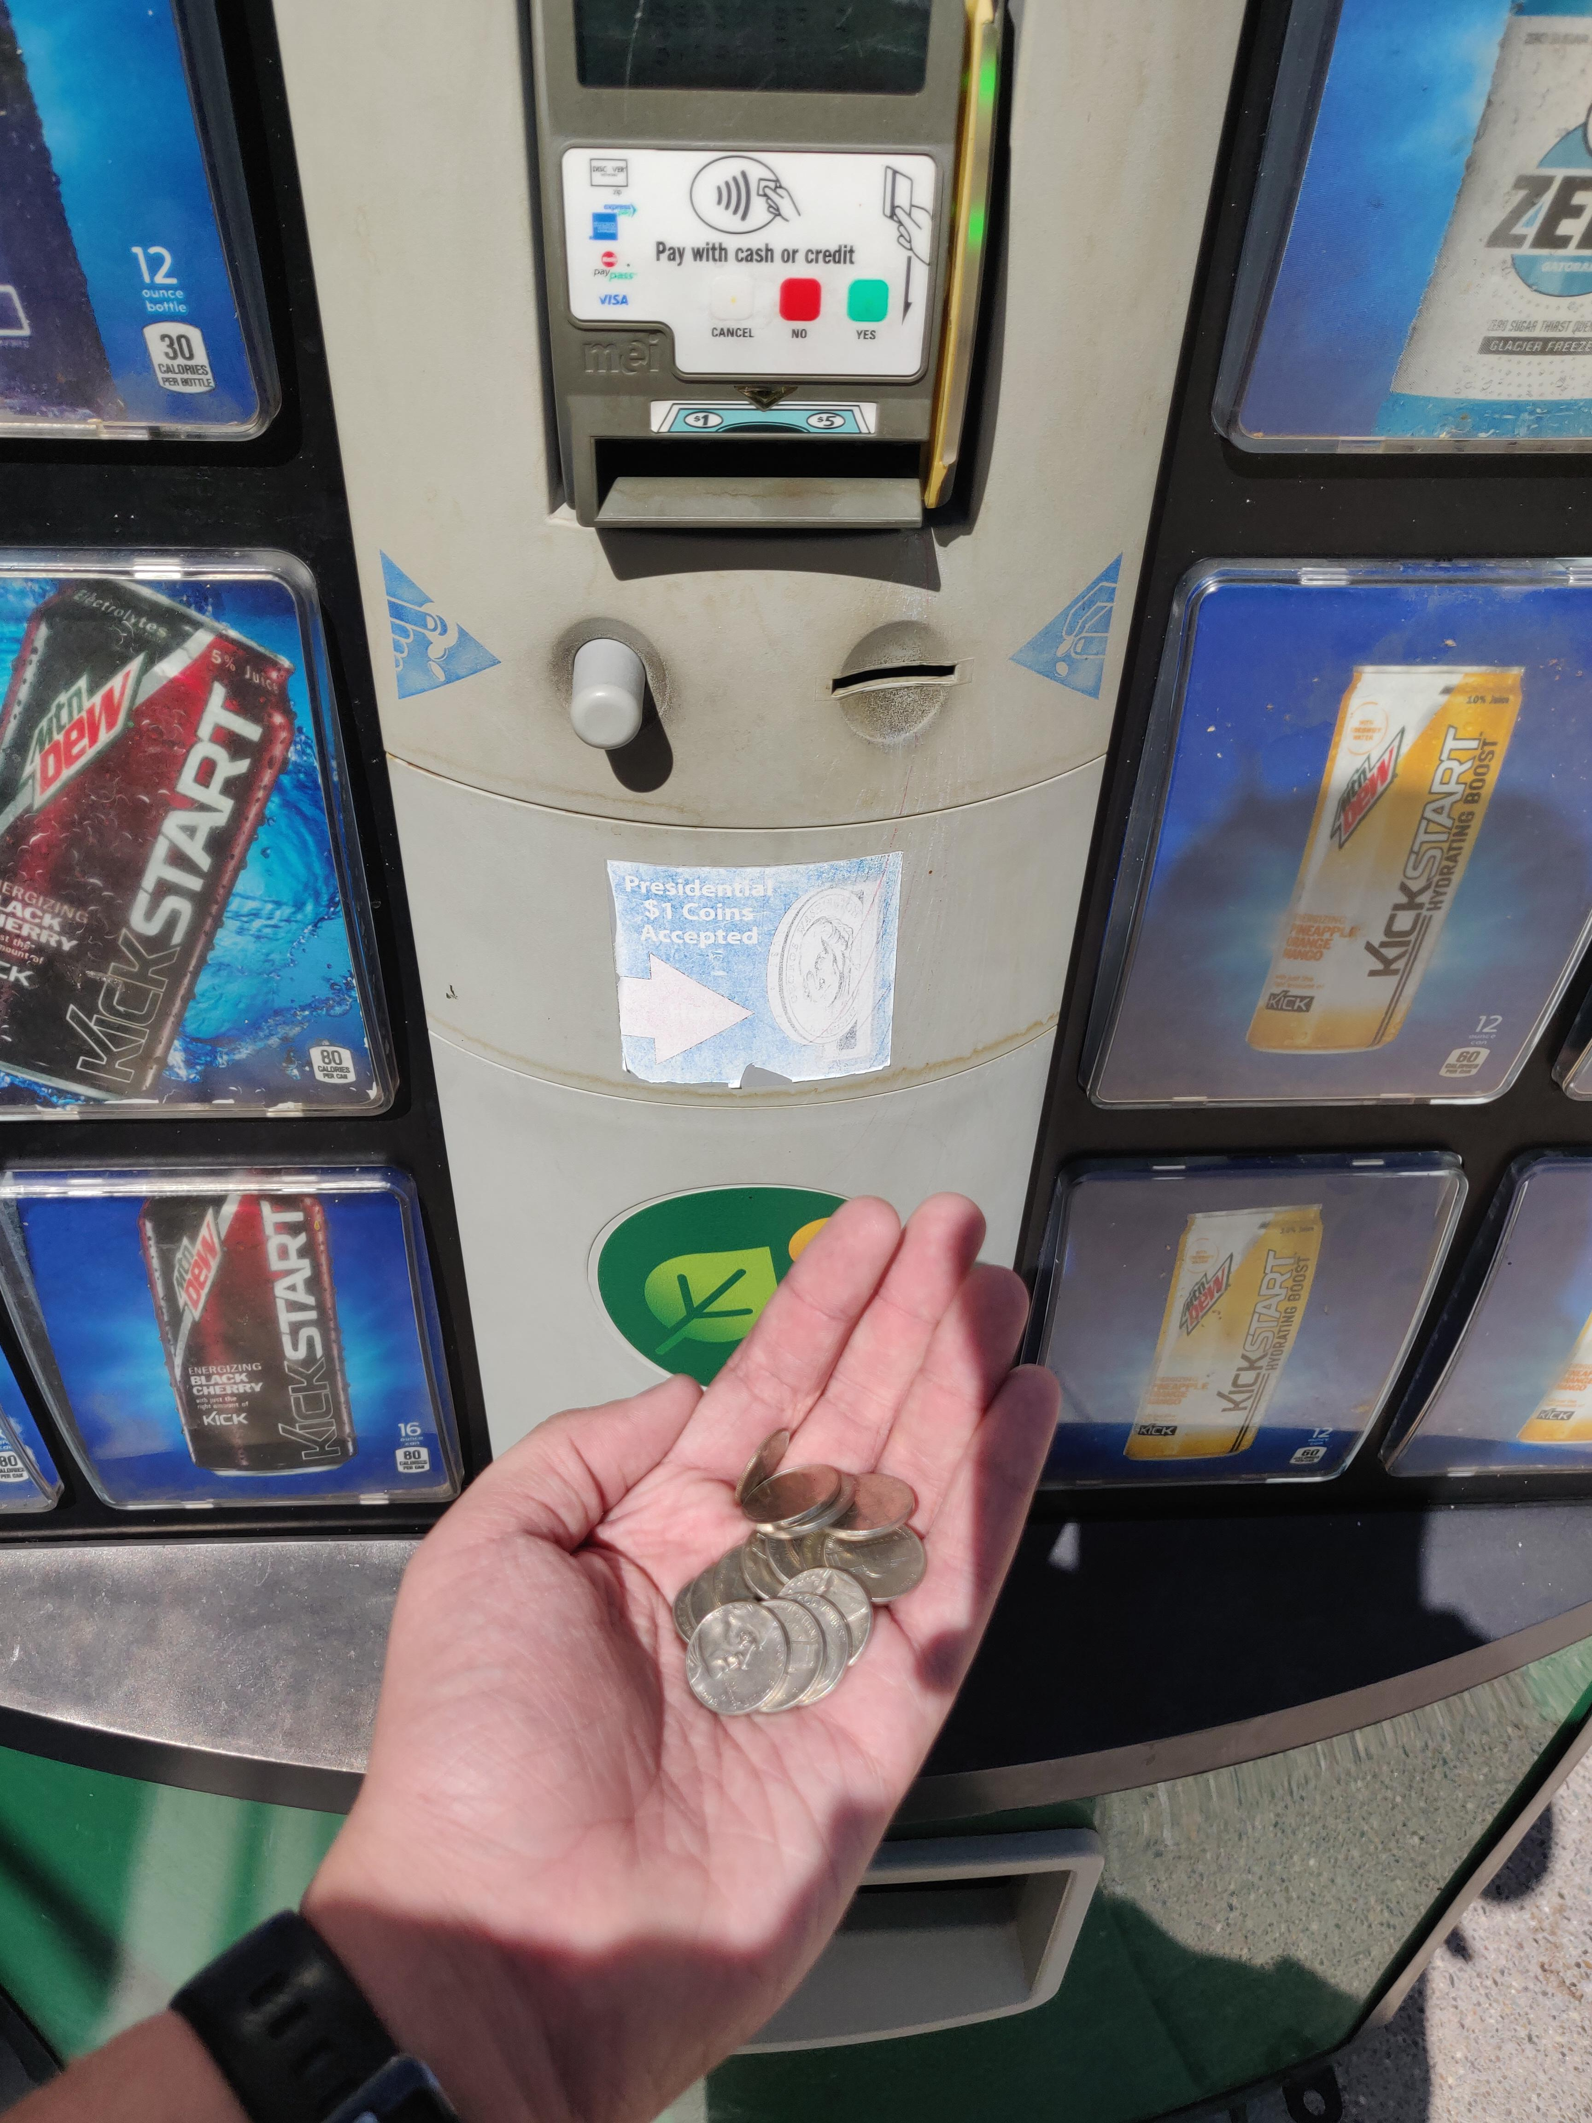
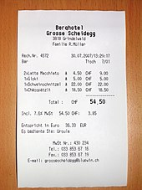
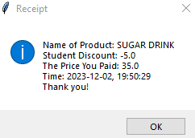
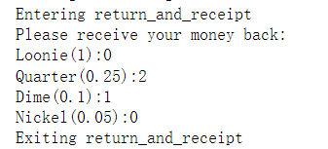
Return Coin & Receipt

Slide 13


Description of methods
1
It determines the max number of one returned coin.
2
It uses returnCoin method to print all returned coins.
3
Method for receipt issuing

Slide 14
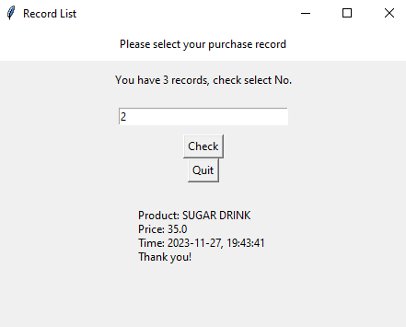
Record GUI
Enter a number here!
Check that record
Leave this page,
return to the login state
Related Record

Slide 15
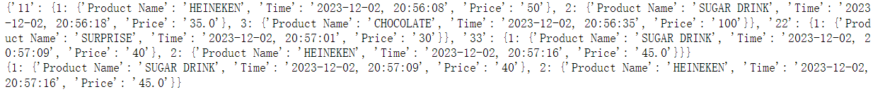



Description of methods
Purchase record dictionary for a student “11”:
Stored in
Entire record dictionary for all students
1
2
3
Add a record (After one purchase
View a student’s record
Create GUI

