Slide 1

Bangalore Institute of Technology
Department of Artificial Intelligence & Machine Learning
K.R. Road, V.V.Pura, Bengaluru-560004
Advanced Machine Learning(18AI72)
Mini Project on
“Stock Price Prediction Using Machine Learning”
Presented by
Batch No - 6
Dhananjay Kumar 1BI20AI009
Harshil Pathria 1BI20AI016

Slide 2
Contents
INTRODUCTION
PROBLEM STATEMENT
PROPOSED METHODOLOGY
SYSTEM REQUIREMENTS
ARCHITECTURE
MODULE DESCRIPTION

Slide 3
Introduction
In the realm of financial markets, accurate predictions of stock price movements play a pivotal role in guiding investment strategies. This project employs advanced predictive modeling techniques to forecast stock prices based on historical data, market trends, and pertinent economic indicators.
By analyzing historical stock movements and integrating diverse market factors, this predictive model aims to anticipate potential future price trends. Such insights serve as valuable tools for investors, enabling them to gauge potential market directions, manage risks, and make informed decisions about buying or selling stocks.
This predictive approach offers investors a comprehensive view of potential price movements, aiding in strategic planning and decision-making within the ever-evolving landscape of financial markets.

Slide 4
Literature Survey
Si. No. | Paper title, Name of Journal , Year of Publication, Authors | Proposed Idea | Gap in literature
1 2 | S&P 500 STOCK PRICE PREDICTION USING TECHNICAL,FUNDAMENTAL AND TEXT DATA International Journal of Computer Science and information technologies,Vol.3 Shan ZhongDavid B. HitchcockSeptember 27, 2021 Predicting Stock Prices Using Machine Learning Techniques Journal of Financial Analytics Author Name & Year: Smith, J. et al. (2018) | predictive models used for stock price prediction and combined them fundamental characteristics and text-based sentiment data to predict S&P stock prices used random forest algorithm Explores the application of machine learning techniques in predicting stock prices. Utilizing a diverse dataset of historical stock data, the study employs regression analysis, neural networks, and ensemble methods. | The paper does not thoroughly address the challenge of real-time adaptability to unforeseen market dynamics and external factors, potentially limiting its applicability in dynamic and rapidly changing financial environments. The study relies on historical data and assumes that past patterns will repeat, which might not account for unforeseen market events.The complexity of machine learning models used might hinder interpretability, impacting the transparency of predictions.

Slide 5
Literature Survey
Si. No. | Paper title, Name of Journal , Year of Publication, Authors | Proposed Idea | Gap in literature
3 4 | Deep Learning Models for Stock Price Forecasting: A Comparative Analysis International Journal of Financial Engineering Chen, L. et al. (2020) Ensemble Learning Approaches for Stock Price Prediction: A Comparative Study Journal of Financial Analytics and Decision Making Wang, Q. et al. (2021) | This study conducts a comparative analysis of deep learning models, including Long Short-Term Memory (LSTM) networks and Gated Recurrent Units (GRUs), for stock price forecasting. Used various ensemble learning approaches, including bagging and boosting techniques, are systematically compared for their effectiveness in stock price prediction. | The study is constrained by the availability and completeness of historical data, potentially limiting the model's ability to adapt to rapidly changing market conditions. The study is constrained by the inherent unpredictability of financial markets, and historical data might not fully capture rapidly changing market dynamics.

Slide 6
Literature Survey
Si. No. | Paper title, Name of Journal , Year of Publication, Authors | Proposed Idea | Gap in literature
5 | Survey of feature selection and extraction techniques for stock market prediction", published in Financial Innovation Htet Htet Htun, Michael Biehl, and Nicolai Petkov, 2023 | survey presents a detailed analysis of 32 research works that use a combination of feature study and machine learning approaches in various stock market applications. The authors conduct a systematic search for articles in the Scopus and Web of Science databases for the years 2011–2022. | authors observed that only two papers studied an ensemble feature selection approach, which is a combination of three feature selection methods, whereas most existing studies employ a single approach for selecting critical features. They also observed that most studies considered either basic features or technical or fundamental indicators.

Slide 7
Problem Statement
Develop a predictive model leveraging historical stock data to forecast future price movements, empowering investors with insights for informed decision-making in financial markets.

Slide 8
Proposed Methodology
Develop a robust stock price prediction system leveraging the Random Forest Classifier to forecast future price movements based on historical data.
By employing data preprocessing and businesses gain insights into distinct customer groups.
This facilitates targeted strategies, resource optimization, and improved customer satisfaction, offering a general solution for data-driven decision-making in various industries.

Slide 9
System requirements
Hardware Requirements:
-CPU : Processor i5 or more
-RAM : 8GB
-Operating System
Software Requirements:
-Jupyter Notebook
-Anaconda Navig
-Python 3.8

Slide 10
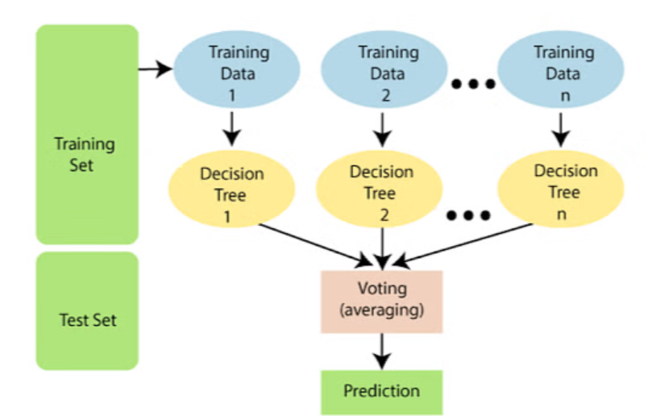
Architecture

Slide 11
1. Customer data: It typically includes demographic information, purchase history, and behavioral attributes, providing businesses with valuable insights into customer preferences and trends. Analyzing this data enables personalized marketing strategies and enhances overall customer experience.
2. Data Preprocessing: Cleanse and transform customer data, handling missing values and preparing it for analysis.
3. Understanding the Dataset: Explore the dataset to grasp its characteristics, distributions, relationships between features, and target variable. Visualizations and statistical summaries help in this analysis.
4.Splitting Data: Divide your dataset into training and testing sets to evaluate the performance of the RandomForestClassifier.

Slide 12
Module Description
Data Ingestion Module:
-Responsibility: Retrieve data from diverse sources (databases, APIs) and load it into the system for further processing.
Data Preprocessing Module:
-Responsibility: Clean, transform, and normalize incoming data. Handle missing values, encode categorical variables, and prepare the data for feature selection and model training.
Feature Selection Module:
-Responsibility: Enable users or the system to select relevant features for classification. Extract chosen features from the preprocessed dataset to enhance model performance.

Slide 13
Random Forest Classifier Module:
-Responsibility: Implement the Random Forest Classifier algorithm for predictive modeling and classification tasks based on the selected features.
Model Evaluation Module:
-Responsibility: Assess the performance of the trained Random Forest Classifier using metrics like accuracy, precision, recall, F1-score, and ROC-AUC.
Hyperparameter Tuning Module:
-Responsibility: Fine-tune the Random Forest Classifier's hyperparameters (such as the number of trees, max depth) to optimize its predictive power.
Result Analysis Module:
-Responsibility: Analyze the outcomes of the Random Forest Classifier's predictions. Evaluate the importance of features in classification and interpret model decisions.
Iterative Improvement Module:
-Responsibility: Establish a feedback loop for continuous enhancement. Incorporate user feedback, adapt to evolving data patterns, and update the classifier or strategies iteratively for improved performance.

Slide 14
Strategy Formulation Module:
-Responsibility: Develop actionable strategies based on the classifier's predictions and insights. Collaborate with domain experts to devise effective plans leveraging the classification outcomes.
Resource Allocation Optimization Module:
-Responsibility: Optimize resource allocation (budget, manpower) considering the classifier's predictions and identified patterns in data.
Implementation and Monitoring Module:
-Responsibility: Implement the formulated strategies in business operations based on classifier predictions. Continuously monitor the effectiveness of implemented strategies.
Customer Experience Enhancement Module:
-Responsibility: Tailor strategies and services based on classifier outcomes to enhance the overall customer experience and satisfaction.
Decision-Making Support Dashboard Module:
-Responsibility: Develop a dashboard presenting insights from the classifier's predictions, aiding stakeholders in strategic decision-making.

Slide 15
Thank You

