Slide 1

MSc DATA SCIENCE PROJECT
Predicting Chemical Bioconcentration in Fish
Using Machine Learning for Environmental Risk Assessment
Comparing Logistic Regression, Random Forest and XGBoost as hazard-screening classifiers on the QSAR fish bioconcentration dataset
Danushmathi Pathmanaban
M.Sc. Data Science Student • Student ID: 23072008
GitHub: https://github.com/DANUSHMATHI2002/Final-Project_Predicting-Chemical-Bioconcentration-in-Fish-Using-Machine-Learning.git
7PAM2002 – Data Science Project
Title
1

Slide 2

SECTION 01
Introduction
Motivation
Research Question
Bioconcentration Factor (BCF) tests are essential for chemical safety regulation (REACH, GHS)
But real BCF testing costs €35,000+ and needs 100+ fish per compound
Machine learning on molecular descriptors offers a cheap, animal-free screening alternative (the “3Rs” principle - Replacement, Reduction, Refinement)
Fast, accurate classifiers could flag hazardous chemicals early — before costly lab testing
Which machine learning model - Logistic Regression, Random Forest, or XGBoost - best detects potentially hazardous chemicals from the QSAR fish bioconcentration dataset, judged by F1-score?
How do the three models differ in trading off recall (catching true dangers) against precision (avoiding false alarms)?
7PAM2002 – Data Science Project
Introduction
2

Slide 3

SECTION 02
Related Work
Grisoni et al. (2016)
Kobayashi & Yoshida (2021)
Pore et al. (2024)
Environment International
Ecological Informatics
Journal of Hazardous Materials
Dataset: 779 chemicals (the dataset used in this project)
Algorithm: CART decision trees
Result: ~ 0.75 accuracy
Conclusion: Simple trees can also reveal why a chemical is dangerous
Dataset: 522 chemicals
Algorithm: Gradient Boosting vs. Linear Regression vs. SVM
Result: Boosting far more accurate (R² = 0.92 train / 0.86 test)
Conclusion: Tree-based boosting beats simple regression
Dataset: 575 chemicals
Algorithm: q-RASAR (similarity search + ML)
Result: Beat standard ML prediction alone
Conclusion: Combining similarity search with ML improves accuracy
All three studies found the same thing: tree-based models beat simple linear models. That's why this project compares Logistic Regression, Random Forest, and XGBoost directly.
7PAM2002 – Data Science Project
Related Work
3

Slide 4

SECTION 03
My Approach & the Gap It Fills
What prior work did
What this project does
Grisoni only tested one simple model — never compared it against stronger options.
Kobayashi and Pore predicted a raw number (BCF value) - not a simple "safe or dangerous" answer.
None of them dealt with the fact that dangerous chemicals heavily outnumber safe ones in the data
Classify samples as Dangerous or Safe (binary hazard classification).
Use a leak-free pipeline: StandardScaler → SMOTE → Classifier.
Refit the pipeline in every CV fold to prevent data leakage.
Compare LR, RF, and XGBoost models. Use GridSearchCV to find the best model based on the F1 score.
Evaluate precision and recall to support regulatory decisions.
Aquatox AI Dashboard
Real-time chemical hazard prediction.
Binary classification (Safe / Dangerous).
Confidence score for each prediction.
Explainable AI (prediction explanation).
Easy-to-use interactive interface.
7PAM2002 – Data Science Project
Approach
4

Slide 5

SECTION 04
Dataset
QSAR Bioconcentration Classes Dataset — UCI Machine Learning Repository
Tabular .csv file, 779 rows × 9 continuous molecular descriptors + 1 categorical target
Target: 3-class bioconcentration category (Class 1/2/3), collapsed to binary Dangerous / Safe
Compiled by Grisoni et al. (Univ. Milano-Bicocca) from literature published 1990–2015
DOI: 10.24432/C56S46 — archive.ics.uci.edu/dataset/510
The 9 molecular descriptors
nHM — heavy atom count
piPC09 — molecular path count
PCD — path / cluster ratio
X2Av — valence connectivity
MLOGP — fat-water partition
ON1V — overall valence index
N-072 — N-fragment count
B02[C-N] — C–N pair (dist. 2)
F04[C-O] — C–O pairs (dist. 4)
779
9
0
Chemicals
Molecular
descriptors
Missing
values
7PAM2002 – Data Science Project
Dataset
5

Slide 6


SECTION 05
Ethical Considerations
No personal or human data
Purely chemical / molecular descriptor data — no individuals involved
Public, open-access source
UCI Machine Learning Repository — freely licensed for research use
Non-identifiable & non-sensitive
No confidential, commercial, or personal information of any kind
Secure, standard storage
Stored locally and in a version-controlled GitHub repository
Supports the 3Rs principle
Reusing existing BCF data reduces the need for new animal testing (Replacement, Reduction, Refinement)
7PAM2002 – Data Science Project
Ethics
6

Slide 7

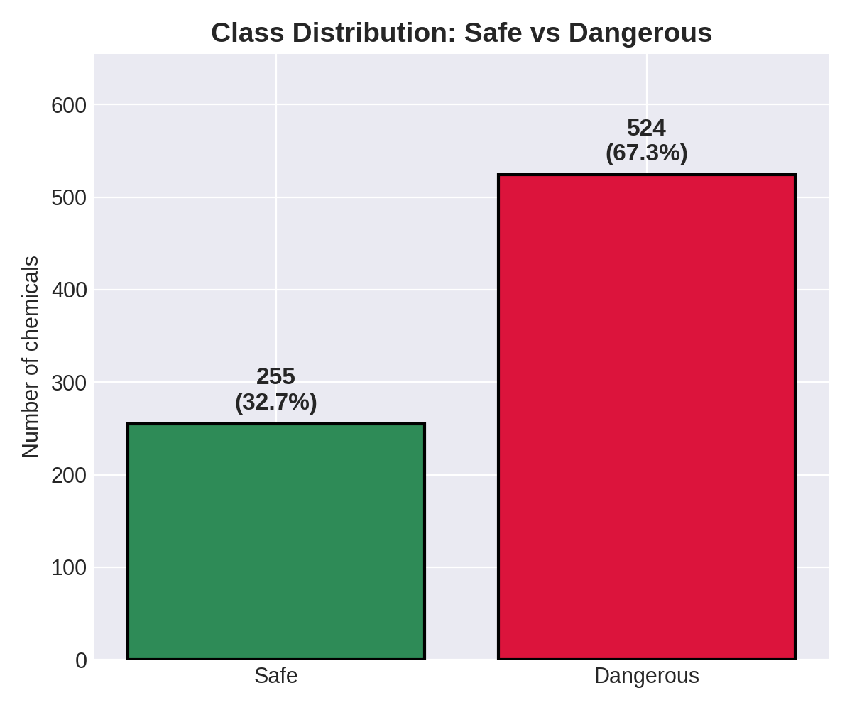
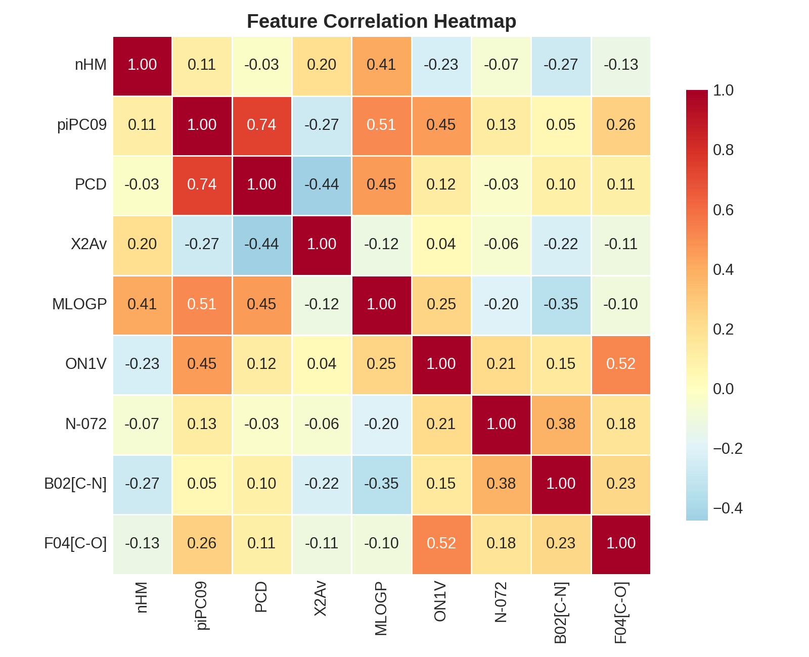
SECTION 06
Exploratory Data Analysis
Key insights
67.3% Dangerous vs 32.7% Safe → class imbalance
→ F1 / recall prioritised over accuracy
Only piPC09 ↔ PCD strongly correlated (r=0.74)
No features removed
No missing values; wide feature ranges → scaling required
7PAM2002 – Data Science Project
EDA
7

Slide 8

SECTION 07
Data Pre-processing
Stratified 80 / 20 train-test split → 623 training / 156 test chemicals
Same Safe : Dangerous ratio preserved in both sets
No missing values — 0 missing across all 779 chemicals, so no imputation needed
Outlier check (IQR method) on all 9 descriptors — very few found, kept deliberately (real chemicals, not data errors)
Feature scaling (StandardScaler) — puts all 9 descriptors on the same scale (zero mean, unit variance), since raw ranges vary hugely
Class balancing (SMOTE) — dataset is 67% Dangerous vs 33% Safe, so SMOTE creates synthetic Safe examples; applied to training data only
Raw
data
→
Train /
Test split
→
Standard
Scaler
→
SMOTE
(train only)
→
Classifier
Zero data leakage — Scaler + SMOTE are refit inside every one of the 5 cross-validation folds
Pipeline refit independently inside every 5-fold cross-validation split
7PAM2002 – Data Science Project
Pre-processing
8

Slide 9

SECTION 08
Models & Method
Logistic Regression
All models share one fair, leak-free procedure:
Linear decision boundary; interpretable coefficients / odds ratios
Tuned: C, penalty (L1 / L2)
pipe = Pipeline([
('scaler', StandardScaler()),
('smote', SMOTE()),
('clf', classifier)])
cv = StratifiedKFold(n_splits=5)
search = GridSearchCV(
pipe, param_grid,
scoring='f1', cv=cv)
search.fit(X_train, y_train)
Random Forest
Ensemble of decision trees voting on the outcome
Tuned: n_estimators, max_depth, min_samples_leaf, max_features
XGBoost
Sequential boosted trees, each correcting the last one's errors
Tuned: n_estimators, max_depth, learning_rate, subsample, colsample_bytree
7PAM2002 – Data Science Project
Models
9

Slide 10
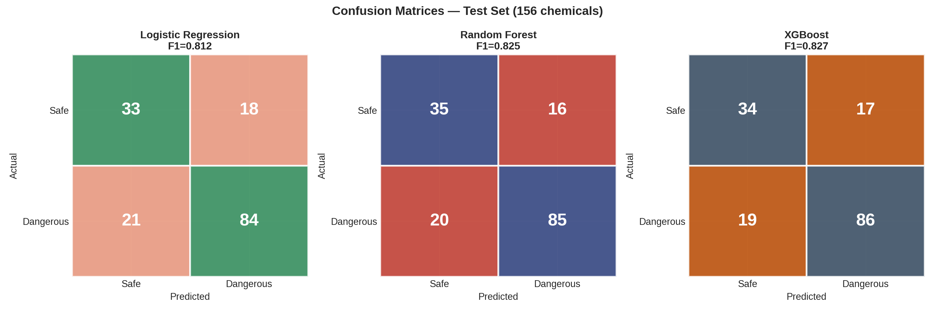
SECTION 09
Model Results
Model | Accuracy | Precision | Recall | F1-score | ROC-AUC
Logistic Regression | 0.750 | 0.824 | 0.800 | 0.812 | 0.748
Random Forest | 0.769 | 0.842 | 0.810 | 0.825 | 0.823
XGBoost | 0.769 | 0.835 | 0.819 | 0.827 | 0.817
7PAM2002 – Data Science Project
Results
10

Slide 11

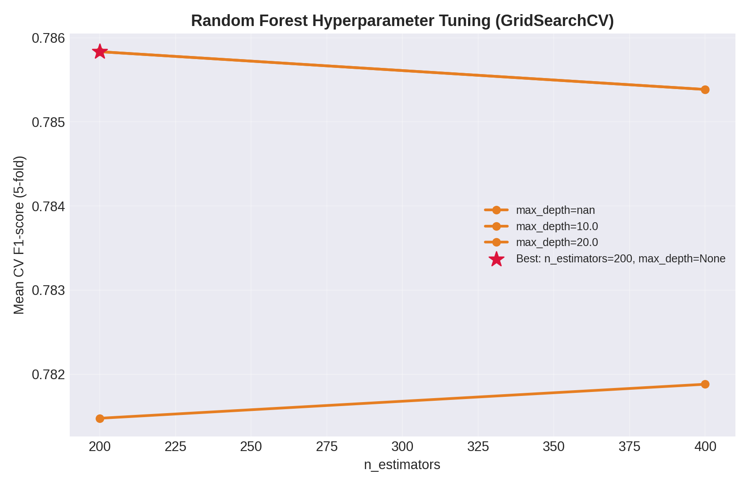
SECTION 10
Hyperparameter Tuning
Best configuration per model (GridSearchCV, 5-fold, scored on F1)
Logistic Regression
C = 1, penalty = L1
Random Forest
n_estimators = 200, max_depth = None, min_samples_leaf = 2, max_features = sqrt
XGBoost
n_estimators = 200, max_depth = 5, learning_rate = 0.1, subsample = 0.8
Not every combination is exhaustively searched — for Random Forest alone the grid covers 2×3×3×1 = 18 settings × 5 folds = 90 fits.
Chart shows Random Forest's tuning process as an example — all three models were tuned the same way via GridSearchCV.
7PAM2002 – Data Science Project
Hyperparameter Tuning
11

Slide 12

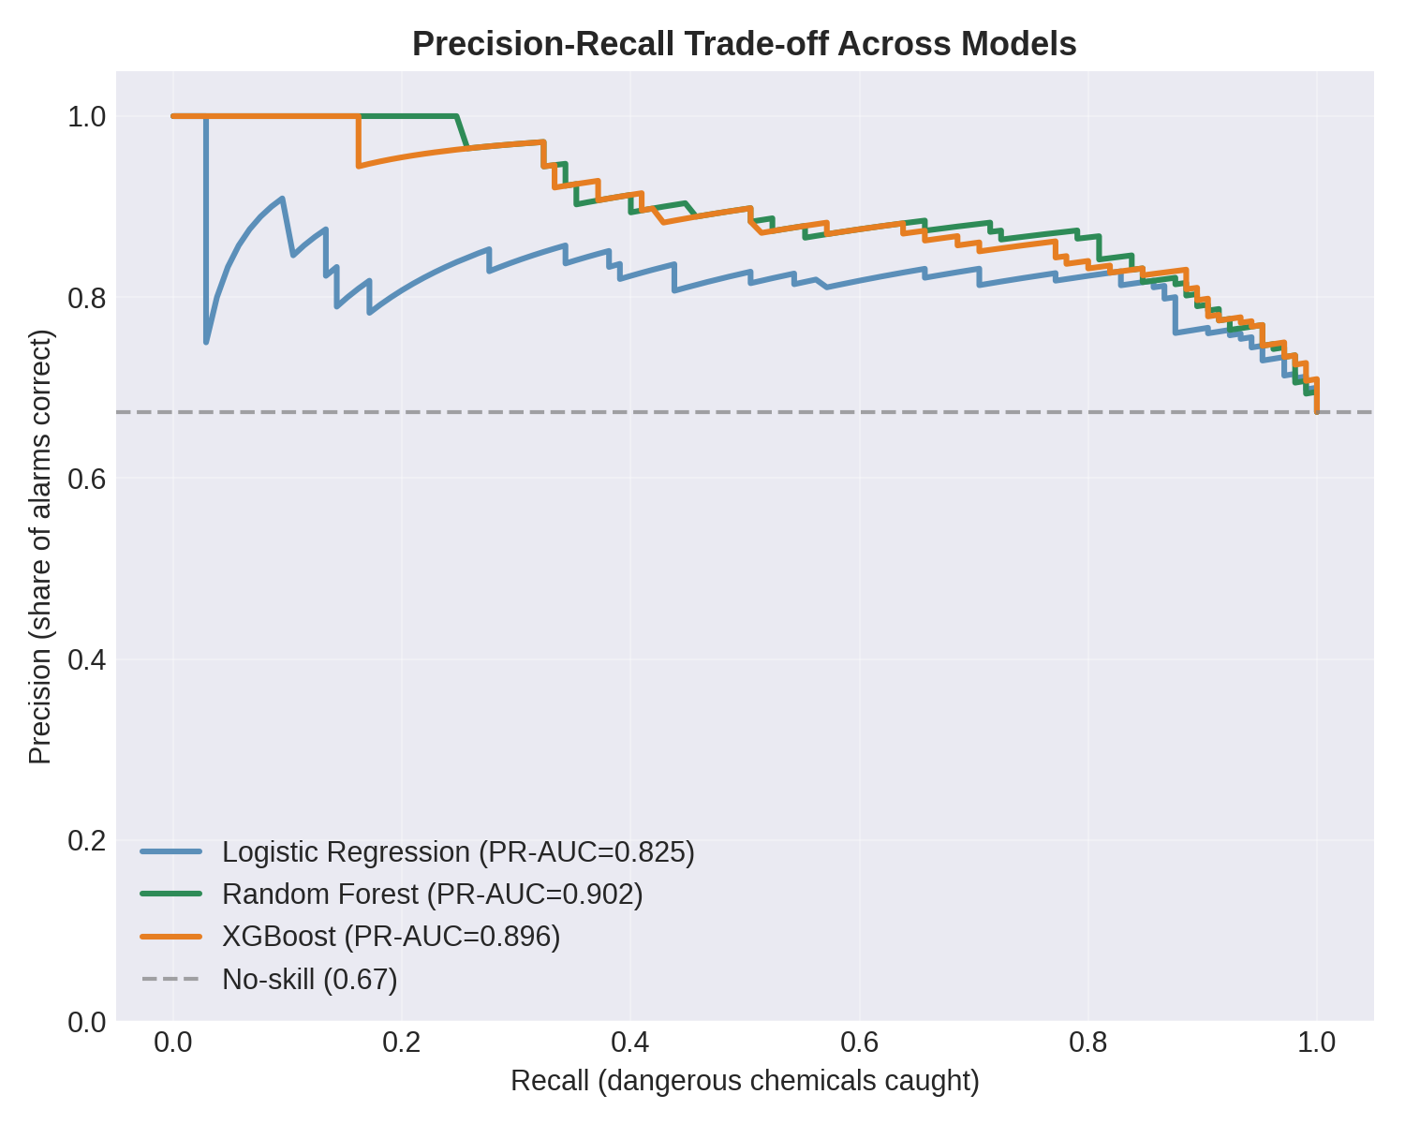
SECTION 11
Analysis & Interpretation
All three models performed much better than the 67% no-skill baseline.
XGBoost achieved the highest F1 score (0.827).
Random Forest achieved the best ROC-AUC (0.823) and PR-AUC (0.902).
Logistic Regression also performed well (F1 = 0.812) and is easy to interpret using odds ratios.
Reducing XGBoost's decision threshold (0.50 → ~0.40) increases recall and improves the F1 score.
For environmental screening, higher recall is preferred because missing a dangerous chemical is more serious than a false alarm
7PAM2002 – Data Science Project
Analysis
12

Slide 13

SECTION 12
Summary & Conclusions
Applied Logistic Regression, Random Forest and XGBoost to classify 779 chemicals as Dangerous or Safe from 9 molecular descriptors
XGBoost achieved the best F1-score (0.827); Random Forest was a close second with the best ROC-AUC (0.823)
With hyperparameter tuning (GridSearchCV, F1-scored), tuned XGBoost - 200 trees, depth 5, learning rate 0.1 - is the best overall result.
Tree-based models (Random Forest, XGBoost) suit this problem better than simple linear models.
For chemical safety screening, catching dangerous chemicals matters more than raw accuracy — so the model's decision threshold can be tuned to prioritise recall..
These results support using ML as an early, low-cost screening step before expensive lab-based BCF testing
7PAM2002 – Data Science Project
Summary
13

Slide 14
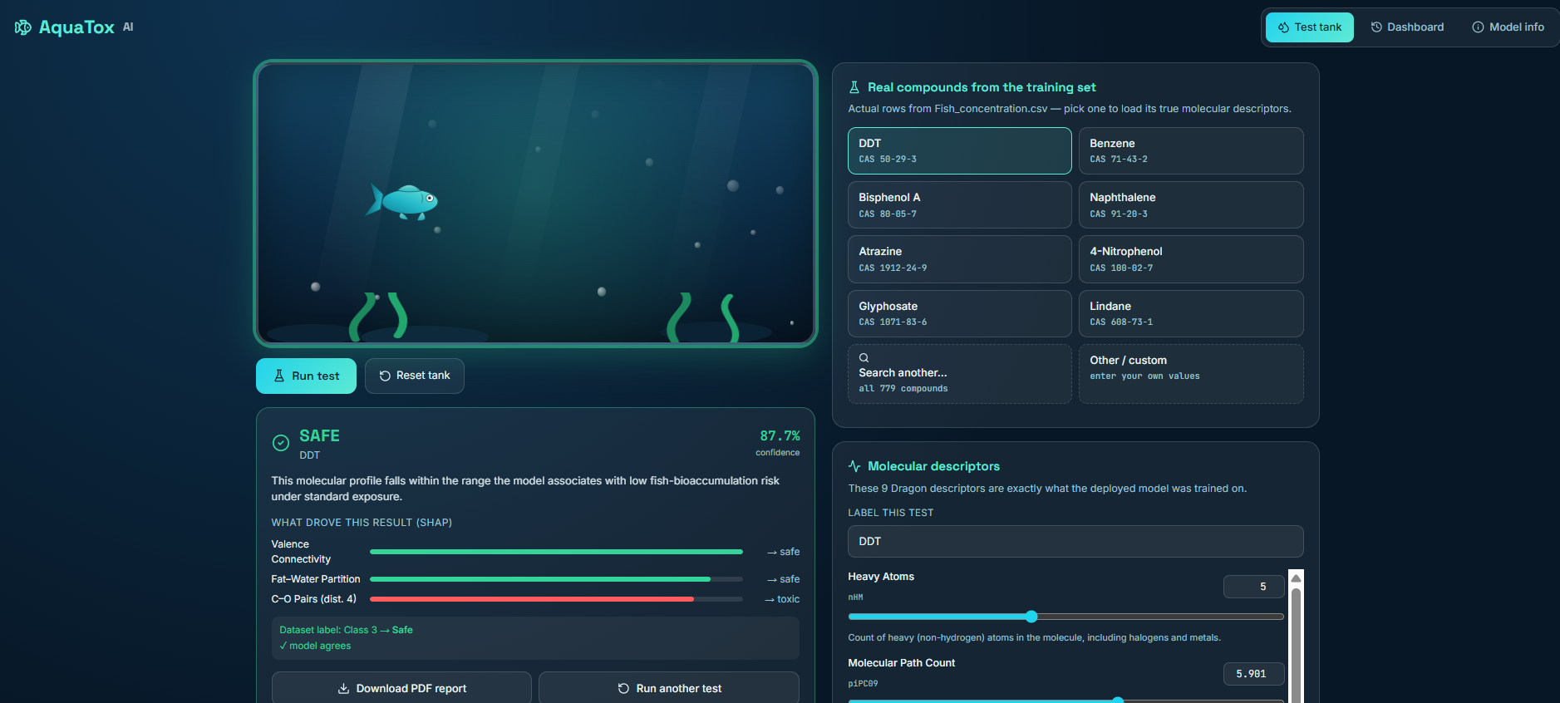
SECTION 13
Dashboard Overview – Test 1(Safe)
7PAM2002 – Data Science Project
Dashboard
14

Slide 15
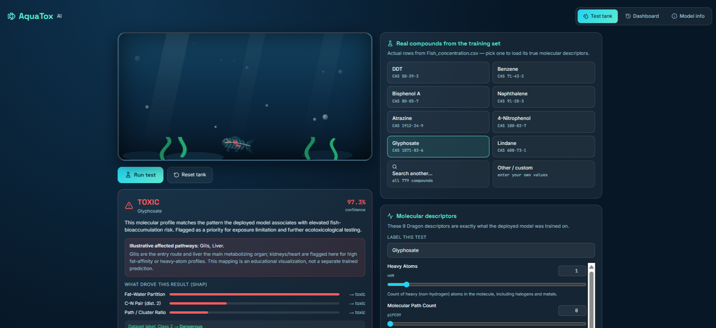
SECTION 13
Dashboard Overview- Test 2 (Toxic)
7PAM2002 – Data Science Project
Dashboard
15

Slide 16
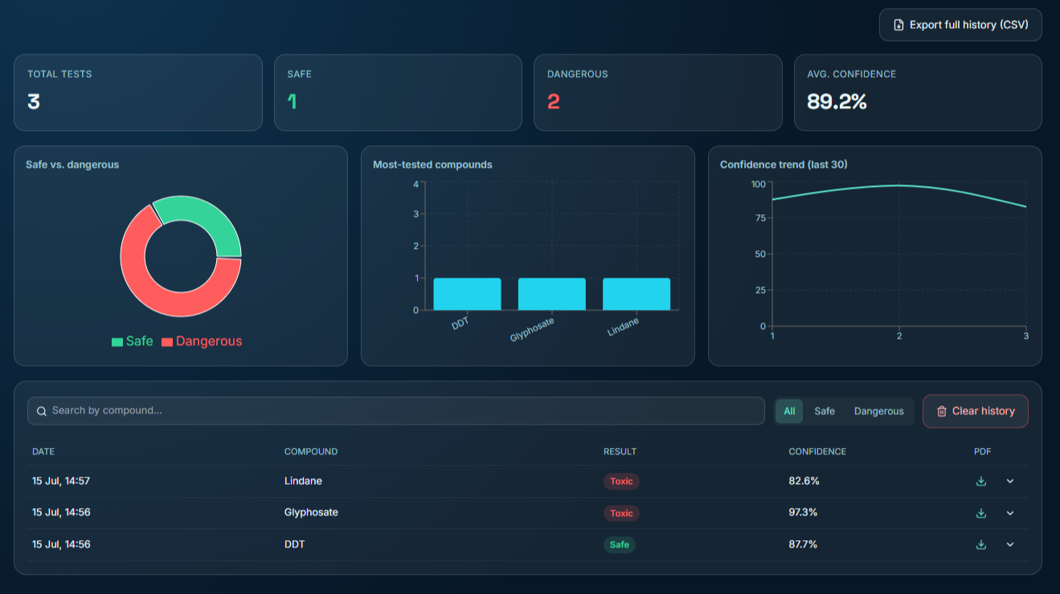
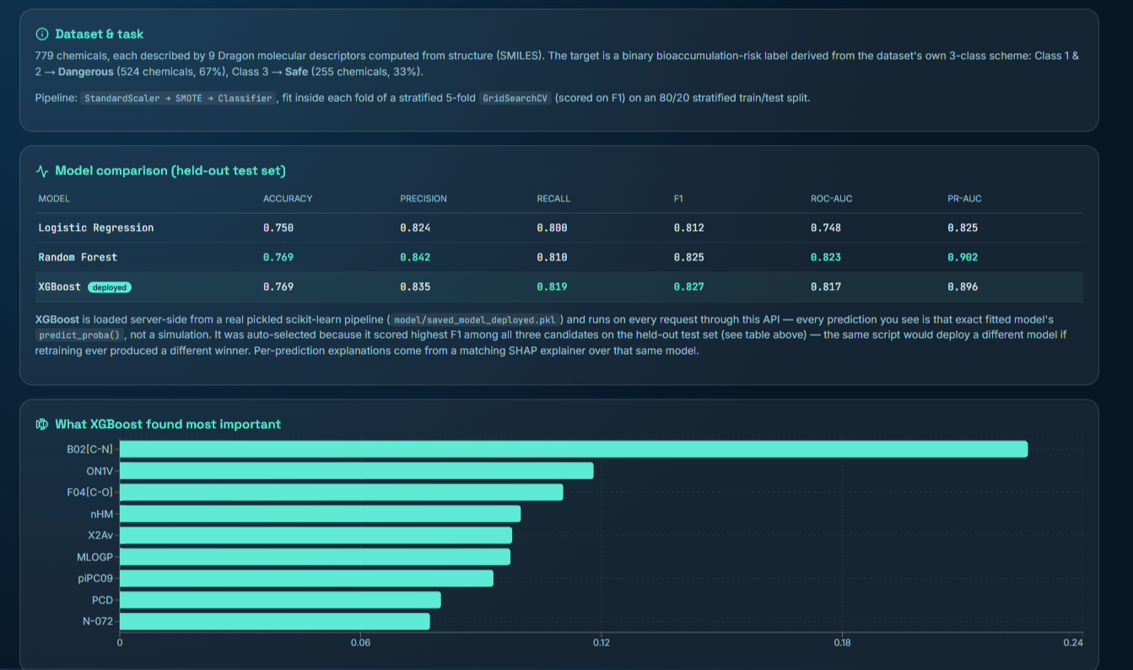
SECTION 13
Dashboard Overview
7PAM2002 – Data Science Project
Dashboard
16

Slide 17
SECTION 14
References
Grisoni, F., Consonni, V., Vighi, M., Villa, S. and Todeschini, R. (2016) 'Investigating the mechanisms of bioconcentration through QSAR classification trees', Environment International, 88, pp. 198–205. https://doi.org/10.1016/j.envint.2015.12.024
Kobayashi, Y. and Yoshida, K. (2021) 'Development of QSAR models for prediction of fish bioconcentration factors using physicochemical properties and molecular descriptors with machine learning algorithms', Ecological Informatics, 63, 101285. https://doi.org/10.1016/j.ecoinf.2021.101285
Pore, S., Pelloux, A., Chatterjee, M., Banerjee, A. and Roy, K. (2024) 'Machine learning-based q-RASAR predictions of the bioconcentration factor of organic molecules estimated following the OECD guideline 305', Journal of Hazardous Materials, 479, 135725. https://doi.org/10.1016/j.jhazmat.2024.135725
7PAM2002 – Data Science Project
References
17

