Slide 1
VAULTURE
SUPERHACK 2024
Notes:
‹#›

Slide 2
WHY VAULTURE?
Creation of simple yield-generation ERC-4626 Vaults completed by Fear & Greed metric to make wiser decisions more easily
Receive more reward points by using a Vault that aggregates and leverages funds
To enable for Off-chain yield generation possibilities
‹#›
Notes:
‹#›

Slide 3
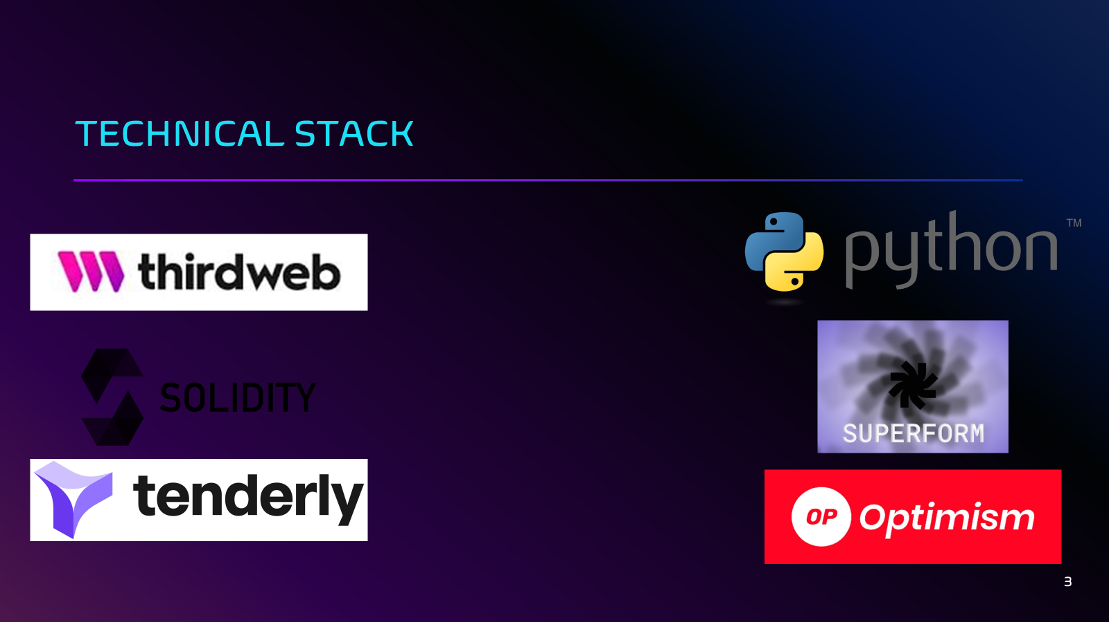


Slide 4
WORKFLOW OF USER
Vaulture
Has ETH in their wallet
2
Vaulture
User connects through thirdweb or wallet
1
Vaulture
Buys ETH with credit card using thirdweb
2
‹#›
Notes:
‹#›

Slide 5
WORKFLOW OF VAULTURE
ezETH/ETH Vault
2
Vaulture
User chooses which vault to deposit in
RWA / Off-chain
1
3
LP/Staking Vault
4
‹#›
Notes:
‹#›

Slide 6




FOCUS ON EZETH/ETH VAULT
1Inch
Silo
Swapping ETH 🡪 ezETH
Depositing ezETH
6
7
Looping until ezETH deposited negligible
Silo
Borrowing ETH (LTV limit)
8
‹#›
Notes:
‹#›

Slide 7
FOCUS ON EZETH/ETH VAULT
Vaulture
Vaulture
User chooses which vault to deposit in
ezETH/ETH Vault
4
5
Vaulture
User gets yield-bearing token
Withdraws with added APY whenever they want
9
‹#›
Notes:
‹#›

Slide 8
FOCUS ON LP/STAKING VAULT
Vaulture
Vaulture
User chooses which vault to deposit in
LP/Staking Vault
4
5
Vaulture
Yearn Finance
User gets yield-bearing token
Withdraws with added APY whenever they want
LP into other ERC-4626 Vaults
Yield-bearing token accruing APY
7
6
‹#›
Notes:
‹#›

Slide 9
FOCUS ON RWA / OFF-CHAIN
Vaulture
Strategy
User chooses RWA vault
Deploy Funds
non 4626 Address
4
5
Vaulture
Off Chain
Funds returned and fees applied in Harvest and Report function
Keeper Invests
in Airbnb/Home/Asset
7
6
‹#›
Notes:
‹#›

Slide 10
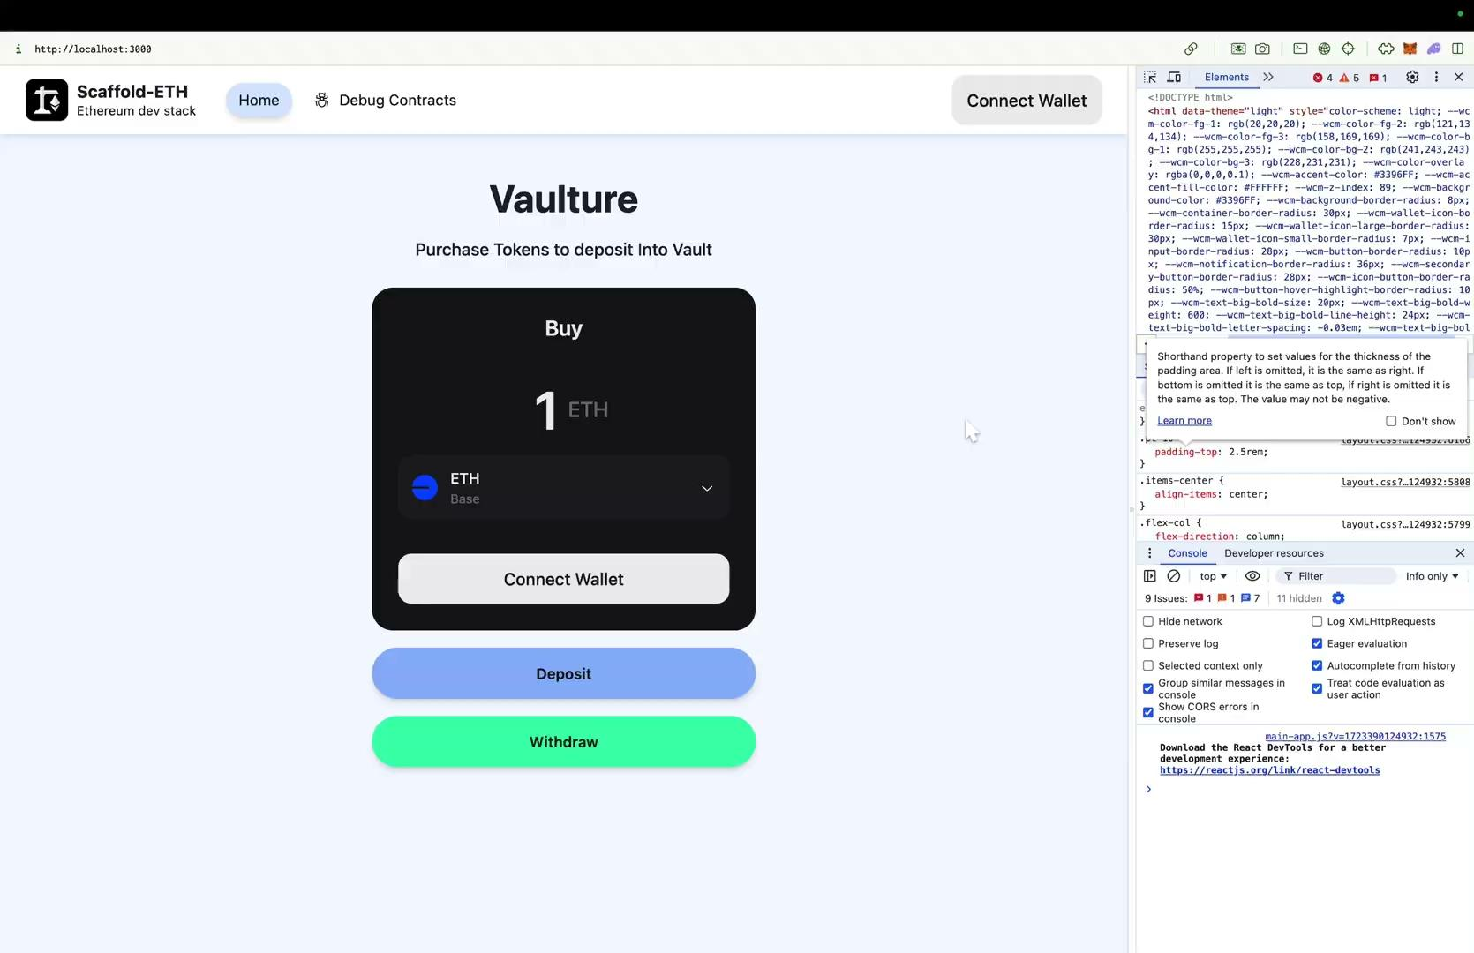
DEMO: Thirdweb Sign In & Purchase
‹#›
Notes:
‹#›

Slide 11
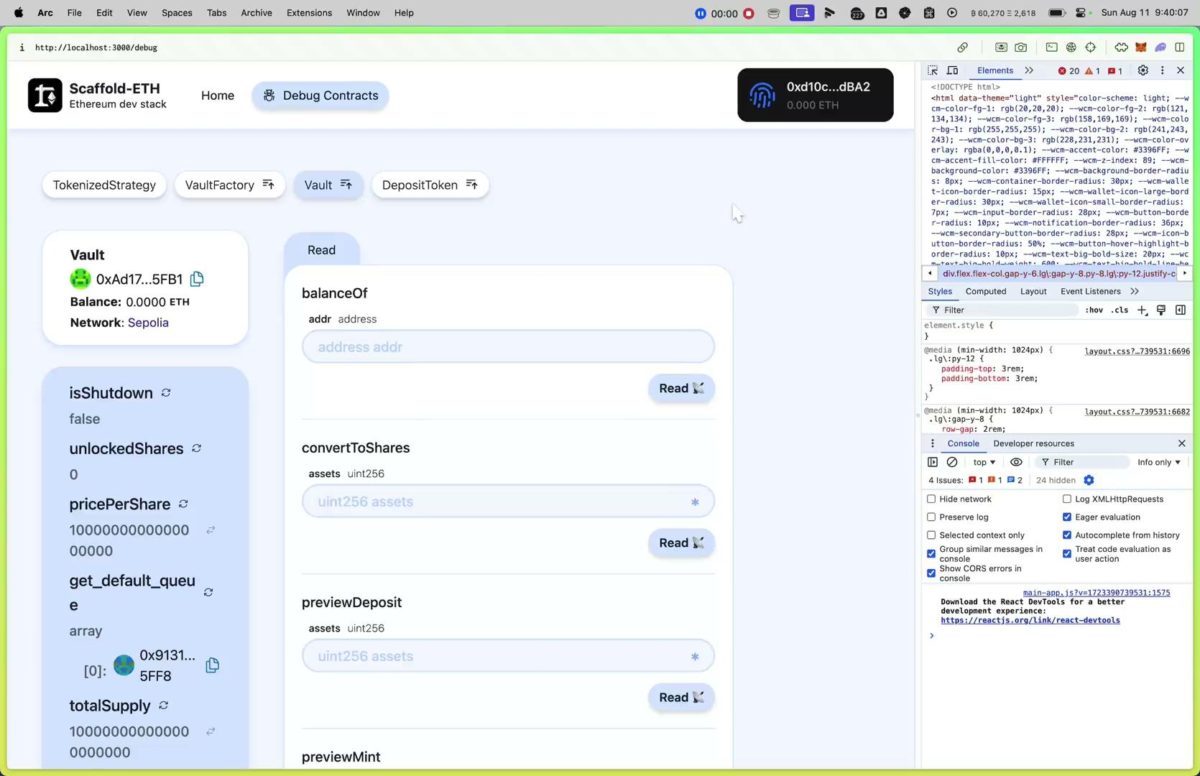
DEMO: RWA 4626 Ecosystem
‹#›
Notes:
‹#›

Slide 12
ROADMAP
Integration of more ERC 4626 compatible vaults for more products
Integration of weETH/ETH looping strategy through Sturdy on Mode to accrue Mode, Eigen Layer and Ether Fi points
Improving the Fear and Greed metric to take more input data into account (polls, news regarding the project, project activeness)
Add a profile page for strategies detailing the manager, the performance strategy, it’s current allocations etc
UX/UI improvements
‹#›
Notes:
‹#›

Slide 13
RWA Notes
In Summary: In order to allow the funds to be used off-chain but still be composable in 4626 vaults we had to create an implementation that would transfer the funds to an arbitrary address that could manually re-deposit the asset after either a profit or loss scenario. This is an anti-pattern of sorts as the “freeFunds” function is basically proved ineffective, perhaps only as a way of alerting the off-chain keeper that he needs to deposit some asset or liquidize it fully depending on the strategy.
The underlying “report” functionality needs to be updated above and beyond the _harvestAndReport function as it needs to be self aware of how much of the asset is being returned and trigger that transfer itself.
Tools: Scaffold-ETH, Hardhat, Thirdweb Connect & PayEmbed Widgets
‹#›
Notes:
‹#›

Slide 14
RWA Code Alterations
function deployFunds(uint256 amount, address recipient) internal {
require(recipient != address(0), "Invalid recipient address");
require(amount > 0, "Amount must be greater than zero");
require(amount <= _totalAssets(_strategyStorage()),"Insufficient assets");
// Transfer the net amount to the recipient
StrategyData storage S = _strategyStorage();
S.asset.safeTransfer(recipient, amount);
// Update the tracking of external allocations
// TODO: allow for multiple accounts to be kept track of with mapping
S.allocatedToExternal += amount;
emit AllocatedToExternalAccount(recipient, amount);
}
function report( uint amount) external nonReentrant onlyKeepers returns (uint256 profit, uint256 loss) {
StrategyData storage S = _strategyStorage();
require(amount > 0, "Amount must be greater than zero");
// Transfer the assets back to the vault
S.asset.safeTransferFrom(msg.sender, address(this), amount);
emit ReturnedFromExternalAccount(msg.sender, amount);
… the rest of the report code for fees/accounting etc
}
‹#›
Notes:
‹#›

