Slide 1
Data Analytics Program
Cohort #1 - 2025
Saturday, January 25th

Slide 2
Core Team
The introduction of the Core Team took place live

Slide 3
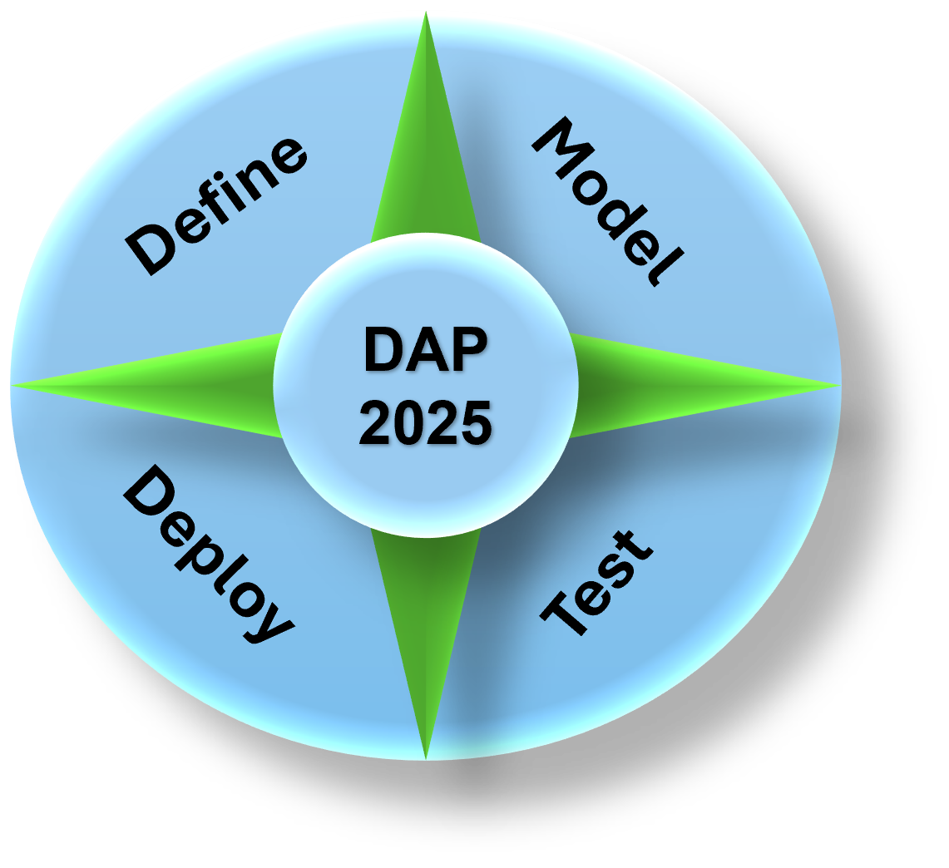
Weeks & Contents
Weeks | Hours
26 – 30 | 39 – 45
January 25th
August 16 (30)
Holidays
Networking (2)
Career meeting (1)
July 19 (26)
Networking (1)
The networking event aims to foster in-person connections, bring together professionals from diverse industries, and provide an opportunity to present final capstone projects (TBD)
We will observe religious holidays if they fall on a weekend. If a break is needed, we will inform you in advance or adjust the session to a week-long project (TBD)
On certain days, we will have guest speakers join us to provide real-world insights from the industry and share their valuable experiences (TBD)

Slide 4
What do we want to deliver to you?
From Zero to Hero - Building the Foundations of Data Analytics!
Understanding Core Analytics Concepts: Lay the groundwork for data-driven problem-solving.
Interactive Tools & Techniques: Get familiar with key platforms and tools like Excel, Python, Power BI, Power Query, M language, and DAX
Practical Applications: Work on small, meaningful projects to apply what you learn immediately.
Our focus is on learning by doing—developing the confidence and competence you need to tackle analytics challenges head-on. Get ready to explore, experiment, and excel!

Slide 5
Tech Skills
Tech Skills | Overview
Excel | Data cleaning, pivot tables, and formula
Python | Data manipulation using libraries like pandas and numpy. data visualization techniques with matplotlib and seaborn.
ML | Learn core ML concepts, such as supervised and unsupervised learning. Apply ML algorithms to solve practical problems, like classification and clustering. Get hands-on experience with tools like scikit-learn for building and evaluating models.
Power BI | Build interactive dashboards and reports for dynamic data exploration. Learn how to connect to multiple data sources and model data effectively. Gain insight into storytelling through data visualization.
Power Query & DAX | Use Power Query to clean, transform, and combine data efficiently. Understand the fundamentals of DAX for creating calculated columns and measures. Explore advanced techniques for building complex data models.

Slide 6
soft skills
Soft Skills | Overview
Critical Thinking | Analyze data logically to uncover insights, identify trends, and solve problems effectively.
Communication Skills | Simplify complex data findings into clear and impactful messages for both technical and non-technical audiences.
Collaboration & Teamwork | Work seamlessly with diverse teams, sharing insights and building consensus to achieve shared goals.
Adaptability | Stay flexible and open to new tools, technologies, and methodologies in a rapidly evolving field.
Attention to Detail | Ensure data accuracy and maintain high standards by thoroughly verifying work and minimizing errors.

Slide 7


Key Expectations for Student Success in the DAP
No prior knowledge or experience
Self-Motivation
Feedback Receptiveness
Critical Thinking
Accountability
Collaboration
Adaptability
Consistency
Engagement

Slide 8






Technical Skills and Setup Requirements
Basic Technical Skills (Not required but preferable):
Familiarity with Excel and commonly used Excel functions such as SUM, AVERAGE, IF, and VLOOKUP.
Software Requirements (Required):
Access to or installation of Microsoft Office 365 (Word, Excel, PowerPoint).
Installation of Power BI Desktop for data visualization tasks.
Python setup is not required, as we will utilize Google Colab as an alternative for Python-related tasks.
Create GitHub account to be able to download the contents shared with you!
Being prepared with these tools and skills will help you engage effectively in the program's technical components.

Slide 9




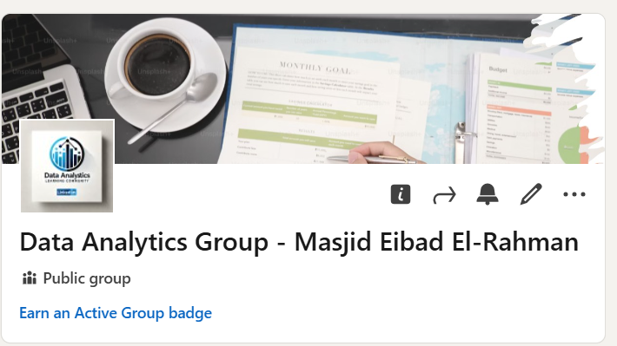
Don’t forget
Accepted Students: 21
Waiting List: 5
Responses Rate: 45% Our Target is >=80%
Important Policies and Procedures for Your Success in the DAP Program
Students
LinkedIn page:

Slide 10
Tell us about yourself
KNOW
GETTING
YOU
TO

Slide 11


