Slide 1
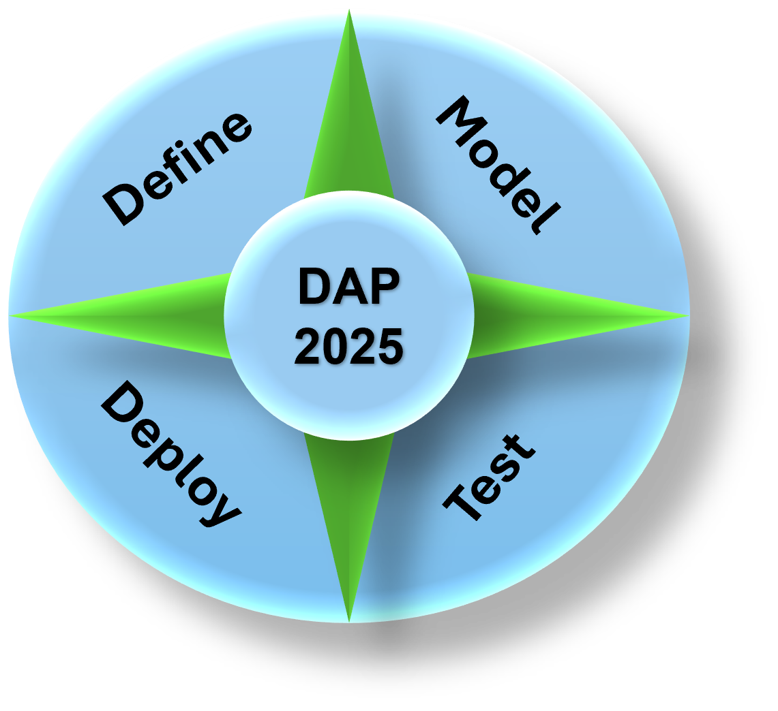
Data Analytics Program
(DAP - 2025)
By Mustapha Bouchaqour
Week #2 – Saturday, February 1
Created from scratch by Mustapha—feel free to modify as needed.

Slide 2
Agenda
Week #1 Recap (15 mins)
What we covered & Our metrics
Brief Overview: Google Colab, Power BI, GitHub
Personality Test & Forming Group
Lecture: (35 mins)
What is data analytics?
What’s so important about data
Data Analytics: Guide of Key Terms
Demo: (25 mins)
Python Notebook in Google Colab
Q&A: (15 mins)

Slide 3








Week #1 Recap
What we covered
Timeline
Expectation
Keys to Success
Ok, Installing …
Quick Walkthrough
Internal Metric(s)
DAP_Demo1.ipynb - Colab
Increase response & engagement rate
Run monthly surveys to collect feedback
Continuously refine metrics as we progress
Download Microsoft Power BI Desktop from Official Microsoft Download Center
DAPLearning2025 (Data Analytics Program)

Slide 4
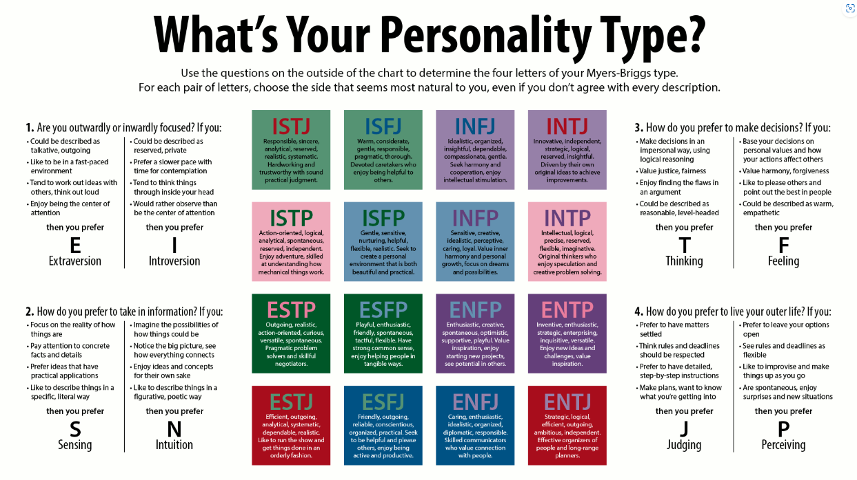
Personality Test & Forming Group

Slide 5
Personality Test & Forming Group
13 Participants submitted their personality test

Slide 6
Forming Group
February Groups
The group is set up, and students will receive further instructions.

Slide 7
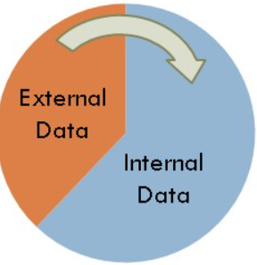
Data Analytics
What is it?
📊 Transforming Data into Insights
Using tools & techniques to turn raw data into meaningful insights
Supports, improves, and automates business decisions
Data is Everywhere
🗂️ We use data every day
Collected from both internal and external sources
Drives business strategy and decision-making
Internal Data: Generated & Stored within the business.
Comes from:
Sensors & barcodes
Website interactions
Business software & databases
External Data: Collected from outside sources business.
Public sources: Government surveys, social media
Paid sources: Stock market data, weather reports
Data as a Business Asset: Critical for success.
Businesses rely on data for competitive advantage
Think about how much data you use daily in your organization!

Slide 8



Data as an Asset
Data should be managed and protected as a valuable business asset
How Businesses Use Data: Companies leverage data in three keyways
Competition
Efficiency
Customer Satisfaction
Increase revenue by optimizing products & services
Reduce costs by streamlining internal processes
Enhance user experience & build loyalty
Making Data Useful with Analytics: Not all data is immediately valuable. It falls into three categories:
Useful Data – Ready for analysis
Messy Data – Needs cleaning to be valuable
Junk Data – Not immediately useful but may provide insights from another angle
your job?
Filter out junk,
Clean messy data,
Transform raw data into insights

Slide 9
Four Types of Data Analytics
Four Types of Data Analytics: Data analytics helps businesses answer different questions
Descriptive Analytics – What happened? (Looks at historical data)
Diagnostic Analytics – Why did it happen? (Finds relationships in data)
Predictive Analytics – What might happen? (Uses statistical models)
Prescriptive Analytics – How can we make it happen? (Combines insights to drive action)
Simple, right?
A weather app uses machine learning models to predict next week’s temperature. This is an example of: a) Diagnostic Analytics b) Prescriptive Analytics c) Predictive Analytics d) Descriptive Analytics
If a company wants to understand why their sales dropped last quarter, which type of analytics should they use? a) Predictive Analytics b) Diagnostic Analytics c) Descriptive Analytics d) Prescriptive Analytics
A business wants to improve customer retention by analyzing past trends and suggesting personalized offers. This is an example of: a) Predictive Analytics b) Prescriptive Analytics c) Diagnostic Analytics d) Descriptive Analytics

Slide 10
Data Analytics Challenges & Solutions
Challenges We Face: The amount of data is rapidly increasing. Did you know? 90% of the world's data was created in the last two years alone! – IBM
Data comes in many formats, making it harder to structure and analyze. Messy data requires extensive cleaning, which is time-consuming. Businesses need usable data to make faster, smarter decisions.
Garbage in, garbage out: Poor-quality data leads to unreliable analytics and bad
How Do We Tackle These Challenges?
By following a structured Data Analytics Process:
Define the Problem – Ask the right questions to identify key issues.
Plan the Work – Estimate the effort needed and create an action plan.
Process the Data – Collect, clean, and transform data into meaningful insights.
With a clear approach, businesses can turn raw data into valuable knowledge!

Slide 11
Data Analytics: Key Terms Guide
Business Analytics (Data Analytics): A process that uses tools and techniques to transform raw data into meaningful insights that support, improve, and automate business decisions.
Big Data: Extremely large datasets with high variety, volume, and velocity, requiring advanced tools for processing and analysis.
Data: Quantitative or qualitative values that can be categorized into different types:
Personal Data: Identifiable information such as demographics, location, and email.
Transactional Data: Data collected from user actions like purchases, website visits, or ad clicks.
Web Data: Publicly available data gathered from the internet, including market research, competitor pricing, and government reports.
Sensor Data: Data generated by devices, such as smartwatches tracking heart rate or sensors monitoring weather conditions.
Data Cleansing: The process of correcting errors, removing duplicates, and ensuring consistency in datasets.
Data Mining: Identifying patterns and extracting insights from large datasets using statistical analysis, machine learning, and AI.
Data Science: A multidisciplinary field that combines statistics, programming, data visualization, machine learning, and database management to solve complex problems.
Hypothesis: A proposed explanation for a phenomenon that is tested using statistical analysis to determine its validity.
Data Visualization: The use of charts, graphs, and other visual formats to represent data in a way that enhances understanding and communication.

Slide 12
Group Assignment
Objective: Each group will explore and present how the power of Big Data is leveraged in strategic planning.
Instructions:
Research and discuss how organizations use Big Data to drive business decisions and long-term strategies.
Identify key benefits, challenges, and real-world examples of Big Data in strategic planning.
Present your findings in a structured response (written report or presentation: 1 – 2 pages).
Group Assignment:
Guiding Questions:
How does Big Data improve decision-making in strategic planning?
What industries benefit the most from Big Data-driven strategies?
What tools and technologies are commonly used to analyze Big Data for planning?
What challenges do organizations face when integrating Big Data into their strategy?
Provide a real-world example of a company successfully using Big Data for strategic planning.
Submission:
Due Date: By Friday, February 21
Format: No restriction
One submission per group.

Slide 13


Slide 14
DAP Teaching Approach
Our teaching style in DAP is not a linear progression through the materials. Instead, we follow a flexible and dynamic approach:
Lectures focus on conceptual understanding but may also introduce some technical content as we progress.
Demos serve as a reflection of what was covered in lectures but can also be used to break patterns and introduce new topics.
The learning experience is designed to be interactive and adaptable, allowing us to explore new materials as needed.

Slide 15
Demo
(Python)

