Slide 1
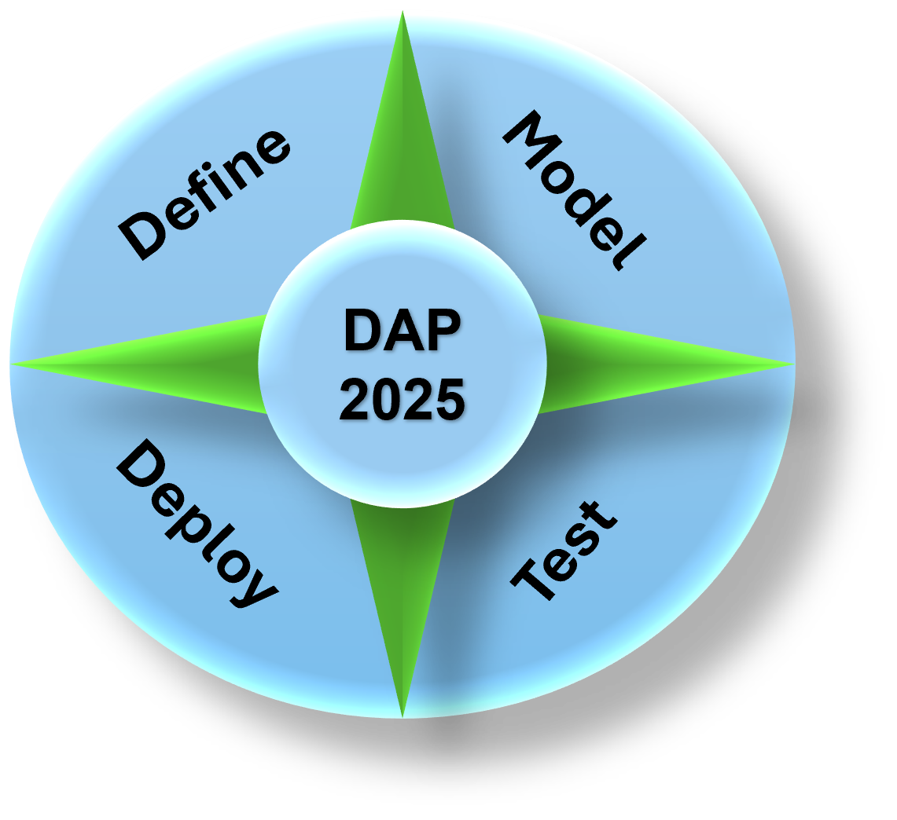
Data Analytics Program
(DAP - 2025)
By Mustapha Bouchaqour
Week #3 – Saturday, February 8

Slide 2

Agenda
Lecture:
Understand the Components of Data Analysis
Visual checks: 10-20 Seconds Rule
Data Storytelling
The 3 Key Questions
Demo:
Python Notebook in Google Colab
Q&A:

Slide 3
Understand the Components of Data Analysis
Analytical Know – How:
Math
Statistics
Coding skills
Area of subject matter expertise
Collect, query, and consume data
Data Engineers:
Capturing and collating large volumes of structured, unstructured, and semi-structured data
Data Analysis:
Focus on insight, prediction, and visualization
Contextual Information: To drive better data-informed decisions, data can be generated from multi data-source
Some of files formats:
Comma – separated values (CSV) – Commonly used scripting languages such as Python or R
Scripts: Files end with extension .py or .ipynb (Python) or .r (R)
Application files: xls or xlsx extension, Geospatial analysis applications such as ArcGIS and QGIS
Web programming files: D3.js – or Data-Driven documents, a JavaScript library for data visualization. When you work in D3.js, you use data manipulate web-based documents using .html, .svg, and .css

Slide 4
Understand the Components of Data Analysis
Statistical methods in data analysis help with:
Understanding data significance
Validating hypotheses
Simulating scenarios
Making predictive forecasts
Advanced statistical skills are rare, even among quantitative analysts.
Learning basic methods can be valuable, including:
Linear and logistic regression
Naïve Bayes classifications
Time series analysis
Play the coding game & Visualization &
Coding (Python, R, Java, …)
Power BI, Tableau, Python, R, ..
SQL for data query

Slide 5
Understand the Components of Data Analysis
Apply Data Analysis to a Subject Area:
Data analysis is most useful when applied to real-world problems.
Choosing a subject area (business, healthcare, sports, etc.) makes data meaningful.
Example: Analyzing Student Performance
Collect test scores from different subjects.
Identify trends in student performance.
Detect patterns, like improvement after tutoring.
Use insights to improve teaching and support struggling students.
The same approach applies to businesses, healthcare, sports, and more.
Data turns raw numbers into smart decisions!

Slide 6
Visual checks
In 10 - 20 seconds, what can you learn from the data below?
Product 1 |  | Product 2 |  | Product 2 |  | Product 4
Month | Sales A (MM) | Month | Sales B (MM) | Month | Sales C (MM) | Month | Sales D (MM)
1 | 5.2 | 1 | 4.3 | 1 | 3.5 | 1 | 6
2 | 6.1 | 2 | 4.8 | 2 | 4 | 2 | 6.5
3 | 5.8 | 3 | 5.1 | 3 | 4.2 | 3 | 7
4 | 6.5 | 4 | 5.6 | 4 | 4.8 | 4 | 7.5
5 | 7 | 5 | 6 | 5 | 5.2 | 5 | 8
6 | 7.5 | 6 | 6.3 | 6 | 5.5 | 6 | 8.2
7 | 8 | 7 | 6.8 | 7 | 6 | 7 | 8.8
8 | 8.2 | 8 | 7 | 8 | 6.3 | 8 | 9
9 | 8.5 | 9 | 7.2 | 9 | 6.5 | 9 | 9.5
10 | 9 | 10 | 7.5 | 10 | 7 | 10 | 10
11 | 9 | 11 | 5 | 11 | 14 | 11 | 11
12 | 4.7 | 12 | 7 | 12 | 5.6 | 12 | 5.7
What story the data says?

Slide 7
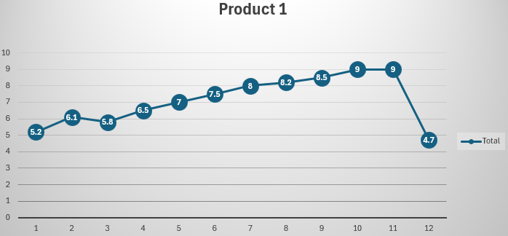
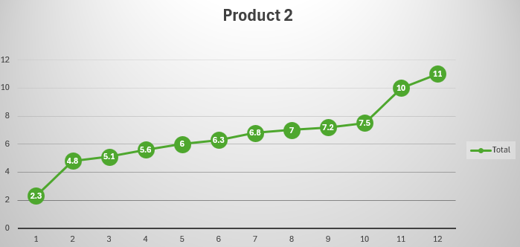
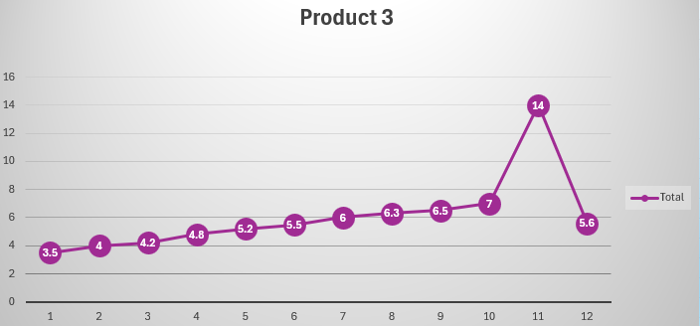
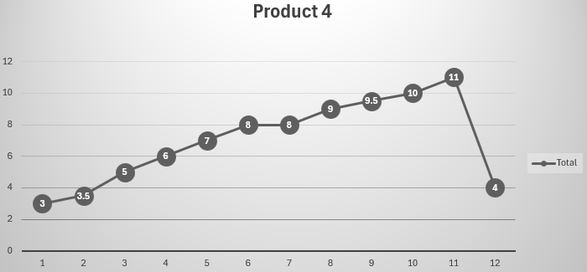
Visual checks
In 20 seconds, what can you learn from the data below? Why?
Both graphs tell different stories
Which story stands for you?
Data visualization does not mean pretty charts

Slide 8
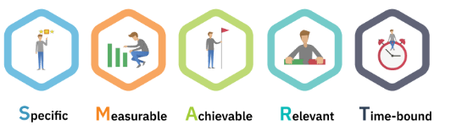
Visual checks
Why did we visual data?
Simplify complex data: Makes complicated data easier to understand.
Spot patterns and trends: Helps identify trends and outliers quickly.
Enhance decision-making: Aids in making informed decisions.
Identify relationships: Shows how different data points are connected.
Better storytelling: Communicates key insights clearly and effectively.
Metrics: These are measurements or key data points used to track and evaluate performance. They could represent anything from sales figures to website traffic or customer satisfaction.
Representation: Metrics are often displayed visually to make the data more understandable (e.g., graphs, charts).
Insights: Visualization helps highlight patterns, trends, and outliers in the metrics, making it easier to interpret data and make decisions.
Tracking progress: Visualizing metrics over time helps track progress toward goals.

Slide 9
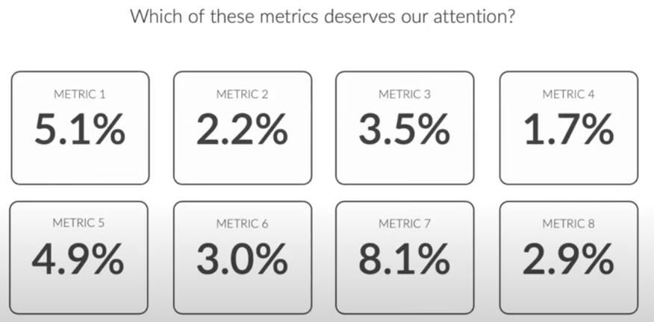
Visual checks
Visual checks
In other words, if you don’t see anything or this numbers does not tell anything, why?

Slide 10
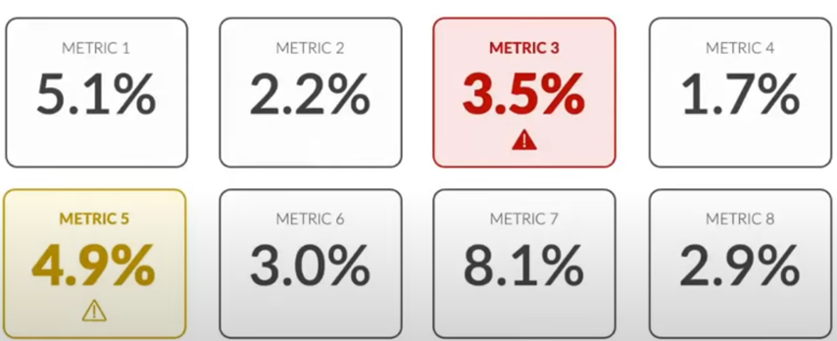
Visual checks
Did you understand the context?
Did you know what metrics is good and what’s bad?
Visual checks
Colors give some context
What else could help provide more context?

Slide 11
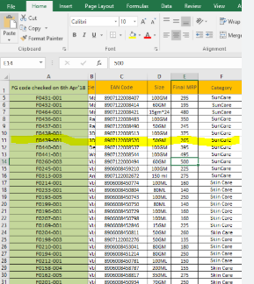
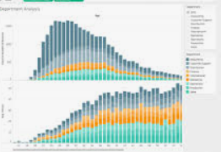
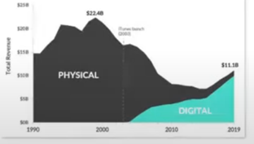
Visual checks
Data storytelling is an extension of visualization, focused on creating narratives designed to communicate insights, influence decisions, or support specific data-driven recommendations.
Raw Data
Data Visualization
Data storytelling
Data storytelling

Slide 12
The 3 Key Questions
What type of data are you working with?
Geospatial? Time-series? Hierarchical? Financial? Educational?
What do you want to communicate?
Comparison? Composition? Relationship? Distribution?
Who is the audience and what do they need?
Analyst? Manager? Executive? General Public?
We will spend great time working on these specific things as we start our Power BI journey

Slide 13


Slide 14
Demo
(Python)

