Slide 1
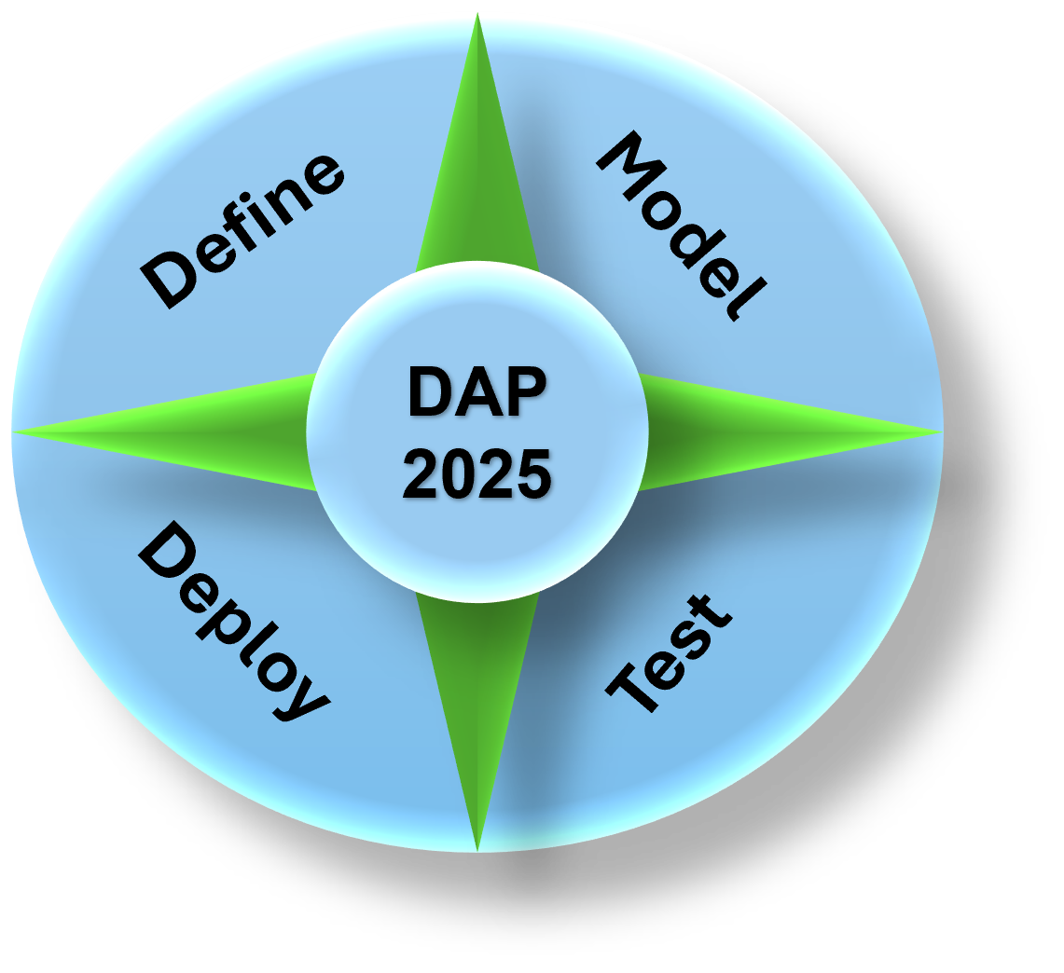
Data Analytics Program
(DAP - 2025)
By Mustapha Bouchaqour
Week #4 – Saturday, February 15

Slide 2
Agenda
Lecture:
Executive Communication
Demo:
Python Notebook (Demo2)
Q&A:

Slide 3

Due Diligence
You're caught up with several tasks early in the morning when your manager unexpectedly stops by, asking you to join an executive meeting to provide a quick update on the major project you've been working on. With only five minutes to prepare, you need to gather your key points and be ready to present concisely.
What would you do?

Slide 4
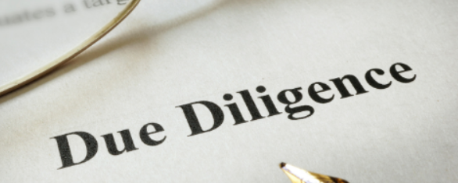
Due Diligence
The answer is: DUE DILIGENCE
Due diligence means carefully checking information before planning
It helps reduce risks and avoid mistakes.
Common in business, finance, and legal matters.
Used before investing, signing contracts, or making big purchases.
Ensures accuracy and informed decision-making

Slide 5


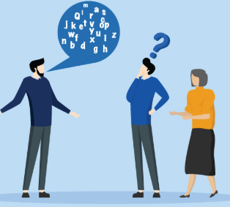
Tripod of Communication
Time
How long are you going to communicate?
How long is your audience attention span?
Audience
Substance
Style
Who are you talking to?
What are you going to say?
How are you going to say it?

Slide 6

Know Your Audience
Audience
Substance
Style
Start with your audience
Start with your audience
Start with your audience
Know who you’re speaking to—Executives focus on high-level impact, not details.
Tailor your message to their priorities (strategy, risks, revenue, efficiency).
Keep it relevant and avoid technical jargon unless necessary.
Provide clear, concise, and data-driven insights.
Focus on key takeaways—what they need to know, not every detail.
Use visuals (charts, graphs) to simplify complex information
Be confident, structured, and direct—executives value clarity and brevity.
Use storytelling where appropriate to make your points memorable.
Engage with eye contact and controlled tone to reinforce credibility.
Time
Time is limited—get to the point quickly.
Structure your message using the Pyramid Principle (start with the conclusion).
Be prepared to adjust if time is cut short—always have a 1-minute summary ready.

Slide 7


Slide 8
Demo
(Python)

