Slide 1
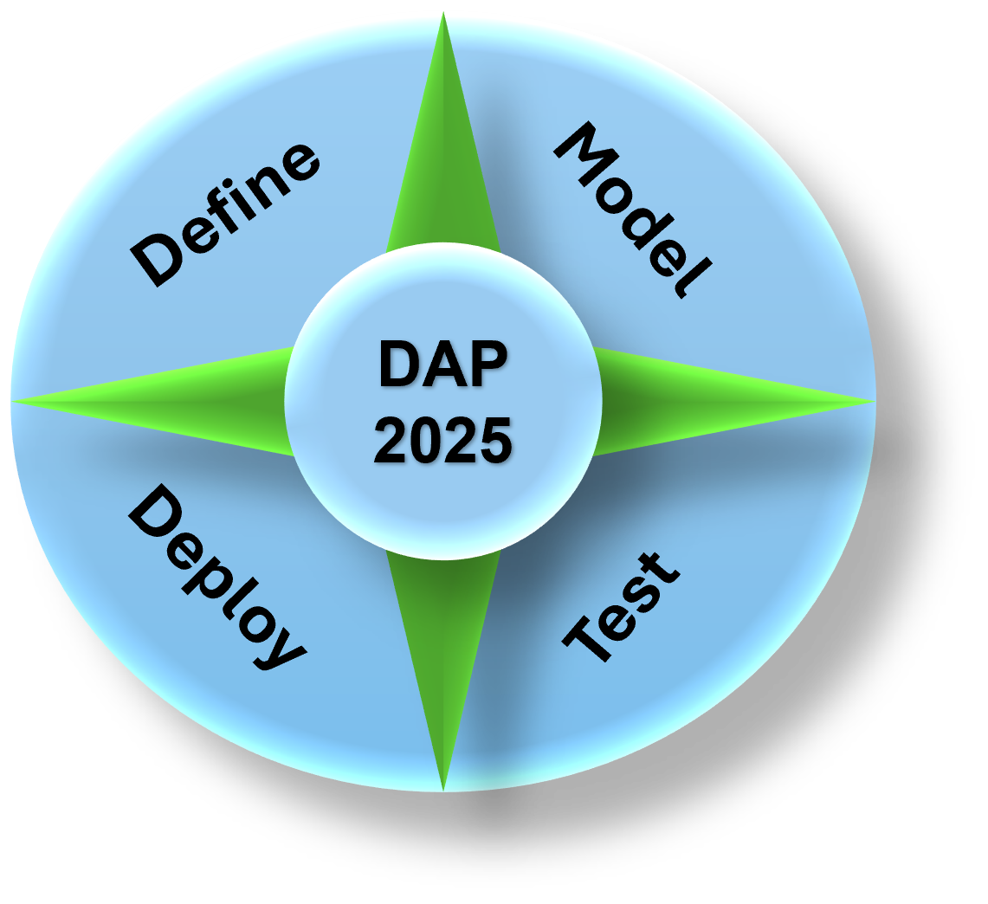
Data Analytics Program
(DAP - 2025)
By Mustapha Bouchaqour
Week #5 – Saturday, February 22

Slide 2
Agenda
Guest Speaker (30 mins)
Viqas Zafar, Director Engineering, Storage R&D at Hewlett Packard Enterprise
Group Assignment Presentations: (35 mins)
Data Each group present findings (5-7 mins per group)
Python Demo 2: Introduction to Functions (25 mins)
Hands-on walkthrough
Ramadan Schedule Discussion: (+10 mins)
Quick poll & Finalizing schedule adjustments

Slide 3
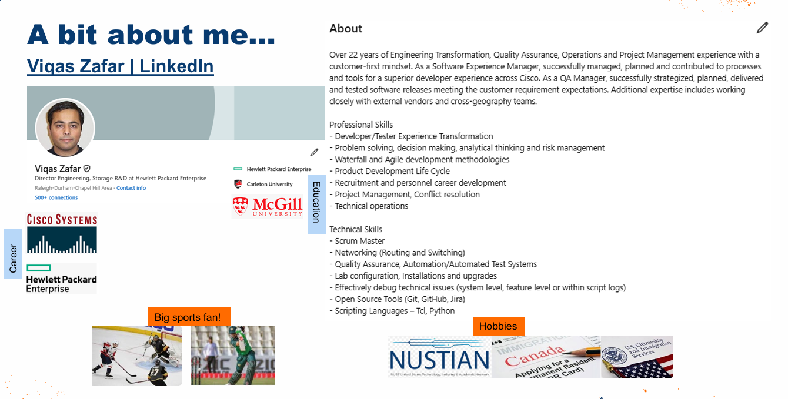

Slide 4
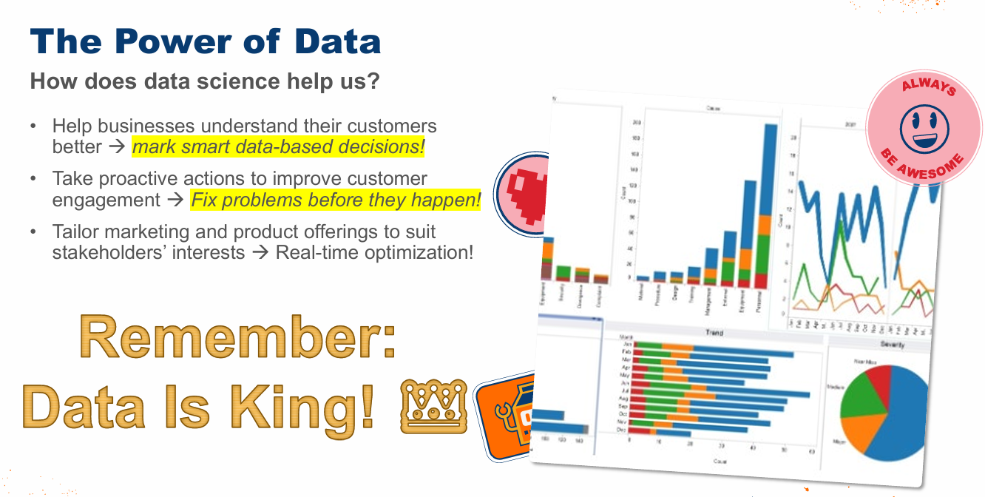

Slide 5



Slide 6


Slide 7
Group Presentations
Group Assignment Submission Status
✅ Submitted Groups:
Group 1
Group 2
Group 4
Group 5
Group 6
Group 3:
Group 7: Leading Team

Slide 8
Group Assignment Review
Objective: Each group will explore and present how the power of Big Data is leveraged in strategic planning.
Instructions:
Research and discuss how organizations use Big Data to drive business decisions and long-term strategies.
Identify key benefits, challenges, and real-world examples of Big Data in strategic planning.
Present your findings in a structured response (written report or presentation: 1 – 2 pages).
Group Assignment:
Guiding Questions:
How does Big Data improve decision-making in strategic planning?
What industries benefit the most from Big Data-driven strategies?
What tools and technologies are commonly used to analyze Big Data for planning?
What challenges do organizations face when integrating Big Data into their strategy?
Provide a real-world example of a company successfully using Big Data for strategic planning.
Submission:
Due Date: By Friday, February 21
Format: No restriction
One submission per group.

Slide 9
Demo
(Python)

Slide 10
Group Presentations
Received
Yes
No
Yes
Yes
Yes
Yes
Yes
No
G1 | G2 | G3 | G4 | G5 | G6 | Lead (2)
Atifur Rahman
Mohammed Ghouse Shaik
Hamza Chenchar
Zameer Shaik
Arshi Sumreen
Sabrina
Arbaz Chanda
Nazreen Banu Shahul Hameed
Said Elghallab
Aalia Abdullah
Muhammad Taha Karimi
Mariam Shah
Mafaaz White
Abdelkrim Ouhda
Yasmeen Sabuur
Alia Yunus
Syed Musharraf Ali Shah
Ali Quadri
Nadia AIT LAASRI
Mohammed Kaddam

