Slide 1
Major Histocompatibility Complex (MHC) peptides
CS341 – Data Structures
Final Project
Ajalon Corcoran and Doug Plager
WSU-R
Spring 2019

Slide 2
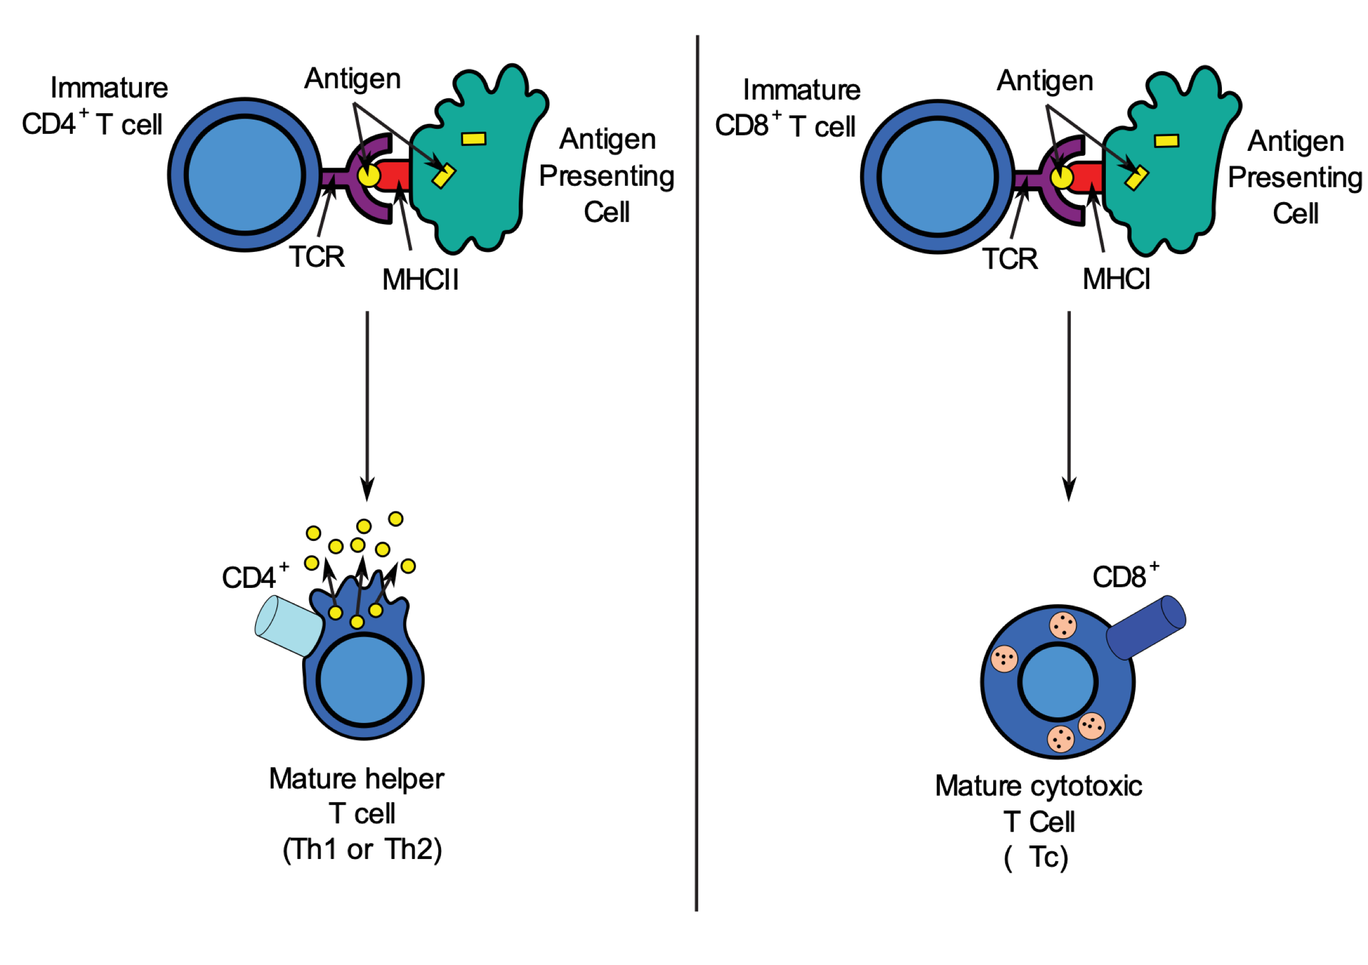
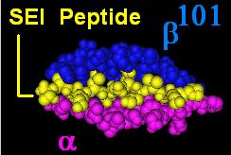
MHC presentation of a peptide
fragment from a protein
MHC-bound peptide from Staph.
enterotoxin subunit I-C protein

Slide 3
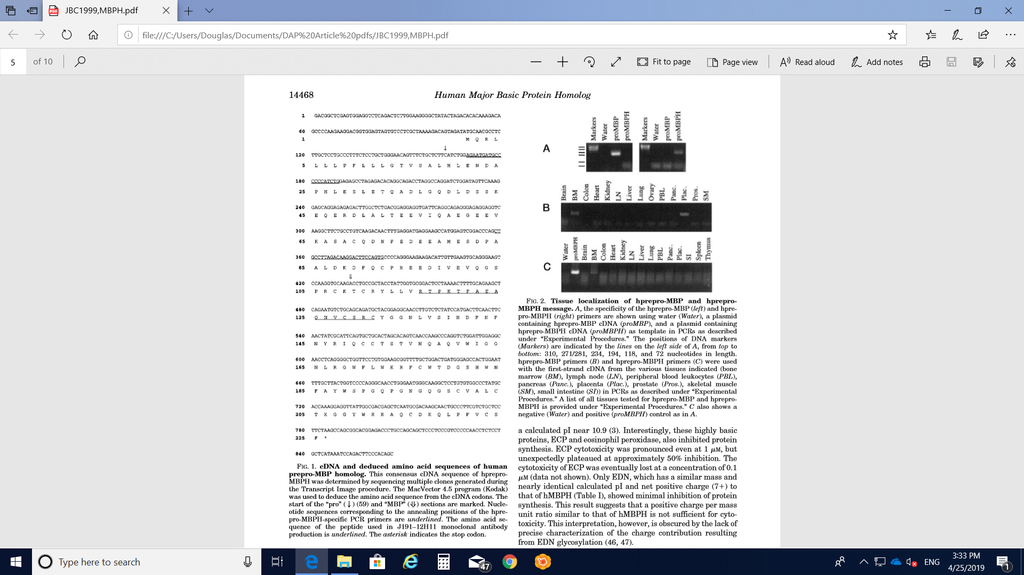
DNA nucleotide(N) = A, T, G, or C
DNA codon = NNN
Each DNA codon >> one amino acid
( ATG >> M )
Protein = full length a.a. chain
Peptide = short fragment a.a. chain
*
*
*
DNA sequence >> a.a. sequence
Notes:
REM: start (ATG) and stop (TAA) codon boxed

Slide 4
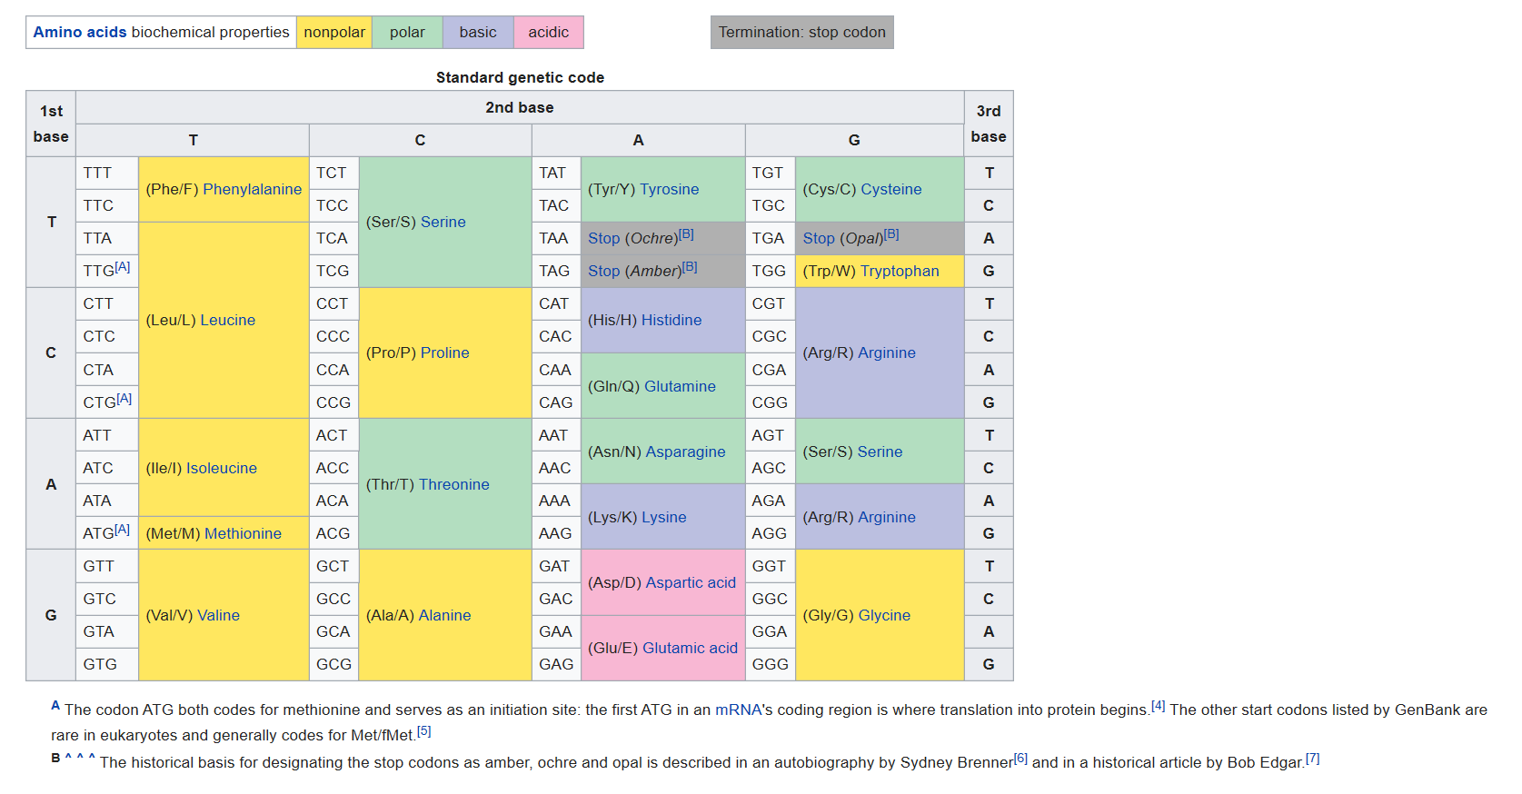
DNA codon table
LinkedHashMap<key, value>
1) mRNA, 2) start codons, 3) stop codons, 4) a.a. electrostatic properties
Notes:
REM: 1) mRNA as the intermediate step b/w DNA and amino acid sequence, 2) ATG start codon (Methionine, M), 3) stop codon (e.g., TAA), 4) electrostatic properties

Slide 5
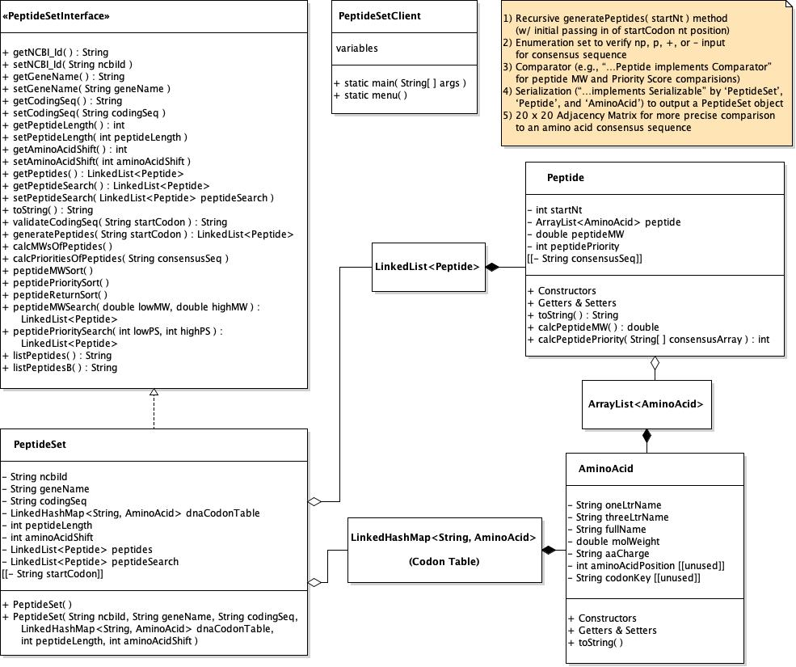
UML Diagram
Notes:
1) PeptideSet ADT = PeptideSetInterface + PeptideSet
PeptideSetInterface: top-half of abstract methods = standard Getter & Setters & toString; bottom-half = peptide-specific methods corresponding to our 10 menu options
PeptideSet private data fields
DNA to amino acids (LHM Codon Table), but also groupings of amino acids as peptides (AL<AminoAcid>)
book (DNA genome; in English letters), chapters/paragraphs (proteins; of Chinese characters), sentences (peptides), characters (amino acids) analogy

Slide 6
Summary of major “design decisions”:
PeptideSet ADT (i.e., PeptideSetInterface & PeptideSet implementing class )
LinkedHashMap<String, AminoAcid> ; for rapid lookup of the specific
codon ‘key’ and its corresponding AminoAcid object ’value’ (i.e., codon table)
Peptide class with an “aggregated” ArrayList<AminoAcid> private data field,
with ArrayList “size” based on user-designated peptide length.
PeptideSet class with an “aggregated” LinkedList<Peptide> private data field
because (a) unknown number of peptides and (b) value-oriented ordering
(other than by starting Nt#) not initially important.
Concern: whether each peptides.get(i) , e.g., to print the list of generated
peptides, would be unacceptably slow?
JCF Collections.sort(_) method to sort the the LinkedList<Peptide> peptides
by molecular weight (MW) or priority score (PS).
Priority Score calculation – utilize a 20 a.a. x 20 a.a. (graph) weighted adjacency
matrix (2D array)?

Slide 7
Grading Milestones:
C) DNA coding sequence to corresponding amino acids
B) Amino acids to peptides
A) MW and Priority Score calculations for each peptide

Slide 8
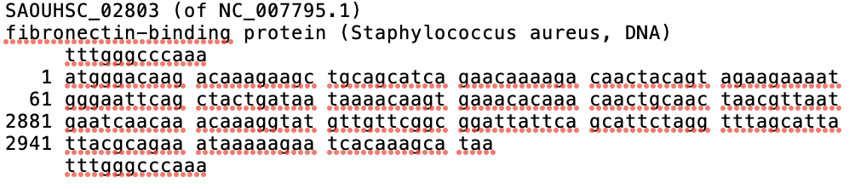
StaphAureusGene(test).txt
… and now, our program.
Notes:
GOOD user input for initial program run: 10 amino acid peptide length, 4 amino acid shift, “atg” start codon; copy and paste example consensus sequence;
then 1300 & 1250 MW limits and 4 & 2 Priority Score limits.

