Slide 1
Quarry Hill Summer Camps Registration Database
Doug Plager and Riley Morrow
CS385, WSU-Rochester
Fall 2019

Slide 2
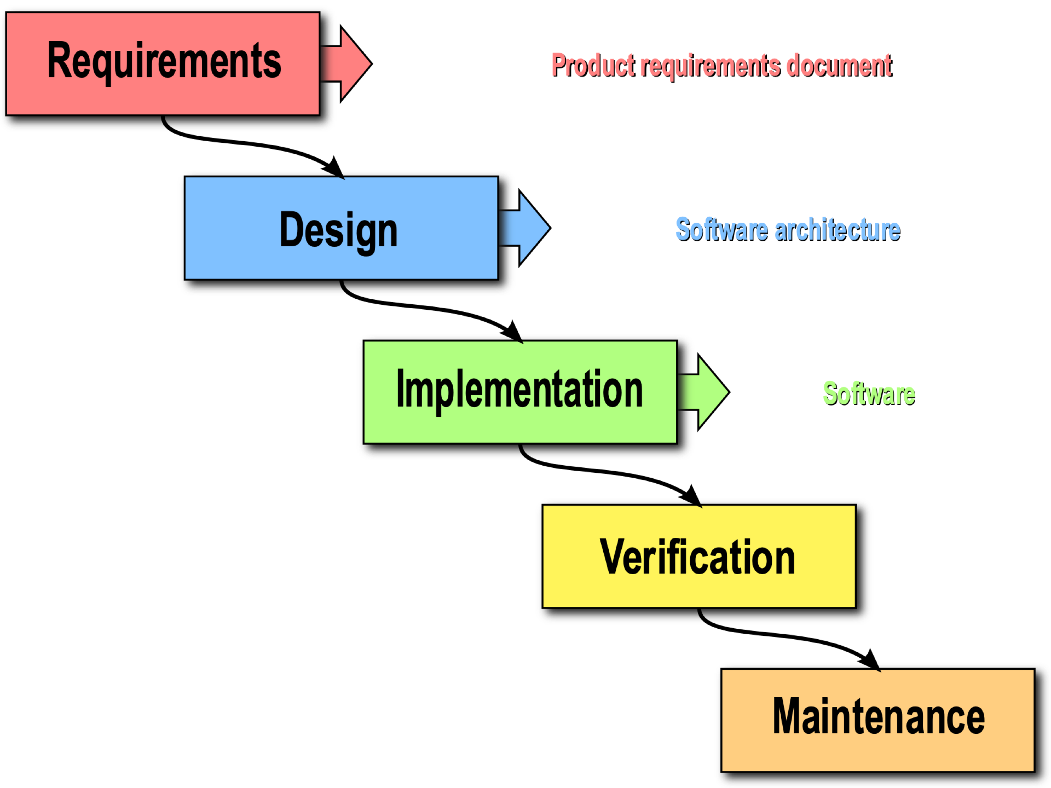
Design Process:
In-practice approach:
A. QH brochure and forms.
a. Noun-like entities
b. Verb-like relationships
B. E-R Diagram (w/o attributes)
C. Prelim. tables & attributes;
potential Primary Keys
D. E-R Connections &
Cardinality Ratios;
potential Foreign Keys
E. Table schemas (PKs & FKs)
(likely questions addressed?)
F. Normalization of tables
Waterfall approach:

Slide 3
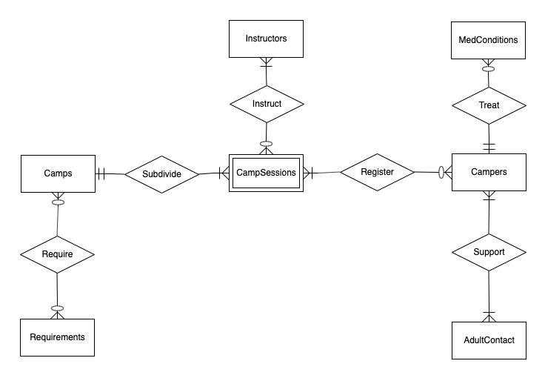
E-R Diagram
Major Challenges:
1. ‘Fee’ (entity) and ‘Payment’ (relationship) information eventual as attributes in
‘Camps’ and ‘Registration’ tables, respectively.
How to handle ‘CampSessions’-associated information (session #-related time and
date range, cyclical date ranges, year-to-year camp adjustments, composite PK).
Increased redundancy in favor of completeness and “historical” accuracy.
3. Session change(s) and/or cancellation. Included within each ‘Registration’ event.

Slide 4
Table schemas
(1) Camps( campID, campTitle, campDescrip, camperAgeGrade, memberFee, nonmemberFee, maxEnroll )
(2) CampSessions( campSessID, campID, sessionID, year, dateRange, rainDate, sessionTime )
FK = campID referencing Camps
(3) CampReqs( campID, reqmntID )
FK = ‘campID’ referencing ‘Camps’ & ‘reqmntID’ referencing ‘Requirements’
(4) Requirements( reqmntID, reqdItem)
(5) Instruction( campSessID, instrID )
FK = ‘campSessID’ referencing ‘CampSessions’ & ‘instrID’ referencing ‘Instructors’
(6) Instructors( instrID, firstName, lastName, email, phone )
Registration( campSessID, camperID, friendRequest, regisFeeAmtPaid, campFeeAmtPaid, scholarship, sessionChange, changeFeeAmtPaid, cancellation, refundAmt )
FK = ‘campSessID’ referencing ‘CampSessions’ & ‘camperID’ referencing ‘Campers’
(8) Campers( camperID, firstName, midInitial, lastName, DOB, member )
(9) Supporters( camperID, adultID )
FK = ‘camperID’ referencing ‘Campers’ & ‘adultID’ referencing ‘AdultContacts’
(10) AdultContacts( adultID, firstName, lastName, email, phone )
(11) MedConditions( medID, medCondition, camperID, emergencyTx, emergencyMed, authorizeToTx )
FK = ‘camperID’ referencing ‘Campers’

Slide 5
3NF (transitive dependency) compromises:
1. 3-4 y/o single-day camps ‘memberFee’ and ‘nonmemberFee’ on ‘camperAgeGrade’.
‘dateRange’ and ‘sessionTime’ on session # (i.e., 1 through 20).
Potential for ‘emergencyTx’ on ‘medCondition’.

Slide 6
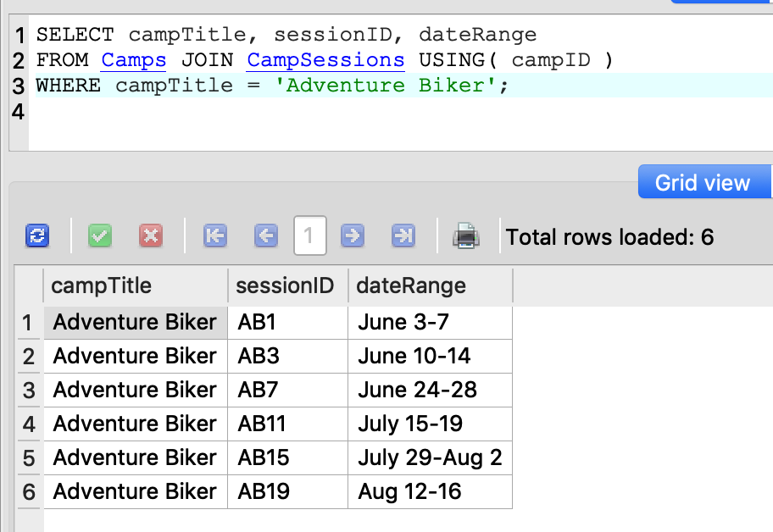
Queries:
1. What weeks is a particular camp available?

Slide 7
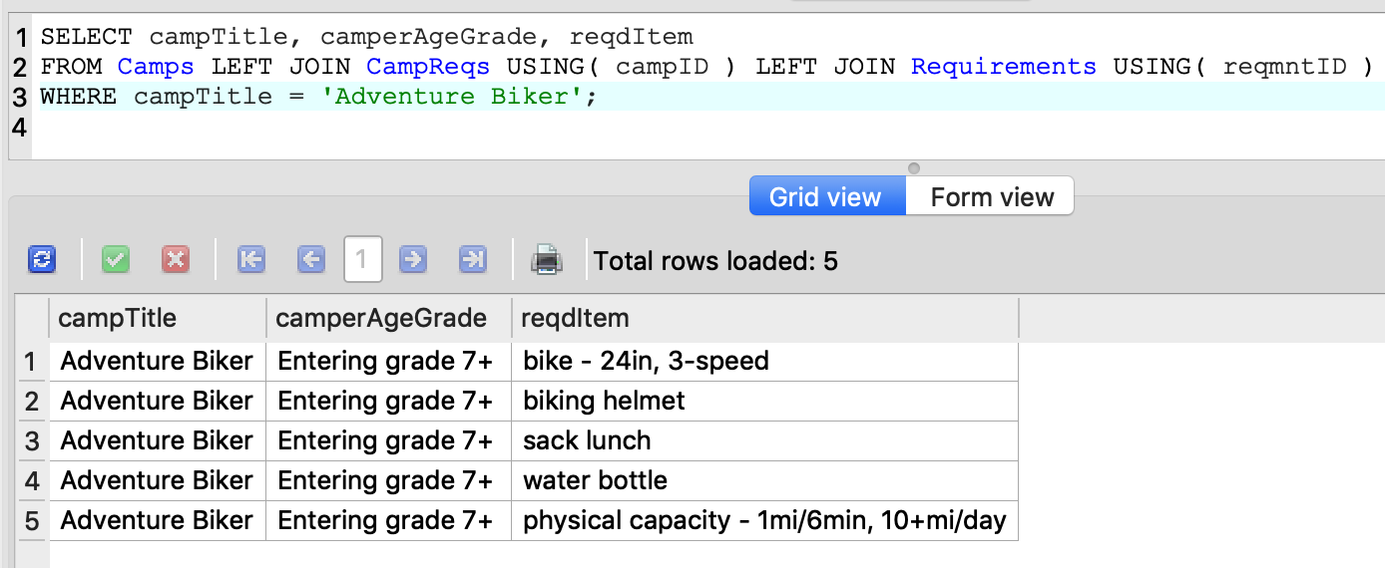
2. The type of camper that can register for a particular camp?

Slide 8
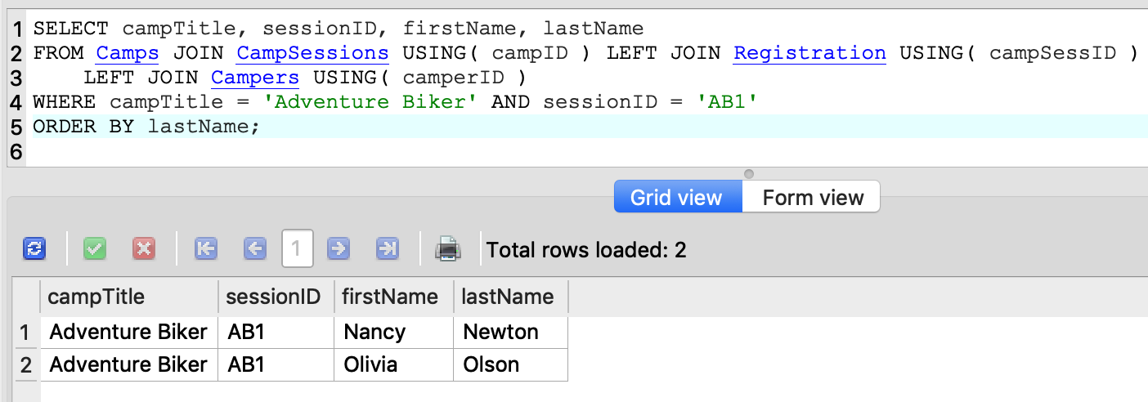
3. Who are the campers registered for the first week of a particular camp?

Slide 9
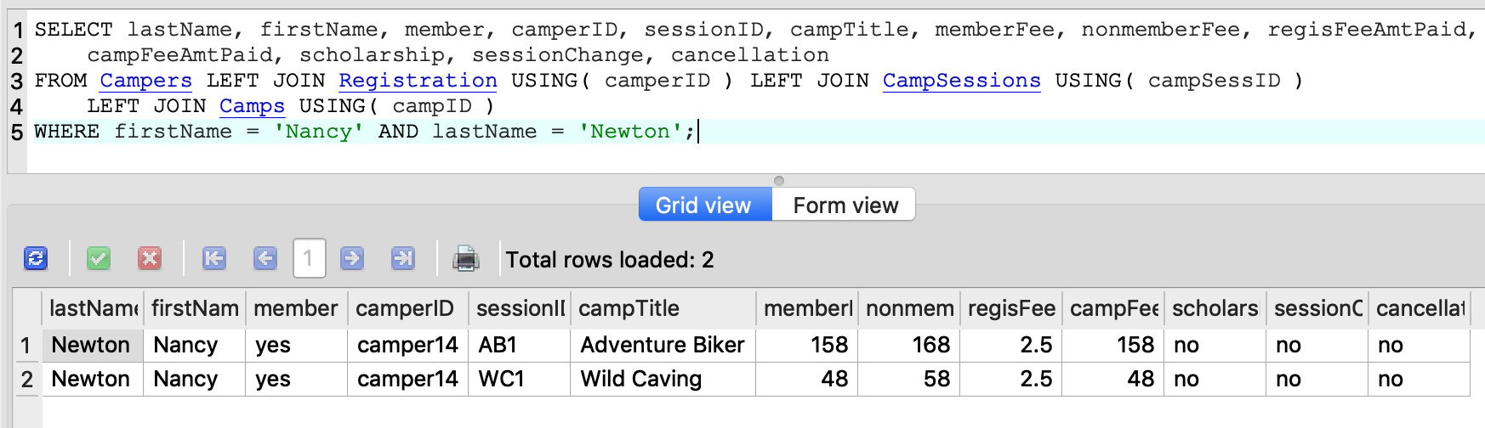
4. Is a particular camper (first and last name) paid in full?

Slide 10
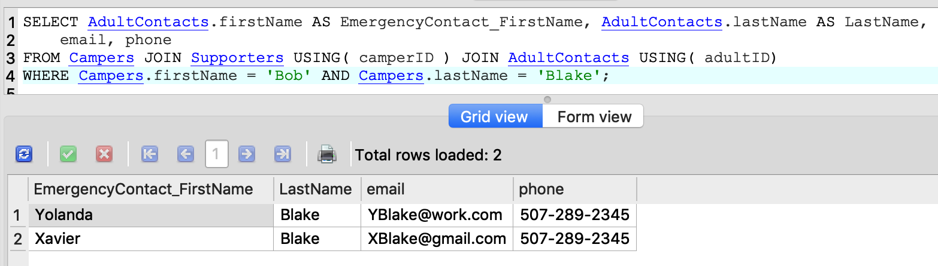
5. Show a particular camper’s emergency contact information?

