Slide 1
MSc Data Analysis for Business Intelligence MA7092 - Data Analytics for Esports - Assessment 3
Project - FIFA YouTube Analysis
Content Source - YouTube
FIFA Game YouTube channels
Tools and languages - Python, Excel, Microsoft PowerBI, Pandas, TextBlob
To analyze the youtube video related trends on YouTube which will add value to FIFA channels and Viewers.

Slide 2
Project Overview
FIFA youtubers streams and post the videos on the platform which include various content like tournament, FUT, Career or Player Mode, Packs and FIFA insider videos.
To learn about data extraction from source like YouTube API and Model the data in useful way.
As discussed, focus is on FIFA 21 to FIFA 23 for year 2022. The Data is extracted from YouTube API V3.
Summary of distribution of FIFA Version as per the channels over last year.
Learning data analysis and visualization. Python and Excel used for primary stage of data cleaning and Power BI used for data modeling and visualizing.

Slide 3
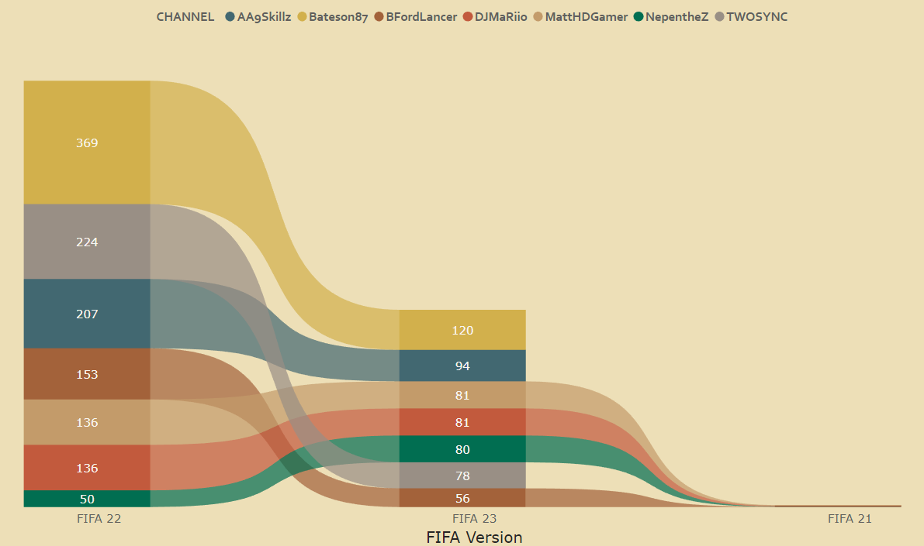
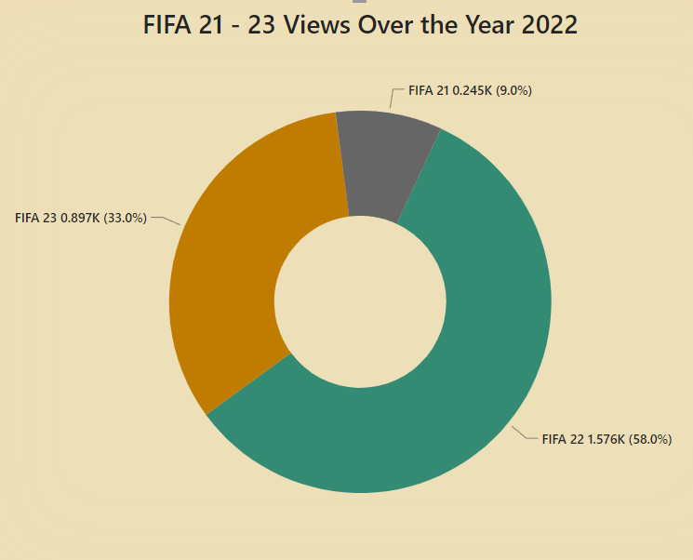
Analysis 1 : Most & Least views for game version and keyword trend across channels
Highest Views : FIFA 22
Lowest Views : FIFA 21
Top 3 channels game version keywords: - FIFA 22: Bateson87 > TWOSYNC > NepentheZ - FIFA 23: Bateson87 > NepentheZ > MattHDGamer
Most used game version by youtubers in Year 2022 : FIFA 22

Slide 4
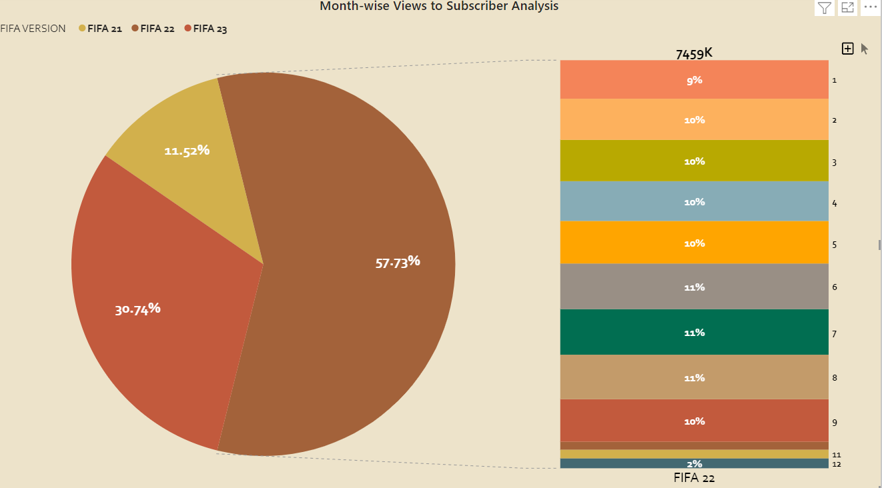
Analysis 2 : Channel trend over subscribers and views
As expected, most of subscribers comes from FIFA 22
Taking FIFA 22 , we can see that there is almost equal amount of subscribers in month 1 to 9.
From October, Instantly most of the youtubers moved to FIFA 23
FIFA 23 claims nearly 31% of subscribers.
Most of the contribution comes from FIFA 22 and FIFA 23 as FIFA 21 is the old version.

Slide 5
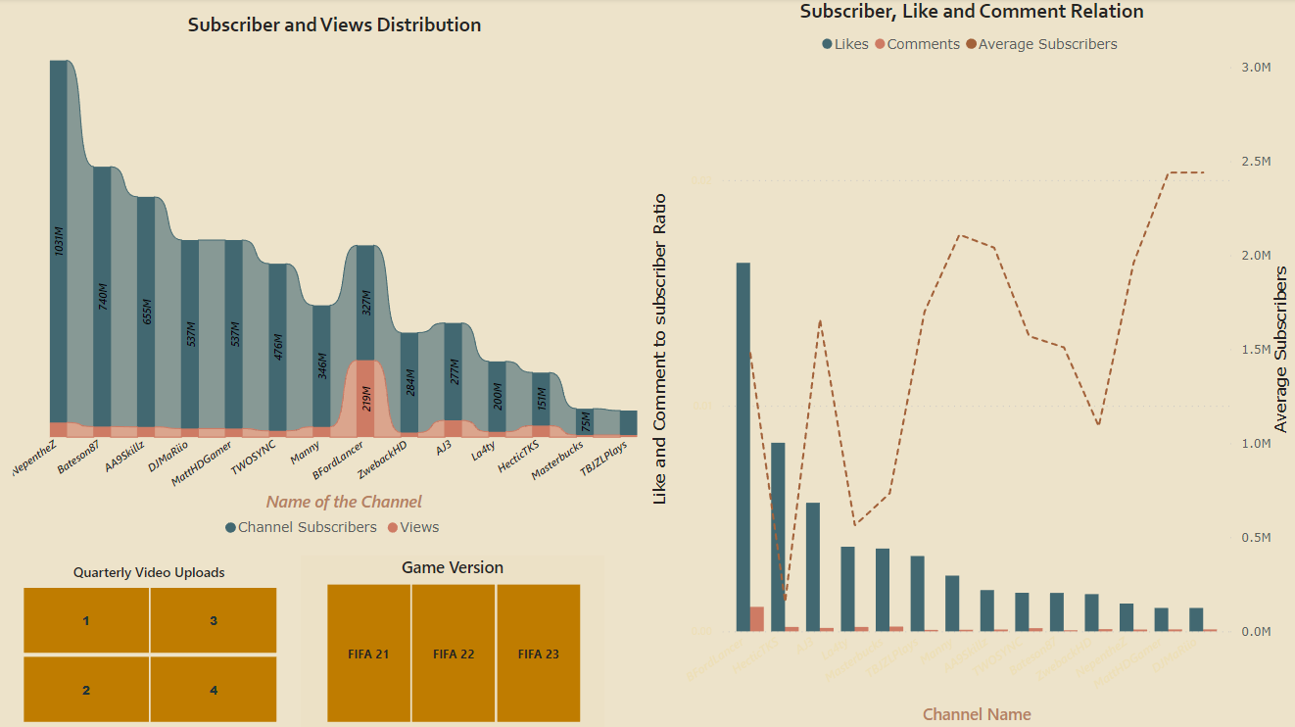
Analysis 3 : Video views, Likes, Comments and Channel Subscriber engagement

Slide 6
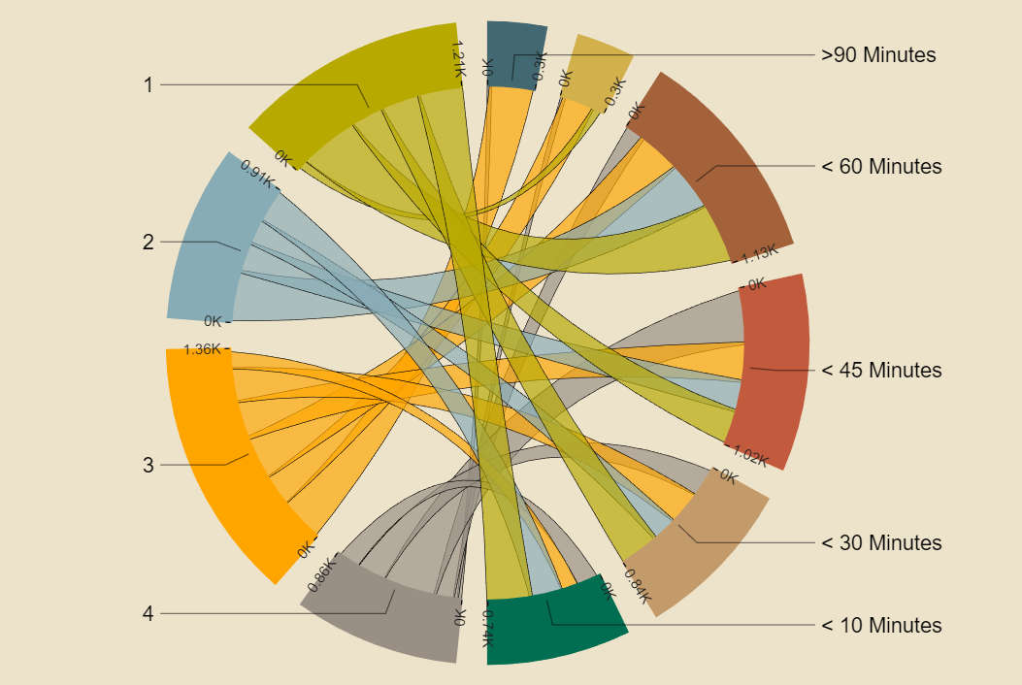
Analysis 4 : How comments does affect on the duration of videos?
This “Chord Graph” shows Quarterly to duration relation with comments.
Low comment to video duration ratio for 3rd Quarter of Year 2022.
Video to comment engagement is low for videos having duration 90+ minutes.
Duration of video strongly relate with the comment engagement on videos.
For videos having duration less than 10 and 30 minutes, comment involvement is very good.

Slide 7

Analysis 5 : Frequently used words in video title which are related to FIFA game
The “Word Cloud” represent the frequently used words in the video title which are related to game.
Words like ‘FIFA , PACKS, TEAM, PLAYER, ICON, ULTIMATE, FUT, PACK, TOTW, DRAFT, EA, TOTS’ are related to FIFA game.
These words viewers can frequently use to search the game related videos.
Abbreviation keywords like ‘FUT, TOTW, SBC, TOTY’ mostly help video and channel to get engagement and view.

Slide 8
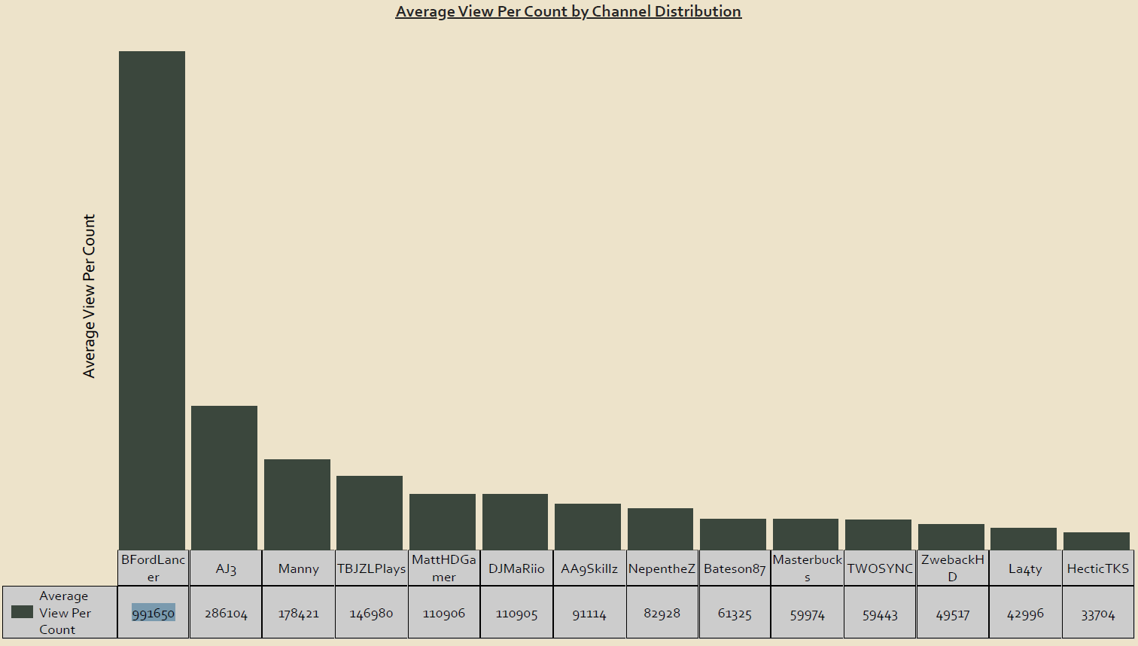
Analysis 6 : Which channel have the highest average view count per video?
Highest average view count per video belongs to youtuber ‘BFordLancer’.
2nd highest goes to ‘AJ3’ followed by ‘Manny’.
Youtuber ‘HecticTKS’ have lowest average view count per video.
This shows the one of key aspect how subscribers and viewers shows activity over the content.
Till now ‘La4ty’ and ‘HecticTKS’ have bad aspects in term of engagement of viewers.

Slide 9
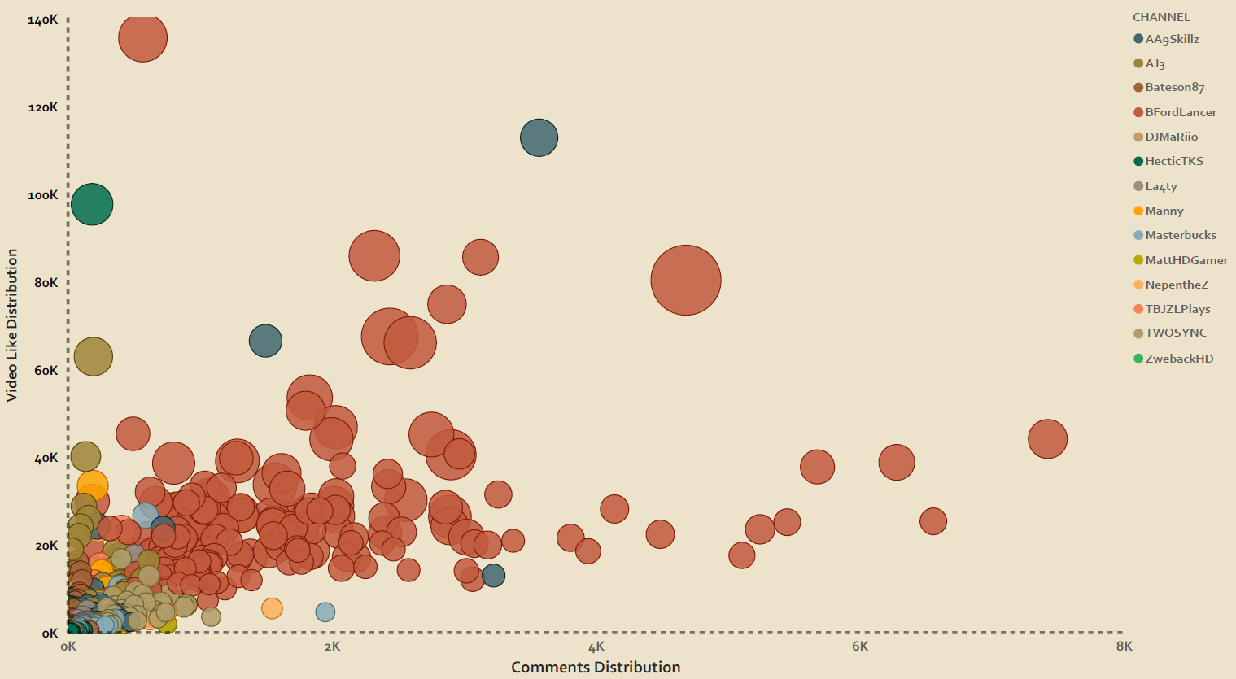
Analysis 7 : How can comments help channel? What is the relation between likes and view count?
The ‘Scatter Plot Graph’ represent the how comments relate with likes and views considering the duration of video per channel.
Most of the contribution is by ‘BFordLancer’ followed by ‘AJ3’.
Video duration surpassing average time 60 + minutes tends to low likes, comment activity.
‘BFordLancer’ shows good engagement and a balanced content duration.

Slide 10
Conclusion :
FIFA 22 dominates the highest viewed game last year among the 15 known YouTubers.
Switching to new FIFA version soon will help YouTubers having low engagement. FIFA 21 is not likely to help in growth.
Including keywords in video title specific to FIFA game event are helpful for engagement and channel growth.
Continuation is key to growth followed by content creativity. Viewers tends to involve in the game events like TOTS, TOTY, TOTW, SBC and other.
Viewers interested in subscribed video channels for FIFA related content like for channels BFordLancer, HecticTKS and AJ3.
BFordLancer’s content is more engaging as around 40% of his views are from subscribers. This shows this channels content is interesting for viewers.
Video time length is one of the aspect that youtuber should consider as this shows a good relation with views.
From the analyzed data, we can conclude that Bateson87 and BFordLancer are more successful. On the other hand, we can say that HecticTKS and Ta4ty are not successful.

Slide 11
Learning and Development needs analysis :
Data collection, cleaning and modelling is very essential steps to present data in well manner.
We have used YouTube API V3 for data collection, taking known 15 YouTube channels.
Python and excel for data cleaning. In this we used libraries like pandas and Numpy. For text analysis, we have learnt about TextBlob library.
PowerBI to model and visualize the data. Learnt about basics of Power BI, dashboards and data modelling with use of Power Query and visual data models.
Visualization of data adds value to make data in better understandable form. The dashboard are interactive way to explore the data.
Data analysis does not only start with data cleaning, but also hold a importance in collection and extraction of the data.
Converting raw data into sensible format is very important aspect to model the data.

