Slide 1
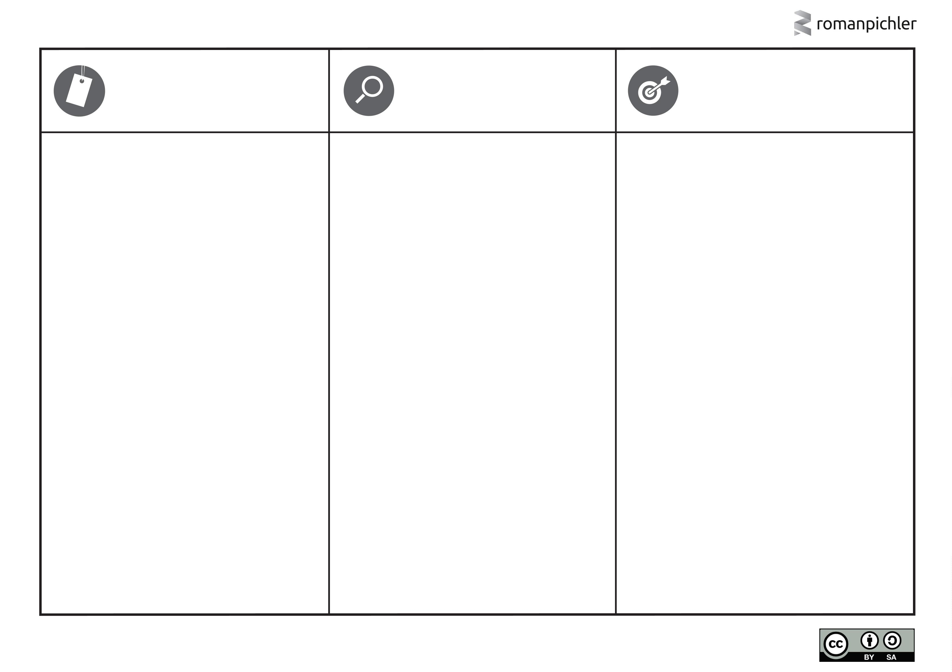
ROMAN’S PERSONA TEMPLATE
D
E
T
A
I
P
L
S
G
O
A
L
I
C
T
U
R
E
&
N
A
M
E
What does the persona look like? What is its name? Choose a realistic and believable picture and name.
What are the persona’s relevant characteristics and behaviours? For instance, demographics, such as age, gender, occupation, and income; psychographics, including lifestyle, social class, and personality; and behavioural attributes like usage patterns, attitudes, and brand loyalty. Only list relevant details.
What problem does the persona want to solve or which beneꢀt does the character seek? Why would the persona want to use or buy the product?
ABC
ABC
ABC
w w w.romanpichler.com
Template version 02/20
This work is licensed under a Creative Commons
Attribution-ShareAlike 4.0 Unported license

