Slide 1


Vessel Trajectory Prediction Using Robust AIS
Preprocessing and Dual-Self-Attention GRU
Marilena Sinni, Dimitris M. Kyriazanos
National Centre for Scientific Research "Demokritos", Institute of Informatics and Telecommunications (IIT)
Workshop on AI-driven Data Engineering and Reusability for Earth and Space Sciences (DARES’25), co-located with the 28th
European Conference on Artificial Intelligence (ECAI 2025), Bologna, Italy, October 25, 2025.
Received funding under project FaRADAI, Grant No 101103386

Slide 2
Motivation
Precise forecasting of vessel trajectories
Why? For safe and efficient maritime traffic management
Difficulties
Maritime data suffer from inherent errors
Continuous forecasting for hours if challenging
Notes:
The motivation of our study is the precise trajectory forecasting of vessel trajectories
This task is fundamental for safe and efficient maritime traffic management: for example:::
port authorities and coastal surveillance systems depend on reliable predictions to prevent collisions and optimize traffic flow
But it has to deal with major challenges concerning the maritime data that suffer from inherent errors and the forecasting task that is a known challenging task and especially if it has to be continued for hours

Slide 3
Goal & Challenges
Prediction Goal
Key Challenge
Predict latitude & longitude, Speed over Ground (SOG) and Course over Ground (COG)
Prediction over a multi-step time horizon spanning several hours.
Bridge the gap between complex Automatic Identification System (AIS) data preprocessing and accurate future trajectory forecasting
Notes:
Our goal is to predict not only the future position of a vessel but also its future speed and course.
We aim to forecast not just a few future points, but the entire trajectory each vessel is likely to follow over the coming hours.
These objectives bring their own challenges, particularly in bridging the gap between complex Automatic Identification System (AIS) data preprocessing and accurate future trajectory forecasting.

Slide 4
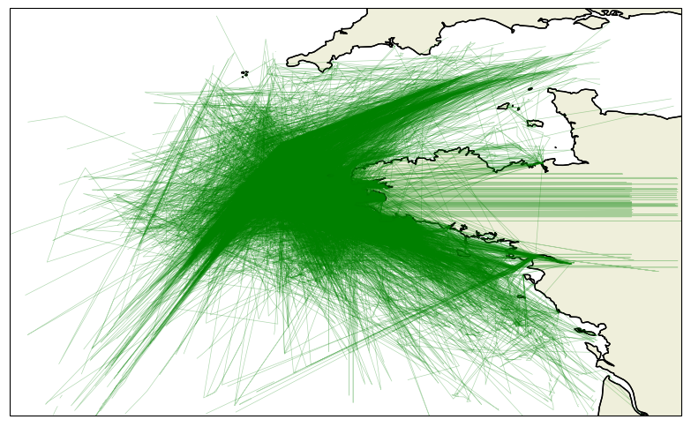
Raw AIS Data Inaccuracies
Irregular sampling & gaps: messages arrive unevenly (seconds → hours).
Noise and anomalies: includes position spikes on land, duplicated or missing reports, and physically impossible speed values.
Heterogeneous vessel behavior: different ship types and manoeuvres.
Notes:
For those that are not familiar let's meet the AIS data. This is a figure depicting the dataset we used before any preprocessing.
Their main inaccuracies are:
The data are irregularly sampled, creating large gaps between transmitted messages. Some messages arrive every second, while others may come only once an hour.
As we can see in the figure, the data also include incorrect transmissions, sometimes showing positions on land, which is a major issue.
Some points are duplicated, missing, or contain physically impossible speed values.
Finally, this dataset includes all types of vessels --- from cargo ships to tugboats --- each with very different sailing behaviours, resulting in highly heterogeneous trajectories.

Slide 5
Our Contributions
Comprehensive AIS preprocessing pipeline ensuring noise-free, consistent trajectories that enhance prediction performance.
Notes:
Read out loud

Slide 6
Our Contributions
Comprehensive AIS preprocessing pipeline ensuring noise-free, consistent trajectories that enhance prediction performance.
A robust sequence forecasting model, combining a single-layer GRU with a dual-head self-attention mechanism.
Notes:
Read out loud

Slide 7
Our Contributions
Comprehensive AIS preprocessing pipeline ensuring noise-free, consistent trajectories that enhance prediction performance.
A robust sequence forecasting model, combining a single-layer GRU with a dual-head self-attention mechanism.
Joint prediction of future vessel position, Speed Over Ground (SOG), and Course Over Ground (COG) up to 7 hours ahead, significantly outperforming LSTM and standard GRU baselines.
Notes:
Read out loud

Slide 8
Methodology (1/2): Preprocessing

Slide 9
AIS data preprocessing
Cleaning
Remove implausible values
Deduplication
Remove stationary vessels
Trajectory extraction
Split voyages
Trajectory segmentation
SOG error correction
Prevent unrealistic jumps
Position error correction
Smooths unrealistic displacements
Temporal resampling to 1-minute fixed interval

Slide 10
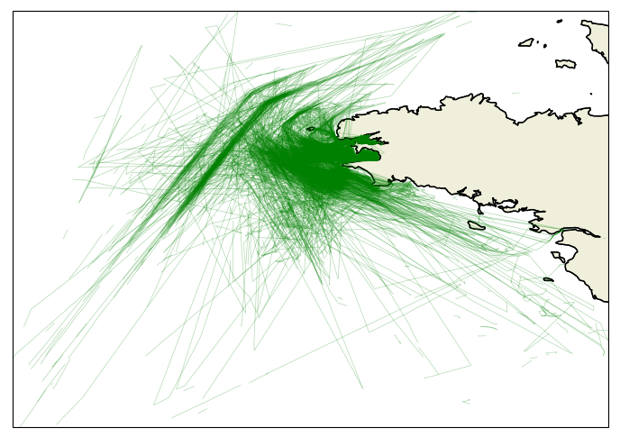
Raw AIS data
Preprocessed AIS data
Notes:
In the figures, we can see the data remaining after preprocessing: some of the corrections can be seen:
The land jumps have been removed.
Most straight lines that implied duplications have been corrected.
The remaining data are informative and meaningful and show the vessels real movement

Slide 11
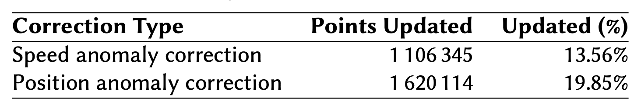
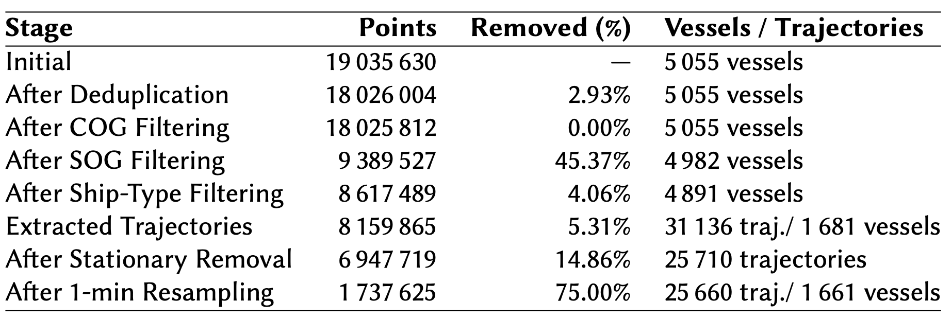



Preprocessing results
Notes:
In the first table we see the percentage of points that had anomalies in their speed or position, and were corrected.
The second table outlines all preprocessing stages, including the number of points at each stage, the percentage of points removed, and the remaining number of vessels and/or trajectories.
The numbers highlighted in yellow indicate the key stages where a significant number of points was removed.
Most points were discarded during the SOG filtering stage, which eliminates vessel points with a speed of zero, and during the resampling stage.
The most significant vessel reduction occurred when large voyages were split into smaller segments. Which means that a lot of vessels had very small voyages or very sparse sampling rate.

Slide 12
Methodology (2/2): Vessel trajectory prediction framework

Slide 13
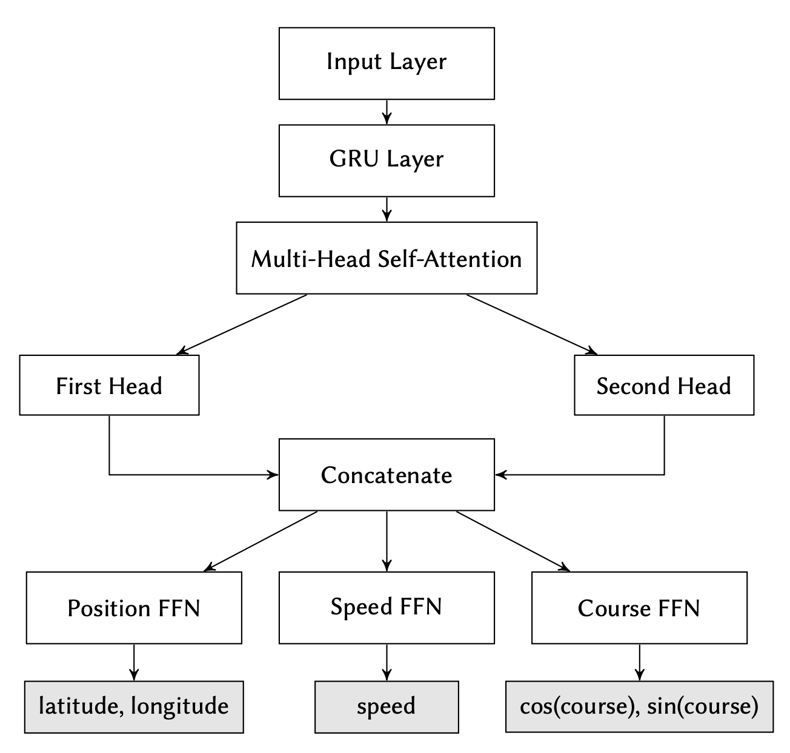
Dual-Self-Attention GRU Prediction Model Architecture
Notes:
Here’s the model in one picture — the GRU encoder with a dual-head self-attention block and three specialized output heads

Slide 14




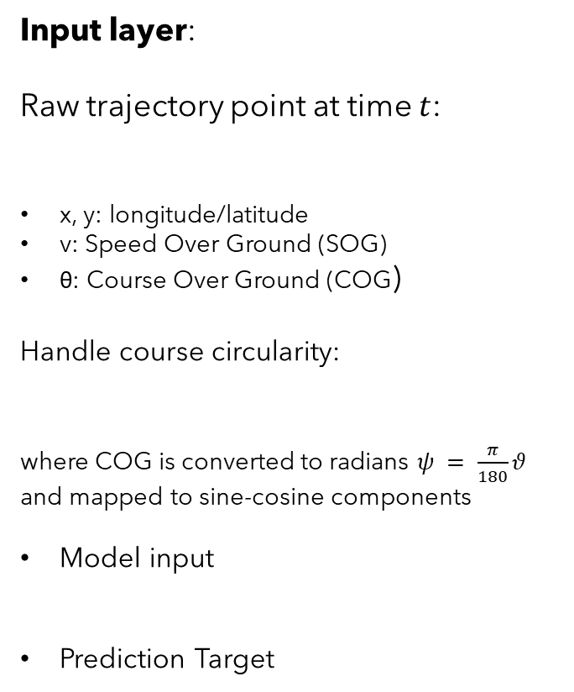
Input layer:
Raw trajectory point at time $t$:
x, y: longitude/latitude
v: Speed Over Ground (SOG)
θ: Course Over Ground (COG)
Handle course circularity:
where COG is converted to radians $ψ = \frac{π}{180}θ$
and mapped to sine-cosine components
Model input
Prediction Target
$$p_{t} = (x_{t}, y_{t}, v_{t},θ_{t})$$
$$p_{t}^{′} =(x_{t}, y_{t},v_{t},\cos{ψ_{t}, \sin{ψ_{t}}})$$
$$Χi={\{\tilde{p}}_{1},{\tilde{p}}_{i+1},{\tilde{p}}_{i+2},{\tilde{p}}_{i+3},{\tilde{p}}_{i+4}\}$$
$$yi= {\tilde{p}}_{i+5}$$
Notes:
Course is converted to radians and then mapped to sine-cosine components to avoid discontinuities at 0∘/360∘.
Sequential patterns are extracted via overlapping sliding windows of length T = 5 over each vessel’s trajectory.
Each window shares four points with the previous one, ensuring smooth transitions and maximal use of the trajectory data for predicting the immediate next point

Slide 15


GRU Layer:
Hidden size = 256
Generates full sequences of hidden states $H = \{h_{1},h_{2},…,h_{T}\} ∈ ℝ^{TX256}$
Dual-head self-attention (two parallel heads):
For each head $kεℝ^{TX256}$,
$${head}^{(k)}=softmax\left(\frac{{Q^{(k)}(K^{(k)})}^{T}}{\sqrt{d_{k}}}\right)V^{(k)}$$
Concatenate heads and project:
$$AttOut=[{head}^{(1)};{head}^{(2)}]W_{o}+b_{o}$$
$$H_{out}= LayerNorm(H+AttOut)$$
Notes:
T=window length
H=the entire GRU output sequence
Dk = 128
Attention Output (AttOut):
a context-enhanced version of the GRU sequence $H$.
Residual Connection and Layer Normalization (Hout)
Residual connection: adds the original GRU output $H$back to the attention output. “Keep what the GRU already learned, and add the extra contextual refinement from attention.”
Layer normalization: stabilizes training and scales features evenly.
Bias term $b_{o}$: just an offset added after the projection.

Slide 16
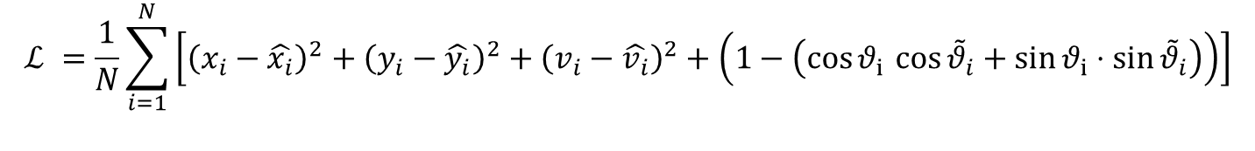
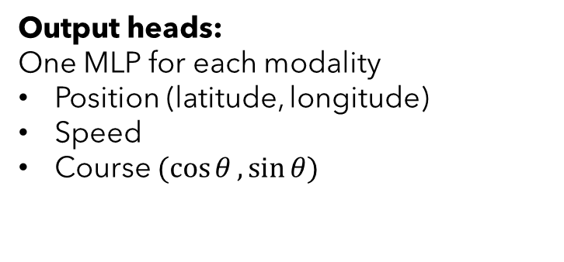
Output heads:
One MLP for each modality
Position (latitude, longitude)
Speed
Course $(cos{θ},\sin{θ})$
$$ℒ =\frac{1}{N}\sum_{i=1}^{N}{\left[{\left(x_{i}−\hat{x_{i}}\right)}^{2}+{\left(y_{i}−\hat{y_{i}}\right)}^{2}+{\left(v_{i}−\hat{v_{i}}\right)}^{2}+\left(1−\left(\cos{θ_{i }\cos{{\tilde{θ}}_{i}}}+\sin{θ_{i}}⋅\sin{{\tilde{θ}}_{i}}\right)\right)\right]}$$
Loss Function:
Notes:
OUPUT HEADS:
The two head outputs are concatenated to restore dimension h = 256.
The fused representation is fed into three specialized output heads
LOSS FUNCTION:
The model employs a Mean Squared Error (MSE) loss function, with a modification for the COG component.
Specifically, cosine similarity loss is used for COG to account for its circular nature, avoiding discontinuities at the 0°/360° boundary. This approach ensures more stable and accurate predictions of directional angles.

Slide 17
Experimental results

Slide 18
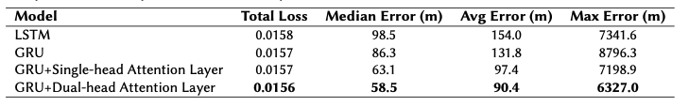
Model performance comparison
Notes:
1. METRICS:
Apart from MSE loss we computed median, average and max error in meters. These measure the distances between the trajectory window and the predicted point.
2. Our model overcomes LSTM and GRU
3. Self-attention helps the model focus on key moments—like a speed change or turn—by comparing all points in the sequence.
Even adding one attention head significantly improved accuracy, dropping the median error from 86.3 to 63.1 meters.
Using two parallel heads improved it even more, reducing interference between different types of input and bringing the median error down to 58.5 meters.
So, multi-head attention clearly boosts trajectory prediction performance.

Slide 19
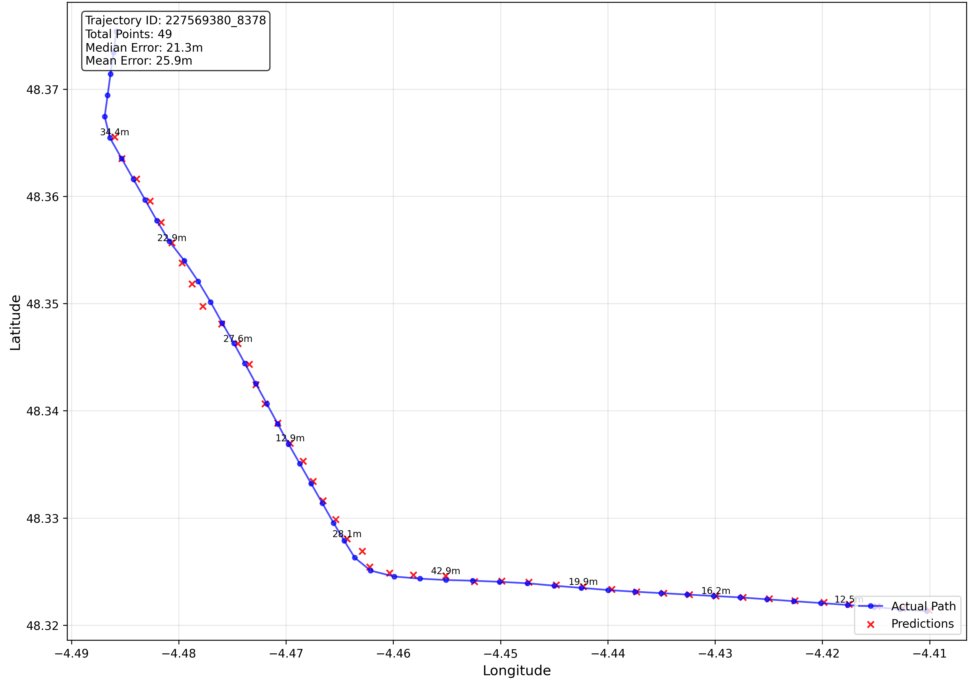
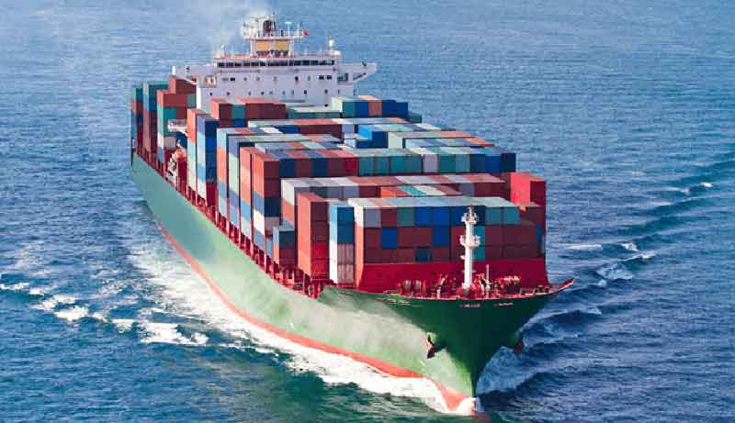
Cargo vessel trajectory prediction
49 points
Figure 1a: latitude and longitude prediction
Notes:
Figure 1 shows the experimental results for one vessel with an average distance error of 25.9 m.
Specifically, it shows the ground truth represented by a blue line and the predicted points marked as red crosses.
As we can see the predictions are almost perfectly aligned with the ground truth trajectory

Slide 20
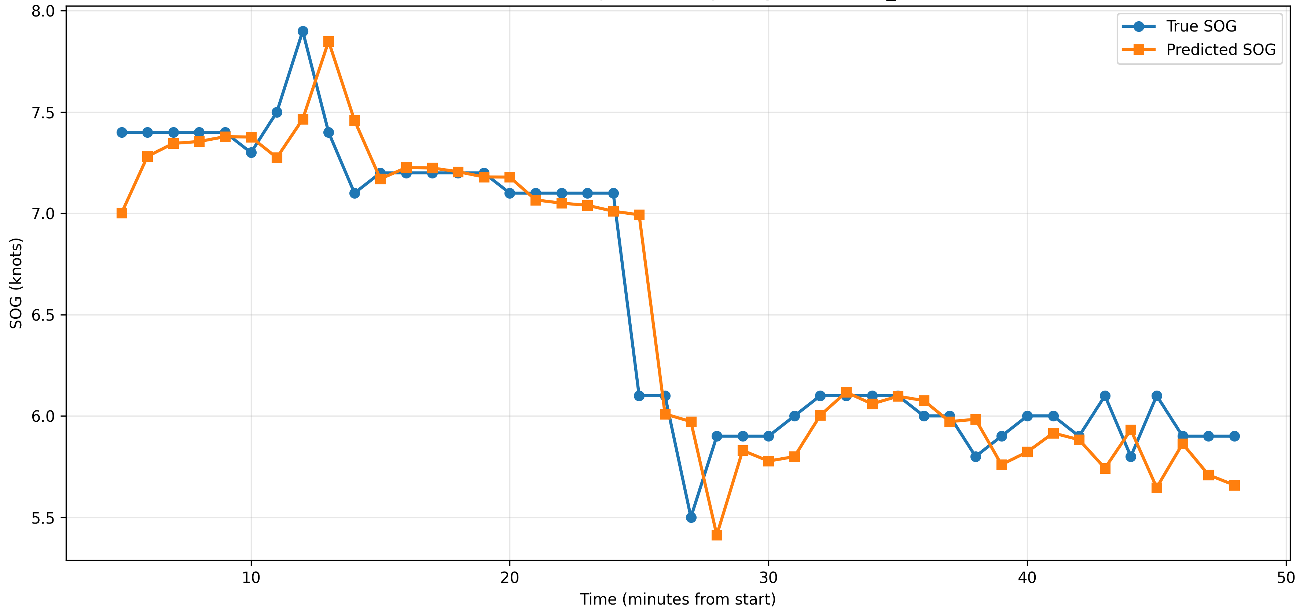
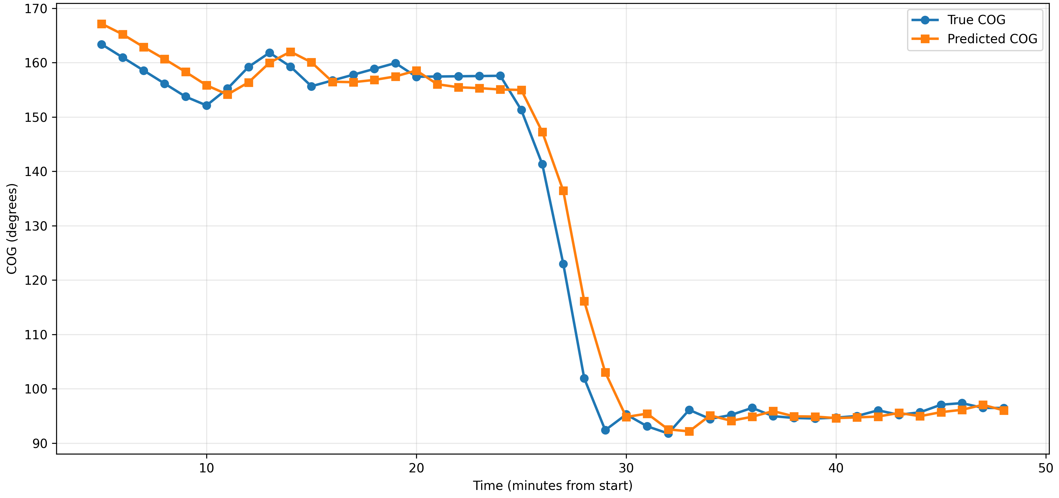
Figure 1.b: SOG prediction
Figure 1.c: COG prediction
Notes:
These two figures demonstrate the SOG and COG predictions, compared with the ground truth.

Slide 21
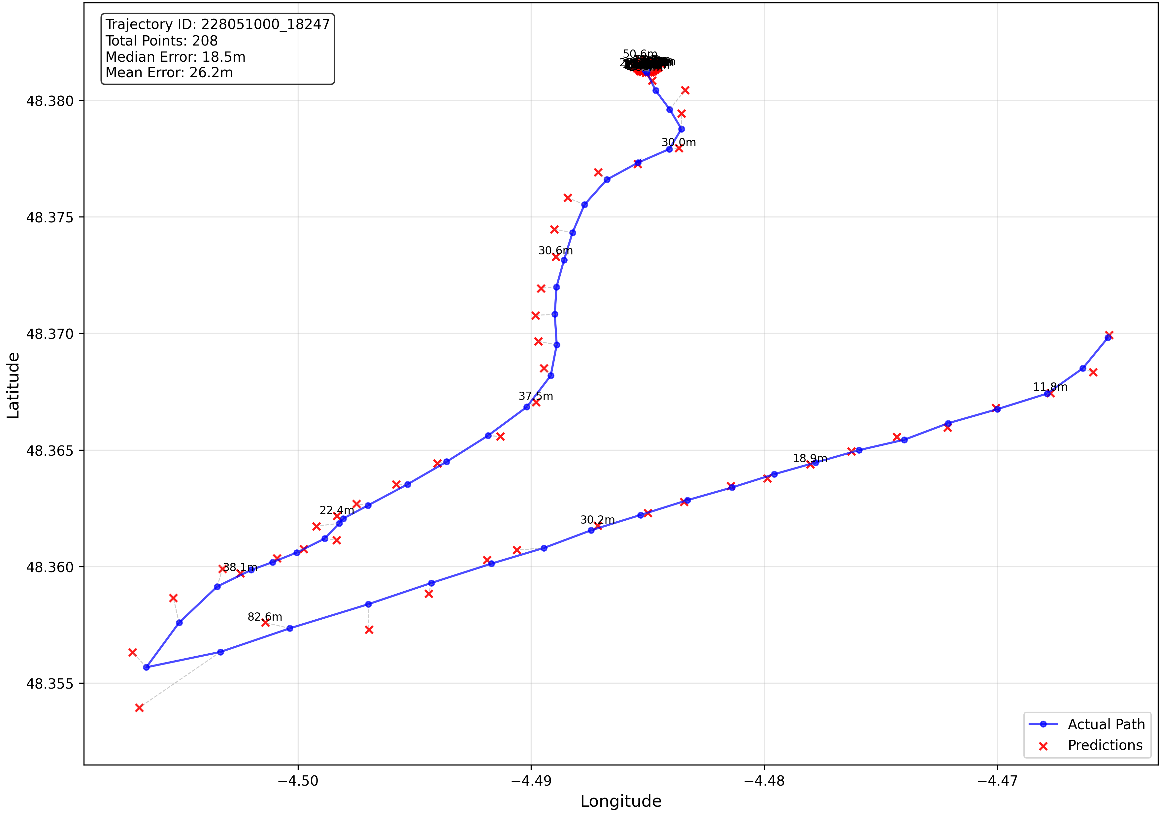
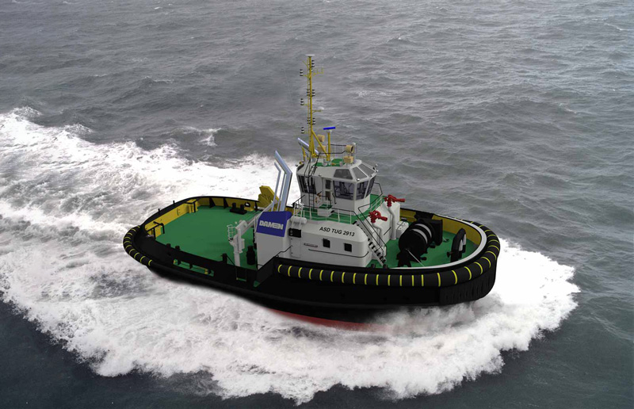
Tug vessel trajectory prediction
208 points
Figure 2a: latitude and longitude prediction
Notes:
Next, we have another example of a tug vessel prediction with an average error of 26.2 m.
This vessel is particularly interesting because, from the position plot, we observe that it remains stationary for 155 minutes;
and despite this, the prediction accuracy remains strong for up to 208 minutes

Slide 22
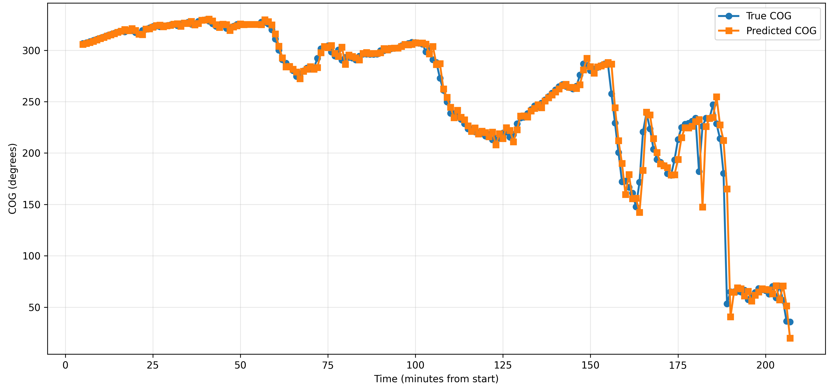
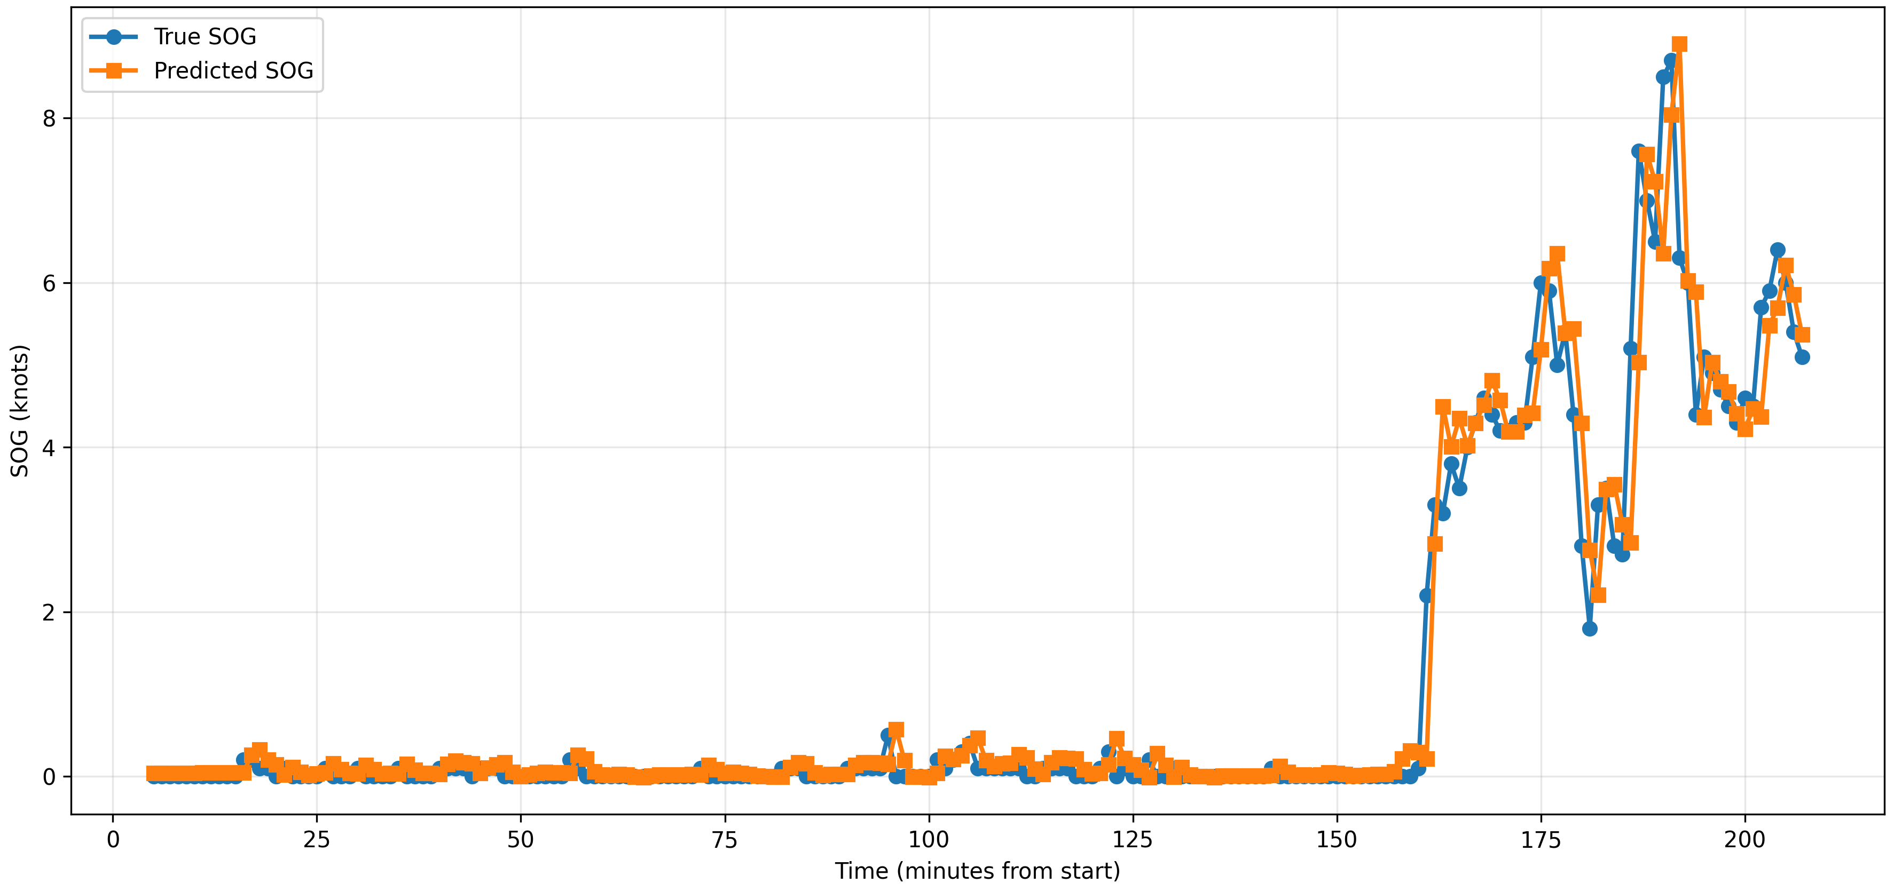
Figure 2.b: SOG prediction
Figure 2.c: COG prediction

Slide 23
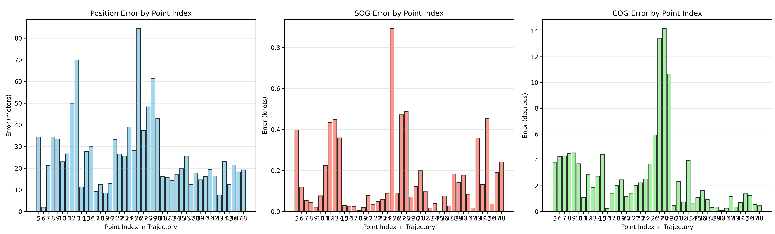
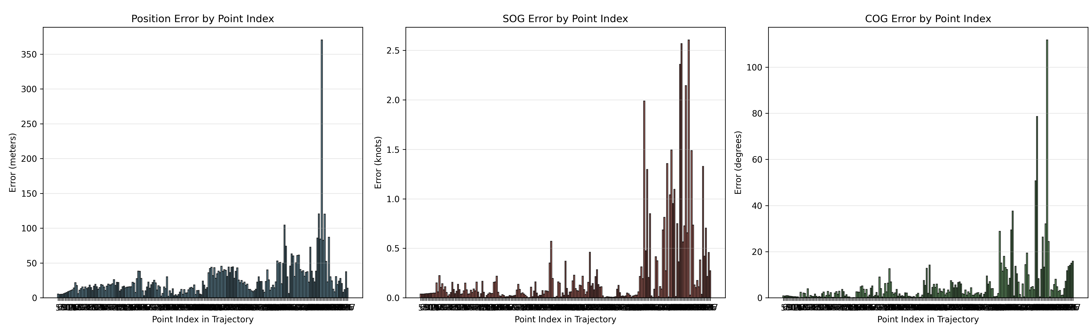
Figure 2.a: Tug vessel error distribution
Figure 2.b: Cargo vessel error distribution
Notes:
An analytical error distribution for the two vessels

Slide 24
Conclusions
Proposed preprocessing pipeline effectively cleans and structures AIS trajectories, making them suitable for prediction and other downstream tasks.
Self-attention dynamically re-weights past time steps, capturing long-range dependencies and abrupt maneuvers that recurrent layers may miss.
GRU + dual-head self-attention architecture accurately forecasts future vessel positions, speeds, and courses for prediction horizons of up to 7 hours.
Dual-head attention outperforms single-head and standard RNN/GRU baselines, demonstrating clear performance gains from learning complementary temporal contexts.

Slide 25
Limitations & future work
The heterogeneity of our dataset enables better generalization across various dataset types - need to be validated.
Benchmark our model’s strong performance against additional state-of-the-art methods, such as transformers and bidirectional RNNs.
Evaluate the preprocessed dataset on anomaly detection tasks.

Slide 26
Thank you! Questions?

Slide 27
Dataset
Automatic Identification System (AIS) data
Publicly available dataset from Brest, France
Time span: 5-months
Vessel types: cargo, tanker, passenger, fishing, pleasure, towing/tug, military, other (includes rare types).

