Slide 1
Version 2.0 (current)

Slide 2


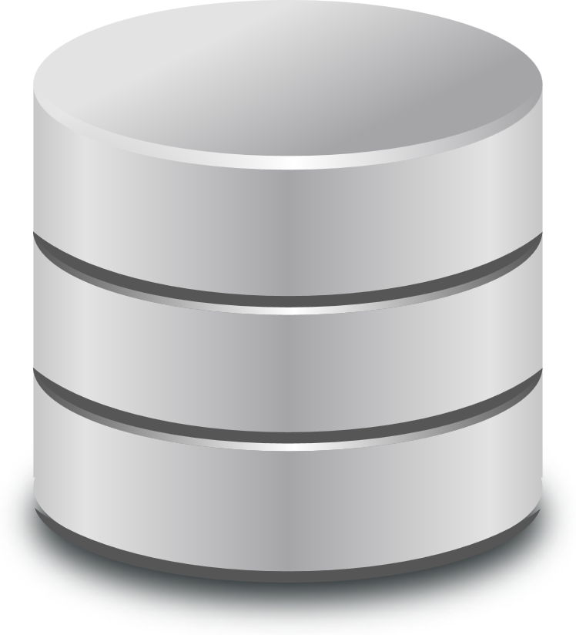




Federation Services
SS
Discovery Service
(direct query)
SS
Software Service
(env. artifacts)
Job Submission Service (indirect query)
SS
SS
Data
Controller
TRE
RAZ
SDZ
QMZ
TRE
RAZ
SDZ
QMZ
Researcher
Security Server
Security Server
TRE-G
TRE-G
Index Service
Software Service
(research artifacts)
SS
SS

Slide 4
Version 1.0 (deprecated)

Slide 5





Data Provider
Discovery Service
Data Controller
TRE
Researcher
Data Provider
Data Controller
Index Service
Information
Governance
Software Service
Today
Internet

Slide 6

DARE UK
SDRI Federation
Data Provider
Discovery Service
Security Server
Security Server
Data Controller
TRE
Researcher
Data Provider
Security Server
Security Server
Data Controller
Index Service
Information
Governance
Software Service
Security Server
Security Server
Federation
Operator
Federation Services
Security Server
Tomorrow

Slide 7
SARA
DARE UK
SDRI Federation
Data Provider
Discovery Service
Security Server
Security Server
TRE-FX
Data Controller
TRE
Researcher
Data Provider
Security Server
Security Server
TELEPORT
Data Controller
Index Service
SATRE
SACRO
Information
Governance
Software Service
Security Server
Security Server
Federation
Operator
5 Driver projects
Prove key technologies
Begin standardisation
Federation Services
Security Server
Now

Slide 8
SARA
DARE UK
SDRI Federation
Data Provider
Discovery Service
Security Server
Security Server
TRE-FX
Data Controller
TRE
Researcher
Data Provider
Security Server
Security Server
TELEPORT
Data Controller
Index Service
SATRE
SACRO
Information
Governance
Software Service
Security Server
Security Server
Federation
Operator
Managed Federation
Common security
Standardised connections
Federation Services
Security Server
Next

Slide 9
DARE UK
SDRI Federation
Gateway
Data Provider
Discovery Service
Security Server
Security Server
Data Controller
TRE
Researcher
Data Provider
Security Server
Security Server
Data Controller
Index Service
Information
Governance
Software Service
Security Server
Security Server
Federation
Operator
Federation Services
Security Server
Phase 2
Gateway??

