Slide 1

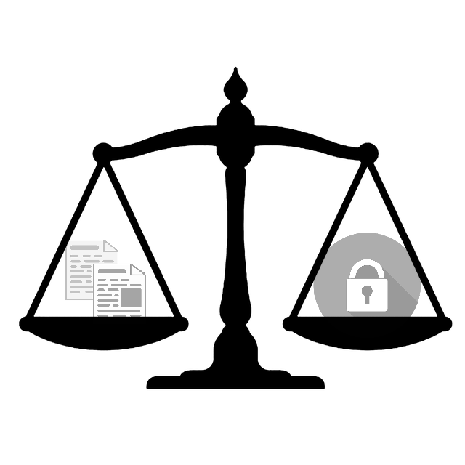
Data protection in research practice

Slide 2
Part II: Principles, rights and responsibilities

Slide 3
Agenda
What is the GDPR and what does it apply to?
What is personal data and what is sensitive data?
What does anonymization or pseudonymization of data mean?
What are the principles of the GDPR?
What are the key roles defined in the GDPR?
How to process data for archiving purposes or scientific or historical research purposes in accordance with the GDPR?
The ELDAH Consent Form Wizard - A Step-by-Step Tutorial

Slide 4
What are the principles of the GDpr?

Slide 5
The 7 principles of the GDPR (Art. 5)
Personal data must (and may only) be processed on the basis of these 7 principles:
Lawfulness, fairness and transparency
Purpose limitation
Data minimization
Accuracy
Storage limitation
Integrity and confidentiality
Accountability

Slide 6
Which key roles are defined in the GDPR and what are their rights and Obligations?

Slide 7

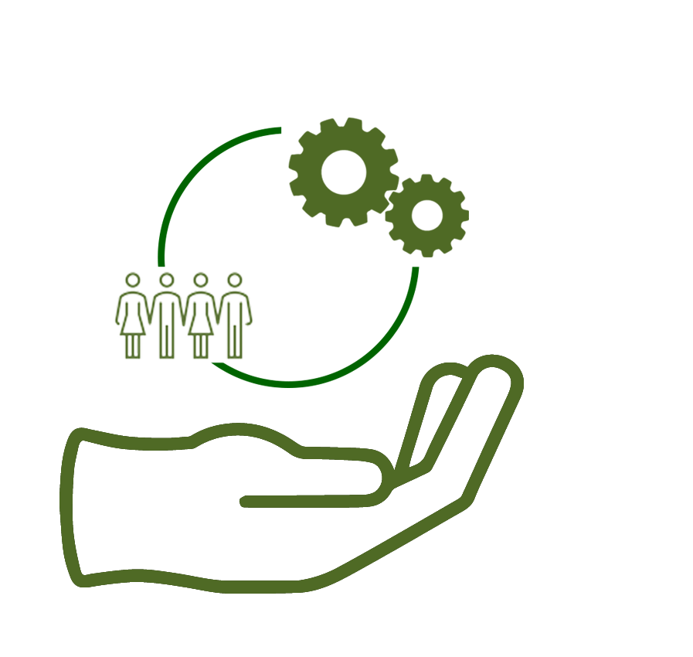
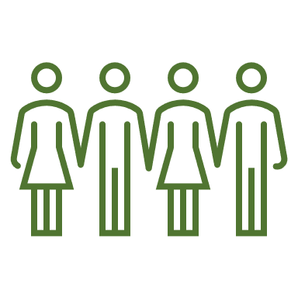
Key roles
Data controller
…the natural or legal person, authority or other legal entity, which alone or jointly with others determines the purposes and means of the processing of personal data.
Data processor
… the natural or legal person […], which processes personal data on behalf of the data controller.
Data subject
… the natural person, whose data is getting processed.

Slide 8

Obligations of Data controllers And Data Processors

Slide 9
Obligations of data controllers and data processors
Obligations of data controllers:
Ensure Data protection by default via technological measurements and data protection-friendly user settings
Records of processing activities (§30)
Appoint a data protection officer
Verification of the legitimacy of the processing
Reporting data breaches to DPAs and data subjects
Obligations of data processors:
Ensure compliance with all requirements of the GDPR

Slide 10
Rights of the data subjects

Slide 11
Rights of the data subjects
Right to be informed (at the moment of data collection!)
Right of access (anytime)
Right to rectification
Right to erasure („Right to be forgotten“)
Right to restrict processing
Right to data portability
Right to object

Slide 12

RECAP

Slide 13

Good to Know
The GDPR is based on 7 principles
Lawfulness, fairness and transparency
Purpose limitation
Data minimization
Accuracy
Storage limitation
Integrity and confidentiality
Accountability
2) Data processing must follow those principles
3) Data controllers and data processors have a variety of obligations
4) Data subjects have a number of rights, that should always be kept in mind

Slide 14

Video II
More material and useful links

Slide 15
Data protection in research practice

