Slide 1


Grew Match
a tree query language for conll-u files
http://universal.grew.fr/?corpus=UD_English-ParTUT#
This project has received funding from the European Union’s Horizon 2020 research and innovation programme under grant agreement No 101004984

Slide 2
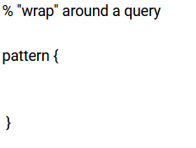
“Wrap around” a query
commented line
here come the conditions;
separated by semicolons;

Slide 3
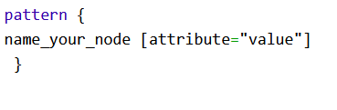

Node with conditions

Slide 4

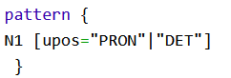
Node with conditions
OR,
note: no parentheses

Slide 5
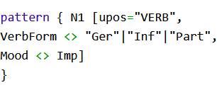

Node with conditions
not equal

Slide 6

Node with conditions

Slide 7
Node with conditions
This feature must be there (any value)
This feature must NOT be there (any value)

Slide 8
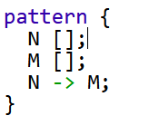
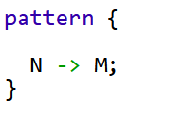
Relations
should be equal
any node N governing any node M, with any syntactic relation

Slide 9
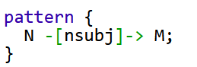
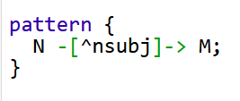
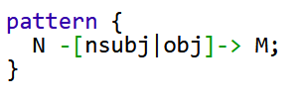
Define relation

Slide 10
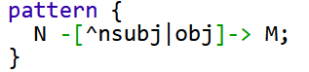
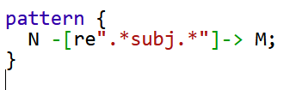
Define relation
not this
neither

Slide 11
The case of beget revisited
https://arboratorgrew.elizia.net/#/projects/dracor_shake/beget
find all occurrences of the lemma beget with possible prefixes (should be 73 in total)
Think of all possible grammatical constructions to extract:
semantic subject (logical subject, agent)
semantic object (logical object, patient)
oblique case
hint:
use also deprel nsubj:pass
implement the constructions one by one, no complex structural disjunctions required!

Slide 12
Clues – beget lemma
pattern { beget [lemma=re".*beg.t.*"] }

Slide 13
Clues – beget agent, not relative clause
%nominal subject of an active clause
pattern { begetnode [lemma=re".*beg.t.*", upos="VERB"] ;
act_subj_nonrelcl [upos="NOUN"|"PROPN"|"PRON"];
begetnode -[nsubj]-> act_subj_nonrelcl;
notrelclause [];
notrelclause -[^acl:relcl]-> begetnode
}

Slide 14
Clues – beget agent, relative clause
%semantic agent in a relative clause
pattern { begetnode [lemma=re".*beg.t.*", upos="VERB"] ;
act_subj_relcl [upos="NOUN"|"PROPN"|"PRON"];
act_subj_relcl -[acl:relcl|acl]-> begetnode ;
}

Slide 15
patient of beget - object
pattern { begetnode [lemma=re".*beg.t.*", upos="VERB"] ;
objnode [upos="NOUN"|"PROPN"|"PRON"];
begetnode -[obj]-> objnode ;
}

Slide 16
patient of beget – passive subject
pattern { begetnode [lemma=re".*beg.t.*", upos="VERB"] ;
objnode [upos="NOUN"|"PROPN"|"PRON"];
begetnode -[nsubj:pass]-> objnode ;
}

Slide 17
beget as adjective – look at them individually (begetting, begot, begotten)
%whatever the tag
pattern { begetnode [lemma=re".*beg.t.*"] ;
nouny [];
nouny -[amod]-> begetnode;
}

Slide 18
prepositional argument of beget
%prepositional arguments
pattern { begetnode [lemma=re".*beg.t.*"] ;
prepgroup [upos="NOUN"|"PROPN"|"PRON"];
preposition [upos="ADP"];
prepgroup -[case]-> preposition;
begetnode -[obl|xcomp]-> prepgroup
}

Slide 19
Discordance in number – verb in singular with plural subject
Operationalize
Implement in several different queries
Notes:
pattern {
noun [Number="Plur"];
verb [Number="Sing", upos="VERB"];
verb -[nsubj]-> noun

Slide 20
Restriction on the equality of two features – like creating groups in CQL
pattern {
N -[nsubj]-> M; N.Number <> M.Number;
}

Slide 21
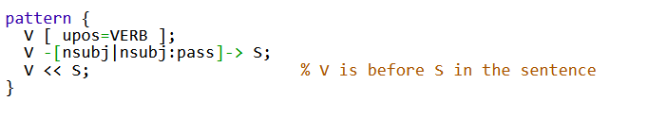
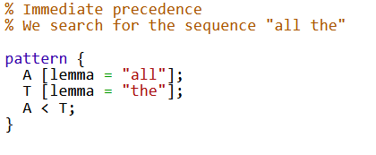
Restriction on word order

Slide 22
How runs the stream?
Find subjects following verbs

Slide 23
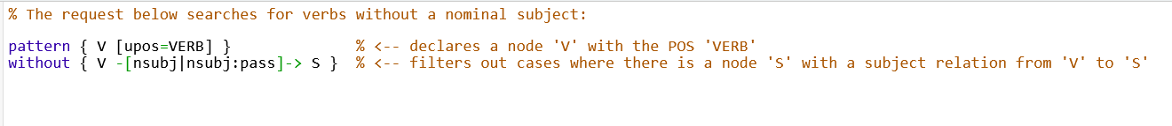
Negative patterns
The preceding query gave too much noise. We cannot say right away that a node is not there, but we can apply a negative filter (or more of them) as a next step.

Slide 24
Negative filter on There is... Here comes... and other noise
Go through the results and decide what is noise.
Try and formulate a negative filter to get rid of at least some noise.

Slide 25
Dost thou love me?
Is there a statistically significant difference between Romeo and Juliet in how often they use the second person to directly comment the other speaker’s activities?
you/thou as nominal verb subject
your/thy/yours as nominal modification of a noun
Get numbers of Romeos and Juliet’s tokens, respectively
DraCor API /corpora/{corpusname}/play/{playname}/cast/csv
Juliet: 4265
Romeo: 4620

Slide 26
Come stay for 3 months, apply in the fall
https://clsinfra.io/opportunities/tnafellowships/
Watch the description of our preferred project proposals https://www.youtube.com/watch?v=H2SYBwzS_Dg

Slide 27
THANK YOU
cinkova@ufal.mff.cuni.cz

