Slide 1
Named Entities
CLS Infra Summerschool Prague 2022

Slide 2
Entity Naming Expressions
Names are of particular interest in DH
Much use of text revolves around finding and tracking names
Named Entities
Not just names of people, but also names for any other type of thing
Not just names proper, but also expressions referring to entities
Not just (existing) entities, but also fictional, imaginary

Slide 3
TEI regions
Just simple XML
<name> - name
<date>, <term>
<orgName> <persName> <placeName>
Searchable as sattributes
With whatever attributes

Slide 4
Named Entity Classification
Indicate the type of name
<name type=“LOC”>
Fixed tagset like POS tags
Most used classification
LOC location (place)
ORG organization
PER person

Slide 5
NERC
Named Entity Recognition and Classification
Automatically recognize and subtype names
NameTag2: Czech, Spanish, English, Dutch, German
SpaCy

Slide 6
Naming Variation
Inflectional languages
Petr Sgall, Petra Sgalla
Names mentioned in different ways
M. Janssen, Maarten Janssen, dr. M. Janssen, etc.
Lemmatization and Regularization
<name type=“PER” lemma=“profesor Petr Sgall” reg=“Petr Sgall”>profesora Petra Sgalla</name>
Name disambiguation
Paris (France), Paris (Texas)

Slide 7
Entity Linking
Refer to large databases of names
WikiData
VIAF (Virtual International Authority File)
Uniquely identify named entities in text
Ivan Goncharov = VIAF id 71391722
WikiData id Q189665
Various ways of linking
<name type=“PER” ref=“https://viaf.org/viaf/71391722">Ivan Goncharov</name>
@ref=“71391722”
@corresp=“#71391722”
@corresp=“ner.xml#71391722”

Slide 8
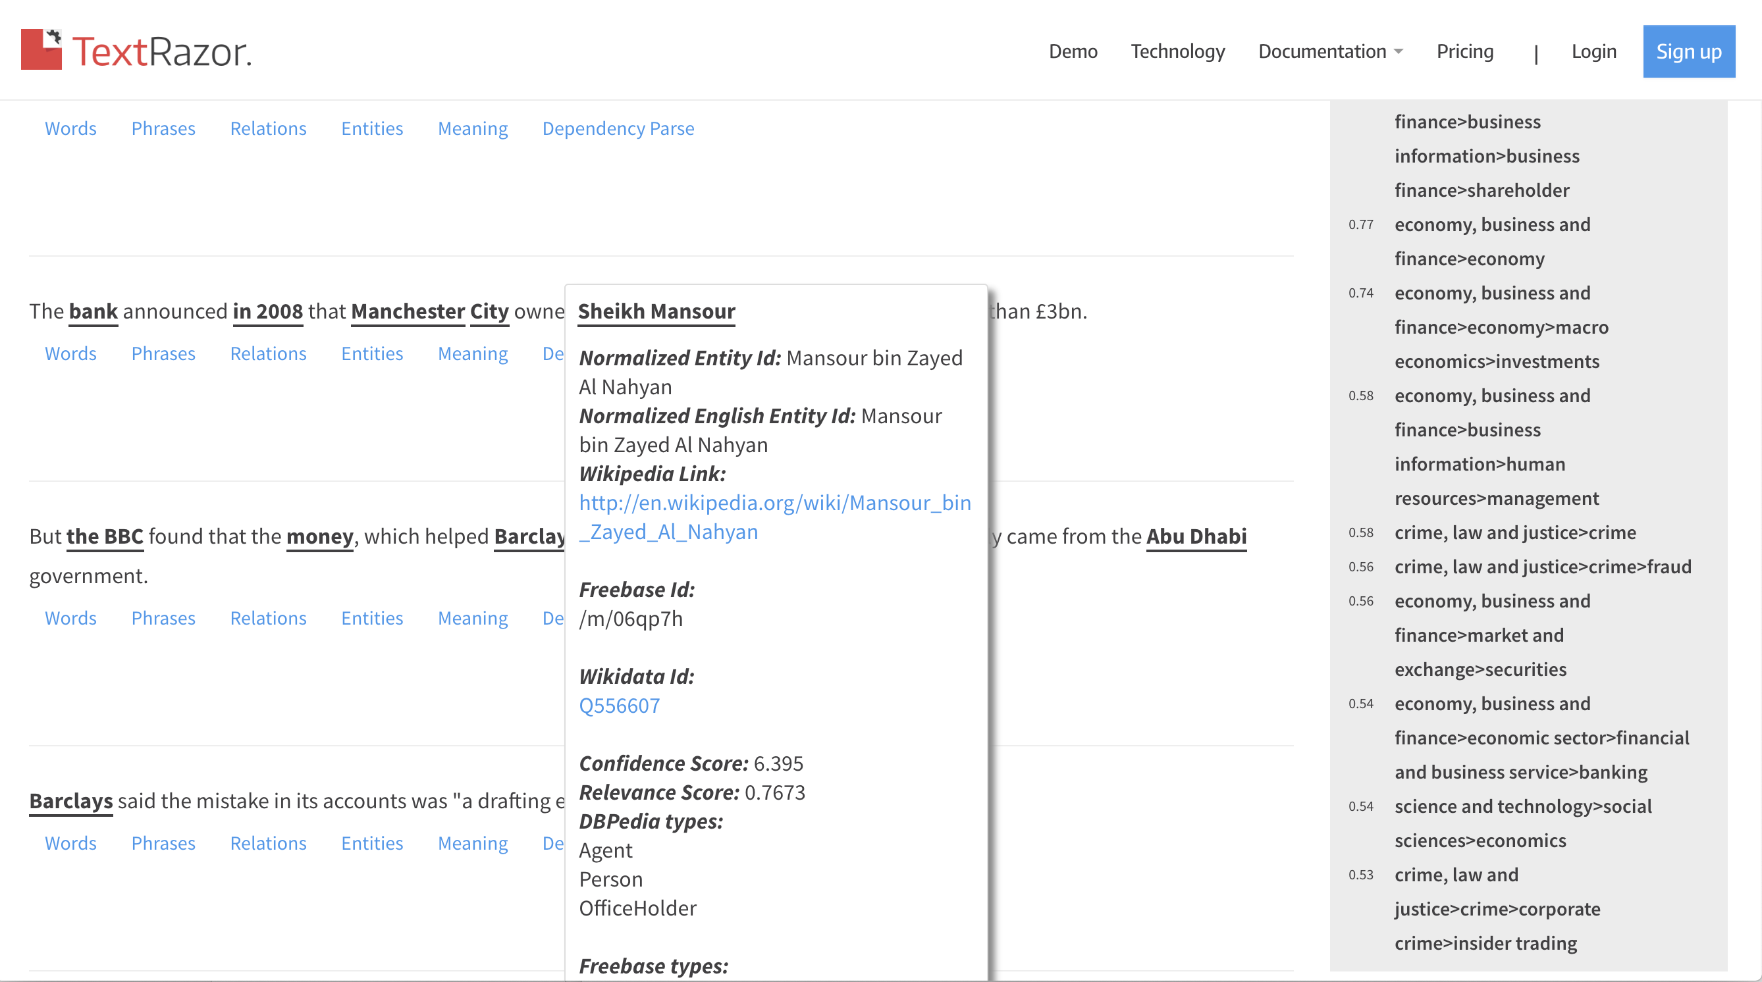
NER Pipelines
https://www.textrazor.com/demo

Slide 9
Biographical data
http://www.wikidata.org/wiki/Q189665
Name: Ivan Goncharov
Name (Russian): Иван Александрович Гончаров
Sex: Male
Instance of: Human
Citizenship: Russian Empire
Birth: 6 June 1812 (Ulyanovsk)– Death: 15 Sept 1891 (St. Petersburg) - pneumonia
Occupation: linguist, writer, novelist, translator, essayist, prosaist, literary critic, …
Works: Oblomov, The Prcipe, The Same Old Story, …

Slide 10
Centralized teiHeader database
TEITOK stored NER data in the teiHeader
Not locally, but in a central file
Make changes once
Reference by filename + id
<name id=“ner-11” type=“PER” ref=“#Q189665">Ivan Goncharov</name>
Typically using WikiData ids
Project-specific ids for not listed names

Slide 11
NER.xml
Store any information about the name
Context-independent information
Not: age of the person
Store links to multiple authority database
Information can be extracted automatically
Define a snippet
Concise information for roll-over

Slide 12
Example
<person id="71391722">
<persName>Goncharov, Ivan Aleksandrovich</persName>
<birth when="1812-06-18"> <placeName>
<settlement type="city">Ulyanovsk</settlement> <country>Russia</country>
</placeName> </birth>
<death when="1891-09-27"> <placeName>
<settlement type="city">Saint Petersburg</settlement> <country>Russia</country>
</placeName> </death>
<linkGrp>
<link type="viaf" target="https://viaf.org/viaf/71391722"/>
<link type="wikipedia" target="https://en.wikipedia.org/wiki/Ivan_Goncharov"/>
<link type=”wikidata" target="https://www.wikidata.org/wiki/Q189665" id=“Q189665/>
</linkGrp>
<note>Goncharov, Ivan Aleksandrovich, 1812-1891. Ivan Alexandrovich Goncharov was a Russian novelist best known for his novels The Same Old Story, Oblomov, and The Precipice. He also served in many official capacities, including the position of censor.</note>
</person>

Slide 13
Corpus Export
name_birthcountry
= (@corresp) /birth/placeName/country
Explicitly calculated
<name id=“ner-11” type=“PER” ref=“#Q189665"><tok>Ivan</tok> <tok>Goncharov</tok></name>
Q189665
<person id=“Q189665”> … <country>Russia</country> … </person>
<country>Russia</country>
<name birthcountry=“Russia">
[]+ :: match.name_birthcountry=“Russia”

